Slide 1
Warm Up-
Complete the following warm up on the notecard that Mrs. Law gave you. Please make sure to put your first AND last name along with class period
How does a historian come to understand the past?
Why is it important to use both primary and secondary sources when looking at historical events?

Slide 2
What is Point of View

Slide 3
Learning Targets
Students will be able to analyze sources to determine point of view.
The purpose of this is so students can evaluate primary and secondary resources to determine point of view/perspectives.
History 1

Slide 4
Definition- copy this definition on pg14
Point of View is the creators/authors opinion, attitude, or judgment.
Bias is the prejudice or tendency to see something in a particular way
So what…
It is the perspective of the person who is telling the story.
Sources have a bias; an opinion about whether something is good or bad that influences how a person or culture believes something should be dealt with.
The persons bias can shape/determine their point of view

Slide 5
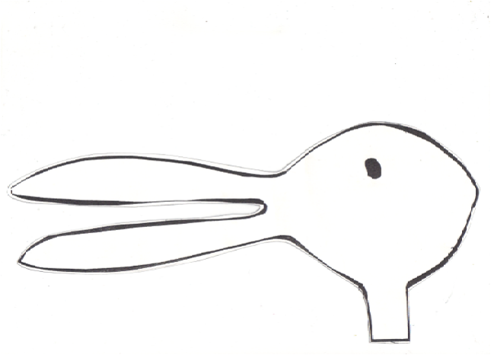
In your notes on page 14, write down what you see quietly… DO NOT SHARE WITH YOUR PEERS!

Slide 6
Reflection Questions
What did you see?
What evidence did you use to come to that conclusion?
Were the people who saw something different wrong?

Slide 7
So what…
What does this tell us about
Point of View?
People see things differently, depending on their perspective. Different doesn’t mean that one is wrong
Notes:
People see things differently, depending on their perspective. Different doesn’t mean that one is wrong

Slide 8
How would United States history be different if it was told from the following perspectives…
Identity | Perspective on the New World
Algonquin Indian Chief
English colonist
African-born female slave

Slide 9
Whose perspective is history currently told from?

Slide 10
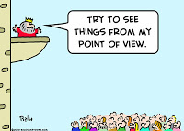
What does this cartoon suggest about point of view?

Slide 11
The king will never see things from the same point of view as his people

Slide 12
Copy the following chart on page 14
Point of View of 3 Little Pigs | Events | Point of View of the Big Bad Wolf
 | As we read through the story, come up with 3 events that occurred making sure to identify the point of view from the 3 Little Pigs and the point of view from the Big Bad Wolf

Slide 13
Copy the following chart on page 14
Point of View of 3 Little Pigs | Events | Point of View of the Big Bad Wolf
 | Pig 1 Pig 2 Pig 3 Wolf

Slide 14
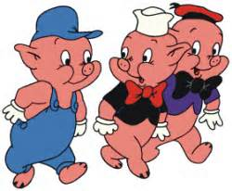
3 Little pigs vs the big bad wolf

Slide 15
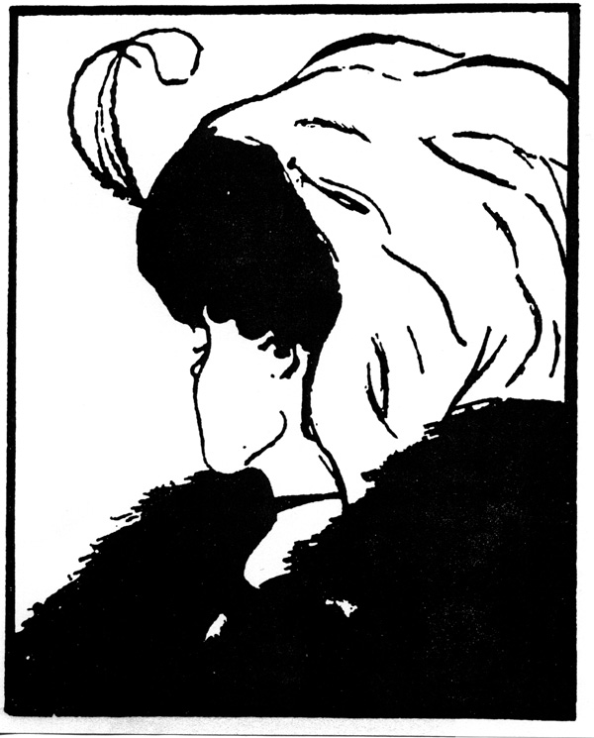
What is Point of View

Slide 16
Processing
When determining the perspective of the 3 Little Pigs, why is it important to learn about perspectives? How does this relate to learning about different topics in Social Studies?

