Slide 1
Warm Up
After coming in quietly and picking up your spirals, write down three words associated with the word civilized. Then create a list of what you think are the features needed to create a civilization?

Slide 2
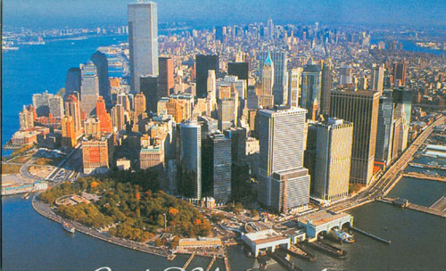
MODERN CIVILIZATION: NEW YORK CITY
WHAT FACTORS MAKE US A “CIVILIZED” AND COMPLEX SOCIETY?
Write down at least 3 ideas.

Slide 3
Critical Thinking
What do you think the early civilizations that arose in different parts of the world have in common?
Advanced Cities
Complex Institutions (government, religion)
Technology
Specialized workers
Record Keeping

Slide 4
5 Characteristics of a Civilization

Slide 5
Essential Question
Students will be able to explain the characteristics that make up a civilization by ranking them and supporting your rank with details.

Slide 6
Key Words
Agriculture- Farming
Domesticate- to raise
Nomadic-Move place to place
Rural-countryside
Settlements-people in living in towns or villages
Civilization- organized society, development

Slide 7
How can a timeline help us better understand events in history?
Decade=a 10 year period
Century= a 100 year period
Millennium= a thousand year history
20th Century=refers to the years between 1900-1999

Slide 8
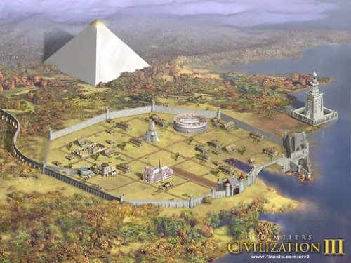
WHAT IS A CIVILIZATION???
CIVILIZATION-
(1) group of people living and working together for the purpose of creating an organized society
(2) “the highest cultural grouping of people which distinguishes humans from other species”
(3) “complex systems or network of cities that emerge from pre-urban culture”

Slide 9
Foldable
Turn page 22 inside to create the
5 Characteristics of Civilization Foldable
Advanced Cities/ Geography
Complex Institutions (government, religion)
Economy
Technology
Writing

Slide 10
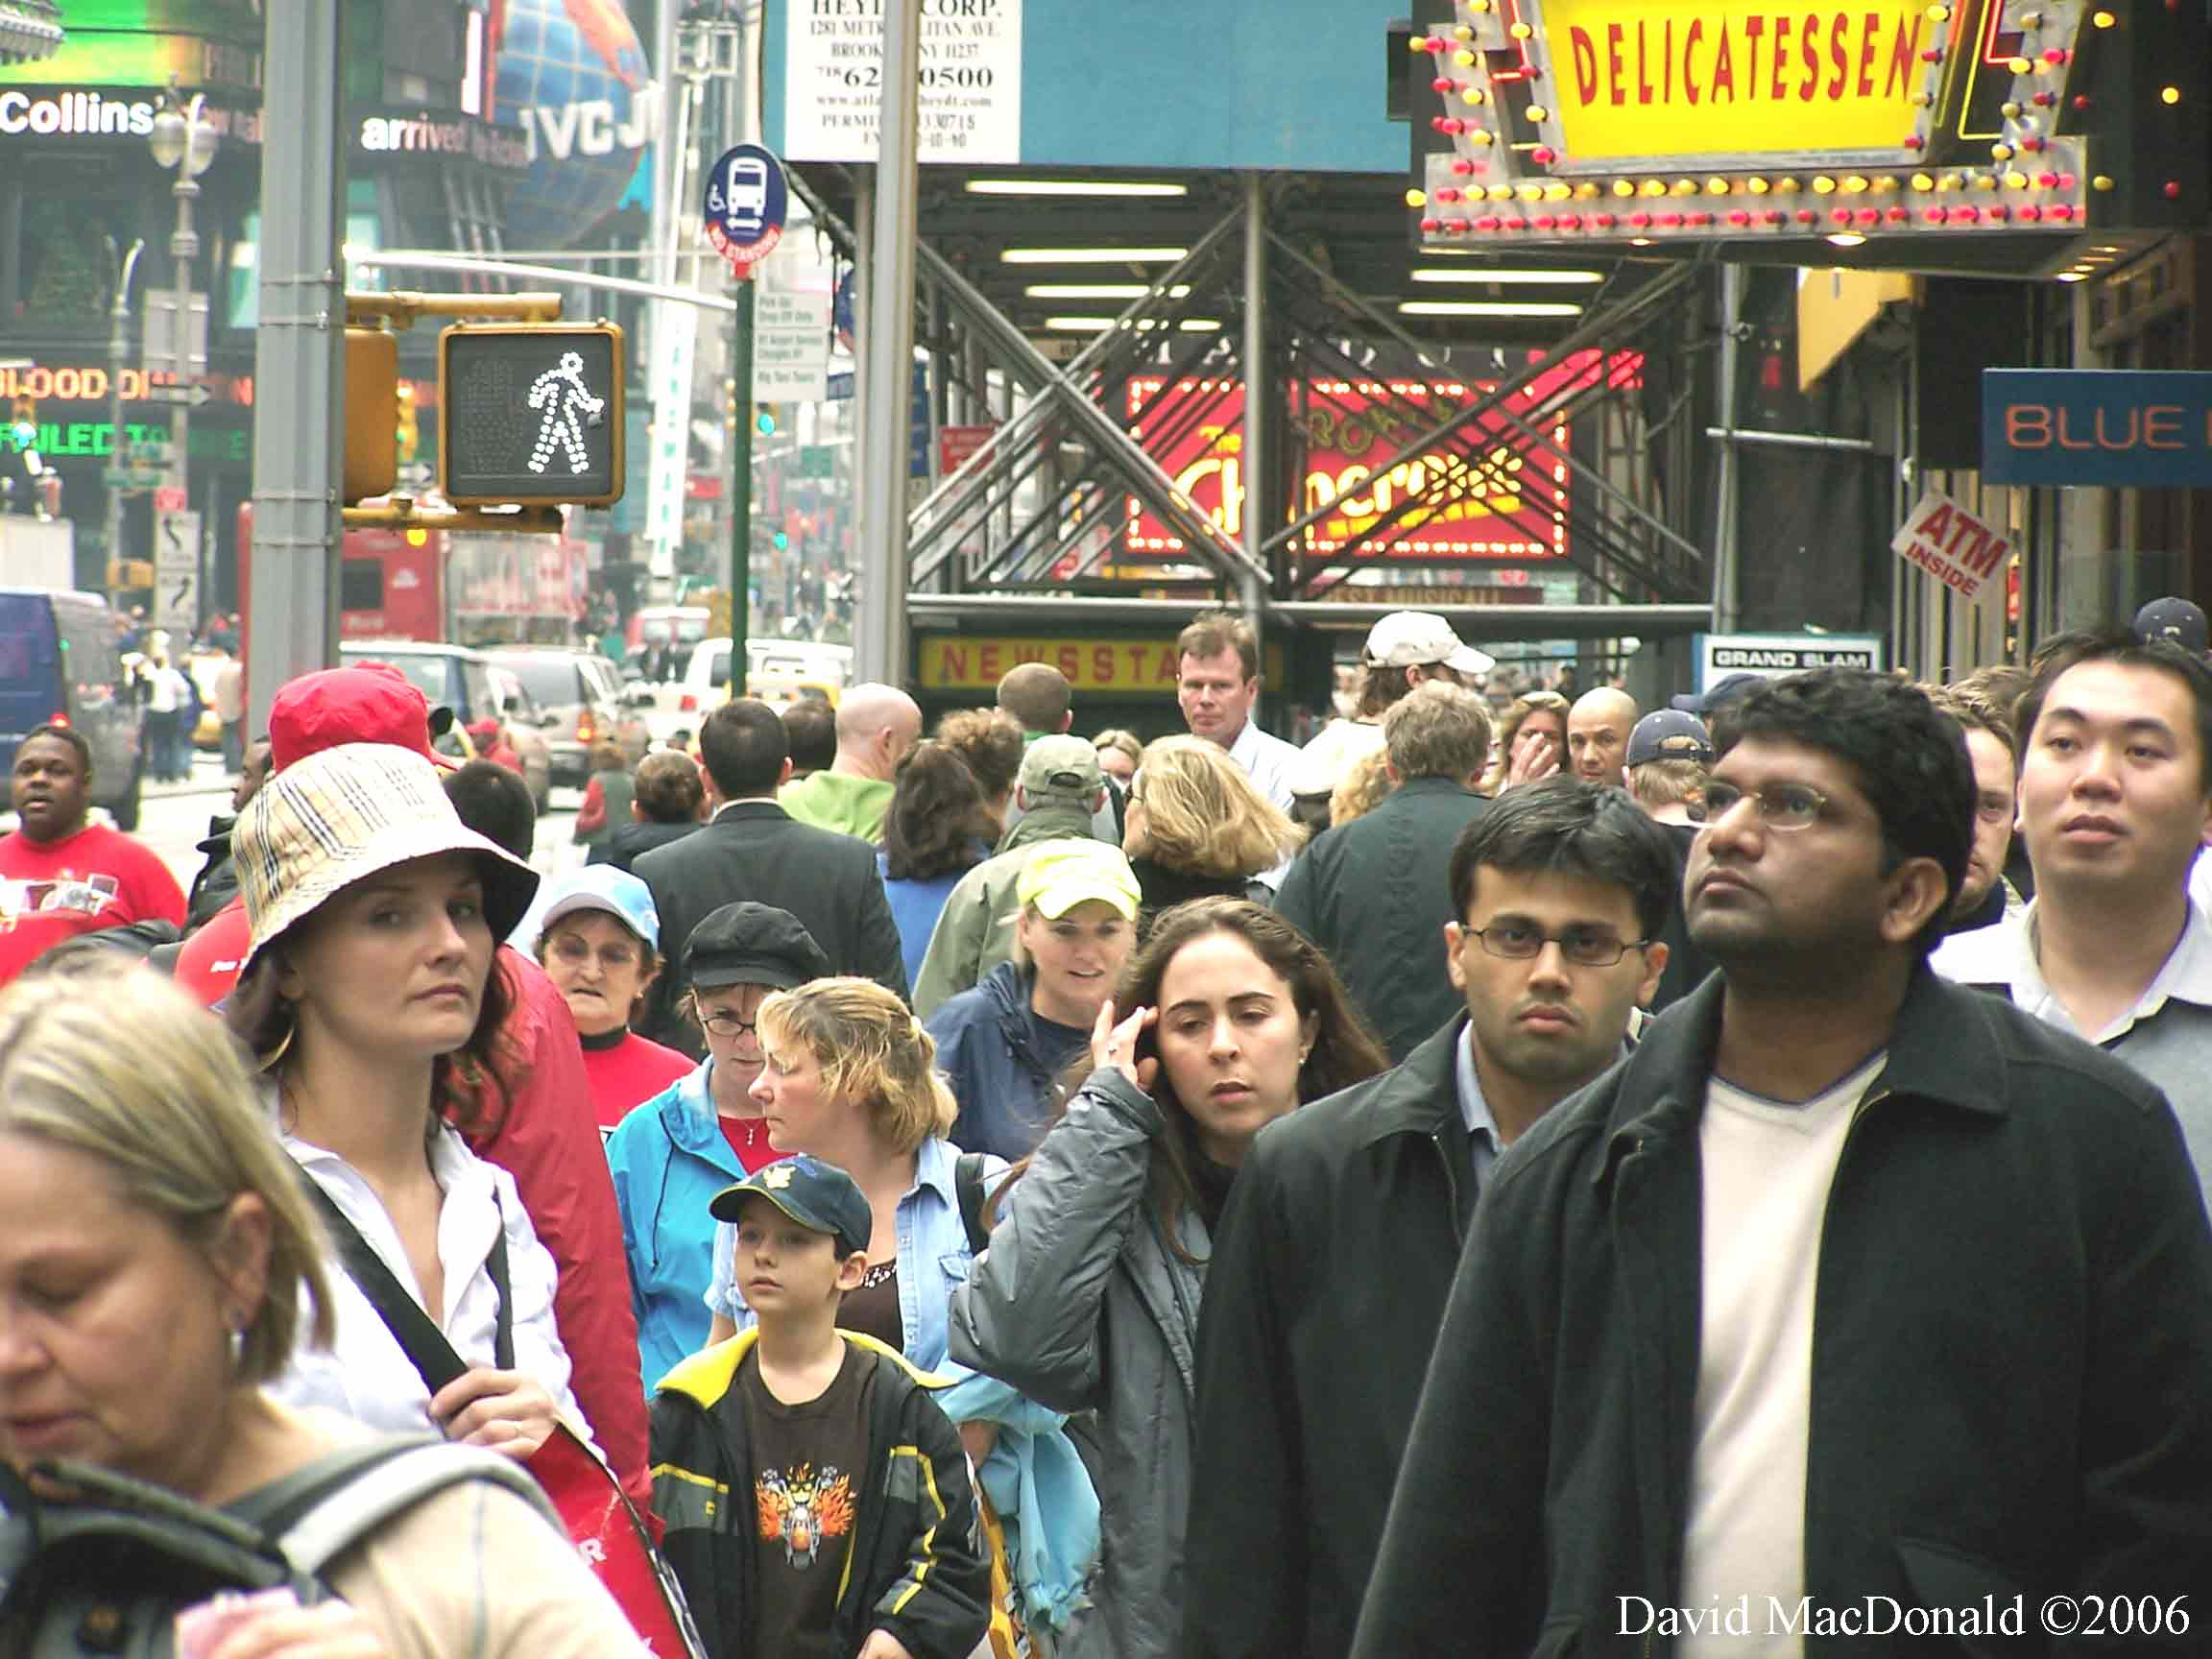
1. Advanced Cities
In order to be considered a city it must have:
1. Large population
2. Must be a center of TRADE
3. Ideal Geographic location
Usable Farmland
Food Source
Water Source
Natural Barriers

Slide 11
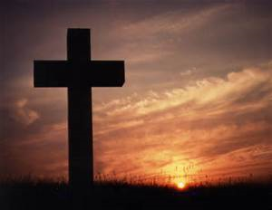
2. Complex Institutions
Institution – a long lasting pattern of organization in a community such as
Government
Religion
Economy

Slide 12
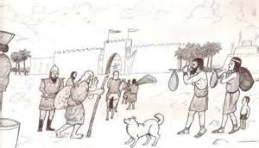
3. Economy with Job Specialization
There is a system in which there are different types of jobs and each worker focuses on one particular type (specialized)
Specialized means someone has the skills to do a specific kind of work
These specialized jobs are bringing in money and trade for the civilization

Slide 13
4. Technology
New tools and techniques that solve problems and make life easier

Slide 14
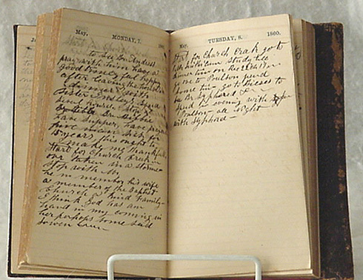
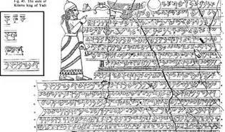
5. Writing
Must have a developed system of writing so the people can:
Record business
Write a set of laws
Priests can record rituals and dates

Slide 15
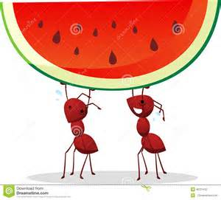
5 Characteristics of Civilizations (Pneumonic Device)
Ants
Advanced Cities/ Geography
Can
Complex Institutions (government, religion)
Eat
Economy
Tasty
Technology
Watermelon
Writing

Slide 16
Draw an image that correlates to each of the 5 Characteristics of Civilization
This is to be completed on the inside of the foldable

Slide 17
Warm Up
After coming in quietly and picking up your spirals, in what ways were river valleys ideal locations for civilizations to develop?

Slide 18
5 Characteristics of a Civilization
Advanced Cities/ Geography
Complex Institutions (government, religion)
Economy
Technology
Writing

Slide 19
Essential Question
Students will be able to explain the characteristics that make up a civilization by ranking them and supporting your rank with details.

Slide 20
Critical Thinking
The basic features of civilizations help show how early civilizations differed from smaller farming societies and nomadic lifestyles. Which features of civilizations do you think most affected the daily lived of average people?
Sentence starter: The feature that most affected the daily life's of average people in early civilizations is ________. According to the notes, _________ (evidence). One reason ________ affected the daily life’s of the average person in early civilizations is _______(reasoning).

Slide 21
Critical Thinking
In early civilizations, how did religion influence government and social classes?
How did the ways in which goods were produced and distributed change as civilizations developed?

Slide 22
5 Characteristics of Civilizations (Pneumonic Device)
Ants
Advanced Cities/ Geography
Can
Complex Institutions (government, religion)
Eat
Economy
Tasty
Technology
Watermelon
Writing

Slide 23
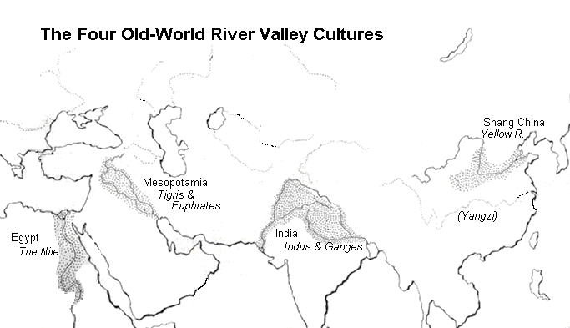

Slide 25
CER Ranking Activity
In a group, using the CER format, you are to create a poster that shows which of the five characteristics of civilization is the most important and why. Use the other 4 characteristics as evidence to support your number one choice
You will need to have the following on your poster:
Claim
Counter Claim
Evidence
Reasoning
Make sure all members first and last names on
the back of the poster

Slide 26
Activity: In a group, using the CER format, you are to create a poster that shows which of the five characteristics of civilization is the most important and why. Use the other 4 characteristics as evidence to support your number one choice
1
2
3
4
5

Slide 27
Processing
On page 21 underneath your rankings, discuss two negative (bad) and two positive (good) consequences of civilization building. What types of issues do complex societies deal with???

