Slide 1
Warm Up
What roles did governments play in early civilizations?

Slide 2
Why Government?

Slide 3
Learning Target
Students will be able to defend the reasons why people and civilizations need government.

Slide 4
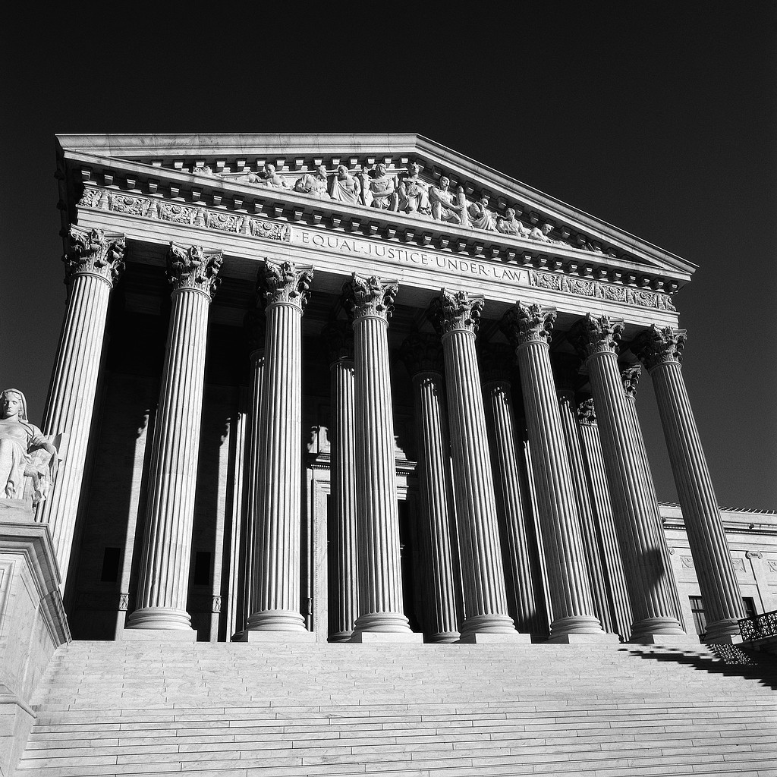
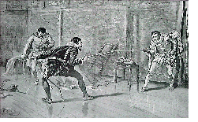
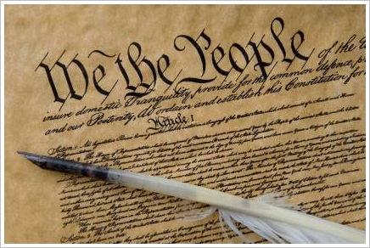
Vocabulary
Government
State of Nature
Natural Rights
Life
Social Contract
Property
Liberty
Laws
Compromise

Slide 5
What is a Philosophers?
These are people who think about questions that don’t have necessarily the right answer
i.e. the meaning of life
i.e. why government?
John Locke and Thomas Hobbes are two of these philosophers that you will be taking a look at

Slide 6
Setting Up Your Spirals Title this page Locke’s Ideas about Government
Draw the following chart in your spirals on page 26. This chart should take your whole page
1 | 2 | 3
4 | 5 | 6
7 | 8 | 9

Slide 7
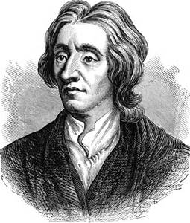
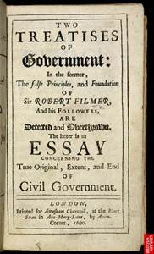
John Locke’s Ideas

Slide 8
Draw what is described for each box…
Draw a man thinking. He’s thinking about government
Draw a picture of life without rules. How might people behave?
Draw a man having three ideas!
Draw someone doing something to survive.
Draw someone owning things.
Draw someone being free to live how they want (or a symbol of freedom)
Draw two people making an agreement with each other.
Draw someone giving something away
Draw a symbol of government

Slide 9
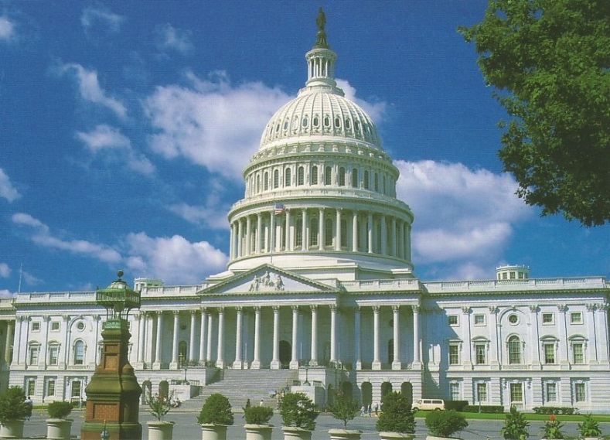
Cut out each of the cards and match them with the picture that illustrates it. Once you have them with the correct pictures, tape them down.

Slide 10
Processing
With your group, come up with a 20 word GIST or less that summarizes John Locke’s idea about government.
Use the following words:
Natural Rights
Life, Liberty, and Property
Social Contract
Government
Write this idea on the top of page 26.

Slide 11
Warm Up
What were John Locke’s Ideas about government? Do you agree or disagree with his ideas about government?

Slide 12
Warm Up
Think about this question from Friday…
What were John Locke’s Ideas about government? Do you agree or disagree with his ideas about government?

Slide 13
Why Government?

Slide 14
Learning Target
Students will be able to defend the reasons why people and civilizations need government.

Slide 15
Vocabulary
Government
State of Nature
Natural Rights
Life
Social Contract
Property
Liberty
Laws
Compromise

Slide 16
Why Government? Worksheet

Slide 17
Why Government? Unpacking the vocabulary
Please write the following terms on the top of Why Government Worksheet 1
Government
State of Nature
Natural Rights
Life
Social Contract
Property
Liberty
Notes:
Review bolded vocabulary from page 26 and use this vocabulary to complete the worksheet

Slide 18
Worksheet pg 1
Using the vocabulary you have just put into the Vocabulary Building section of the worksheet along with the information you completed yesterday on page 26 to complete the rest of worksheet pg 1 with your partner next to you. You will have 15 minutes to complete this.

Slide 19
Why Government?
Worksheet pg 1 answer check

Slide 20
Thomas Hobbes Ideas about Government
Title page 25 Hobbes Idea about Government

Slide 21
Hobbes Critical Thinking
Worksheet pg 2
You are to read through the little blurb about Thomas Hobbes as a class then answering questions 1 and 2 independently.
Next, complete the critical thinking QUIETLY and INDEPENDTLY!

Slide 22
Review

Slide 23
Processing
With your group, come up with a 20 word GIST or less that summarizes Thomas Hobbes ideas about government.
Include the following words in your GIST:
Government
State of Nature
Wicked/Evil
Write this idea on the top of page 25.

Slide 24
Warm Up
As a human being, what are your rights?
What are things you should be allowed to do?

Slide 25
Warm Up
In your spirals, answer the following question….do you think government was important in early civilizations? Explain your thinking

Slide 26
Why Government?

Slide 27
Learning Target
Students will be able to defend the reasons why people and civilizations need government.

Slide 28
Vocabulary
Government
State of Nature
Natural Rights
Life
Social Contract
Property
Liberty
Laws
Compromise

Slide 29
Think about…
Why do people create governments?
What purpose do they serve?
Where did we get our ideas about government?
These questions are the questions that have kept scholars busy for centuries!!!

Slide 30
Title page 28 Why Government?
Draw the following chart in your spirals on page 28. This chart can take up your whole page
 | John Locke | Thomas Hobbes
Ideas about Government

Slide 31
Why Government? Thomas Hobbes Ideas
Question/Responders Activity
You will be paired up with the person next to you. Decide who is going to be the questioner (green) and who is going to be the responder (red)
After we have completed reading the first section, go into the question/responder roles for two minutes

Slide 32
Critical Thinking
What did Hobbes believe with why do people create governments?
What purpose does government serve?
Where did Hobbes get his ideas about government?

Slide 33
Fill in your Why Government? chart
 | John Locke | Thomas Hobbes
Ideas about Government

Slide 34
Why Government? John Locke Ideas
Question/Responders Activity
You will be paired up with the person next to you. Decide who is going to be the questioner (green) and who is going to be the responder (red)
After we have completed reading the first section, go into the question/responder roles for two minutes

Slide 35
Critical Thinking
What did Locke believe with why do people create governments?
What purpose does government serve?
Where did Locke get his ideas about government?

Slide 36
Fill in your Why Government? chart
 | John Locke | Thomas Hobbes
Ideas about Government

Slide 37
Review

Slide 38
Processing
On page 27, answer the following questions…
Whose ideas do you prefer about government, Hobbes/Locke’s? Explain your reasoning.

