Slide 1
Warm Up:
On the back of the piece of paper Mrs. Law handed you, sort the following words into one three piles.
Green: a pile for words you could teach to another student offering several examples
Yellow: a pile for words you know the meaning to
Red: a pile for words you really are not sure what the meaning is
Topography
Fertile Crescent
Silt
Irrigation Canals
Flooding
Tributary
Tigris River
Euphrates River
Hammurabi Laws
Sumer

Slide 2
Discussion Question:
What techniques have you used in the past to remember vocabulary?

Slide 3
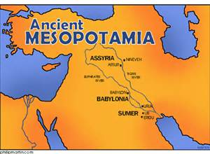
Mesopotamia Vocab
Day 1

Slide 4
Spiral Set Up
Title Page 32
Unit 3
Mesopotamia
(Highlight the edge of the
Title page 31
Vocabulary

Slide 5
Learning Target
Students will be able to participate in vocabulary activities about the civilization of Mesopotamia.

Slide 6
Key Vocabulary
Topography
Fertile Crescent
Silt
Irrigation Canals
Flooding
Tributary
Tigris River
Euphrates River
Hammurabi Laws
Sumer

Slide 7
Circle
Don’t Know- Heard It- Know It

Slide 8
Vocabulary Pre-Groupings
Without knowing the definitions, with your group members, organize the 11 words into categories and be ready to explain why you organized them the way you did.

Slide 9
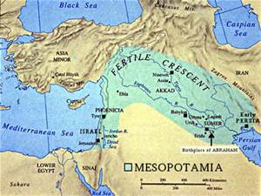
Vocabulary Chant
Repeat after me the following terms:
Topography
Fertile Crescent
Silt
Irrigation Canals
Flooding
Tributary
Tigris River
Euphrates River
Hammurabi Laws
Sumer

Slide 10
Vocabulary Definitions
Topography- the surface features (physical features) of a place or region, such as mountains and desert
Fertile Crescent- a crescent-shaped area of fertile land in the Middle East that extends from the eastern Mediterranean coast through the valley of the Tigris and Euphrates rivers to the Persian Gulf. It was the center of the Neolithic development of agriculture in Mesopotamia
Silt- fine sand, clay, or other earthy material carried by running water and deposited as a sediment
Irrigation Canals- the artificial application of water to land through a canal to assist in the production of crops.
Flooding- overflow of water that submerges land which is usually dry
Tributary- a stream that feeds into a larger river
Tigris River- one of the two main rivers in Mesopotamia
Euphrates River- one of the two main rivers in Mesopotamia
Hammurabi Laws- oldest deciphered writings of significant length in the world
Sumer- an area in the southern part of Mesopotamia, where cities first appeared

Slide 11
Sentences:
Individually you are to complete the following:
Read the definitions that you and your group came up with for each word.
Create an image that will help you remember each word.
Write a sentence that contains each word.

Slide 12
Definitions:
As a group, you need to complete the following:
Read the handout with the definitions for all of the words
Put the definition on your paper in 8 words or less.
Draw a picture representing each word in the box with the definition
With the 2 assigned vocab words, draw and color a picture for each word, on the computer paper, that represents the word.

Slide 13
Sentences:
As a group, you need to complete the following:
Read the definitions that you and your group came up with for each word.
Create an image that will help you remember each word.
Write a sentence that contains each word.

Slide 14
Warm Up:
Pick up your vocabulary worksheet from yesterday (located on the counter). You will have 5 minutes to finish completing your images that go along with each word.

Slide 15
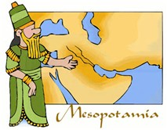
Mesopotamia Vocab
Day 2

Slide 16
Objective
Students will be able to participate in vocabulary activities about the civilization of Mesopotamia.

Slide 17
Key Vocabulary
Topography
Fertile Crescent
Silt
Irrigation Canals
Flooding
Tributary
Tigris River
Euphrates River
Hammurabi Laws
Sumer

Slide 18
Sentences:
Individually you are to complete the following:
Read the definitions that came up with for each word.
Create an image that will help you remember each word.
With your partner, you are to…
Write a sentence that contains each word.

Slide 19
Vocabulary Definitions
Topography- the surface features (physical features) of a place or region, such as mountains and desert
Fertile Crescent- a crescent-shaped area of fertile land in the Middle East that extends from the eastern Mediterranean coast through the valley of the Tigris and Euphrates rivers to the Persian Gulf. It was the center of the Neolithic development of agriculture in Mesopotamia
Silt- fine sand, clay, or other earthy material carried by running water and deposited as a sediment
Irrigation Canals- the artificial application of water to land through a canal to assist in the production of crops.
Flooding- overflow of water that submerges land which is usually dry
Tributary- a stream that feeds into a larger river
Tigris River- one of the two main rivers in Mesopotamia
Euphrates River- one of the two main rivers in Mesopotamia
Hammurabi Laws- oldest deciphered writings of significant length in the world
Sumer- an area in the southern part of Mesopotamia, where cities first appeared

Slide 20
Words in Words
Divide your paper into 9 boxes, (3 boxes in 3 rows). Choose 9 of your vocabulary words; write one vocabulary word at the top of each box. Now try to find as many words as you can within each chosen vocabulary word.

Slide 21
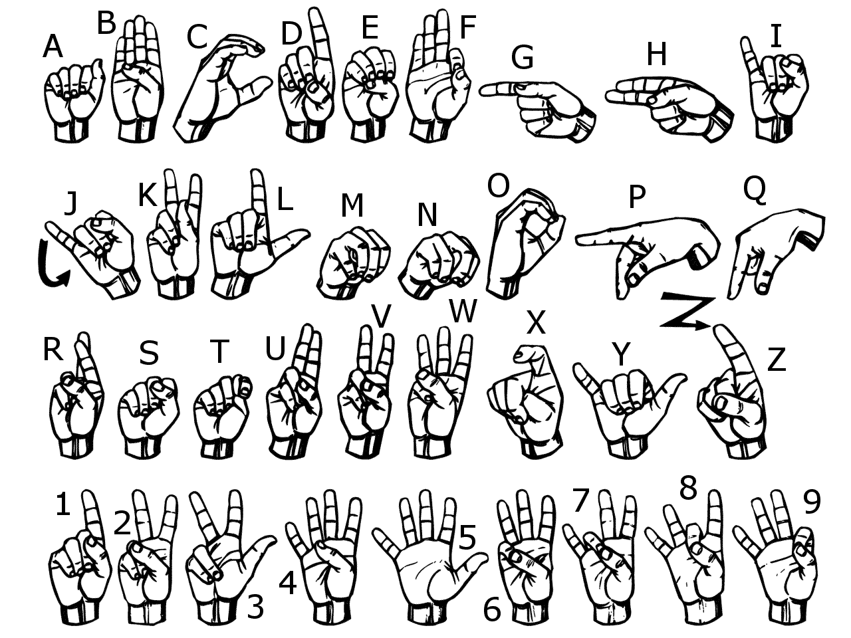
Sign Language
Use American Sign Language to spell each vocabulary word.
Now use your finger and write each word in the air

Slide 22
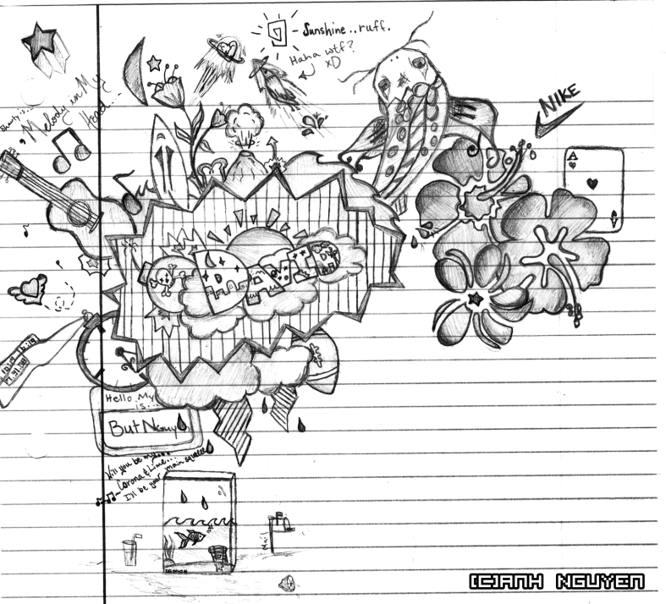
Doodle Words
Choose 5 words you totally understand and write your words using doodles to show what each word means. When you are done, put a star by your favorite doodle word.

Slide 23
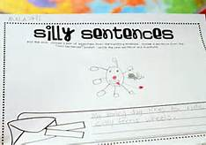
Silly Sentences
Create several silly sentences by using as many vocabulary words as you can. Can you turn a silly sentence into a tongue twister ?

Slide 24
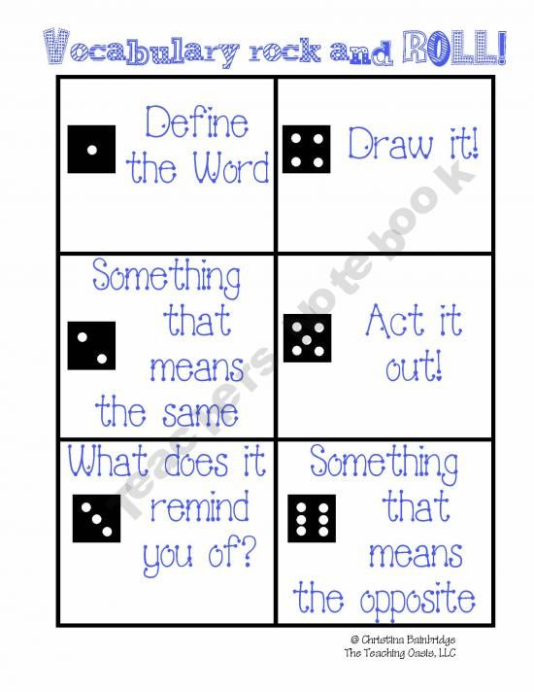
Vocabulary Rock and Roll

Slide 25
Sort Your Words
Sort your words by making three piles. A pile for words you could teach to another student offering several examples, a pile for words you know the meaning to, a pile for words you really are not sure what the meaning is.

