Slide 1
Warm Up:
What does inference mean to you?
a conclusion reached on the basis of evidence and reasoning
How can you use maps to make inferences about a region?

Slide 2
Warm Up
Think to yourself…why is inferencing an important skill to have?
An inference is a conclusion reached on the basis of evidence and reasoning

Slide 3
Review…
What is a civilization?
Organized society that is developed
What are the 5 characteristics needed to create a civilization?
Advanced Cities
Complex Institutions
Economy/Job Specialization
Technology
Writing/Record Keeping

Slide 5
Learning Target
Students will use maps to make inferences about Mesopotamia

Slide 6
Discussion
What can a map tell or not tell you about a civilization?

Slide 7
Draw the following chart on pg 34
Mesopotamia | Physical Map | Political Map | Thematic Map
Observe (What do you see on the maps)
Question (What questions to you have after making your observations)
Reflect/Inference (A statement or conclusion about the civilization of Mesopotamia based upon the maps)

Slide 8
Mesopotamia
Modern Day Middle East

Slide 9
Analyzing Maps
What can you learn about Mesopotamia by analyzing a physical, political, and thematic maps?

Slide 10
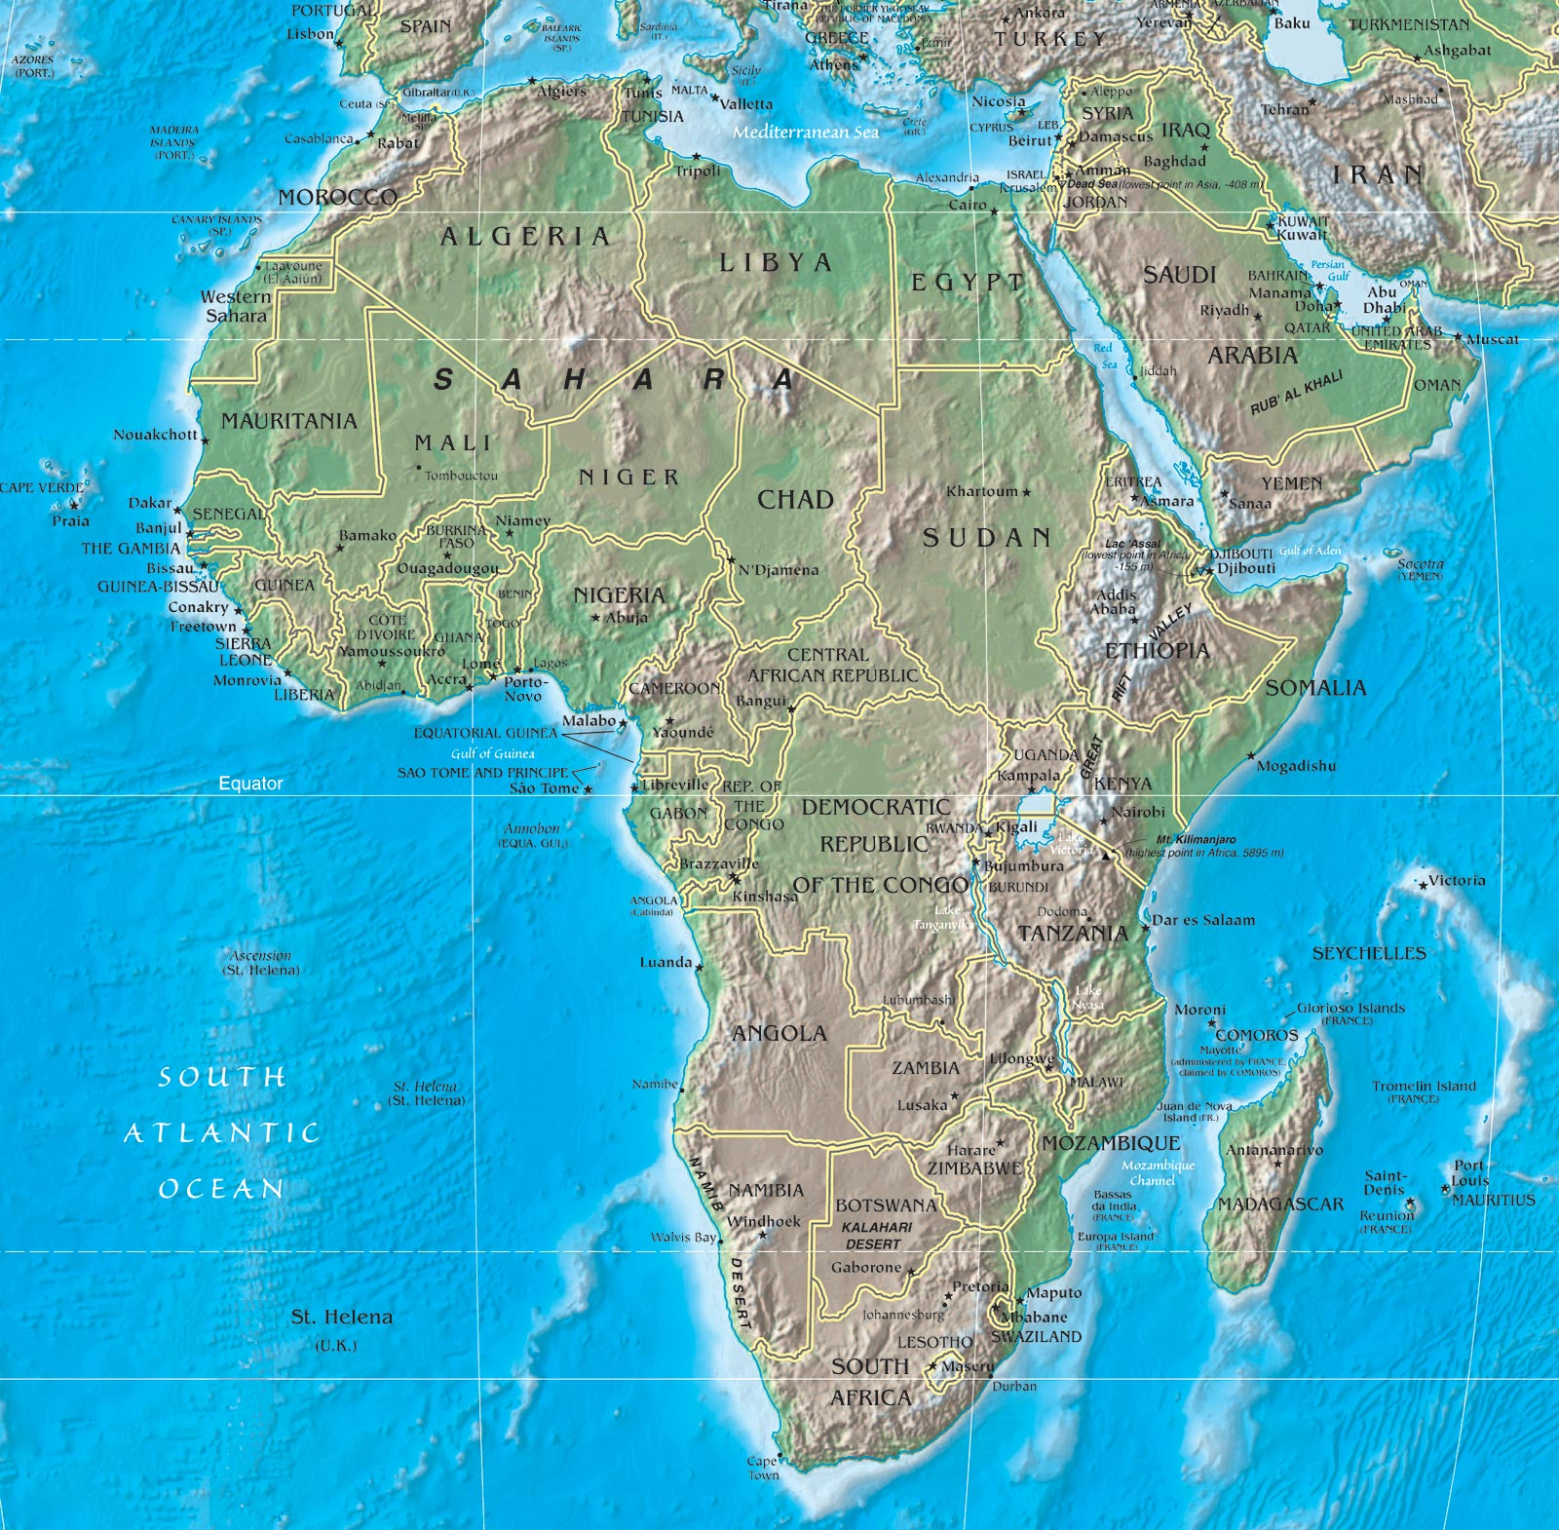
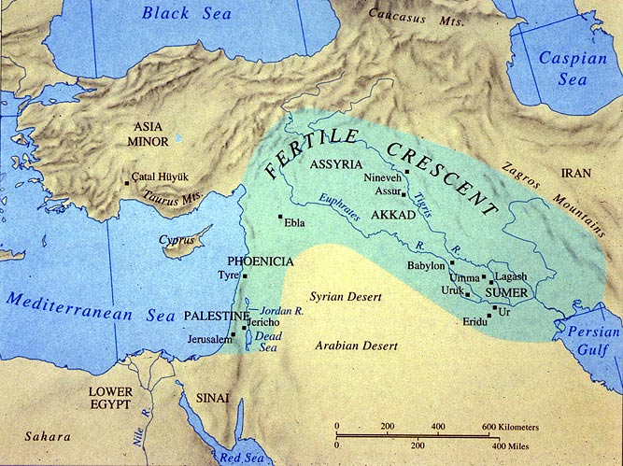

Slide 11
Predictions
Analyzing the following physical, political, and thematic maps of Mesopotamia and make inferences about what that civilization was like.

Slide 12
Physical Map of Mesopotamia

Slide 13
Task
Yesterday we had the analyze a physical map as a class. Today, you are going to continue the same process with your partner of observe/question/reflect with a political and thematic map of Mesopotamia.
Remember…
7 observations: What do you see on the maps
3 questions: What questions to you have after making your observations
2 inferences: A statement or conclusion about the civilization of Mesopotamia based upon the maps

Slide 14
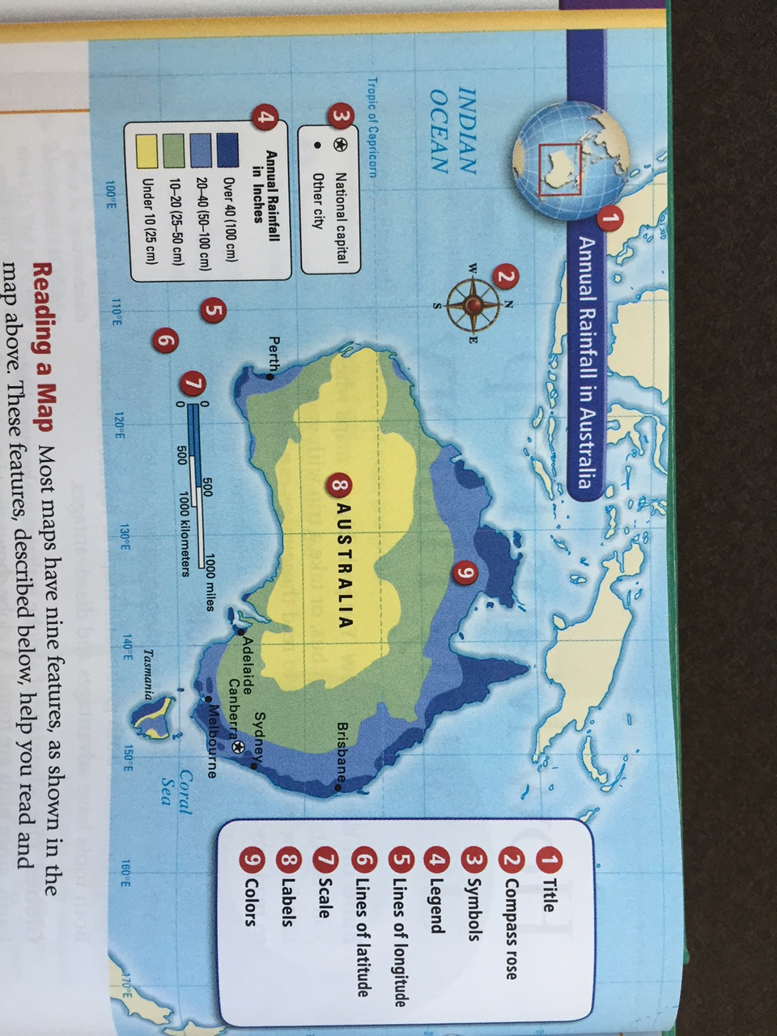
Remember to TLC when reading a Graphs/ Charts/ Maps/ Data
TLC a map:
Title
Legend
Compass Rose
Symbols
Scale
Labels
Colors
Caption
In addition, look for:
Lines of Longitude
Lines of Latitude

Slide 15
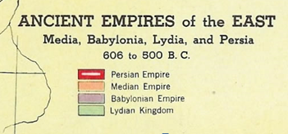
Political Map of Mesopotamia

Slide 16
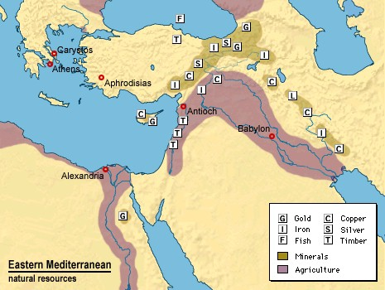
Resource Map of Mesopotamia

Slide 17
Thematic Map of Modern Day Mesopotamia
Using your Classroom Atlas, open up to page 104, 105, and 107…
Analyze the Climate, Economic, Population, Transportation, Environments, and Natural Hazards maps…
What can you learn about this region using the Thematic Maps?

Slide 18
Task
Select your strongest inference from the political map reflection and the strongest inference from the thematic map reflection.
On the blank notecard, write those reflections that you selected on each side of the notecard.
Make sure to identify which is the political map reflection and which one is the thematic map reflection.
Also put you and your partners name on the card

Slide 19
Reflection
With your partner, discuss the following questions and give feedback on each inference
Is this an inference? Why or Why not?
What is the evidence from the map that supports/lead to this inference
Remember, an inference is a conclusion reached on the basis of evidence and reasoning. You take what you see and draw a conclusion. It isn’t obvious!
It is statement or conclusion about the civilization of Mesopotamia based upon the maps

Slide 20
Exit Ticket
Based upon the maps, the FAB 5, and the characteristics of a civilization, why was Mesopotamia the location of the first major civilization?
Extension:
What would physical/political/thematic maps teach someone about the American Civilization?

