Slide 1
Warm Up:
On a separate sheet of paper, sort the following words into one three piles.
Green: a pile for words you could teach to another student offering several examples
Yellow: a pile for words you know the meaning to
Red: a pile for words you really are not sure what the meaning is
Subcontinent
Physical Features
Monsoon
Plateau
Glaciers
Citadel
Granary
Sewer System
Hinduism
Dharma
Caste System
Deities
Karma
Reincarnation
Pilgrimages

Slide 2
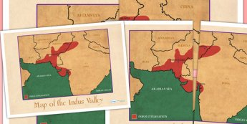
Indus Civilization Vocab
Day 1

Slide 3
Objective
Students will be able to explain how the physical environment of India influences it economy, culture and trade patterns. The purpose is for students to understand how the past has influenced our society today.
This means students will be able to participate in vocabulary activities about the civilization of India.

Slide 4
Key Vocabulary
Subcontinent
Physical Features
Monsoon
Plateau
Glaciers
Citadel
Granary
Sewer System
Hinduism
Dharma
Caste System
Deities
Karma
Reincarnation
Pilgrimages

Slide 5
Circle
Don’t Know- Heard It- Know It

Slide 6
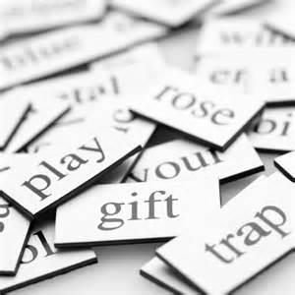
Vocabulary Pre-Groupings
Without knowing the definitions, with your group members, organize the 15 words into categories and be ready to explain why you organized them the way you did.

Slide 7
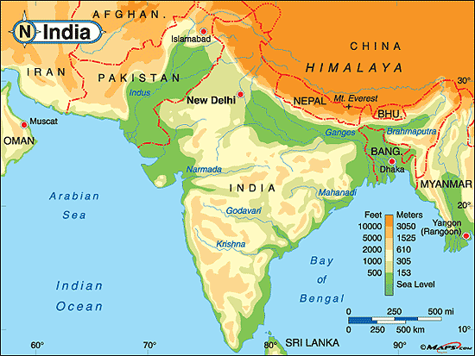
Vocabulary Chant
Repeat after me the following terms:
Subcontinent
Physical Features
Monsoon
Plateau
Glaciers
Citadel
Granary
Sewer System
Hinduism
Dharma
Caste System
Deities
Karma
Reincarnation
Pilgrimages

Slide 8
Definitions:
As a group, you need to complete the following:
Read the handout with the definitions for all 15 words
Put the definition on your paper in 8 words or less.
Draw a picture representing each word in the box with the definition
With the 2 assigned vocab words, draw and color a picture for each word, on the computer paper, that represents the word.

Slide 9
Definitions
Subcontinent: a landmass, such as India, that is of great size but smaller than a continent
Physical Features: an aspect of the land, such as mountains, plateaus, and rivers
Monsoon: a strong wind that brings heavy rain to southern Asia
Plateau: a flat area of land that is elevated, or raised, above the land around it
Glaciers: a huge mass of ice that slowly slides over a land area
Citadel: a fortress built to protect a city
Granary: a place to store grain
Sewer System: a network of pipes that disposes of sewage, or waste water
Hinduism: India’s first major religion
Dharma: one of the basic beliefs of Hinduism that stands for law, obligation, and duty
Caste: a class, or group, in Hindu society
Deities: in Hinduism, the forms that represent the various qualities of Brahman
Karma: in Hinduism, the belief that how a person lives will affect their next life
Reincarnation: the belief that a person’s soul is reborn into a new body after death
Pilgrimages: a journey to a holy place

Slide 10
Sentences:
As a group, you need to complete the following:
Read the definitions that you and your group came up with for each word.
Create an image that will help you remember each word.
Write a sentence that contains each word.

Slide 11
Warm Up:
Pick up your vocabulary worksheet from yesterday (located on the counter).

Slide 12
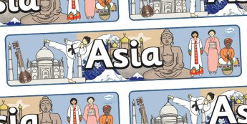
Indus Civilization Vocab
Day 2

Slide 13
Objective
Students will be able to explain how the physical environment of India influences it economy, culture and trade patterns. The purpose is for students to understand how the past has influenced our society today.
This means students will be able to participate in vocabulary activities about the civilization of India.

Slide 14
Key Vocabulary
Subcontinent
Physical Features
Monsoon
Plateau
Glaciers
Citadel
Granary
Sewer System
Hinduism
Dharma
Caste System
Deities
Karma
Reincarnation
Pilgrimages

Slide 15
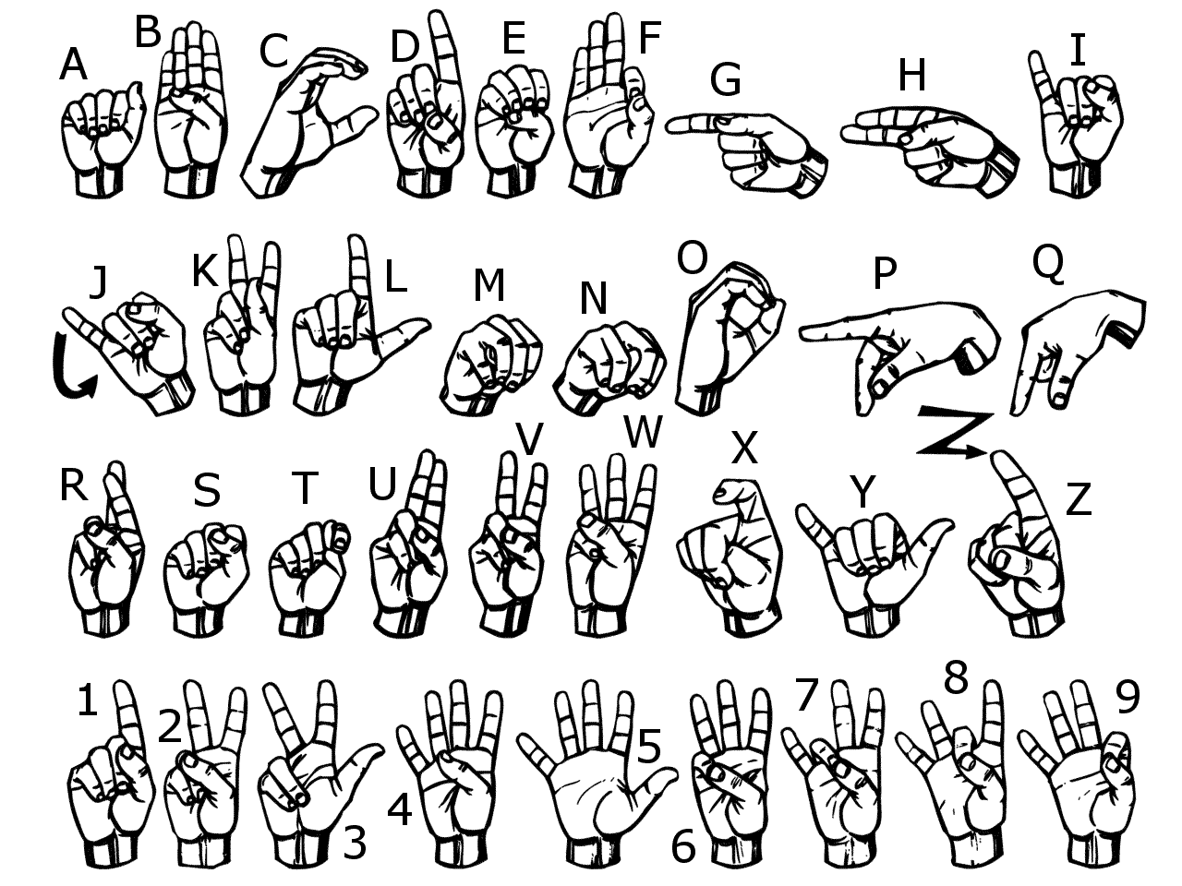
Sign Language
Use American Sign Language to spell each vocabulary word.
Now use your finger and write each word in the air

Slide 16
Sort Your Words
Sort your words by making three piles. A pile for words you could teach to another student offering several examples, a pile for words you know the meaning to, a pile for words you really are not sure what the meaning is.

Slide 17
Words in Words
Divide your paper into 9 boxes, (3 boxes in 3 rows). Choose 9 of your vocabulary words; write one vocabulary word at the top of each box. Now try to find as many words as you can within each chosen vocabulary word.

Slide 18
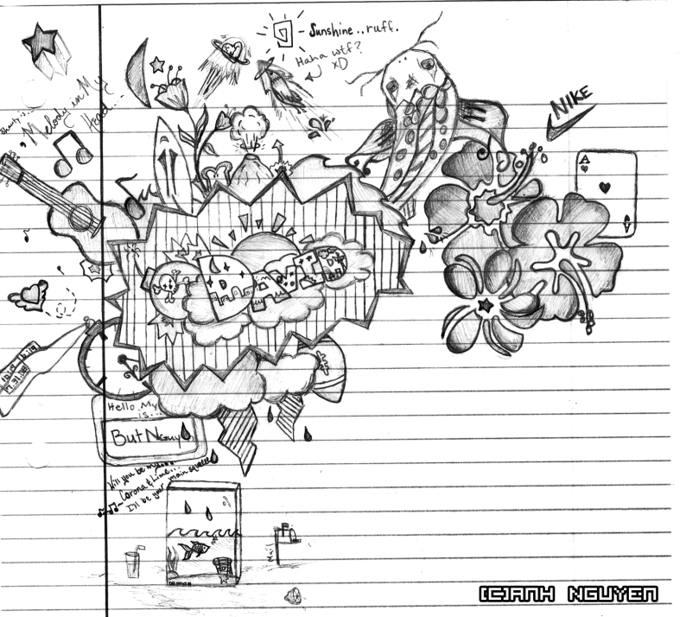
Doodle Words
Choose 5 words you totally understand and write your words using doodles to show what each word means. When you are done, put a star by your favorite doodle word.

Slide 19
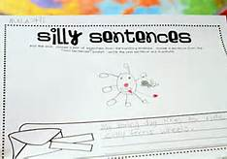
Silly Sentences
Create several silly sentences by using as many vocabulary words as you can. Can you turn a silly sentence into a tongue twister ?

Slide 20
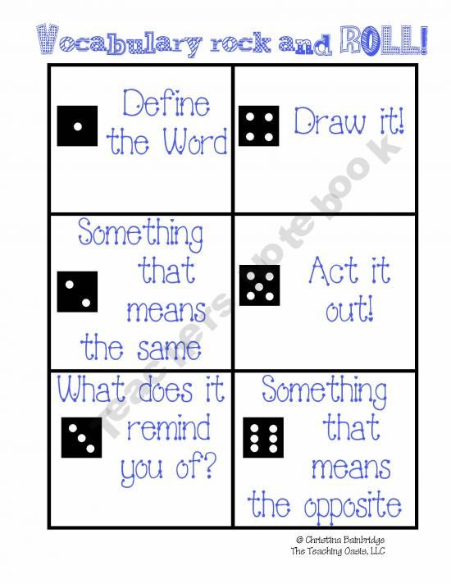
Vocabulary Rock and Roll

Slide 21
Vocab Game
As a group, you need to complete the following:
Listen to a sentence that Mrs. Law reads aloud.
Figure out the vocab word that fits into the blank in the sentence.
Be able to explain why that word fits into the blank.

Slide 22
Vocabulary Quiz
Directions:
Choose 5 vocabulary words from your list and free write a paragraph using all 5 words.
Be sure to underline all 5 words.
Your paragraph will be graded on you using all of the words correctly and creatively.
If your paragraph does not make sense, then you will not receive a passing grade.

