Slide 1
Warm Up
You are a member of a group of people living in ancient times. Your group needs to move, and you have been chosen to find a new location where the group can resettle. You travel around until you find the perfect spot. No one lives there, and it has everything your group needs. What a place! Now you have to convince the others that this is the right place.
On your warm up page, draw and label a picture of the place you have found. Show what you would find in an ideal place to settle.

Slide 2
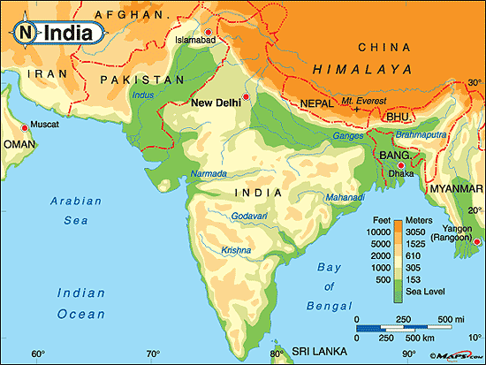

Slide 3
Discussion
What makes a place ideal for settlement?
What do you see?
What geographic features might make India a good place to settle?
What geographic features might make India a bad place to settle?
Based on the map, what is the most ideal location for settlement in India?

Slide 4
Spiral Set Up
On page 44, please write the following:
Title : Ancient Indus River Valley Civilization
Essential Question: How did the physical setting of India contribute to the location and rise of civilizations throughout the subcontinent

Slide 5
Key Terms Page 43
Subcontinent
Physical Features
Monsoon
Plateau
Glaciers
Citadel
Granary
Sewer System
Hinduism
Dharma
Caste System
Deities
Karma
Reincarnation
Pilgrimages

Slide 6
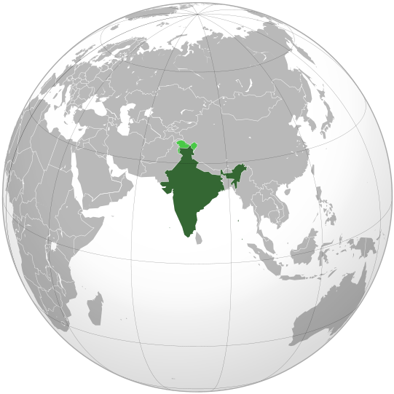
Ancient India
Indus Early River Valley Civilization

Slide 7
Objective
Students will be able to analyze how the physical setting contributed to the location and rise of civilizations in India.
The purpose of this is to understand how the geography of Indian influenced its culture.
This means that students will be able analyze the different geographic features of India.

Slide 8
Vocabulary
Subcontinent
Physical Features
Monsoon
Plateau
Glaciers

Slide 9
Create the following table on pg 48
Physical Feature | Description | Rating
Brahmaputra River
Deccan Plateau
Eastern and Western Ghats
Ganges River
Himalaya Mountains
Hindu Kush Mountains
Indus River
Thar Desert

Slide 10
Create the following table on pg 48
Physical Feature | Description | Rating
Brahmaputra River | Starts in the Himilayas River becomes slower and deeper as it move into the valleys When it floods, it leaves rich minerals behind Joins the Ganges river on the plains
Deccan Plateau
Eastern and Western Ghats
Ganges River
Himalaya Mountains
Hindu Kush Mountains
Indus River
Thar Desert

Slide 11
Create the following table on pg 48
Physical Feature | Description | Rating
Brahmaputra River | Starts in the Himalayas River becomes slower and deeper as it move into the valleys When it floods, it leaves rich minerals behind Joins the Ganges river on the plains | High
Deccan Plateau | Is a flat area between two mountain ranges in southern India. The plateau is fairly dry, but is watered by monsoons. Some of the land is fertile | Mid
Eastern and Western Ghats | Are long mountain ranges near India’s coasts. The Western Ghats are high and very wet . The Eastern Ghats are lower and not so wet. | Mid
Ganges River | Begins in the Himalayas. It leaves sediment on the northern plains, making that area fertile | High
Himalaya Mountains | Are the highest mountain range in the world. The highest peaks are always covered in snow | Low
Hindu Kush Mountains | Are high mountains that form a barrier between India and Afghanistan. The Khyber Pass through these mountains connects central Asia to India | Low
Indus River | Begins in the Himalayas and empties into the Arabian Sea. It deposits sediment in the Indus River valley. It is also a source of fish and water for farming. | High
Thar Desert | Is a hot area of sand and stones with little water. It is a home for lizards, snakes, gazelles, and birds | Low

Slide 12
Geography and Early Settlement of India
As you read chapter 13 of the textbook, enter the name of the feature in your table
Write a brief description of the feature
In the appropriate place on the map, color and label the feature

Slide 13
With your table, discuss the rating of the features on a scale of 1 to 5, with 1 meaning “unsuitable for settlement” and 5 meaning “very suitable for settlement”. Enter your rating in the table.

Slide 14
Spectrums
Send one group member up to get 13A Physical Features Cards and Three Spectrums
Discuss the eight features and arrange them along Spectrum A of where your group thinks they belong
Select a Spokesperson to represent your group for the Human Spectrum of A. We will be creating a human spectrum ☺

Slide 15
Processing
Design a real estate advertisement to convince people to settle near one of the eight physical features you studies in this unit.
Include these things in your advertisement:
A catchy slogan
Three great reasons to settle in this place
An illustration of the location

