Slide 1
Warm Up
Based on the arguments presented by your four classmates, which of the four options below do you think is the true description of this object?
I think this is object is:
A petrified bagel
A heavy bracelet
A form of money
An ancient toilet seat
I think this because….

Slide 2
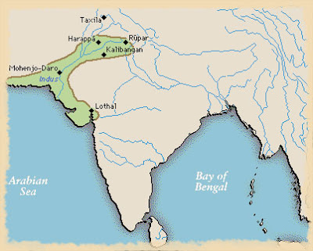
Unlocking the Secrets of Mohenjodaro

Slide 3
Objective
Students will be able to analyze how the physical setting contributed to the location and rise of civilizations in India.
The purpose of this is to understand how the geography of Indian influenced its culture.
This means that students will be able analyze the different geographic features of India.

Slide 4
Key Vocabulary
Mohenjodaro
Indus- Sarasvati Civilization
Citadel
Granary
Sewer System

Slide 6
Discussion Questions
What do you see here?
What might these structures be?
What objects might one find at this site?
What might those objects teach us about daily life in this ancient city?

Slide 7
Create the following chart on pg 50
Stations | Your Ideas | Archeologist Ideas | Name
A
B
C
D
E
F
G
H

Slide 8
Stations
You are going to be learning about Mohenjodaro by visiting eight research stations at this important archeological site. (Remember you will be taking notes at each station)
You will get only 5 minutes at each station.
When you get to a station, you will be directed to “excavate” an artifact, record your ideas about what it may have been used for, and
Remember… read the Station Directions before touching any station materials

Slide 9
Processing
What are the main physical features of this city?
What are the main cultural features of this city? In other words, what have you learned about daily life in ancient India from this activity?
In what ways do you think Mohenjodaro is like a modern city? Unlike a modern city?

