Slide 1
Warm Up
What makes a place ideal for settlement?
What geographic features might make India a good place to settle?
What geographic features might make India a bad place to settle?
Based on the map, what is the most ideal location for settlement in India?

Slide 2
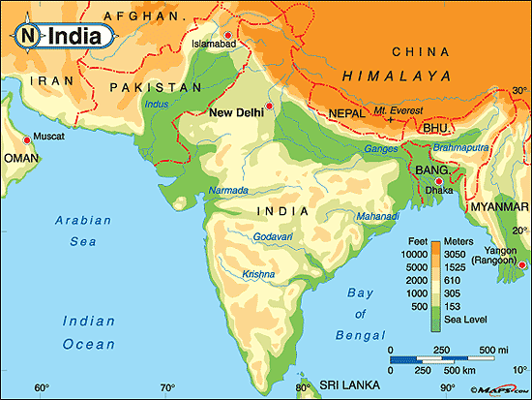

Slide 3
Ancient Indus Civilization Persuasive Essay

Slide 4
Objective
Students will be able to analyze how the physical setting contributed to the location and rise of civilizations in India through a persuasive essay.
The purpose of this is to understand how the geography of India influenced its culture and how to communicate it in a persuasive essay.
This means that students will be able write a persuasive essay about where to establish a settlement in India

Slide 5
Key Vocabulary
Subcontinent
Physical Features
Monsoon
Plateau
Glaciers
Citadel
Granary
Sewer System

Slide 6
Ancient Indus River Civilization Due Tuesday, Dec. 2 at the beginning of class!
A small group of people has just migrated to India, crossing through the Khyber Pass. They are looking for a place to settle down and start a village. You are the scout who has gone ahead and identified some possible locations. Make your best pitch to the group about where would be the best place to live and why. Plan your presentation below. It should include:
An introduction that clearly states the location you have chosen
Two paragraphs that gives supporting evidence for your choice of location
One paragraph that explains why you did not select at least one other location. Include supporting details that show why this place is not a good choice.
A conclusion that restates your position and reminds the group of your main points.
A map that shows where in India you think the new settlement should be placed
Key Vocabulary:
Subcontinent, Physical Features, Monsoon, Plateau, Glaciers, Citadel, Granary, Sewer System

Slide 7
Outline
P1- Intro
State your claim and preview your supporting points
P2- Support Point/ Idea 1
Evidence 1
Reasoning 1
P3- Support Point/ Idea 2
Evidence 2
Reasoning 2
P4- Counter Point/ Idea
Evidence supporting your claim
Reasoning
P5- Concluding
Restate your Intro

Slide 8
