Slide 1
Warm Up:
Think of as many words as you can that relate to Egypt? Write down these words.
Why do you think there are so many word that are unique to Egyptian civilization?

Slide 2
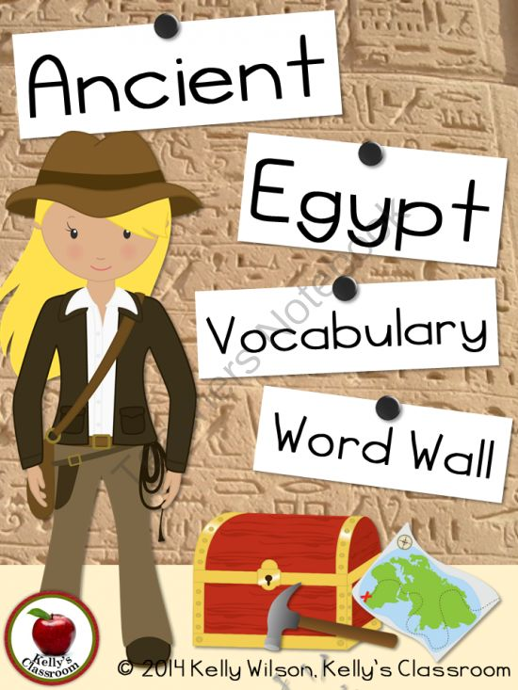
Egypt Vocab
Day 1

Slide 3
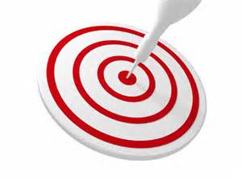
Learning Target
I can use new vocabulary when discussing Egypt.

Slide 4
Key Vocabulary
Archeologist
Topography
Pharaoh
Hieroglyphics
Barren
Social Class
Polytheistic
Natural Resources
Papyrus
Artisan
Embalm
Peasant

Slide 5
Circle
Don’t Know- Heard It- Know It

Slide 6
Groupings:
On the back of the piece of paper Mrs. Law handed you under pre grouping, sort the following words into one three piles.
Green: a pile for words you could teach to another student offering several examples
Yellow: a pile for words you know the meaning to
Red: a pile for words you really are not sure what the meaning is
Archeologist
Topography
Pharaoh
Hieroglyphics
Barren
Social Class
Polytheistic
Natural Resources
Papyrus
Artisan
Embalm
Peasant

Slide 7
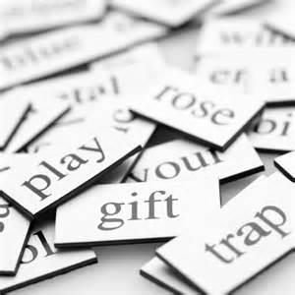
Vocabulary Pre-Groupings
Without knowing the definitions, with your group members, organize the 12 words into categories and be ready to explain why you organized them the way you did.

Slide 8
Key Vocabulary Chanting
Archeologist: a specialist in archaeloly, the scientific study of prehistoric peoples and their cultures by analysis of their artifacts, inscriptions, monuments, etc.
Topography: the arrangement of the natural and artificial physical features of an area
Pharaoh: A ruler in Ancient Egypt
Hieroglyphics: a system of writing mainly in pictorial characters
Barren: unproductive; unfruitful
Social Class: a group of people of similar status, commonly sharing comparable levels of power and wealth
Polytheistic: The worship of or belief in multiple deities usually assembled into a pantheon of gods and goddesses, along with their own religions and rituals.
Natural Resources: the natural wealth of a country, consisting of land, forests, mineral deposits, water, etc.
Papyrus: a material on which to write, prepared from thin strips of the pith of this plant laid together, soaked, pressed, and dried, used by the ancient Egyptians, Greeks, and Romans
Artisan: a worker in a skilled trade, especially one that involves making things by hand.
Embalm: to treat (a dead body) so as to preserve it, as with chemicals, drugs, or balsams.
Peasant: a poor farmer or farm worker who has low social status

Slide 9
Definitions:
Individually, you need to complete the following:
Read the handout with the definitions for all 12 words
Put the definition on your paper in 10 words or less.
Draw a picture representing each word in the box with the definition
With the 2 assigned vocab words, draw and color a picture for each word, on the computer paper, that represents the word.

Slide 10
Definitions:
As a group, you need to complete the following:
Read the handout with the definitions for all 12 words
Put the definition on your paper in 10 words or less.
Draw a picture representing each word in the box with the definition
With the 2 assigned vocab words, draw and color a picture for each word, on the computer paper, that represents the word.

Slide 11
Warm Up:
As you come in, pick up your spiral, sit in your seat, and finish up your pictures QUIETLY

Slide 12
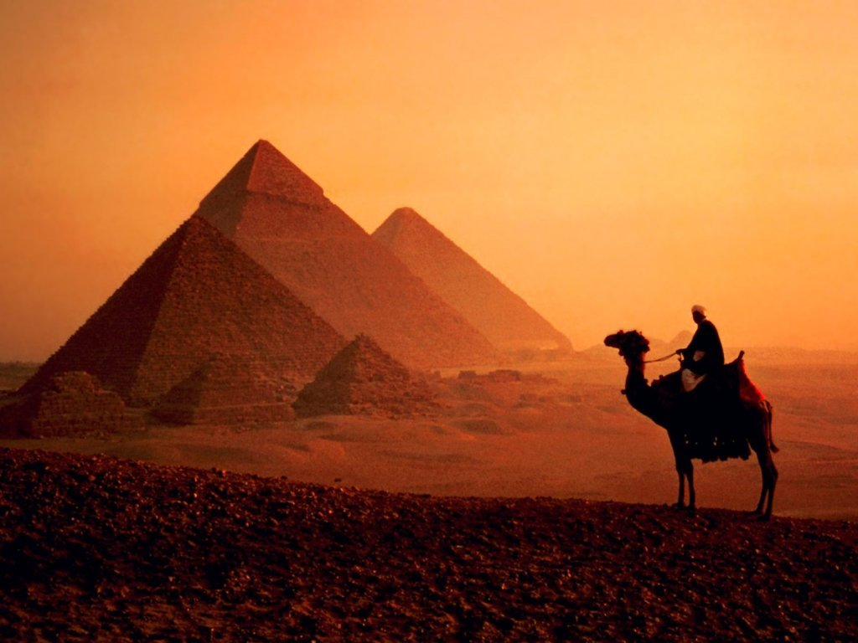
Egypt Vocab
Day 2

Slide 13
Learning Target
I can use new vocabulary when discussing Egypt.

Slide 14
Key Vocabulary
Archeologist
Topography
Pharaoh
Hieroglyphics
Barren
Social Class
Polytheistic
Natural Resources
Papyrus
Artisan
Embalm
Peasant

Slide 15
Sentences:
As a group, you need to complete the following:
Read the definitions that you and your group came up with for each word.
Write a sentence that contains each word.

Slide 16
Key Vocabulary Chanting
Archeologist: a specialist in archaeloly, the scientific study of prehistoric peoples and their cultures by analysis of their artifacts, inscriptions, monuments, etc.
Topography: the arrangement of the natural and artificial physical features of an area
Pharaoh: A ruler in Ancient Egypt
Hieroglyphics: a system of writing mainly in pictorial characters
Barren: unproductive; unfruitful
Social Class: a group of people of similar status, commonly sharing comparable levels of power and wealth
Polytheistic: The worship of or belief in multiple deities usually assembled into a pantheon of gods and goddesses, along with their own religions and rituals.
Natural Resources: the natural wealth of a country, consisting of land, forests, mineral deposits, water, etc.
Papyrus: a material on which to write, prepared from thin strips of the pith of this plant laid together, soaked, pressed, and dried, used by the ancient Egyptians, Greeks, and Romans
Artisan: a worker in a skilled trade, especially one that involves making things by hand.
Embalm: to treat (a dead body) so as to preserve it, as with chemicals, drugs, or balsams.
Peasant: a poor farmer or farm worker who has low social status

Slide 17
Sort Your Words
Sort your words by making three piles. A pile for words you could teach to another student offering several examples, a pile for words you know the meaning to, a pile for words you really are not sure what the meaning is.

Slide 18
Words in Words
Divide your paper into 9 boxes, (3 boxes in 3 rows). Choose 9 of your vocabulary words; write one vocabulary word at the top of each box. Now try to find as many words as you can within each chosen vocabulary word.

Slide 19
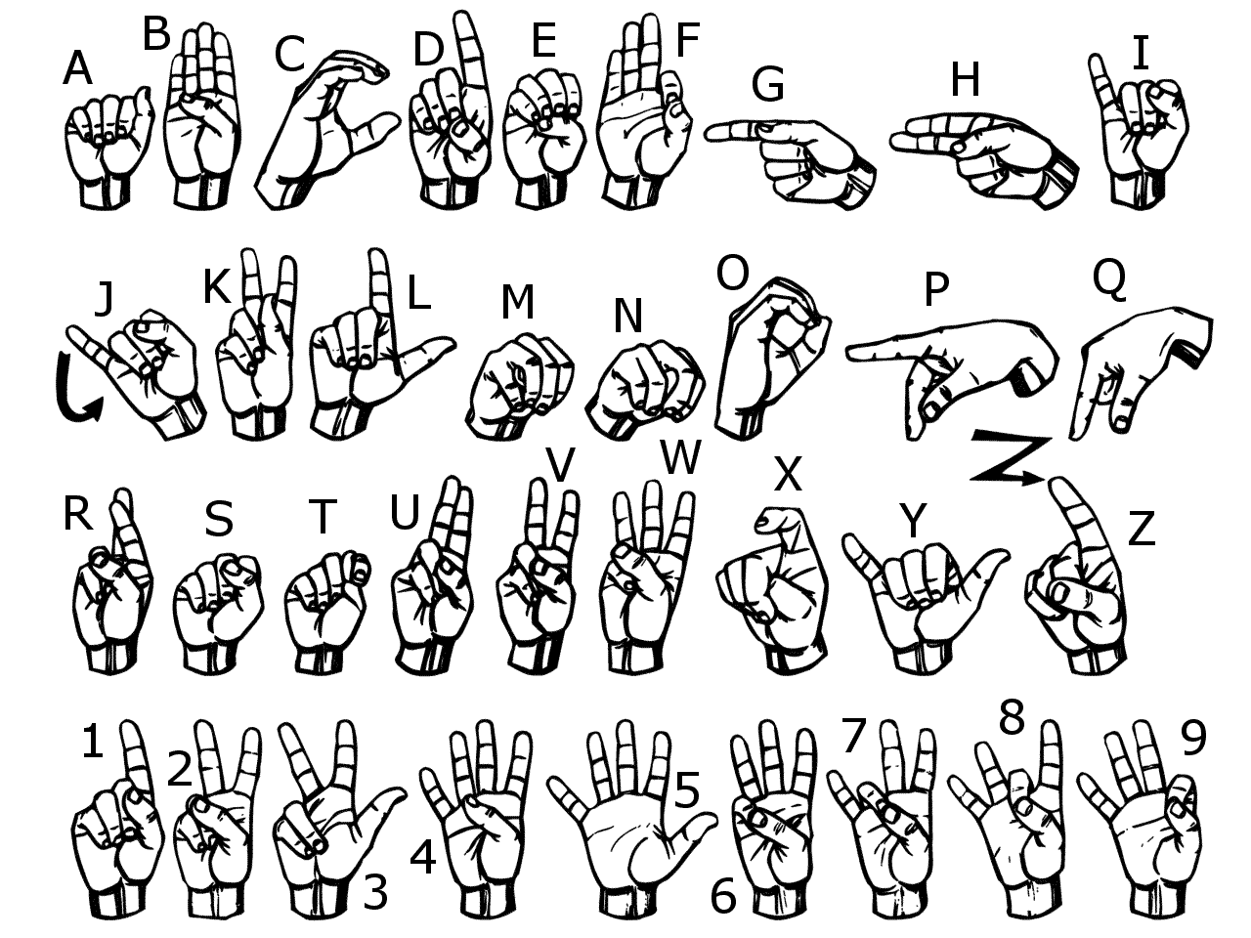
Sign Language
Use American Sign Language to spell each vocabulary word.
Now use your finger and write each word in the air

Slide 20
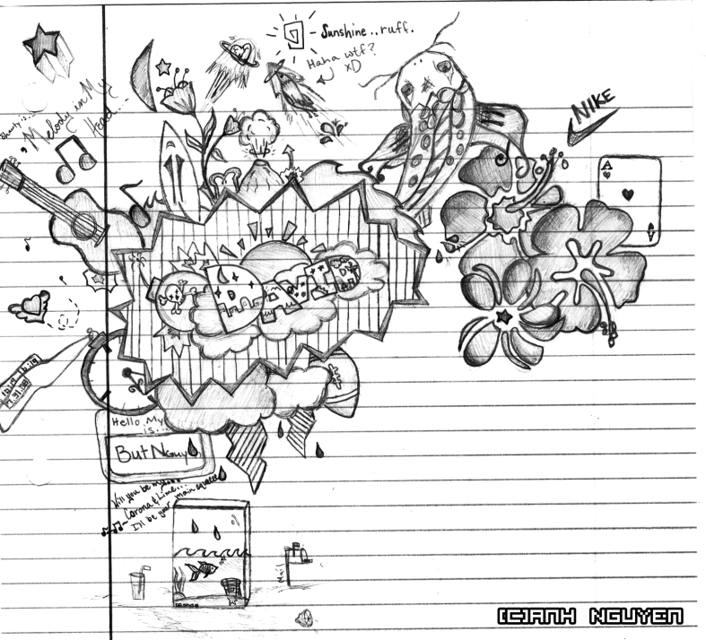
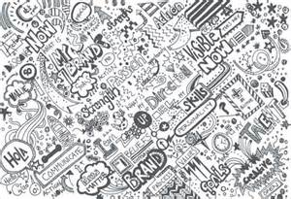
Doodle Words
Choose 5 words you do not totally understand and write your words using doodles to show what each word means. When you are done, put a star by your favorite doodle word.

Slide 21
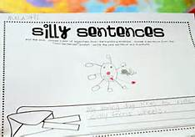
Silly Sentences
Create several silly sentences by using as many vocabulary words as you can. Can you turn a silly sentence into a tongue twister ?

Slide 22
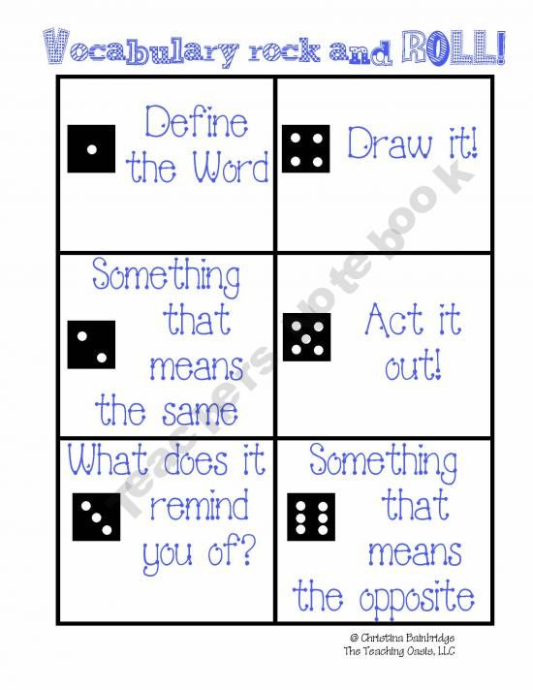
Vocabulary Rock and Roll

Slide 23
Vocab Game
As a group, you need to complete the following:
Listen to a sentence that Mrs. Law reads aloud.
Figure out the vocab word that fits into the blank in the sentence.
Spell the word out on your table in noodles.
Be able to explain why that word fits into the blank.

Slide 24
Key Vocabulary
Archeologist
Topography
Pharaoh
Hieroglyphics
Barren
Social Class
Polytheistic
Natural Resources
Papyrus
Artisan
Embalm
Peasant

Slide 25
Vocab Game
A ______ was a farmer or agricultural worker of lower status.
The monument that tells about the Ancient civilization of Egypt through the use of ______, which helped keep records.
The coroner had to ______ the dead man's body before his funeral
The land contained a lot of ______ such as fish, oil, minerals, etc.

Slide 26
Vocab Game
5. Within the ______religion, they believe in more than one god/deities.
6. Flat ______would be an economic advantage for a civilization, would it not.
7. The desert was ______except for some rocks and the occasional scorpion.
8. Last year ______ reported discovering a bunch of pyramids in Egypt.

Slide 27
Vocab Game
9. ______, used as a material to write on, appears to be of Egyptian origin.
10. The mummified body of Egyptian ______Ramses V, shows what are believed to be signs that he died of smallpox.
11. A blacksmith is an example of an ______.
12. There were many different ______ that divided up where citizens belong among the Egyptian society.

Slide 28
Vocabulary Quiz
Directions:
Choose 5 vocabulary words from your list and free write a paragraph using all 5 words.
Be sure to underline all 5 words.
Your paragraph will be graded on you using all of the words correctly and creatively.
If your paragraph does not make sense, then you will not receive a passing grade.

