Slide 1
Warm Up
Read:
Many mysteries surround the pyramids of Egypt. The greatest of these is how the ancient Egyptians were able to build the Great Pyramid. The Great Pyramid is over 450 feet tall- taller than a 40 story building! It is made of approximately 2,300,000 blocks, many of which weight 3 tons or more. And yet most scientist agree that it was build in just over 20 years.
Question:
How were the ancient Egyptians able to create this incredible monument in so little time?

Slide 2
Task
You are look at three hypotheses (educated guesses) about how the Egyptians were able to complete this incredible task. With your partner, rank the hypotheses from 1 to 3, with 1 being the hypothesis you think is most likely and 3 the hypothesis you believe is least likely. Be sure to have reasons to support your rankings.

Slide 4
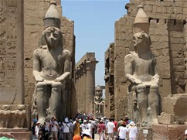
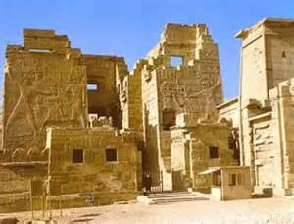
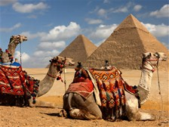
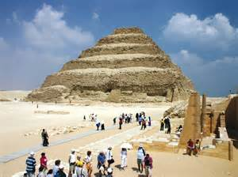
Touring Ancient Egypt

Slide 5
Learning Target
I will learn the accomplishments of the pharaohs and the importance of their monuments. The purpose is to understand how different governments/leaders lead civilizations.
Success Criteria:
Correctly identify each Pharaoh’s accomplishments and the purpose of the monuments they created.

Slide 6
Title Page 50 Egyptian Pharaohs and their Monuments

Slide 7
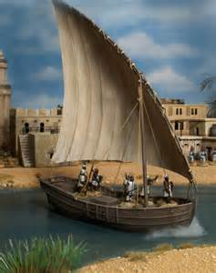
Background
You will be taking a trip down the Nile River on a felucca, or Egyptian sailboat. On your trip, you will learn about three important periods in ancient Egyptian history- the Old, Middle, and New Kingdoms- and about the role and major accomplishments of the Egyptian pharaohs. You will do this by visiting important monuments built by the pharaohs, such as the pyramids.

Slide 8
After reading Section 8.1 and 8.2, answer the following questions on page 50 of your spiral in complete sentences
What are the three key periods in ancient Egyptian history?
What is each period most known for?
What was the role of the pharaohs in ancient Egypt?
What are some of the places in Egypt where we might see monuments built by these pharaohs?

Slide 9
After reading Section 8.1 and 8.2, answer the following questions on page 50 of your spiral in complete sentences
What are the three key periods in ancient Egyptian history?
Old Kingdom
Middle Kingdom
New Kingdom
What is each period most known for?
Old Kingdom- Strong central government and was known for building the great pyramids being called the Age of Pyramids
Middle Kingdom- Period of Reunification having many achievements in literature, art, and architecture.
New Kingdom- Golden Age of peace and stability. There was an increase in trade and gigantic monuments
What was the role of the pharaohs in ancient Egypt?
They were kings, generals, and religious leaders all at once.
What are some of the places in Egypt where we might see monuments built by these pharaohs?
Cairo
Giza
Karnak
Dayr al-Bahri
Abu Simbel

Slide 10
Task
For each tour site that you visit on your felucca tour of ancient Egyptian monuments, you are to send a postcard to a friend or relative.
Tour Site 1- 8.3
Tour Site 2- 8.4
Tour Site 3- 8.5
Tour Site 4- 8.6
Make sure to follow the following steps:
Begin with a proper greeting (such as Dear Maria,)
Fill in the blank with the name of the monument
Write at least one interesting thing you learned about the monument
Fill in the black with name of pharaoh
Write at least one interesting thing you learned about the pharaoh.
Draw an appropriate symbol or visual for the stamp
Write a proper closing (such as See you soon!)

Slide 11
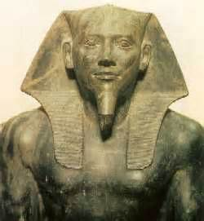
Example for Tour Site 1
Dear Maria,
The monument I just visited is the Great Pyramid. The great pyramid is made of more than 2 million stone blocks but was built in just over 20 year.
It was built by the pharaoh Khufu. Khufu helped establish the pharaoh as a central authority.
See you soon!
Mrs. Law

