Slide 1
Warm Up
On the notecard, fill out
What do you already know about China
What do you want to know about China

Slide 2
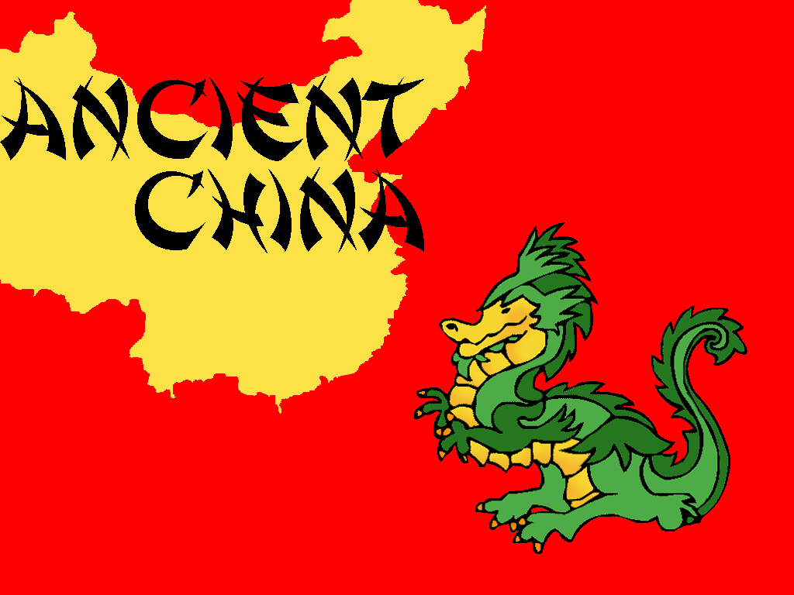
Ancient China Civilization Vocab
Day 1

Slide 3
Learning Target
I can use new vocabulary when discussing China.
This means I will be able to participate in vocabulary activities about the civilization of China.

Slide 4
Key Vocabulary
Emperor
Dynasty
Economy
Logograph
Philosophies
Confucianism
Daoism
Legalism
Mandate of Heaven
Feudalism
Civil Servant
Exile
Immortal
Bureaucracy
Anesthetic
Cultural
Diffusion

Slide 5
Circle
Don’t Know- Heard It- Know It

Slide 6
Vocabulary Pre-Groupings
Without knowing the definitions, with your group members, organize the 15 words into categories and be ready to explain why you organized them the way you did.

Slide 7
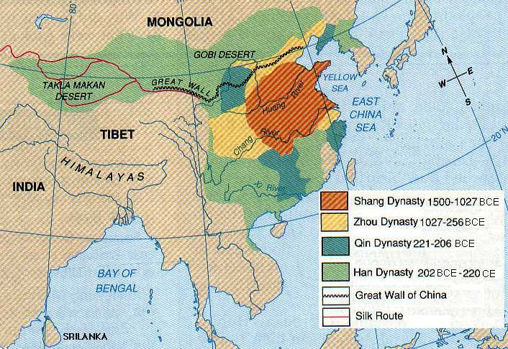
Vocabulary Chant
Repeat after me the following terms:
Emperor
Dynasty
Economy
Logograph
Philosophies
Confucianism
Daoism
Legalism
Mandate of Heaven
Feudalism
Civil Servant
Exile
Immortal
Bureaucracy
Anesthetic
Cultural
Diffusion

Slide 8
Definitions:
With your elbow partner, you need to complete the following:
Read the definitions for all 17 words on the back
Put the definition on your paper in 8 words or less.
Draw a picture representing each word in the box with the definition
With the 2 assigned vocab words, draw and color a picture for each word, on the computer paper, that represents the word.

Slide 9
Definitions
Dynasty: a family or group that rules for several generations
Emperor: people are grouped into a set of hierarchical social categories
Economy: a system of managing the wealth of a community or region
Logograph: a written character that represents a word
Philosophies: a theory of set of values by which one lives
Confucianism: a Chinese philosophy that emphasizes proper behavior
Daoism: a Chinese philosophy that emphasizes living in harmony with nature
Legalism: a Chinese philosophy that emphasizes strict obedience to laws
Mandate of Heaven: a power or law believed to be granted by God
Feudalism: a system of government based on landowners and tenants
Civil Servant: a person who works for a government
Exile: living away from one’s native country
Immortal: able to live forever
Bureaucracy: a form of government in which a few people rule many others
Anesthetic: something that takes away the feeling of pain
Cultural Diffusion: the spreading of ideas or products from one culture to another

Slide 10
Sentences:
As a group, you need to complete the following:
Read the definitions that you and your group came up with for each word.
Create an image that will help you remember each word.
Write a sentence that contains each word.

Slide 11
Word Wall
You are going to create a vocab poster to be hung up in the classroom.
Select one word from the list that you find difficult to understand. Your poster must include:
Word (large enough to read from a distance)
Definition in your own words
A COLORED picture that represents the word
This is to be completed on computer paper!

Slide 12
Warm Up:
Pick up your notecard from yesterday on the counter.
On back, sort the following words into one three piles.
Green: a pile for words you could teach to another student offering several examples
Yellow: a pile for words you know the meaning to
Red: a pile for words you really are not sure what the meaning is
Oasis
Economy
Philosophies
Confucianism
Daoism
Legalism
Mandate of Heaven
Feudalism
Civil Servant
Exile
Immortal
Bureaucracy
Anesthetic
Compass
Cultural Diffusion

Slide 13
Warm Up:
Pick up your vocabulary worksheet from yesterday (located on the counter).

Slide 14
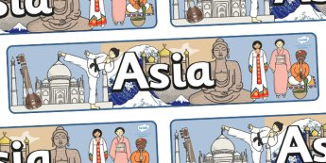
Ancient China Civilization Vocab
Day 2

Slide 15
Objective
Students will be able to explain how the physical environment of China influences it economy, culture and trade patterns. The purpose is for students to understand how the past has influenced our society today.
This means students will be able to participate in vocabulary activities about the civilization of China.

Slide 16
Key Vocabulary
Oasis
Economy
Philosophies
Confucianism
Daoism
Legalism
Mandate of Heaven
Feudalism
Civil Servant
Exile
Immortal
Bureaucracy
Anesthetic
Compass
Cultural Diffusion

Slide 17
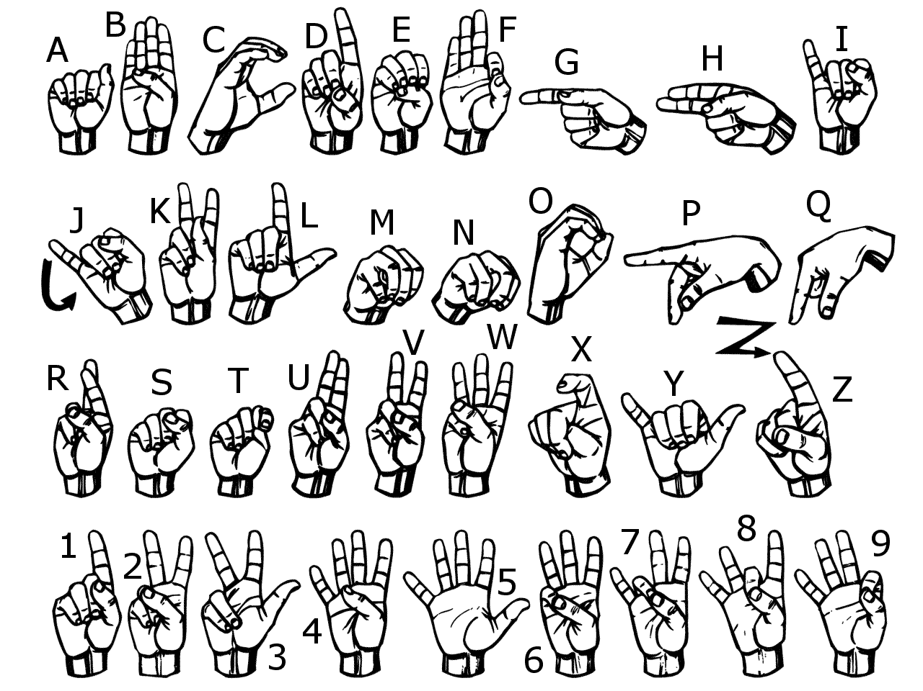
Sign Language
Use American Sign Language to spell each vocabulary word.
Now use your finger and write each word in the air

Slide 18
Sort Your Words
Sort your words by making three piles. A pile for words you could teach to another student offering several examples, a pile for words you know the meaning to, a pile for words you really are not sure what the meaning is.

Slide 19
Words in Words
Divide your paper into 9 boxes, (3 boxes in 3 rows). Choose 9 of your vocabulary words; write one vocabulary word at the top of each box. Now try to find as many words as you can within each chosen vocabulary word.

Slide 20
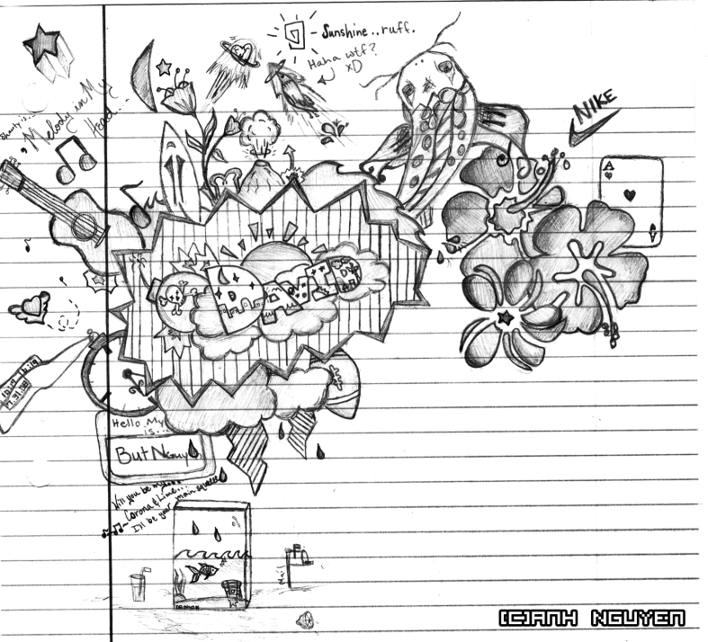
Doodle Words
Choose 5 words you totally understand and write your words using doodles to show what each word means. When you are done, put a star by your favorite doodle word.

Slide 21
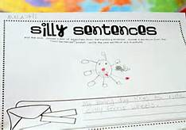
Silly Sentences
Create several silly sentences by using as many vocabulary words as you can. Can you turn a silly sentence into a tongue twister ?

Slide 22
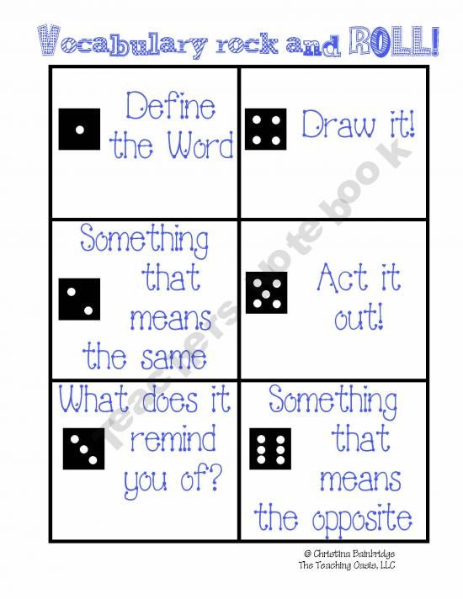
Vocabulary Rock and Roll

Slide 23
Vocab Game
As a group, you need to complete the following:
Listen to a sentence that Mrs. Law reads aloud.
Figure out the vocab word that fits into the blank in the sentence.
Be able to explain why that word fits into the blank.

Slide 24
Vocabulary Quiz
Directions:
Choose 5 vocabulary words from your list and free write a paragraph using all 5 words.
Be sure to underline all 5 words.
Your paragraph will be graded on you using all of the words correctly and creatively.
If your paragraph does not make sense, then you will not receive a passing grade.

