Slide 1
Warm Up
Would you ever live in China?
Why or Why not?

Slide 2
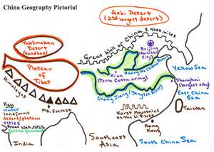
China Geography Challenge

Slide 3
Learning Target
I can describe the geography of China.
Success Criteria:
Answer questions based on China’s geography

Slide 4
Task
Using page 181 of the textbook, independently, complete the geography challenge worksheet. You will be answering questions and labeling the map of China.
Use a separate sheet of paper to give you more room to answer the questions.
All questions must be answer in complete sentences.
You have the period to work on this and it will be due at the end of the period TODAY!

