Slide 1
Warm Up
After picking up your spiral, answer the following question in your warm up section…
Based on the physical map and physical features map on the next slide…
  where was the most ideal place to establish a civilization, justify?

Slide 2
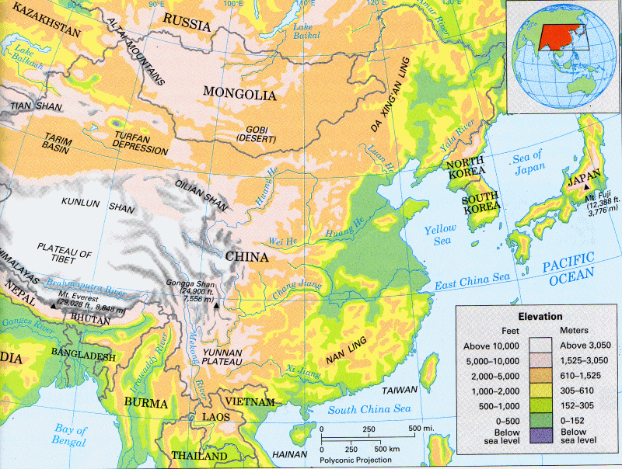
  Where was the most ideal place to establish a civilization, justify?

Slide 3
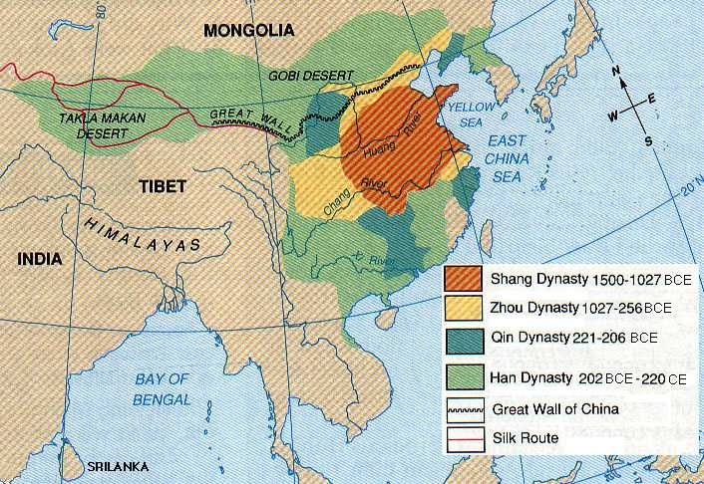
The Shang Dynasty
The Zhou Dynasty
The Qin Dynasty
The Han Dynasty
Stations

Slide 4
Objective
I can describe how Ancient China developed over time
The purpose is for students to be able to understand how the past has influenced the present.
Success Criteria:
  Spiral Set Up
  China Overview/ Geography Review
  4 major dynasties

Slide 5
Key Vocabulary
Emperor
Dynasty
Economy
Logograph
Philosophies
Confucianism
Daoism
Legalism
Mandate of Heaven
Feudalism
Civil Servant
Exile
Immortal
Bureaucracy
Anesthetic
Cultural Diffusion

Slide 6
Spiral Set Up
Label page 51
  How did the Nile Shape Ancient Egypt DBQ
    Staple your DBQ on this page
Label page 52
  How did the Nile Shape Ancient Egypt DBQ Outline
    Staple your DBQ outline on this page
Label page 54
  Ancient Chinese River Valley Civilization
    Highlight the edges of the page pink
  Essential Question: How did the physical setting contributed to the location and rise of civilizations in China?

Slide 7
Label page 53 Key Vocab
Write down the following word:
Emperor
Dynasty
Economy
Philosophies
Confucianism
Daoism
Legalism
Mandate of Heaven
Feudalism
Civil Servant
Exile
Immortal
Bureaucracy
Anesthetic
Cultural Diffusion

Slide 8
Spiral Set Up Conti…
Leave page 55 empty
Label page 56 Geography of Early China
  Staple your China Geography Challenge on this page
Label page 58 The Xia and Shang Dynasties
Label page 59 The Zhou Dynasty
Label page 60 The Zhou Dynasty Philosophies
Label page 61 The Qin Dynasty
Label page 62 The Han Dynasty and Chinese Achievements

Slide 9
I have who has Ancient China Activity
Notes:
http://misscollishawsocialstudies6.cmswiki.wikispaces.net/Unit+11+Ancient+China

Slide 10
China Overview:
A Brief Overview of Chinese Dynasties

Slide 11
Review of the
Geography of China
Larger than the United States
Climate varies
  North
    Temperate and cold
  South
    Subtropical
    Erosion
    Floods and droughts
Important rivers
  Huang He (Yellow River) – north
  Yangtze River – central China
  Pearl River- coastal South
Enclosed by high mountains, hot deserts, wide oceans

Slide 13
Ancient History
By 4000 BCE
  Village settlements along Huang He River (Yellow)
  Farming, stone tools, weapons (bow and arrow), animal domestication, pottery
Circa 1500 BCE
  Picture writing (oldest writing in existence)
  Now circa 40,000 characters

Slide 14
What are dynasties?
A dynasty is a series of rulers from the same family.
Historically, royal rule was descended from father to son.
DYNASTIC CYCLE
Emperor comes to power and gains the Mandate of Heaven.
Upward rise (wealth and population increase) to peak.
Downward spiral (natural disasters, corruption, etc.).
Emperor loses the Mandate of Heaven.
Civil war until a new emperor, with the Mandate of Heaven, comes to power.
MANDATE OF HEAVEN – Described by philosopher Mencius (men-shee-uh s) Belief that the emperor was chosen by heaven to rule.

Slide 15
XIA (a.k.a. Sha) DYNASTY
(ca. 2070-ca. 1600 BCE)
China’s first dynasty
Founded by Yu
Built roads and irrigation projects

Slide 16
Shang Dynasty
(ca. 1600-1046 BCE)
Writing began
Developed bronze, glazed pottery, and silk industries

Slide 17
Zhou (a.k.a. Chou, Joe, Chow) Dynasty
(1045-256 BCE)
Invaded China from the northwest
Set up a loose central government
Feudal power held by strong nobles
Philosophers
  Confucius
  Mencius (his follower)
    men-shee-uh s

Slide 18
Qin (a.k.a. Chin) Dynasty
(221-206 BCE)
Military dictatorship centralized China
Emperor Shih Huang Ti (shœ hwahng tee)
  Destroyed nobles’ feudal power
  System of taxation
  Established weights and measures
  Great Wall (1500 miles)

Slide 19
Han Dynasty
(206-220 CE)
Conquerors
Empire – central Asia to China Sea, Indochina to Korea
Trade
  Chinese fruits, silks, and spices in Rome (1st century CE)
  Buddhism came from India
Civil service system
First paper made

Slide 20
Chinese Dynasty stations
At each station, read the directions carefully and complete the task on the correct page of your spiral
You will only get 20 minutes at each station to complete the task

Slide 21
Chinese Dynasty Stations
Station 1 (pg 58) Class
  Xia & Shang Dynasty Reading Passage and Questions
Station 2 (pg 59) Individual
  Zhou Dynasty Reading and Questions
Station 3 (pg 60) Individual
  Zhou Dynasty Philosophies
Station 4 (pg 61) Individual
  Qin Dynasty Reading and Filling in a Chart
Station 5 (pg 62) Group
  Han Dynasty Sorting/Matching and Drawing

Slide 22
Station 1: Xia and the Shang
Complete together as a class
Read the Directions
Complete the Assigned Reading
Answer the questions on page 58 in your spiral

Slide 26
Assign Groups
Number 2-9

Slide 27
Warm Up
After picking up your spiral, answer the following question in your warm up section…
Based on the physical map and physical features map on the next slide…
  do you think that the civilization of China was isolated from other civilizations or were they open to cultural exchange and invasion from other civilizations. Why?

Slide 28
  Do you think that the civilization of China was isolated from other civilizations or were they open to cultural exchange and invasion from other civilizations. Why?

Slide 29
The Shang Dynasty
The Zhou Dynasty
The Qin Dynasty
The Han Dynasty
Stations

Slide 30
Objective
I can describe how Ancient China developed over time
The purpose is for students to be able to understand how the past has influenced the present.
Success Criteria:
  4 major dynasty stations

Slide 31
Key Vocabulary
Emperor
Dynasty
Economy
Philosophies
Confucianism
Daoism
Legalism
Mandate of Heaven
Feudalism
Civil Servant
Exile
Immortal
Bureaucracy
Anesthetic
Cultural Diffusion

Slide 32
Chinese Dynasty stations
At each station, read the directions carefully and complete the task on the correct page of your spiral
You will only get 20 minutes at each station to complete the task

Slide 33
Chinese Dynasty Stations
Station 1 (pg 58)
  Xia & Shang Dynasty Reading Passage and Questions
Station 2 (pg 59)
  Zhou Dynasty Reading and Questions
Station 3 (pg 60)
  Zhou Dynasty Philosophies
Station 4 (pg 61)
  Qin Dynasty Reading and Filling in a Chart
Station 5 (pg 62)
  Han Dynasty Sorting/Matching and Drawing

Slide 34
Chinese Dynasty stations
Pick up your spiral
Move to the next station from where you ended yesterday.
At each station, read the directions and complete the task on the correct page of your spiral
You will only get 20 minutes at each station to complete the task

Slide 35
Warm Up
On a separate sheet of paper, which of the statements on government do you most agree with? Why?
  People just try to look out for their own best interests, so government needs to be ready to harshly punish people who break the rules.
    Legalism- people are naturally selfish. Left to themselves, people always pursue their own self –interest. So rulers need to then set strict laws and enforce them
  Government should not interfere in people’s lives and allow each person find his or her own harmony with the world around them.
    Daoism/ Taoism- people gained happiness and peace by living in harmony or agreement, with the way of nature. That nature is full of opposites (i.e. life/ death, light/ darkness). True harmony comes from balancing the opposite forces of nature
  A government is only effective if it has integrity. A corrupt government will not have the respect or the support of its citizens.
    Confucianism- based up on roles and relationships (i.e. father/ son, friend/friend) all people must respect and obey those above them and their elders

Slide 36
Processing
In a short response, compare how the various dynasties (Shang,/Zhoe/ Qin/ Han) define the rights, responsibilities, and roles of citizens?

