Slide 1
Warm-Up
Thinking about the ancient societies that we have studied, were they connected to one another? Why or why not?
Are we more or less connected today? Why or why not?

Slide 2
Warm Up
As you come in, sit in your assigned seat, take out a pen or pencil, note the homework, and think about the following question….
What does the following phrase “International Towne” mean?

Slide 3
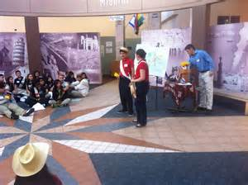
International Towne

Slide 4
Learning Target
I can evaluate how people/societies develop and change over time.
Success Criteria:
Describe Paleolithic Times
Describe Neolithic Times
Describe factors that lead to global connections today

Slide 5
Discussion Questions
How would you define a town?
How would you define international?
What do you think is more important… a local community (town) or global community (international)
How can these two terms be used to explain the upcoming unit?

Slide 6
Background
Most countries trade the goods and services they produce for some form of currency. When countries exchange the goods and services they produce with people in the same country they call it domestic trade. When the exchange takes place between countries, businesses, and people living in different countries, it is referred as global or international trade
What businesses do you know participate in global/international trade?
i.e.cars

Slide 7
How did we get to a global economy? Paleolithic to Neolithic Era
Why were civilizations less “advanced” during the Paleolithic times?
Why did it take thousands of years during the Neolithic times for societies to start developing advancements?
How did different civilizations eventually become connected, what was the purpose?
Notes:
http://www.history.com/shows/mankind-the-story-of-all-of-us/season-1/episode-1

Slide 8
Civilizations develop at different rates. Now that we are connected globally due to a variety of advancements, we have become dependent on other countries

Slide 9
People/Societies develop and change over time
Paleolithic
Neolithic
Global Community

Slide 10
Processing
Why are civilizations today more interconnected then in ancient times?

Slide 11
Warm Up
What does the following phrase “International Towne” mean?

Slide 12
Warm Up
As you come in, sit in your assigned seat making sure you have your ID on, take out a pen or pencil, note the homework, and think about the following question….
What are the pros of being in an international community?
What are the cons of being in an international community?

Slide 13
Introduction to International Towne Tour

Slide 14
Learning Target
I can describe what International Towne will be like and what I will be doing to prepare.
Success Criteria:
Pretest
Explore International Towne

Slide 15
Pre-Assessment
International Towne

Slide 16
Pre-Assessment Grading: Swap workbooks with your partner and be ready to grade. Mark only incorrect answers with an “X”. Be ready to share your partners score with the teacher.
B
B
A
D
A
A
B
D
B
C
C
A
B
E
A
D
B
D
B
D
B
A
A
C
C

Slide 17
Student Workbook Overview

Slide 18
International Town Countries AmeriLat-PacAsia-EuRussia-MidAfri
International Towne is comprised of four regions, which represent 16 countries from those areas around the world. Citizens of International Towne apply and interview for positions of their choice. Every country has a President who oversees country operations and acts as a member of the Peacekeeping Force, a Finance Minister who is responsible for maintaining Balance of Payment operations, and a Customs Agent who greets tourists, issues an “official” stamp for tourists’ passports during Towne operations. Other positions in Towne are specific to each country’s cultural or functional contribution. The International Towne day experience creates the opportunity for students to provide goods and services to other countries that reinforces the concepts of global economics and trade. Finally, students have assigned breaks to “travel” as tourists, participate in cultural activities and purchase souvenirs of their travels.

Slide 19
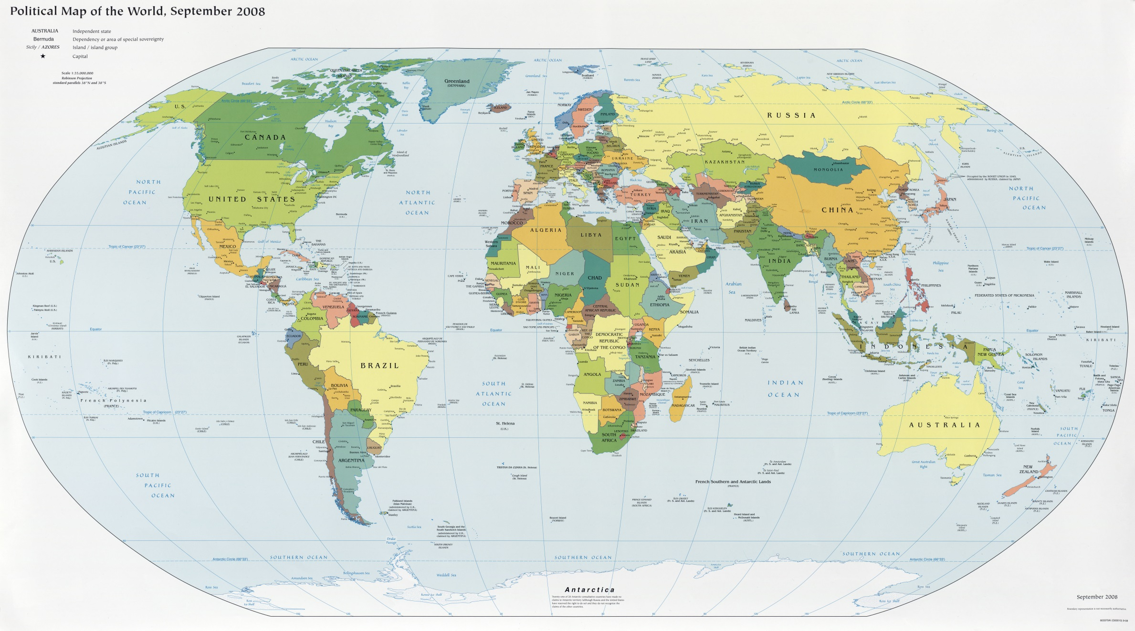
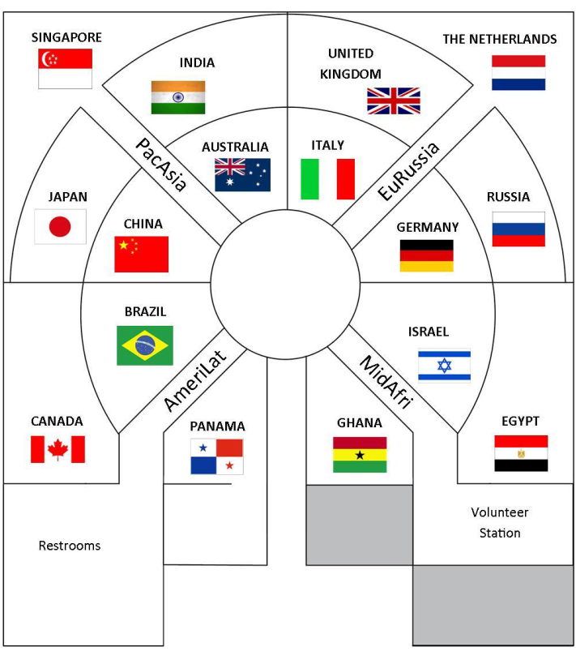

Slide 20
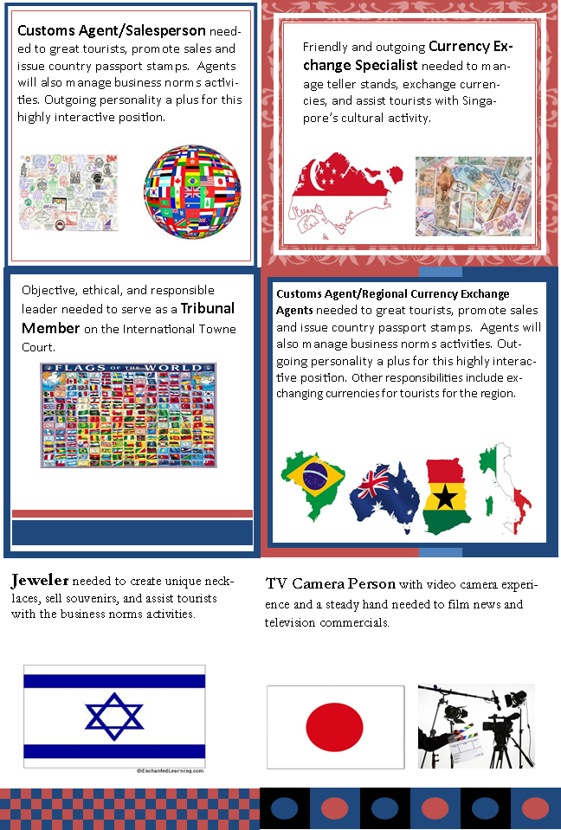
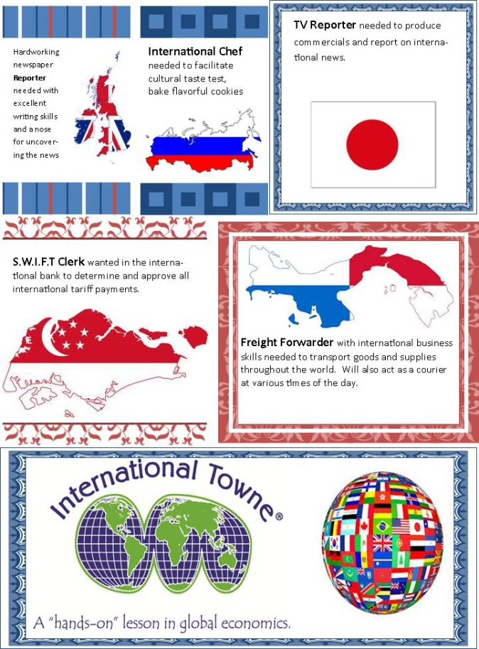
International Town Career Opportunities: Scan through pages 10-13 putting a star next to the jobs you are most interested in at this time.

Slide 21
International Towne Newsletter and homework
Homework: Take this letter home and share/discuss what International Towne is with your parents. Then read through page 8 with your family and due tomorrow at the beginning of class, respond to the following prompt:
Besides geography, why do you think the countries grouped the way they are?

