Slide 1
Warm Up
As you come in, sit in your assigned seat making sure you have your ID on, take out a pen or penciland on your warm up section of your workbook(pages 59-62), answer the following two questions,
What do you already know about Economics?
What do you want to know about Economics?

Slide 2
International Towne
Day 1

Slide 3
Learning Target
I can use new vocabulary when discussing Economics.
Success Criteria:
Participate in vocabulary activities about International Towne.

Slide 4
Key Vocabulary
Currency:
Domestic:
Exchange Rate:
Exports:
Imports:
Interdependence:
Scarcity:
Specialization:
Resources:
Tariff:
Trade:
Economy:
Sustainability:
Productivity:

Slide 5
Circle
Don’t Know- Heard It- Know It

Slide 6
Vocabulary Pre-Groupings
Without knowing the definitions, with your group members, organize the 15 words into categories and be ready to explain why you organized them the way you did.

Slide 7
Vocabulary Chant
Repeat after me the following terms:
Currency:
Domestic:
Exchange Rate:
Exports:
Imports:
Interdependence:
Scarcity:
Specialization:
Resources:
Tariff:
Trade:
Economy:
Sustainability:
Productivity:

Slide 8
Definitions:
With your elbow partner, you need to complete the following:
Read the definitions for all 17 words on the back
Put the definition on your paper in 8 words or less.
Draw a picture representing each word in the box with the definition
With the 2 assigned vocab words, draw and color a picture for each word, on the computer paper, that represents the word.

Slide 9
Definitions
Currency: money in circulation. The form of money used by a country.
Domestic: Having to do with the internal affairs of a country
Exchange Rate: the formula used to convert one currency to another. The value of ones country’s currency as to another.
Exports: goods shipped out of one country for trade or sale with another.
Imports: goods brought in from a foreign country for trade or sale.
Interdependence: the condition where countries become dependent on one another because of specialization and trade.
Scarcity: the basic economic problem that arises because people have unlimited wants but resources are limited. Because of scarcity, various economic decisions must be made to allocate resources efficiently. People must make choices between different items because the resources necessary to fulfill their wants are limited.
Specialization: when production is concentrated on producing only those goods and services that can most efficiently be produced given existing resources.
Resources: things of value and efforts used to produce goods and services: land, labor, capital, and entrepreneurship.
Tariff: a tax on imports
Trade: an exchange of goods or services
Economy: the wealth and resources of a country or region, especially in terms of the production and consumption of goods
Capital: man-made resources used to produce other goods and services, for example, machines, factories, tools.
Sustainability: the ability to provide for the needs of the world’s current population without damaging the ability of future generations to provide for themselves.
Productivity: the amount of goods or services produced by each person in a country in a given time.

Slide 10
Sentences:
As a group, you need to complete the following:
Read the definitions that you and your group came up with for each word.
Create an image that will help you remember each word.
Write a sentence that contains each word.

Slide 11
Word Wall
You are going to create a vocab poster to be hung up in the classroom.
Select one word from the list that you find difficult to understand. Your poster must include:
Word (large enough to read from a distance)
Definition in your own words
A COLORED picture that represents the word
This is to be completed on computer paper!

Slide 12
Warm Up:
Pick up your notecard from yesterday on the counter.
On back, sort the following words into one three piles.
Green: a pile for words you could teach to another student offering several examples
Yellow: a pile for words you know the meaning to
Red: a pile for words you really are not sure what the meaning is
Currency:
Domestic:
Exchange Rate:
Exports:
Imports:
Interdependence:
Scarcity:
Specialization:
Resources:
Tariff:
Trade:
Economy:
Sustainability:
Productivity:

Slide 13
Warm Up: As you come in, sit in your assigned seat making sure you have your ID on, take out a pen or pencil, and on your warm up section of your workbook(pages 59-62), answer the following question…
Why is it important to understand the vocabulary terms from Friday at your age?

Slide 14
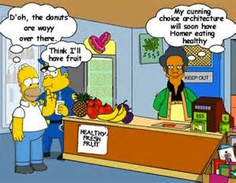
International Towne Vocab
Day 2

Slide 15
Learning Target
I can use new vocabulary when discussing Economics.
Success Criteria:
Participate in vocabulary activities about International Towne.

Slide 16
Key Vocabulary
Currency
Domestic
Exchange Rate
Exports
Imports
Interdependence
Scarcity
Specialization
Resources
Tariff
Trade
Economy
Sustainability
Productivity

Slide 17
Homework for Tonight
In an effort to see how global trade impacts our daily lives, complete page 14 of your workbook for homework tonight. Due tomorrow at the beginning of class!

Slide 18
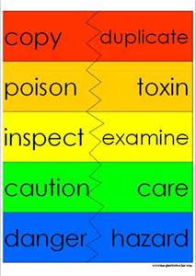
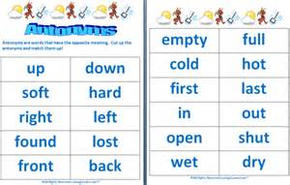
Synonyms/ Antonyms
With your elbow partner, come up with a synonym as well as an antonym for each word.
Synonym: a word or phrase that means exactly or nearly the same as another word
Antonym: a word or phrase that means the opposite in meaning to another word

Slide 19
Sentences:
As a group, you have completed the following:
You and your group came up with a definition in your own words for each word.
Created an image that will help you remember each word.
Came up with synonyms/antonyms for each word
Now you are to…
Write a sentence that contains each word.

Slide 20
Heads Up for Vocabulary
Here's how you play:
One player holds the flash card up to his/her forehead.
The other players give clues to help the player guess the word (without using the word).
Once the word is guessed correctly, the player will pick up another flashcard so that a new word will pop up on the screen.
A player can "pass" on a word by saying “pass” and placing that card in a separate pile.
Play continues for 60 seconds.
Player counts the words solved correctly.
The notecards are then shuffled and passed to another player and the game continues until everyone has a turn.
For an extra challenge:
Try the 'the act it out - no words' rule.

Slide 21
Definitions
Currency: money in circulation. The form of money used by a country.
Domestic: Having to do with the internal affairs of a country
Exchange Rate: the formula used to convert one currency to another. The value of ones country’s currency as to another.
Exports: goods shipped out of one country for trade or sale with another.
Imports: goods brought in from a foreign country for trade or sale.
Interdependence: the condition where countries become dependent on one another because of specialization and trade.
Scarcity: the basic economic problem that arises because people have unlimited wants but resources are limited. Because of scarcity, various economic decisions must be made to allocate resources efficiently. People must make choices between different items because the resources necessary to fulfill their wants are limited.
Specialization: when production is concentrated on producing only those goods and services that can most efficiently be produced given existing resources.
Resources: things of value and efforts used to produce goods and services: land, labor, capital, and entrepreneurship.
Tariff: a tax on imports
Trade: an exchange of goods or services
Economy: the wealth and resources of a country or region, especially in terms of the production and consumption of goods
Capital: man-made resources used to produce other goods and services, for example, machines, factories, tools.
Sustainability: the ability to provide for the needs of the world’s current population without damaging the ability of future generations to provide for themselves.
Productivity: the amount of goods or services produced by each person in a country in a given time.

Slide 22
Heads Up
Two students will be selected to come to the front of the class.
One vocab word will be placed behind the two students heads. The classes goal is to get those two students to come up with the correct word.
You are not allowed to look at the word behind you or say that word that they are trying to guess.

Slide 23
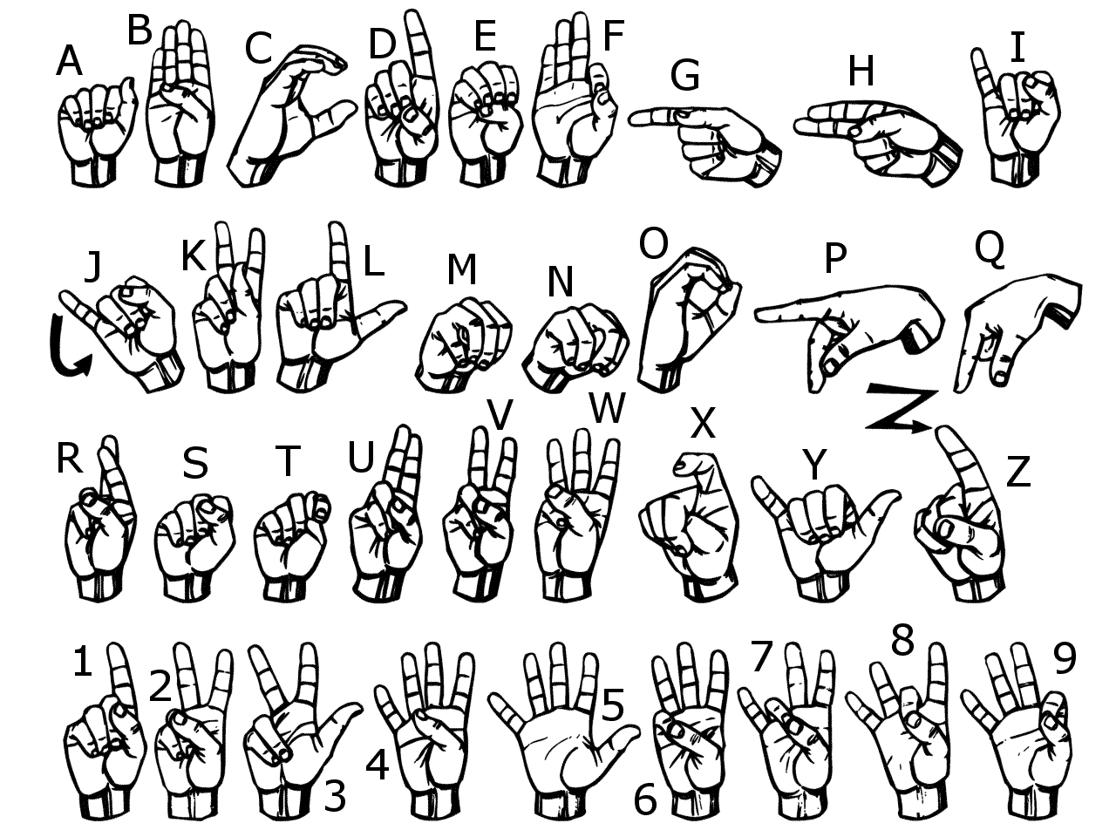
Sign Language
Use American Sign Language to spell each vocabulary word.
Now use your finger and write each word in the air

Slide 24
Sort Your Words
Sort your words by making three piles. A pile for words you could teach to another student offering several examples, a pile for words you know the meaning to, a pile for words you really are not sure what the meaning is.

Slide 25
Words in Words
Divide your paper into 9 boxes, (3 boxes in 3 rows). Choose 9 of your vocabulary words; write one vocabulary word at the top of each box. Now try to find as many words as you can within each chosen vocabulary word.

Slide 26
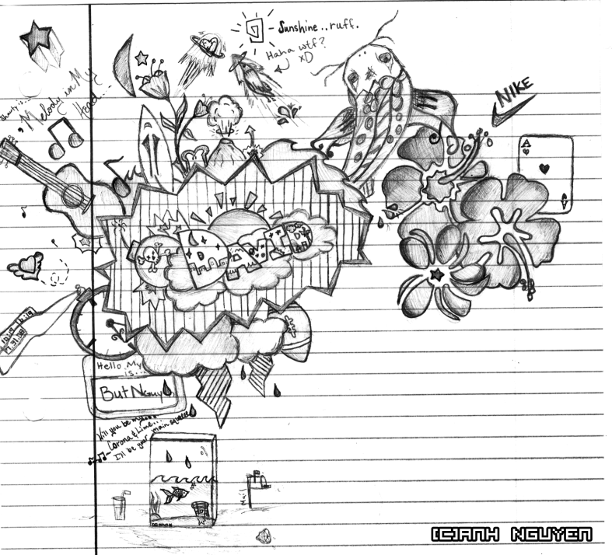
Doodle Words
Choose 5 words you totally understand and write your words using doodles to show what each word means. When you are done, put a star by your favorite doodle word.

Slide 27
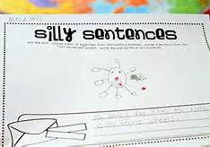
Silly Sentences
Create several silly sentences by using as many vocabulary words as you can. Can you turn a silly sentence into a tongue twister ?

Slide 28
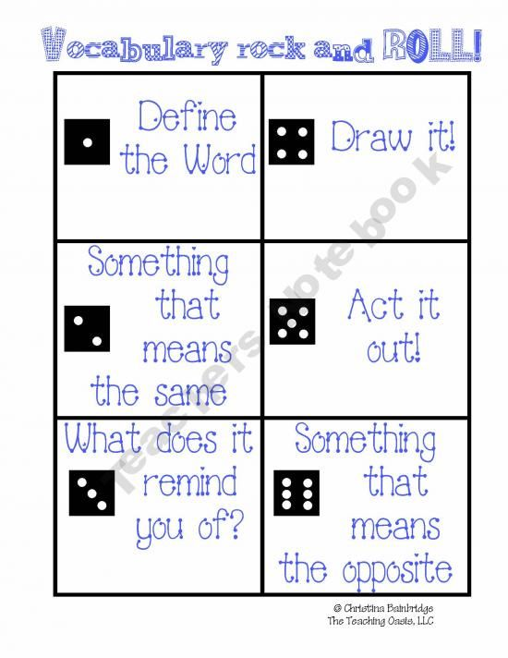
Vocabulary Rock and Roll

Slide 29
Vocab Game
As a group, you need to complete the following:
Listen to a sentence that Mrs. Law reads aloud.
Figure out the vocab word that fits into the blank in the sentence.
Be able to explain why that word fits into the blank.

Slide 30
Vocabulary Quiz
Directions:
Choose 5 vocabulary words from your list and free write a paragraph using all 5 words.
Be sure to underline all 5 words.
Your paragraph will be graded on you using all of the words correctly and creatively.
If your paragraph does not make sense, then you will not receive a passing grade.

