Slide 1
Warm Up
As you come in, sit in your assigned seat making sure you have your ID on, take out a pen or pencil, your International Towne vocabulary sheet and your Global Treasure Hunt worksheet, and discuss the following questions with your elbow partner…
With your elbow partner, share out the three countries that showed up the most on their own lists.
You will then place a small colored dot on the map in the front of the room

Slide 2
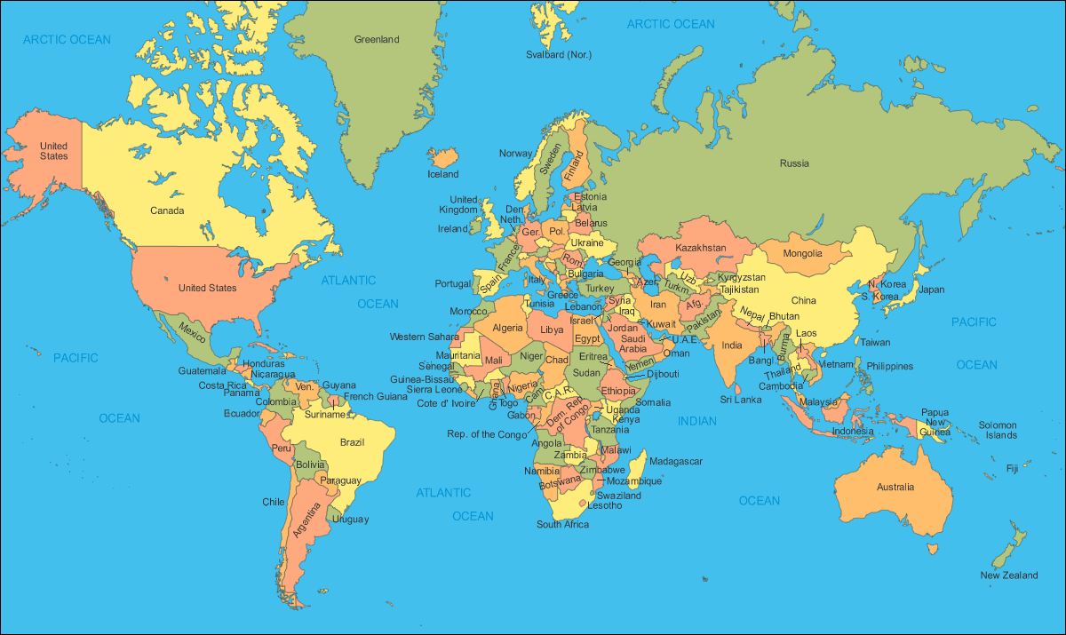

Slide 3
Discussion
What would happen if the United States decided to stop trading with the rest of the world?
How would decreased trade change people’s lives?
What are some products that are essential to our economy?
What are products that you could live without, but have come to rely upon as part of your lives, such as video games, athletic shoes, or personal electronics

Slide 4
Interdependence

Slide 5
Learning Target
I can learn the importance of international trade and how countries depend on each other.
Success Criteria:
Define interdependence
Describe the benefits of international trade
Recognize the inequalities that often accompany international trade
Appreciate the advantages and disadvantages of participating in global trade

Slide 6
Key Vocabulary
Trade- an exchange of goods or services
Domestic Trade: having to do with the internal affairs of a country
Global Trade/ International Trade: an exchange of goods or services throughout the world
Import: goods brought in from a foreign country for trade or sale
Export: goods shipped out of one country for trade or sale with another
Interdependence: The condition where countries become dependent on one another because of specialization and trade

Slide 7
just as we have come to depend on products from other countries, people in other parts of the world depend on the United States for many products they use every day. i.e. consumer goods, autos, agriculture, industrial supplies

Slide 8
Scramble for Wealth
You are going to participate in an activity in which you will have the chance to acquire a great deal of the world’s wealth.
You will be representing the leaders of countries from around the world.
The world’s wealth will be represented by 100 pennies.
Those pennies represent the goods and services of the world.
Your objective is to acquire as many pennies as possible… However, you cannot touch each other as you “scramble” for wealth.

Slide 9
count your pennies and Tally

Slide 10
Manufactured Goods Card
For every 5 pennies, you will receive manufacturing good cards.
Students who fall beneath this number will be awarded 1 raw goods card.
Remember that your goods are being awarded based on the number of pennies you have.
Additionally, remember that students with manufactured goods cards have already met their basic needs, and are not necessarily in want of additional raw goods.

Slide 11
RELAXATION
Students with the manufactured goods cards can now sit comfortably in your seats provided and eat a piece of candy
Students with the raw goods cards are to remain standing.

Slide 12
TRADE
Students with manufactured goods are now able to trade with other students who have manufactured goods.
For example, a student with an iPod can trade his product for a laptop computer, if so desired.
Students with raw goods may not allowed to trade during this interaction. You are to continue to stand in the front of the classroom

Slide 13
Foreign Aid: money, food, Military Aid, or other resources given or lent by one country to another for purposes of relief and rehabilitation, for economic stabilization, or for mutual defense.
After this first round of trade is complete, students with manufactured goods have an opportunity to make offers of foreign aid to others.
Remember that cards and privileges will be lost if a you drop below the established threshold.
You will have one minute or so for this interaction.

Slide 14
Question…
Students who have raw materials, would you like any of the manufactured goods?
If so, what?
Why would countries offer foreign aid to another country?
It provides some type of benefit to the country offering foreign aid
Alliances
Trading partners
Pressure to do the right thing
Relationship building
Prevent corrupt governments from coming to power
Notes:
Make mental notes to ensure that there is sufficient desire for these manufactured goods as they respond.

Slide 15
Open Trade
All students are allowed to exchange cards with anyone they wish during this second round of trade.
Did any students with manufactured goods trade with students who have raw goods?

Slide 16
Poll/ Plan
Who is satisfied with their material goods and who is not?
If you are, go to the right side of the room
If you are not, go to the left side of the room

Slide 17
Warm-UP
As you come in, sit in your assigned seat making sure you have your ID on, take out a pen or pencil, and answer the following question in your warm up section of your workbook…
What did you learn about the inequalities of trading between countries from yesterday’s activity?
(think about countries with raw good versus countries with manufactured goods)
There are a smaller number of countries with manufactured goods but because of the wealth they possess, they have the controlling power.

Slide 18
Interdependence

Slide 19
Learning Target
I can learn the importance of international trade and how countries depend on each other.
Success Criteria:
Define interdependence
Describe the benefits of international trade
Recognize the inequalities that often accompany international trade
Appreciate the advantages and disadvantages of participating in global trade

Slide 20
Poll/ Plan
Who is satisfied with their material goods and who is not?
If you are, go to the right side of the room
If you are not, go to the left side of the room
With in your group, review the plans to redistribute the world’s wealth to make everyone happy.
Remember, you are the presidents of a country and have the interests of your people to consider when deciding on a plan.
Select a plan, as a group write down the 3 main points as to why you selected the plan that you did.
Make sure to select a spokesperson to answer questions about your plan for the class

Slide 21
Suggested Plan Ideas
Wealthy or “satisfied” countries
Plan A: Offer equal amounts of “foreign aid” to poorer countries. The wealthy countries could agree to a net amount and divide that amount equally among the poorer countries.
Plan B: Do nothing. This position could rest upon the rationale that the nature of the world economy is competition, and there are “winners” and there are “losers.” Poorer countries need to figure out ways to obtain more pennies in order to produce manufactured goods that will be worth more in the global economy.
Poor or “dissatisfied” countries
Plan A: Require wealthy countries to offer “foreign aid” so as to create a situation where the amount of pennies would be equally distributed among all countries.
Plan B: For each raw good traded, attach a “tax” or “tariff” to be paid by the wealthy country to the poorer country. [This would promote a more gradual increase in wealth to poorer countries.]

Slide 22
Share out
Each side must present their suggested plan. Each person will get one vote after hearing out the suggested plans.

Slide 23
Vote on the Plans
Take a vote on the plans. However, students who met or exceeded the threshold have 5 votes, and that all others have only 1 vote.
Why do the countries with greater wealth have more votes?

Slide 24
So how would you define the word Interdependence?
The condition where countries depend upon each other as a result of specialization and trade.

Slide 25
Key Vocabulary
Trade- an exchange of goods or services
Domestic Trade: having to do with the internal affairs of a country
Global Trade/ International Trade:
Import: goods brought in from a foreign country for trade or sale
Export: goods shipped out of one country for trade or sale with another
Interdependence: The condition where countries become dependent on one another because of specialization and trade

Slide 26
REview
You have learned the importance of international trade and how countries depend upon one another for international trade to take place in the world economy.
You participated in an experiential activity that illustrates the volatility and inequalities that may sometimes accompany interdependence in a global world economy.

Slide 27
Discussion
Was the voting process was fair. Would you have suggested a different voting arrangement? What would be the basis of the arrangement?

Slide 28
Discussion
Can you better appreciate the perspective of countries that are poorer or rely upon fewer modes of production for trade, or are dependent on raw good production for trade.

Slide 29
Discussion
Can you think of other examples in the real world that are often grounds for trade disputes?
Continued farm subsidies to U.S. farmers and the relationship to countries that are heavily dependent on agricultural products; subsidies make U.S. agricultural products more competitive vis-à-vis foreign agricultural products.
We have to be able to sustain our people with our own products since international trade has its risks!
A subsidy is a sum of money granted by the government to assist a business or industry

Slide 30
Processing
Is it realistic for a country to behave as an isolated “island” in the world community, or do countries need to trade in order to survive?
Can the United States, for example, produce its own coffee?

Slide 31
Supplement Activity
Giving Foreign Aid

Slide 32
Foreign Aid: money, food, Military Aid, or other resources given or lent by one country to another for purposes of relief and rehabilitation, for economic stabilization, or for mutual defense.
Why would countries offer foreign aid to another country?
It provides some type of benefit to the country offering foreign aid
Alliances
Trading partners
Pressure to do the right thing
Relationship building
Prevent corrupt governments from coming to power
Protect America and Americans
Support economic growth and human rights around the world
Increase support for American values like democracy and freedom

Slide 33
Giving Foreign Aid…
Directions: Listed below are four scenarios. Each scenario describes the situation of a country. Each of the countries has requested financial aid (money) from the United States. The US has $50 million to give and our foreign policy states that we can only give the money to one of the four countries. In your groups, please answer the following questions on a separate piece of paper:
1. To which country would you give the $50 million? List at least two reasons why you picked this country.
2. Explain why you did not give the money to the other three countries. List separate reasons for each country.

Slide 34
Country 1: Has always raised most of its own food. However, the population has continued to grow at a rapid rate and recent natural disasters have cut farm production in half. As a result, famine threatens. A rare ore has been discovered that could turn the economy around. However, the country has resisted efforts from multinational corporations to develop mining.
Country 2: Has been developing rapidly in the past ten years. Heavily populated, it is attractive to multinational corporations as a source of inexpensive labor. Although the country has had a primarily agricultural economy, many people have moved into the cities to work. Cities are becoming overcrowded and the country's largest city is experiencing an outbreak of cholera. A cheap source of energy is available to attract even more industry, provide more jobs, and have enough money to provide basic services for increasing numbers of city dwellers.
Country 3: An island nation, this country has always depended on its export of tropical fruit to survive. However, rapid population growth has caused the country to experience economic problems. Its income from exports has not matched the amount needed to import food. Because of an inadequate, unbalanced diet, many people are suffering the effects of malnutrition. The only resource the country has, other than its fruit growing ability, is its natural beauty.
Country 4: This country has recently gained its independence from another nation that had largely supplied its economic needs and exploited its natural resources. The people of the country are largely uneducated and do not posses the technological skills necessary to operate the industry established by the mother country. Basic needs of the people are not being met, the unemployment rate is high, and there is political unrest.

