Slide 1
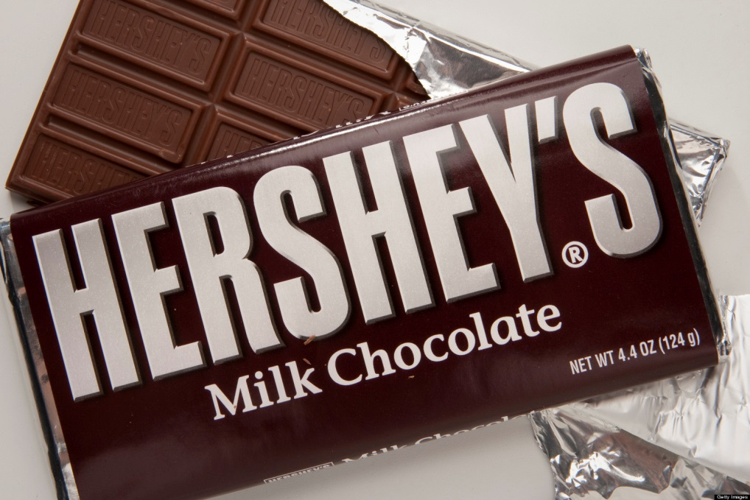
Warm Up
List the ingredients that you think are in this candy bar.
Guess the country/countries of origin for those products?

Slide 2
Basic Ingredients:
corn syrup
cream
milk
sugar
salt
roasted, salted peanuts
egg
water
creamy peanut butter
vanilla
chocolate

Slide 3
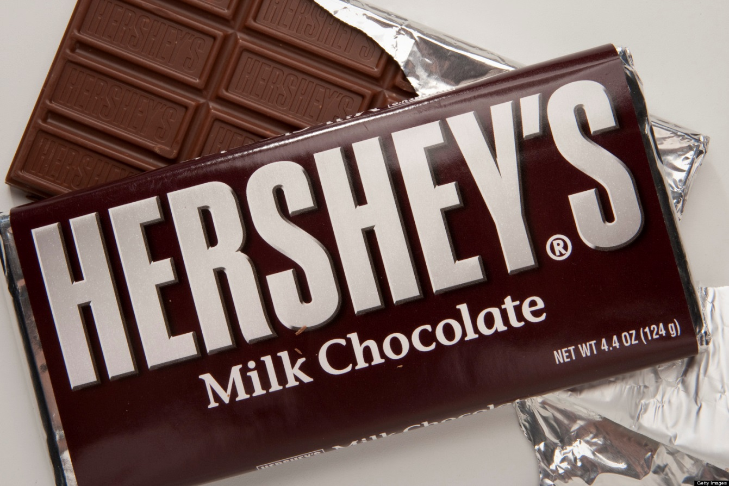
What factors might influence the cost of the finished product?
Transportation Cost
Weather
Season or time of year
Supply or Demand
Notes:
transportation costs, weather, season or time of year, or supply and demand

Slide 4
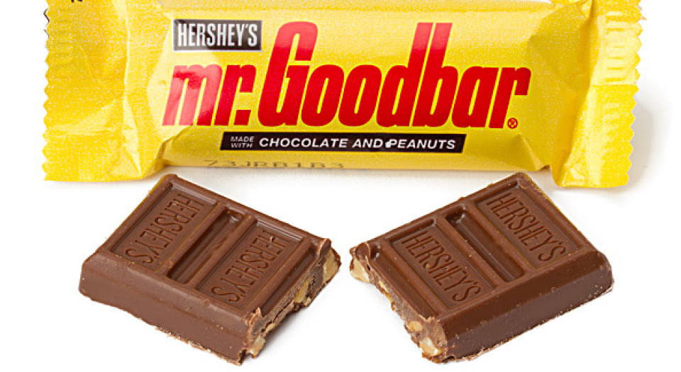
Going After Mr. Goodbar: How Something So Little Can Cost So Much!

Slide 5
Learning Target
I can explain interdependence and how one country effects others.
Success Criteria:
Provide an example of interdependence in a global market
Recognize how decisions made in one part of the world can impact countries in other parts of the world
Explain why some countries might develop policies regarding foreign aid

Slide 6
Overview
By way of a simple simulation using a candy bar, students appreciate the complexity of global interdependence by playing the Going After Mr. Goodbar game. By acting as members of the international business world, students will not only grasp the concept of interdependence, but also see how their decisions affect others.

Slide 7
Key Vocabulary Review
Trade- an exchange of goods or services
Domestic Trade: having to do with the internal affairs of a country
Global Trade/ International Trade: an exchange of goods or services throughout the world
Import: goods brought in from a foreign country for trade or sale
Export: goods shipped out of one country for trade or sale with another
Interdependence: The condition where countries become dependent on one another because of specialization and trade

Slide 8
Key Vocabulary Review Conti…
Resources: Things of value and efforts used to produce goods and services: land, labor, capital, and entrepreneurship
Capital: Material Wealth; The money, machines, factories, and tools used (or available for use) in the production of other goods and services.
Entrepreneurship: The willingness to assume the risks of organizing and coordinating resources to produce goods and services.
Land: Natural resources used to produce goods and services; for example, land, minerals, and trees.
Labor: All human effort, including the knowledge and skills used in the production of goods and services.
Specialization: when countries or businesses concentrate on producing only those goods and services that they can most efficiently produce given their existing resources.

Slide 9
Key Vocabulary Review Conti…
Trade Barriers: limits or restrictions on foreign trade
Tariffs: a tax on imports
Quotas: a limit on the amount of goods that can be imported
Embargoes: when on nation prohibits trade with another, often for political reasons

Slide 10
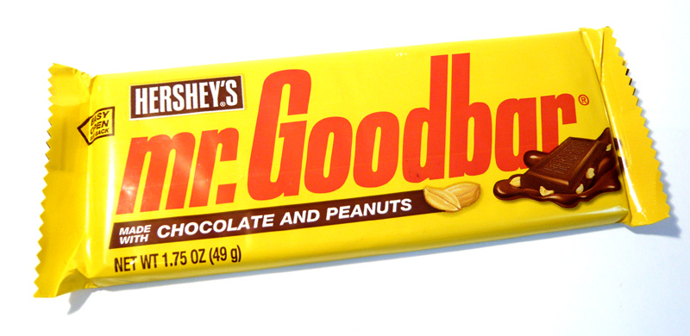
Going after Mr. Goodbar

Slide 11
Trade Simulation
You are all the Chief Purchasing Officers (CPO) for major candy companies in countries around the world. You are responsible for obtaining the necessary ingredients and technology to produce candy for their respective companies….Your goal is to produce as many candy bars as possible.
Being smart CPOs, you recognize that the candy bars you produce must be made with certain ingredients. Customers who buy their candy expect a certain taste and quality that only they can provide.
Notes:
Purchasing Officer: this is the person organize and cordinate the purchasing of all products needed to create the Mr. Goodbar

Slide 12
In order to produce one candy bar, you will need the following ingredients
1 chocolate kiss
1 peanut
2 Poker Chips
Technology to preserve key ingredients--one poker chip preserves one peanut from one round to the next and one poker chip preserves one chocolate kiss from one round to the next (every peanut and every chocolate kiss must be accompanied by a poker chip or they will lose it.)
$500 to maintain and produce the above ingredients and technology
Notes:
Teacher will act as the “International Monetary Fund” (IMF) Director

Slide 13
Going After Mr. Goodbar Play
Round One:
Each student with get a random cup.
The cup in front of you is what you will start with in business trading. You may need to trade or buy the necessary items to make the candy bar. All trading will cease when you hear the bell from the IMF (International Monetary Fund) Director.
Round should last about 2-5 minutes

Slide 14
In order to produce one candy bar, you will need the following ingredients
1 chocolate kiss
1 peanut
2 Poker Chips
Technology to preserve key ingredients--one poker chip preserves one peanut from one round to the next and one poker chip preserves one chocolate kiss from one round to the next (every peanut and every chocolate kiss must be accompanied by a poker chip or they will lose it.)
$500 to maintain and produce the above ingredients and technology
Notes:
Teacher will act as the “International Monetary Fund” (IMF) Director

Slide 15
At the end of Round One…
If you have the correct ingredients to make a candy bar (1 chocolate kiss, one peanut, $500, and 2 poker chips) you can do 1 of 2 things:
Trade in the ingredients for a candy bar, OR
Trade in the ingredients to the IMF Director who will pay them $500

Slide 16
The IMF director is going to come around and Check if you preserved your Chocolate and peanuts…
In order to preserve your peanuts, you must have 1 poker chip for each peanut.
In order to preserve your chocolate, you must have 1 poker chip for each chocolate.
You may have to make some tough decisions to decide what you want to preserve!

Slide 17
Remember…
Remember… the IMF Director will take away any raw materials (peanuts and chocolate kisses) that do not have a technology chip associated with them.
Raw materials need “preservatives” to keep them fresh. As the IMF Director, I will visit each CPO and either exchange the correct ingredients for a candy bar or $500.
Make sure that you gather up the ingredients and put them back in your bag when you make the exchange.
I will also remove any peanuts and/or kisses that do not have poker chips “preserving” them.

Slide 18
Going After Mr. Goodbar Play
Round Two:
The cup in front of you is what you will continue with in business trading. You may need to trade or buy the necessary items to make the candy bar. All trading will cease when you hear the bell from the IMF Director.
Round should last about 2-5 minutes

Slide 19
In order to produce one candy bar, you will need the following ingredients
1 chocolate kiss
1 peanut
2 Poker Chips
Technology to preserve key ingredients--one poker chip preserves one peanut from one round to the next and one poker chip preserves one chocolate kiss from one round to the next (every peanut and every chocolate kiss must be accompanied by a poker chip or they will lose it.)
$500 to maintain and produce the above ingredients and technology
Notes:
Teacher will act as the “International Monetary Fund” (IMF) Director

Slide 20
Remember…
Remember… the IMF Director will take away any raw materials (peanuts and chocolate kisses) that do not have a technology chip associated with them.
Raw materials need “preservatives” to keep them fresh. As the IMF Director, I will visit each CPO and either exchange the correct ingredients for a candy bar or $500.
Make sure that you gather up the ingredients and put them back in your bag when you make the exchange.
I will also remove any peanuts and/or kisses that do not have poker chips “preserving” them.

Slide 21
Going After Mr. Goodbar Play
Round Three:
Students with limited resources will be identified.
Students can have the opportunity to provide foreign aid to anyone in the class.
The form of the aid is at their sole discretion (i.e. money, chips, peanuts, chocolate kisses).
There will be no discussion during this period of time.
This activity does not include trading
You will have 30 seconds to make your “foreign aid” decisions SILENTLY!
The cup in front of you is what you will continue with in business trading. You may need to trade or buy the necessary items to make the candy bar. All trading will cease when you hear the bell from the IMF Director.
Round should last about 2-5 minutes

Slide 22
In order to produce one candy bar, you will need the following ingredients
1 chocolate kiss
1 peanut
2 Poker Chips
Technology to preserve key ingredients--one poker chip preserves one peanut from one round to the next and one poker chip preserves one chocolate kiss from one round to the next (every peanut and every chocolate kiss must be accompanied by a poker chip or they will lose it.)
$500 to maintain and produce the above ingredients and technology
Notes:
Teacher will act as the “International Monetary Fund” (IMF) Director

Slide 23
Going After Mr. Goodbar Play
Round Four
Announcement of New Forecast:
It is predicted that it is going to be a good year for rain. 2 Peanuts and 2 Chocolates are going to 6 random kids.
The cup in front of you is what you will continue with in business trading. You may need to trade or buy the necessary items to make the candy bar. All trading will cease when you hear the bell from the IMF Director.
Round should last about 2-5 minutes

Slide 24
In order to produce one candy bar, you will need the following ingredients
1 chocolate kiss
1 peanut
2 Poker Chips
Technology to preserve key ingredients--one poker chip preserves one peanut from one round to the next and one poker chip preserves one chocolate kiss from one round to the next (every peanut and every chocolate kiss must be accompanied by a poker chip or they will lose it.)
$500 to maintain and produce the above ingredients and technology
Notes:
Teacher will act as the “International Monetary Fund” (IMF) Director

Slide 25
The weather has damaged peanut and cocoa crops around the world. You will have to surrender 20% of your peanuts and chocolate kisses.

Slide 26
Going After Mr. Goodbar Play
Round Five
The cup in front of you is what you will continue with in business trading. You may need to trade or buy the necessary items to make the candy bar. All trading will cease when you hear the bell from the IMF Director.
Round should last about 2-5 minutes
Due to increased demand, technology costs have risen and the cost of a technology chip has risen to $1,000 to maintain and produce the ingredients.

Slide 27
In order to produce one candy bar, you will need the following ingredients
1 chocolate kiss
1 peanut
2 Poker Chips
Technology to preserve key ingredients--one poker chip preserves one peanut from one round to the next and one poker chip preserves one chocolate kiss from one round to the next (every peanut and every chocolate kiss must be accompanied by a poker chip or they will lose it.)
$1000 to maintain and produce the above ingredients and technology
Notes:
Teacher will act as the “International Monetary Fund” (IMF) Director

Slide 28
Going After Mr. Goodbar Play
Final Round
This is your last opportunity to claim a candy bar if they have all the required ingredients.
1 chocolate kiss
1 peanut
2 Poker Chips
Technology to preserve key ingredients--one poker chip preserves one peanut from one round to the next and one poker chip preserves one chocolate kiss from one round to the next (every peanut and every chocolate kiss must be accompanied by a poker chip or they will lose it.)
$1000 to maintain and produce the above ingredients and technology

Slide 29
Who had the most candy bars?

Slide 30
Overview
By way of a simple simulation using a candy bar, students appreciate the complexity of global interdependence by playing the Going After Mr. Goodbar game. By acting as members of the international business world, students will not only grasp the concept of interdependence, but also see how their decisions affect others.
There are only a certain amount of resources in the world and they are not divided equally.
When something happens in a country that impacts one of their exports, this directly effects countries around the world.
Countries don’t function all the same way… what worked with one country when trading may not work with another country when trading.
Producing a good and service requires many components. It is not a simple as you would think!

Slide 31
Processing
Think about how the game illustrates dynamics of a global free market environment.
How satisfied were they with their initial ingredients?
Did they have to work very hard to produce a candy bar? Or was it a fairly easy process? Why or why not?
Who set the trade limits?
How can a country with limited resources or raw materials effectively thrive in a free market environment?
Who felt that they were successful? Have those students explain what strategies they used to help them succeed.
Did some students decide to join together as a team? Why? How does this dynamic resemble the activities of regional trading blocs such as NAFTA or the European Union?

