Slide 1
Warm Up
What do you think the terms supply and demand mean?

Slide 2
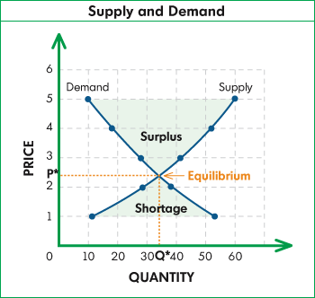
Supply and Demand

Slide 3
Learning Target:
I can explain the relationship between supply and demand
Success Criteria:
Define supply and demand.
Determine profitability of goods.
Provide examples of how supply and demand may affect prices charged by producers or traders.

Slide 4
Overview
Students will role-play the principles of supply and demand and determine the most profitable price at which to sell a candy bar.

Slide 5
Key Vocabulary Review
Trade- an exchange of goods or services
Domestic Trade: having to do with the internal affairs of a country
Global Trade/ International Trade: an exchange of goods or services throughout the world
Import: goods brought in from a foreign country for trade or sale
Export: goods shipped out of one country for trade or sale with another
Interdependence: The condition where countries become dependent on one another because of specialization and trade

Slide 6
Key Vocabulary Review Conti…
Resources: Things of value and efforts used to produce goods and services: land, labor, capital, and entrepreneurship
Capital: Material Wealth; The money, machines, factories, and tools used (or available for use) in the production of other goods and services.
Entrepreneurship: The willingness to assume the risks of organizing and coordinating resources to produce goods and services.
Land: Natural resources used to produce goods and services; for example, land, minerals, and trees.
Labor: All human effort, including the knowledge and skills used in the production of goods and services.
Specialization: when countries or businesses concentrate on producing only those goods and services that they can most efficiently produce given their existing resources.

Slide 7
Key Vocabulary Review Conti…
Trade Barriers: limits or restrictions on foreign trade
Tariffs: a tax on imports
Quotas: a limit on the amount of goods that can be imported
Embargoes: when on nation prohibits trade with another, often for political reasons

Slide 8
New Key Vocabulary
Demand is the different quantities of a resource, good, or service that will be purchased at various prices during a specific time period (willingness and ability to purchase goods and services for a particular price).
Supply is the different quantities of a resource, good, or service that will be offered for sale at various possible prices during a specific time period (quantity of a product producers are willing to provide at a particular price).

Slide 9
Businesses decide how much to charge for goods and services based on the principles of supply and demand. By using the supply and demand chart they will determine the most profitable point at which to produce and sell candy bars.
PRICE (a) | DEMAND (b) | SALES INCOME (c) (a) X (b) | TOTAL (d) COST AT $.50 EACH (b) X .50 | PROFIT (e) (c) – (d)
$5.00
$4.50
$4.00
$3.50
$3.00
$2.50
$2.00
$1.50
$1.00
$.50

Slide 10
Chocolate Bar Activity
You are going to be asked how many of you are willing to buy a chocolate bar at a particular price. As we go through this activity, you will fill in the demand column then completing the rest of chart.

Slide 11
PRICE (a) | DEMAND (b) (at what price is the demand the greatest) | SALES INCOME (c) X (b) (at what price is the Revenue the greatest) | TOTAL (d) COST AT $.50 EACH (b) X .50 | PROFIT (e) (c) – (d)
$5.00
$4.50
$4.00
$3.50
$3.00
$2.50
$2.00
$1.50
$1.00
$.50

Slide 12
Directions
Before starting, looking at the price have the students select which price they feel will provide the greatest profit
Begin by determining consumer demand. Explain to students that you have a candy bar to sell. Tell each student they have $5.00 to spend and ask them to raise their hands if they would be willing to spend $5.00, $4.50, $4.00 etc… to purchase your candy bar. Record the number willing to buy at each price under the demand column.
Once the demand column is complete, ask students at what price consumer demand is the greatest. Ask students to help complete the income column. At which point is the revenue the greatest? Tell students that even though the revenue may be the greatest at (blank) price, that may not be the most profitable point to sell the candy bars because production costs may be greater than revenue.
Determine total cost at each selling point by asking students to help complete the cost column. Determine profit by subtracting how much it costs to produce that many candy bars.
What price is the most profitable?
Is it the same as the price where there is the greatest demand or where there is the most revenue?
How many candy bars should be produced and at what

Slide 13
Discussion
What would happen to the price of chocolate if a medical discovery found that eating two chocolate bars a day increased a person's life span by 5 years? What would increase, supply or demand?
What would happen to the price of chocolate if an epidemic of choco bugs killed most cocoa crops worldwide? What would decrease, supply or demand?

Slide 14
Processing
What is a “real world” examples of how prices are affected by goods or services that are in high demand and have low supply?
(athletes like Peyton Manning, air conditioners during a heat wave, soft drinks at Rockies games, hockey tickets during the Stanley Cup playoffs).
What are examples of how prices are affected by goods and services in low demand and high supply
(e.g. winter clothes in spring, Christmas ornaments in January, Bronco merchandise during a losing season).

Slide 15
Law of Demand
Explain the Law of Demand in your own words?
The law of demand states that, if all other factors remain equal, the higher the price of a good, the less people will demand that good. In other words, the higher the price, the lower the quantity demanded.
The higher the price of a product, the lower the quantity demanded; the lower the price, the higher the quantity demanded—demand is inversely related to price. The relationship is called: The Law of Demand

Slide 16
Law of Supply
Explain the Law of Supply in your own words?
the law of supply demonstrates the quantities that will be sold at a certain price. But unlike the law of demand, the supply relationship shows an upward slope. This means that the higher the price, the higher the quantity supplied.
When prices are low, the quantity supplied is low, and when prices are high, the quantity supplied is high. This positive relationship between price and quantity supplied is known as the Law of Supply.

Slide 17
Warm Up
How do companies/countries determine price/profitability of their goods?

Slide 18
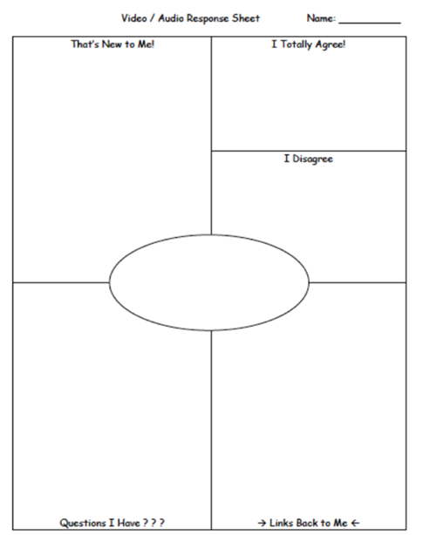
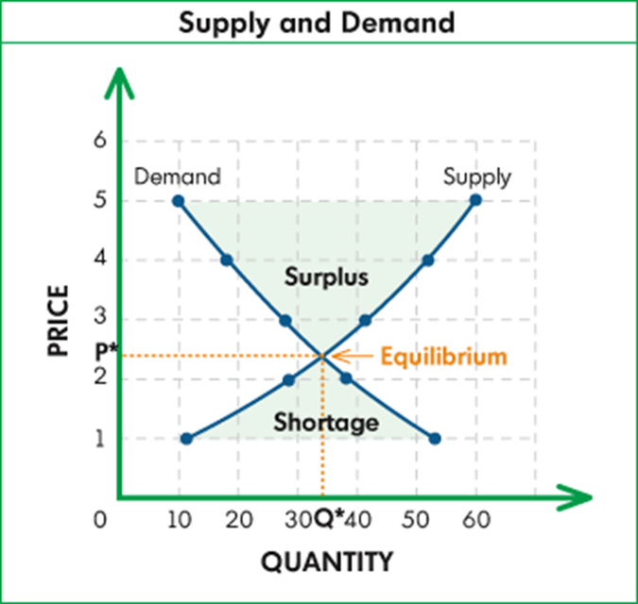
Reviewing Supply and Demand
As you watch this video, please fill out the following worksheet:
Supply/Demand
Notes:
Law of Supply
https://www.youtube.com/watch?v=nKvrbOq1OfI
Law of Demand
https://www.youtube.com/watch?v=kUPm2tMCbGE
Equilibrium
http://www.mruniversity.com/courses/principles-economics-microeconomics/equilibrium-price-supply-demand-example

Slide 19
Discussion
What is something that you really want, why don’t you have it?

Slide 20
Scarcity and What Opportunities May Cost

Slide 21
Learning Target:
I can determine if a good is scarce.
Success Criteria:
Define scarcity.
Explain that people make choices about which wants to satisfy.

Slide 22
Overview
Students will determine if a particular good is scarce by participating in a simulation involving chocolate.

Slide 23
Key Vocabulary
Demand is the different quantities of a resource, good, or service that will be purchased at various prices during a specific time period (willingness and ability to purchase goods and services for a particular price).
Supply is the different quantities of a resource, good, or service that will be offered for sale at various possible prices during a specific time period (quantity of a product producers are willing to provide at a particular price).

Slide 24
Scarcity
Scarcity is the situation in which wants are greater than available resources.
All people, businesses and societies must decide how to use scarce resources.
Scarcity is a basic economic problem. Human wants are unlimited and resources are limited, people cannot have all of the goods and services that they want.

Slide 25
Scarcity Example:
John wants to ride his bike to the park. His mom tells him that he has to clean his room before dinner. It is already 5:30 and dinner is usually served at 6:00.
Do you think John has a problem?
What is scarce?
What are John’s choices?
Notes:
Ex. time

Slide 26
Scarcity Activity
Do you like chocolate candy?
Do you think this chocolate is scarce?

Slide 27
Is the Chocolate Scarce? page 24 of your workbook
Hershey’s Chocolate | How many of each would you like?
Mr. Goodbar
Krackle
Special Dark
Hershey's
Total pieces desired

Slide 28
Is Chocolate Scarce?
Hershey’s Chocolate | Class Numbers | Available Candy
Mr. Goodbar
Krackle
Special Dark
Hershey's
Total pieces desired

Slide 29
Is Chocolate Scarce?
Do you still believe that this chocolate is not scarce, explain?

Slide 30
Scarcity Processing
Explain why people can’t have everything that they want?
Include:
Supply
Demand
Scarcity

