Slide 1
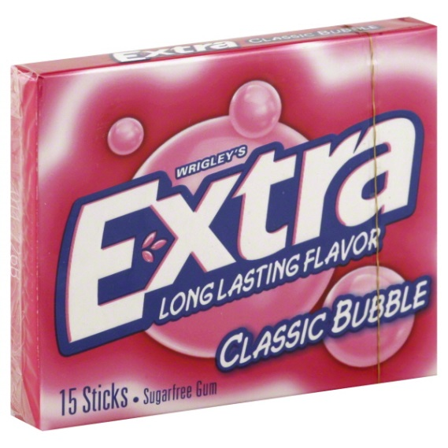
Warm Up
Choose one of the following items that you would like and explain why?
Goldfish
EXTRA Gum
If you don’t want either, explain why?

Slide 2
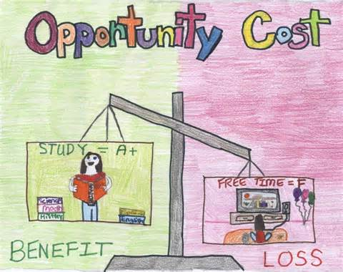
Opportunity Costs

Slide 3
Key Vocabulary Review
Trade- an exchange of goods or services
Domestic Trade: having to do with the internal affairs of a country
Global Trade/ International Trade: an exchange of goods or services throughout the world
Import: goods brought in from a foreign country for trade or sale
Export: goods shipped out of one country for trade or sale with another
Interdependence: The condition where countries become dependent on one another because of specialization and trade

Slide 4
Key Vocabulary Review Conti…
Resources: Things of value and efforts used to produce goods and services: land, labor, capital, and entrepreneurship
Capital: Material Wealth; The money, machines, factories, and tools used (or available for use) in the production of other goods and services.
Entrepreneurship: The willingness to assume the risks of organizing and coordinating resources to produce goods and services.
Land: Natural resources used to produce goods and services; for example, land, minerals, and trees.
Labor: All human effort, including the knowledge and skills used in the production of goods and services.
Specialization: when countries or businesses concentrate on producing only those goods and services that they can most efficiently produce given their existing resources.

Slide 5
Key Vocabulary Review Conti…
Trade Barriers: limits or restrictions on foreign trade
Tariffs: a tax on imports
Quotas: a limit on the amount of goods that can be imported
Embargoes: when on nation prohibits trade with another, often for political reasons

Slide 6
Key Vocabulary Review Conti…
Demand: the different quantities of a resource, good, or service that will be purchased at various prices during a specific time period (willingness and ability to purchase goods and services for a particular price).
Supply : the different quantities of a resource, good, or service that will be offered for sale at various possible prices during a specific time period (quantity of a product producers are willing to provide at a particular price).
Scarcity: the situation in which wants are greater than available resources.

Slide 7
New Key Vocabulary
Opportunity Cost- the cost of something in terms of opportunity foregone.
For example, if a city decides to build a hospital on some vacant land, the opportunity cost is the other things that might have been done with that same land instead. In building the hospital, the city has forgone the opportunity to build a sporting centre, or a car park, or sell the land off to reduce debt, and so on.

Slide 8
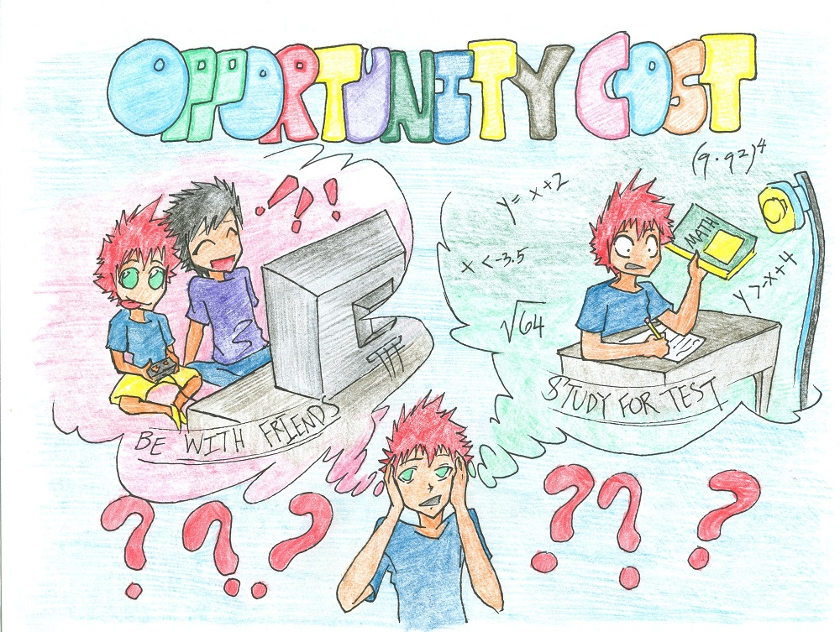
Opportunity Cost

Slide 9
Characteristics of Cost Activity
Costs are to people. All costs are costs to the decision-maker.
Costs are subjective; individuals value costs differently.
Opportunity costs may change and changes in costs affect people’s choices.
Only actions have costs. “Things” have no costs independent of decisions about their use.
All costs lie in the future. The anticipation of future consequences shapes people’s decisions.

Slide 10
Choosing A Snack
What were the considered alternatives in your choice?
If someone made a different choice (different type of candy, or no candy) than you did, did one person make the right choice and one the wrong choice?

Slide 11
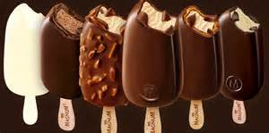
Suppose an ice cream bar had been offered as an alternative along with two types of candy.
Would your opportunity cost have changed? Why or why not?
What is the opportunity cost to the person who chose the ice cream bar from among the 3 options?
What is the opportunity cost to someone who sticks with their original choice when the ice cream bar is included in the alternatives?

Slide 12
Suppose the “rules of the game” had been that “the class” could choose one snack, and the choice was Candy A.
Does that configuration of the situation change the opportunity cost? (If so, in what way and to whom?)

Slide 13
Suppose all 4 types of snack had been on one table and everyone could select from that table.
Would that change your opportunity cost? Why?
Is the availability of a greater number of alternatives is likely to increase or decrease opportunity costs? Why?

Slide 14
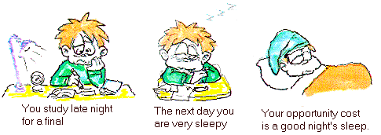
Practice With Opportunity Cost
With your elbow partner, on a separate sheet of paper, use the concept of opportunity cost to explain the following behaviors

Slide 15
Questions
Why would a student choose not to study for an exam even though she knows from past experience that she performs better on exams when she has spent time studying?
Why would a teenager not ask to a dance the person he’d like to ask, even though he knows she does not have another date?
Why would a hot dog vendor on a New York street corner lower the price of dogs late in the day?
Why do Americans today find themselves much more pressed for time than their great -grandparents were, despite the fact that we have so many machines and appliances that save us labor and time?
Why would a poor family in a developing country choose to send a 10 year-old to work in a factory rather than to school, even though they know that being able to read and write would offer the child better options for the future?
Why do so many more inventions and innovations come from western countries where property rights are secure than from developing and communist countries where they are not?
Why are people in some parts of the world willing to work for $1 per day and in the U.S. employers often have trouble finding people willing to work minimum wage jobs?

Slide 16
Debrief
Countries and regions must make many decisions as producers and consumers in both International Towne and real life. They have personal buying power as individuals in what they may demand as goods. This happens by what they may decide to wear, or what they may decide to purchase as food and products, and how they spend their money. All decisions have an opportunity cost.
By picking one choice, they have to give up something else.
Also they may discover that, for example, the US produces many goods because they have both the capital and resources to do so.

Slide 17
Processing
Think about the decisions you made today and the things they gave up for that choice… are you happy with your choices? Support your answer with details.

Slide 18
Summary
Think about the choices they will have to make in International Towne…
how to use time, money, labor and supplies.
As consumers, students will have to decide how to spend their money and what to do during their break time.
As producers, they have to decide how to the make the most of the resources available to their countries.
Remember, there will not be enough of every item for sale for every student.

