Slide 1
Warm Up
Why are we considered an international towne?
Each country specializes and to get the other things we need, we trade. This makes use interdependent on the other countries within International Towne

Slide 2
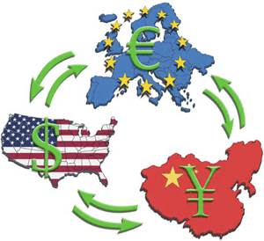
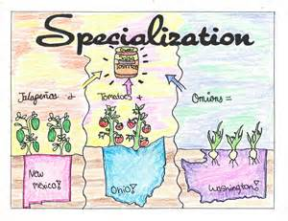
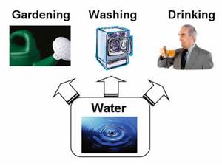
Interdependence/Resources/Specialization Flow Chart

Slide 3
Learning Target
I can visually communicate the process of interdependence
Success Criteria:
Illustrate Interdependence
Describe Specialization
Describe Resources
Explain how interdependence/specialization/resources are connected

Slide 4
Key Vocabulary Review
Trade- an exchange of goods or services
Domestic Trade: having to do with the internal affairs of a country
Global Trade/ International Trade: an exchange of goods or services throughout the world
Import: goods brought in from a foreign country for trade or sale
Export: goods shipped out of one country for trade or sale with another
Interdependence: The condition where countries become dependent on one another because of specialization and trade

Slide 5
Key Vocabulary Review Conti…
Resources: Things of value and efforts used to produce goods and services: land, labor, capital, and entrepreneurship
Capital: Material Wealth; The money, machines, factories, and tools used (or available for use) in the production of other goods and services.
Entrepreneurship: The willingness to assume the risks of organizing and coordinating resources to produce goods and services.
Land: Natural resources used to produce goods and services; for example, land, minerals, and trees.
Labor: All human effort, including the knowledge and skills used in the production of goods and services.
Specialization: when countries or businesses concentrate on producing only those goods and services that they can most efficiently produce given their existing resources.

Slide 6
Key Vocabulary Review Conti…
Trade Barriers: limits or restrictions on foreign trade
Tariffs: a tax on imports
Quotas: a limit on the amount of goods that can be imported
Embargoes: when on nation prohibits trade with another, often for political reasons

Slide 7
Key Vocabulary Review Conti…
Demand is the different quantities of a resource, good, or service that will be purchased at various prices during a specific time period (willingness and ability to purchase goods and services for a particular price).
Supply is the different quantities of a resource, good, or service that will be offered for sale at various possible prices during a specific time period (quantity of a product producers are willing to provide at a particular price).
Scarcity is the situation in which wants are greater than available resources.

Slide 8
Task:
We've studied interdependence/resources/specialization in our study of economics using the Hersey candy bar as an example.
Now create a new pretend product using the interdependence model and include a flow chart.
Select 3 countries as sources of a raw material needed for US manufacturing of the final product which could be sold both here and internationally.
Show on your flow chart the countries and the raw materials using pictures and arrows to represent the flow of raw materials to finished product.
Explain the steps of the process and how each item is connected! Make sure to use the following words: interdependence/specialization/resources
Due tomorrow at the BEGINNING of CLASS!
Notes:
resources and specialization are interdependent to each other… we import/export goods to get the goods that we need!

Slide 9
Flow Chart
What is a flow chart?
a diagram that shows step-by-step progression through a procedure or system especially using connecting lines and a set of conventional symbols
The purpose of all flowcharts is to communicate how a process works

Slide 10
Example Flow Charts

Slide 11
Task:
We've studied interdependence/resources/specialization in our study of economics using the Hersey candy bar as an example.
Now create a new pretend product using the interdependence model and include a flow chart.
Select 3 countries as sources of a raw material needed for US manufacturing of the final product which could be sold both here and internationally.
Show on your flow chart the countries and the raw materials using pictures and arrows to represent the flow of raw materials to finished product.
Explain the steps of the process and how each item is connected! Make sure to use the following words: interdependence/specialization/resources
Due tomorrow at the BEGINNING of CLASS!
Notes:
resources and specialization are interdependent to each other… we import/export goods to get the goods that we need!

