Slide 1
Warm Up
Suppose your sibling or friend owed you $500.
Would you rather have this money repaid to you right away, in one payment, or spread out over a year in four installment payments?
Would it make a difference either way?

Slide 2
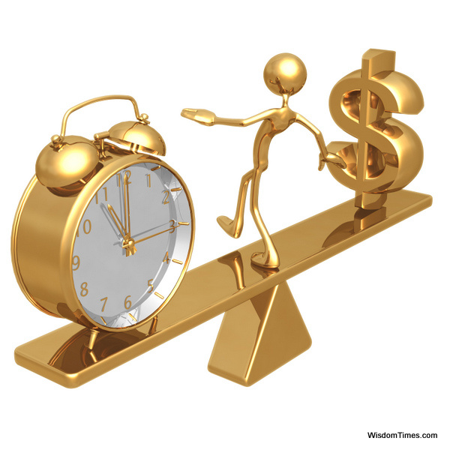
Time, Value of Money

Slide 3
Overview
Students are introduced to the concept of opportunity costs and the economic term, Time, Value of Money. Suppose your sibling or friend owed you $500. Would you rather have this money repaid to you right away, in one payment, or spread out over a year in four installment payments with interest? Would it make a difference either way?

Slide 4
Learning Target
I can analyze the relationship between time and the value of Money.
Success Criteria:
Describe the relationship between Time and the Value of Money.
Explain the concept of Opportunity Costs.
Practice using a Decision Tree to analyze the Opportunity Costs of your choices.
Examine the trade-off between money now and money later. This depends on the rate of interest you can earn by investing.
Evaluate the power of investing in interest-bearing accounts.

Slide 5
Key Vocabulary Review…
Demand: the different quantities of a resource, good, or service that will be purchased at various prices during a specific time period (willingness and ability to purchase goods and services for a particular price).
Supply : the different quantities of a resource, good, or service that will be offered for sale at various possible prices during a specific time period (quantity of a product producers are willing to provide at a particular price).
Scarcity: the situation in which wants are greater than available resources.
Opportunity Cost- the cost of something in terms of opportunity foregone

Slide 6
New Key Vocabulary
Savings- equals disposable income minus consumption
Disposable Income- what one can spend after taxes
Consumption- spending on goods and services
Interest (how it is calculated)- A fee paid by a borrower of money to the owner as a form of compensation for the use of that money. It is most commonly the price paid for the use of borrowed money (ex. Credit Cards) or money earned by depositing money (ex. Savings account at a bank.)

Slide 7
New Key Vocab
Future value (FV)- the amount of money to which an investment will grow over a finite period of time at a given interest rate.
Put another way, future value is the cash value of an investment at a particular time in the future.
Compounding- The process of leaving the initial investment plus any accumulated interest in a bank for more than one period is reinvesting the interest

Slide 8
Discussion
What is an interest rate?

Slide 9
Discussion
How are interest rates used when investing similar to the interest rates used with credit cards?

Slide 10
Discussion
What is then future value?
Future value (FV) refers to the amount of money to which an investment will grow over a finite period of time at a given interest rate.
Put another way, future value is the cash value of an investment at a particular time in the future.

Slide 11
Investing for a Single Period
Suppose you invest $100 in a savings account that pays 10 percent interest per year.
How much will you have in one year?
You will have $110. This $110 is equal to your original principal of $100 plus $10 in interest. We say that $110 is the future value of $100 invested for one year at 10 percent, meaning that $100 today is worth $110 in one year, given that the interest rate is 10 percent.
In general, if you invest for one period at an interest rate r, your investment will grow to (1 + r) per dollar invested.
In our example, r is 10 percent, so your investment grows to 1 + .10 = 1.10 dollars per dollar invested. You invested $100 in this case, so you ended up with $100 x 1.10 = $110.

Slide 12
Discussion
If interest is a fee paid for borrowing money, then what do you think compound interest is?

Slide 13
Investing for More than One Period
Consider your $100 investment that has now grown to $110. If you keep that money in the bank, what will you have after two years, assuming the interest rate remains the same?
You will earn $110 x .10 = $11 in interest after the second year, making a total of $110 + $11 = $121.
This $121 is the future value of $100 in two years at 10 percent.
Another way of looking at it is that one year from now, you are effectively investing $110 at 10 percent for a year. This is a single-period problem, so you will end up with $1.10 for every dollar invested, or $110 x 1.1 = $121 total.
This $121 has four parts.
The first part is the first $100 original principal.
The second part is the $10 in interest you earned in the first year.
The third part, is the other $10 you earn in the second year, for a total of $120.
The fourth part is $1 which is interest you earned in the second year on the interest paid in the first year: ($10 x .10 = $1 )

Slide 14
Investing
The process of leaving the initial investment plus any accumulated interest in a bank for more than one period is reinvesting the interest. This process is called compounding.
Compounding the interest means earning interest on interest so we call the result compound interest.
With simple interest, the interest is not reinvested.
The interest is earned each period is on the original principal only.

Slide 15
Time, Value of Money Worksheet

Slide 16
Compound Interest Activity

Slide 17
How many years did it take to double your money?
 | Amount on Interest | Interest Rate | Interest Earned | Balance
1 | $1,000 | 10% | $100 | $1100
2 | End of Year | 10% | $110 | $1210
3 |  | 10%
4 |  | 10%
5 |  | 10%
6 |  | 10%
7 |  | 10%
8 |  | 10%
9 |  | 10%
10 |  | 10%
11 |  | 10%
12 |  | 10%

Slide 18
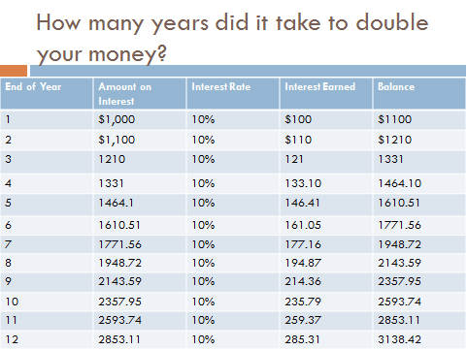

Slide 19
Complete page 26 of your workbook for homework

Slide 20
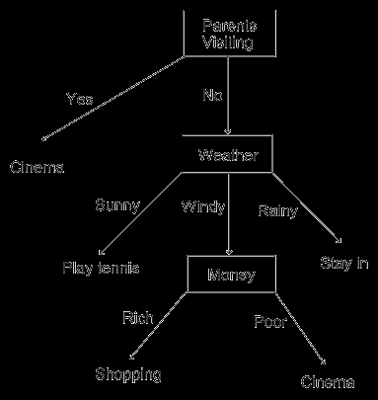
Discussion
When deciding what to do with your money, why would someone want to use a decision tree?
It is a tool that uses a tree-like graph or model of decisions and their possible consequences.
A decision tree is used to identify the strategy most likely to reach a goal.

Slide 21
Decision Tree
Problem: State the problem or question that needs to be answered.
Develop a list of questions?
YES
NO
Place possible
outcomes in boxes
Place yes or no Questions in boxes
NO
YES
NO
YES
For each choice, name the results or consequences of each choice. Write your responses under the appropriate choice and put a plus sign next to the positive results and a minus sign next to the negative ones. If one consequence is more important than another, you may wish to use double plus or minus signs. The negative consequences are opportunity costs, or the next best thing that is given up when a choice is made.
YES
NO
YES
NO

Slide 22
Decision Tree Example
Imagine that you are deciding if you should lend $500 to your brother. Your brother is younger then you, doesn’t work yet, and can be responsible at times.
Think about some of the cost and benefits involved with your decision
Remember… each choice has opportunity cost and your job is to determine if you should lend money to you sibling.

Slide 23
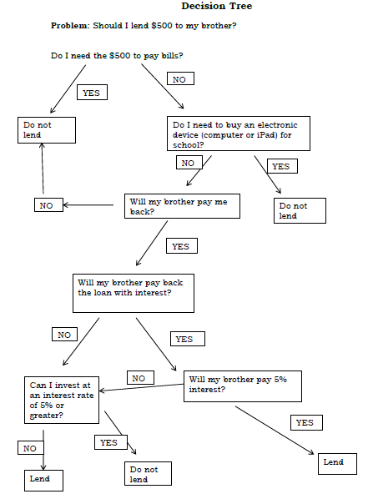

Slide 24
Name the results or consequences of each choice.
Write their responses under the appropriate choice and put a plus sign next to the positive results and a minus sign next to the negative ones.
If one consequence is more important than another, students may wish to use double plus or minus signs.
Or if a production of a resource has both positive and negative effects there could be both a plus and minus sign.
Remember that the negative consequences are opportunity costs, or the next best thing that is given up when a choice is made.

Slide 25
PROS and CONS
Remember.. individuals have different values, each person weighs the pros and cons differently.

Slide 26
Decision Tree Scenario
What are possible questions you should ask yourself about interest rates, as well as how they could invest or spend the $500?
Remember each choice has opportunity cost and that your job is to determine if you should lend money to your sibling.

Slide 27
Consider the possible choices and make their own decisions because individuals have different values, each person weighs the pros and cons differently.
Lets vote… which choice had the most support?

Slide 28
Debrief
Did the choice with the most votes also have the highest ―net value?

Slide 29
Extension Activity
Interest on Interest...
Suppose you locate a two-year investment that pays 14 percent per year. If you invest $325, how much will you have at the end of two years? How much of this is simple interest? How much is compound interest?
At the end of the first year, you will have $325 x (1 + .14) = $370.50.
If you reinvested this entire amount, and thereby compound the interest, you will have $370.50 x 1.14 = $422.37 at the end of the second year.
The total interest you earn is thus $422.37 – 325 = $97.37.
Your $325 original principal earns $325 x.14 = $45.50 in interest each year, for a two-year total of $91 in simple interest.
The remaining $97.37 -- 91 = $6.37 results from compounding.
How much will you have in the third year?

Slide 30
Suppose you go in for an interview for a part-time job. The boss offers to pay you $50 a day for a 5-day, 10-week position. Otherwise, you can earn only one cent on the first day but have your daily wage doubled every additional day you work.
Which option would you take?

