Slide 1
Warm-Up
What is a decision tree?
With your should partner, create a decision tree based on the following question:
Should I have a credit card?

Slide 2
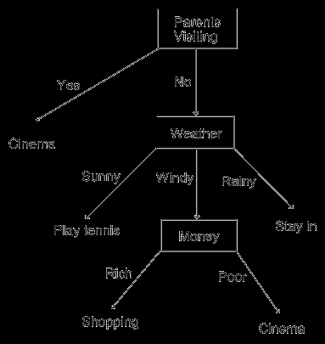
Discussion
When deciding what to do with your money, why would someone want to use a decision tree?
It is a tool that uses a tree-like graph or model of decisions and their possible consequences.
A decision tree is used to identify the strategy most likely to reach a goal.

Slide 3
Decision Tree
Problem: State the problem or question that needs to be answered.
Develop a list of questions?
YES
NO
Place possible
outcomes in boxes
Place yes or no Questions in boxes
NO
YES
NO
YES
For each choice, name the results or consequences of each choice. Write your responses under the appropriate choice and put a plus sign next to the positive results and a minus sign next to the negative ones. If one consequence is more important than another, you may wish to use double plus or minus signs. The negative consequences are opportunity costs, or the next best thing that is given up when a choice is made.
YES
NO
YES
NO

Slide 4
Decision Tree Example
Imagine that you are deciding if you should lend $500 to your brother. Your brother is younger then you, doesn’t work yet, and can be responsible at times.
Think about some of the cost and benefits involved with your decision
Remember… each choice has opportunity cost and your job is to determine if you should lend money to you sibling.

Slide 5
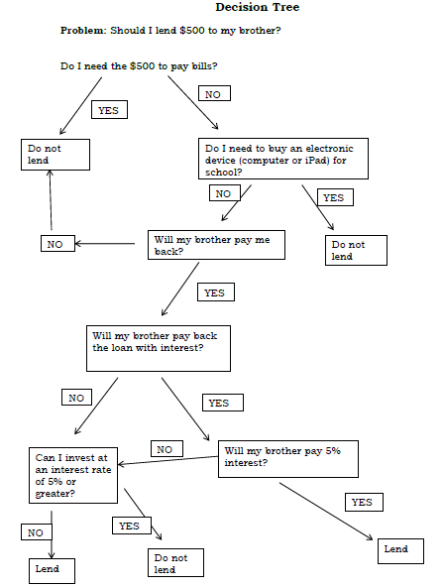

Slide 6
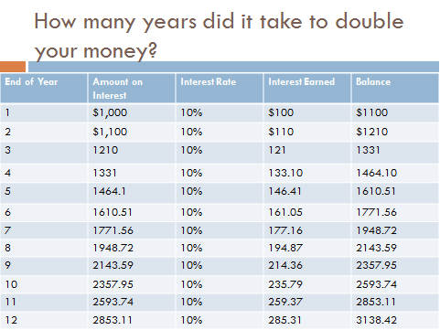
Homework Check

Slide 7
5 years - $701. 10 years - $984. 20 years - $1,935
5 years - $805. 10 years - $1,297. 20 years - $3,364
41%
24%
$208
$288
$25.20 monthly payments. $104.80 in interest ($25.20 x 24 = $604.80 - $500 (the original balance))
$126.02 monthly payments. $524.48 in interest

Slide 8
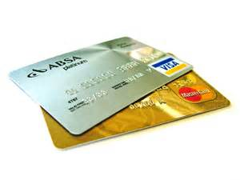
Credit cards

Slide 9
Overview
Students will play a game exploring the costs of using credit so that they can make good decisions about when and how to use credit.
Students will learn how credit cards will be used in International Towne

Slide 10
Learning Target
I can explore the costs of using a credit card and make good decisions about when and how to use it
Success Criteria
Explain the 3 C’s of Credit
Identify differences between debit and credit cards
Explore the costs and benefits of using a credit card, especially while travelling
Determine if I am ready to use a credit card
Practice filling out a credit card application

Slide 11
Key Vocabulary Review…
Demand: the different quantities of a resource, good, or service that will be purchased at various prices during a specific time period (willingness and ability to purchase goods and services for a particular price).
Supply : the different quantities of a resource, good, or service that will be offered for sale at various possible prices during a specific time period (quantity of a product producers are willing to provide at a particular price).
Scarcity: the situation in which wants are greater than available resources.
Opportunity Cost- the cost of something in terms of opportunity foregone

Slide 12
Key Vocabulary Review…
Savings- equals disposable income minus consumption
Disposable Income- what one can spend after taxes
Consumption- spending on goods and services
Interest (how it is calculated)- A fee paid by a borrower of money to the owner as a form of compensation for the use of that money. It is most commonly the price paid for the use of borrowed money (ex. Credit Cards) or money earned by depositing money (ex. Savings account at a bank.)

Slide 13
New Key Vocab
Future value (FV)- the amount of money to which an investment will grow over a finite period of time at a given interest rate.
Put another way, future value is the cash value of an investment at a particular time in the future.
Compounding- The process of leaving the initial investment plus any accumulated interest in a bank for more than one period is reinvesting the interest

Slide 14
Discussion
What is credit?
Credit is the borrowing of funds with the intent of paying them back.
With credit cards, there may be a charge when you borrow funds. The charge is usually in the form of fees and/or interest.
If you pay off you entire credit card bill every month you will not pay interest.
However, there may be an annual (yearly) fee or other fees.
If you carry over some of your balance to the next month, you will pay interest.

Slide 15
Discussion
Why is important to recognize the cost of using credit?
Using credit wisely will help you build a good credit history – which will be very important in helping you build your long-term assets in the future.
When traveling it could be helpful at times to use credit cards because they can be very convenient and beneficial in emergencies.
When you are travelling in can help helpful and convenient and beneficial if there is an emergency

Slide 16
How do people get a loan or credit card?
Banks and credit card companies decide if they will extend credit to you and what your credit limit will be.
If you apply for a credit card or loan you will be asked to fill out an application.

Slide 17
Banks will make a decision based upon the 3 C’s
Character: Will you repay the debt?
Capacity: Can you repay the debt?
Capital: What if you don’t repay the debt?

Slide 18
Banks will make a decision based upon the 3 C’s
Character: Will you repay the debt?
From your credit history, does it look like you possess the honesty and reliability to pay credit debts?
Have you used a credit card before?
Do you pay your bills on time?
Do you have a good credit report?
Can you provide character references?
How long have you lived at your current address?
How long have you been at your present job?

Slide 19
Banks will make a decision based upon the 3 C’s
Capacity: Can you repay the debt?
Have you been working regularly in an occupation that is likely to provide enough income to support your use of credit?
Do you have a steady job?
How many other loan payments do you have?
What are your current living expenses?
What are your current debts?
How many dependents do you have?

Slide 20
Banks will make a decision based upon the 3 C’s
Capital: What if you don’t repay the debt?
Do you have any valuable assests such as real estate, savings, or investments that could be used to repay credit debts if income is unavailable?
What property or possessions do you own that can secure the loan?
Do you have a savings account?
Do you have investments to use a collateral?

Slide 21
Review the 3 C’s
Character: Will you repay the debt?
Capacity: Can you repay the debt?
Capital: What if you don’t repay the debt?

Slide 22
How many of you Are interested in having a credit card? Why would you like a credit card?

Slide 23
Credit Card Game
This game will teach you more about how credit cards work.

Slide 24
Credit Card Game Rules
Each group must select one spokes person
All students in the group must decide on an answer
The majority prevails whenever the group disagrees on the answer
The spokesperson must hold up the TRUE/FALSE card to indicate the group decision on the question.
Teams must answer each question.
The spokesperson must hold up the DOUBLE DOWN card if the group wants to use this option
Each group earns 5 points for each correct answer. Each group loses 5 points for each incorrect answer.
Each group may choose to DOUBLE DOWN on any question up to a total of 5 questions. If the group answers correctly, it receives 10 points, if the group is incorrect, they loses 10 points.
Groups should use the DOUBLE DOWN on questions they are most confident about.
A total of 100 points is a perfect score. To earn this score, the students must answer all questions correctly and DOUBLE DOWN correctly on 5 questions.
Team with the most points wins.

Slide 25
How to play:
For each question, students will need to decide in their groups if they think the statement is true or false.
The spokesperson will then hold up the appropriate side of the TRUE/FALSE card to reveal your group’s decision.
The spokesperson should also hold up the DOUBLE DOWN card if this tactic was chosen for the question.
Wait to hold up your card until you hear me say, “reveal your answers.”
Make sure to also hold up the TRUE/FALSE and DOUBLE DOWN card at the same time if you choose to DOUBLE DOWN

Slide 26
Scoring
You will have to keep track of your own score on your score sheet.
I will keep a point total on the board for each team.
You will use this information to decide when to DOUBLE DOWN.

Slide 27
Question 1:
Interest is the amount you pay for borrowing money.

Slide 28
Answer 1:
TRUE:
Interest can be fixed or variable; charges of interest can depend on your credit history. The interest rate is sometimes referred to as the ARP or Annual Percentage Rate. The higher the APR, the more you pay.

Slide 29
Question 2:
When using a credit card, you purchase now and pay now.

Slide 30
Answer 2:
FALSE:
You purchase now and pay later.
Because of this, you might be tempted to overspend but if you don’t pay off your balance each month, items can cost more because of fees and interest charges.

Slide 31
Question 3:
A credit limit is the amount of money available to you to spend when using credit.

Slide 32
Answer 3:
TRUE:
Credit cards are NOT a blank check and you have a spending limit that you cannot exceed. If you do, credit card companies charge an over-the-limit fee.

Slide 33
Question 4:
It can be really convenient to pay with a credit card when travelling.

Slide 34
Answer 4:
TRUE:
Credit Cards, when used correctly, can be very beneficial while travelling, for the following reasons:
Credit cards can be used for purchases when you don’t have the currency of the country you are visiting.
They can be cancelled easily when lost or stolen-cash you cannot replace.
With some credit cards you even get a better exchange rate because you are not paying a commission to the currency exchange company or bank.

Slide 35
Question 5:
It’s a good idea to complete every new credit card application that you receive in the mail.

Slide 36
Answer 5:
FALSE:
Completing every new credit card application that you receive hurts your credit score.
Your credit score is a number that represents your credit worthiness. The higher the score, the better. This also hampers your ability to establish a good credit history.

Slide 37
Question 6:
Credit card companies usually charge a currency conversion fee or using your credit card overseas.

Slide 38
Answer 6:
TRUE:
Savvy travelers know their rates! Each credit card is different but most will charge a currency conversion fee and some have additional fees for foreign purchases. It is wise to call your credit card company before you travel to be clear on all fees.
Then you will know how much it will cost you to use your credit card when travelling.
Also, credit card companies will know you are travelling and won’t think your credit card has been stolen

Slide 39
Question 7:
When you sign up for a credit card with a low introductory rate that is the rate you will always receive.

Slide 40
Answer 7:
FALSE:
Low Introductory Rates or Low Interest Teaser are a way of making a credit card look like a really good deal when you first sign up. However, usually this rate will go up after a couple of months.

Slide 41
Question 8:
Credit cards and debit cards look the same because they are the same.

Slide 42
Answer 8:
FALSE:
Credit cards and debit cards may look the same but they are very different.
Debit cards function like a check and are connected directly to your checking account and the money is automatically withdrawn.
With credit cards you are borrowing the money with the expectation of paying it back. If you pay your entire monthly balance each month you will NOT pay interest.
If you only pay part of the balance, you WILL be charged interest on the remaining balance the next month and so on until the balance is paid in full. For example, if you owe $150 and you only pay $50, the next month you will be charges interest on the remaining $100. If your interest rate were 12% you would owe $112 the next month.
Not paying off the entire monthly balance means that will you pay more for an item than the original price. In our example, the item that was $150 would cost you $162 over 2 months.

Slide 43
Question 9:
If the citizens of a country have bad credit, it doesn’t affect the country’s financial health.

Slide 44
Answer 9:
FALSE:
When a country’s citizens as a whole have poor credit, it affects the entire country and the government. Citizens with poor credit have to declare bankruptcy. This costs the government money in the form of court fees and other costs.
On a larger scale, when too many people cannot repay their loans if affects the overall financial health of a country, especially the banks.
We saw recently in the United States that this led to a government bailout-the government paying the banks to help with the financial situation.

Slide 45
Question 10:
Credit cards can be cancelled if stolen or lost.

Slide 46
Answer 10:
TRUE:
This is a nice safety feature of credit cards. If you cancel your card as soon as you notice it is gone then no one else can use it.
If you lose your card you might have to pay a LOST CARD REPLACEMENT FEE but this is better than a stranger charging things on your card!

Slide 47
Question 11:
You don’t need to know how much money you owe on your credit cards-that’s why they send you a bill every month!!

Slide 48
Answer 11:
FALSE:
You want to keep track to make sure that your monthly bill is correct and that you will have the money to pay off your bill!
It is very important to check your bills closely to make sure that all of the charges are accurate.

Slide 49
Question 12:
Having good credit is only part of being money savvy; it is also important to save and invest.

Slide 50
Answer 12:
TRUE:
Money savvy people pay themselves first by saving and investing a portion of their income every month. This sets them up for complete financial success. This is also beneficial when it comes time to borrow a large sum of money for a car, house, or business. It helps in your CAPACITY to repay the larger amount.

Slide 51
Question 13:
When exchanging cash or currency, banks and currency exchange companies charge a commission or fee for exchanging the money.

Slide 52
Answer 13:
TRUE:
Banks and currency exchange companies charge a commission or fee for exchanging the money. It is usually a certain percentage of the money you exchange. If you exchange $100 you will not receive exactly what it is worth in the other currency because the fee will be deducted.
NOTE: In International Towne, each country pays Singapore for the Currency Exchange Service, therefore individuals are not charged a commission.

Slide 53
Question 14:
The credit card company doesn’t care if you pay your bill late or if you miss a month as long as you pay it eventually.

Slide 54
Answer 14:
FALSE:
Credit card companies will increase the interest rate to a penalty rate on your card if you miss payments or send them in late repeatedly. With each late payment you will also be charged a late fee.

Slide 55
Question 15:
The 3 C’s of credit are Character, Capacity, and Capitalism.

Slide 56
Answer 15:
FALSE:
The 3 C’s of credit are Character, Capacity, Capital.
These are the questions to ask before taking on any credit:
Do you have the character to repay the debt?
Do you have the capital to offset the debt if you can’t repay?
Do you have the capacity or are you able to repay?

Slide 57
Which team is the Winner?

Slide 58
Summary:
At International Towne, credit cards are accepted in every country and 25% off their salary will be on their credit cards.
Using a credit card may be more convenient because you will not need to have the correct currency in hand to make purchases.
Using card cards can be safer when travelling
Students will be issued a credit card from your countries Finance Minister; it is like receiving a card from the national bank.
Students are responsible for paying for any credit card purchases by the end of the day in International Towne.
If you do not pay their for their purchases, you will be marked down a level on the passport rubric.
Credit card bills will be delivered to you during the second half of the day.
Also, if you do not pay your bill, your country will be forced to pay for its citizens unpaid debt. This will negatively affect the country’s financial performance.

Slide 59
Credit Card Pros and Cons
The ease of swiping a credit card for purchases has its pros and cons.
It may either help when handled properly or become a detriment.
If you are able to pay your bills on time every month and not carry over a balance, credit cards can be a great convenience.
The card can also land you deep in debt. This often occurs if you are unaware of the terms of the credit card agreement, and if you carry too many credit cards.

Slide 60
Credit card pros:
You can use them practically anywhere
They can boost your purchasing power because they can be used to buy goods and services over the phone, through the mail and online.
They provide financial backup in the event of an emergency, such as an unexpected healthcare cost, or auto repair.
They allow you to purchase items and pay them off in monthly installments.
They offer discounts at stores and rewards. For example, you can use them and get points that can be turned into things like airline tickets.
Some may offer a cash back incentive.
They can help build your credit history.
They keep record of your expenses, helping you monitor your financial activities.
They help raise your credit score, such as FICO credit score, when you pay balances down by the due date. This improved credit history paves the way for lower borrowing rates on other loans, including a mortgage.
Credit cards allow you the right to dispute billing errors and defective merchandise.
They allow you to withhold payments

Slide 61
Credit card Cons:
Credit cards can have their disadvantages though, especially when they’re used in an unwise manner.
Some consumers feel compelled to spend more than they have.
Consumers may continuously roll over a balance for several months.
When you default on credit card payments, you are charged with late fees and interest, increasing your debt load.
Carrying a large amount of credit cards also inst too favorable in the eyes of lenders.
Acquiring too much credit card debt can ruin your credit score.
Studies have indicated credit card debt as a significant factor in consumer bankruptcies.
Credit card fraud is a possibility.

Slide 62
Avoiding Credit card pitfalls
How to maximize credit card benefits:
Keep track of your purchases
Have a budget and avoid overspending
Make an effort to pay off credit card balances at the end of each month.
Make purchases with reliable companies and take extra precautions when making a purchase online.
Report stolen cards immediately to the credit card company.

Slide 63
Homework:
Take the “ARE YOU READY FOR CREDIT?” Quiz
This quiz is located on page 29 in your workbook
Practice filling out a credit application by “applying” for a credit card for International Towne.
Complete page 30 in your workbook

