Slide 1
Warm Up
After picking up the Personal Finance: Taxes worksheet from the sub, please answer the first question on the top of the sheet…
What is a tax?
How many different types of taxes that you can think of in 10 seconds.

Slide 2
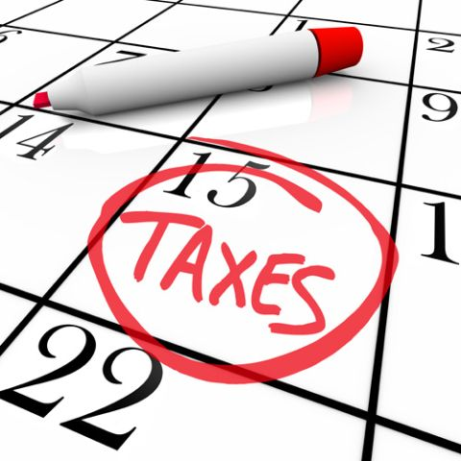
Personal Finance: Taxes

Slide 3
Learning Target
I can differentiate between the 6 different types of taxes
Success Criteria
explain why we pay taxes
list some goods and services that are paid with taxes
list different types of taxes and describe them
explain the basic process of collecting taxes
state which agency monitors taxation and what could happen if taxes aren’t paid

Slide 4
Types of Taxes Video
You are going to be learning about the 6 different types of taxes.
As you watch the video, take notes on the different types of taxes.

Slide 5
What is a tax?
It is a charge leveed on the people by the government
Meaning… it is a specific fee that the government collects depending on the type of activity they are taxing

Slide 6
What do you think the Government taxes?
Discussion

Slide 7
Why do we have taxes? What is the purpose of taxes?
Discussion

Slide 8
The purpose of Taxes
Pay for Government Services
This tax is used to pay for services provided by the government.
i.e. national parks, highways, roads, bridges, damns, military, government secret services, schools

Slide 9
The purpose of Taxes continued
Change Behaviors
This taxes is used to encourage and discourage peoples behaviors
i.e. the Government wants to discourage people to use alcohol or tobacco but wants to encourage people to buy their own home

Slide 10
The purpose of Taxes continued
Wealth Redistribution
Moving money for one person to another or from one time period to another
i.e. food stamps, health and welfare programs, transferring wealth from one point in your life to another as is with social security
In all these instances, the government collects wealth then redistributes i

Slide 11
What are the different types of taxes?
Discussion

Slide 12
Types of Taxes
Income
Sales
Payroll
Property
Sin
License/Occupational

Slide 13
Income Tax
Taxes that are taken from the money that you earn and used in a general fund.
Two types: Federal vs State
Who pays?
Federal: Everyone pays
State: Only applies to states who have them

Slide 14
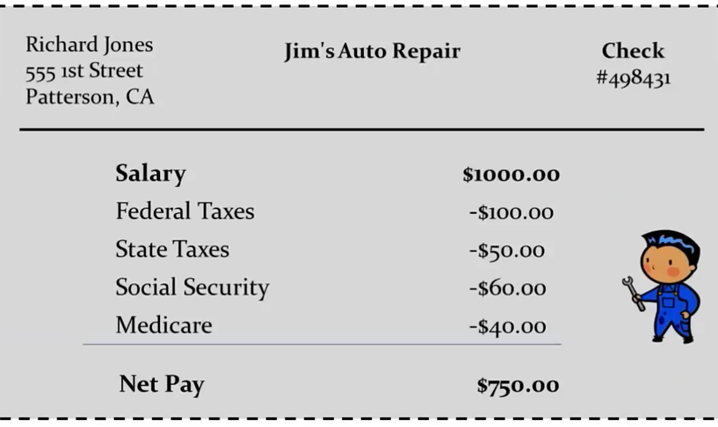
Example of Income Tax
Notes:
With this one… just talk about the federal and state tax that is taken out. We will go over later social security and medicare

Slide 15
Sales Tax
Taxes that are collected when a good or service is purchased.
Sales taxes are determined by each state.
Each state has in purchase taxes as well as on line taxes

Slide 16
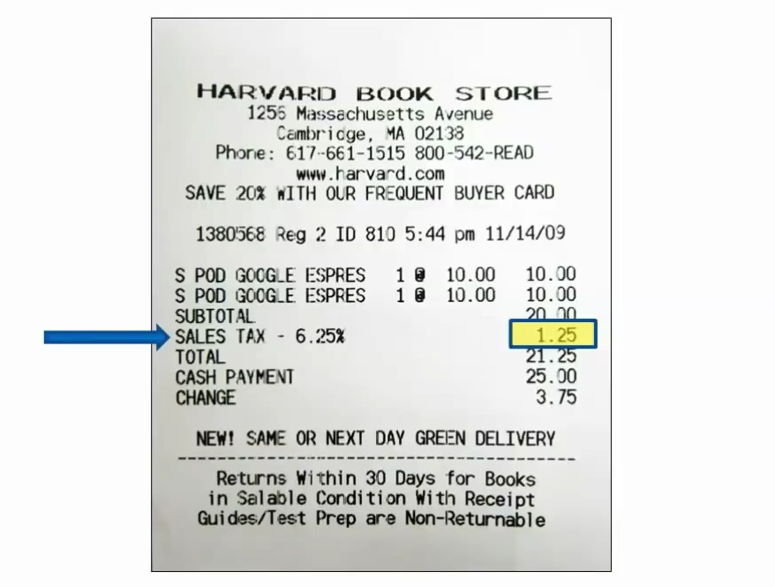
Sales Tax Example

Slide 17
Payroll Tax
Taxes collected from you and you employer when you get paid and is used for specific programs.
Different than income tax because these funds a used for specific programs
Examples:
Medicare
Social Security

Slide 18
Example of a Payroll Tax
Paycheck

Slide 19
Property Tax
Taxes collected based on property that you own.
Collected twice a year
Example:
Home
Airplane
Boat

Slide 20
Property Tax Example

Slide 21
Sin Tax
Taxes collected when a specific good or service is purchased that the government considers unhealthy.
Purpose is to discourage the activity as well as pay for government expenses with healthcare costs that come about due to these activities.
Examples:
Tobacco
Fast-food
Gambling
Indoor tanning tax with tanning beds

Slide 22
License/Occupational Tax
Tax to purchase a license or job certificate issued by the government. You are basically paying a tax that allows you to drive or work in a certain occupation
Examples:
Driver License
State ID Card
Real State License
Teaching License
Cosmetology License

Slide 23
Which type of tax do you think is the most important?
Discussion

Slide 24
Remember
Taxes are collected to pay for things that we all share, like roads, parks, and playgrounds.
We also share in the cost of services such as the public school system or the police department.
There are different types and amounts of taxes based on where a person lives and his/her income

Slide 25
Reviewing the 3 Key Taxes…

Slide 26
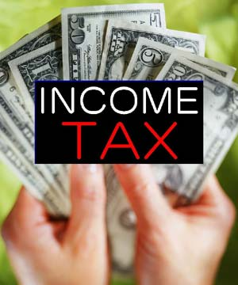
Review
Income Tax – most people in the country have money taken from each paycheck to pay income taxes so the federal government can pay for things like national defense, inspecting food, researching cures for diseases, and helping with disasters

Slide 27
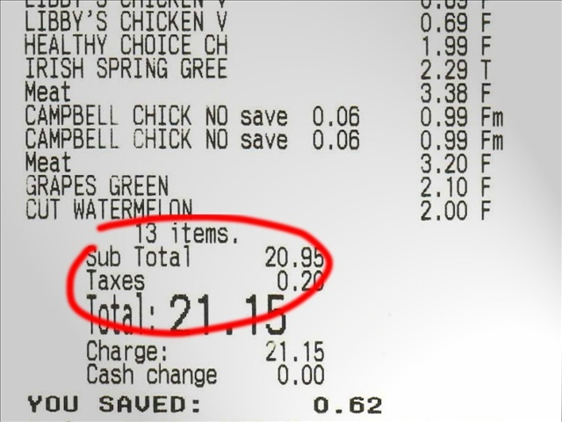
Review conti…
Sales Tax - When a student wants to buy something with his own money, he finds out about sales tax when his purchase unexpectedly costs more than the “sticker price”.
Remember that states and cities charge taxes on almost everything that is purchased so they can provide their own services, and that the sales tax rate can vary from state to state

Slide 28
Review conti…
Property Tax - every year, some adults pay taxes to the local government based on their house's value.
Remember that properties are assessed periodically to determine their value. Even in rented property, explain that the property taxes still get paid, but they're probably included in the monthly rent

Slide 29
Tax Season
Each person is responsible for calculating and paying his share of federal and state government income taxes in April.
People can calculate their tax debt themselves or go through a third party to fill out the appropriate forms.
The Internal Revenue Service establishes the rules, provides the proper forms, and collects and monitors tax payments.
There are penalties when people don’t pay their taxes.

Slide 30
Discussion
What happens if people have too much or not enough money taken from their paychecks for taxes?
When taxes are calculated and it is discovered that too much money was taken, the person gets a refund, and when not enough money is taken, the person owes the difference

Slide 31
Processing
In a CER paragraph on the back of your worksheet, think about everything that you have learned about personal finance over the past week and defend which aspect you think is the most important achieve personal financial success?
This will be due at the beginning of class on Monday prior to the Personal Finance Assessment!

