Slide 1
Warm Up: take a couple minutes to answer the following question on page 131 of your spiral
Why do you think understanding geography will be important to the study of history?
Geography will help explain how some civilizations rose and fell

Slide 2
Warm Up: As you come in, please fill out your planner, sit in your assigned seat, and take a couple minutes to answer the following question on page 131 of your spiral
Can humans settle anywhere? Explain

Slide 3
Warm Up: As you come in, please fill out your planner, sit in your assigned seat, and take a couple minutes to think about the following question from yesterday:
Can humans settle anywhere? Explain

Slide 4
Warm Up: As you come in, please fill out your planner, sit in your assigned seat, and take a couple minutes to answer the following question on page 131 of your spiral.
What is the purpose of the 5 themes of geography?
Organize information about a civilization
Help us study all the different parts of a civilization

Slide 5
WARM-UP 9-1-2015
If you were moving to a new town, what questions would you ask yourself? Consider each of the 5 themes, write one question for each theme.

Slide 6
Introduction to the World’s Geography
The Tools to World History
Essential Questions: How does geography affect human settlement? Can humans settle anywhere?

Slide 7
Objective
Students will be able to
Describe the key features of Earth’s surface
Explain the five themes of geography
Summarize how humans are affected by their environment

Slide 8
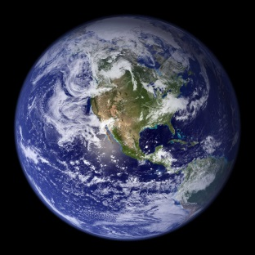
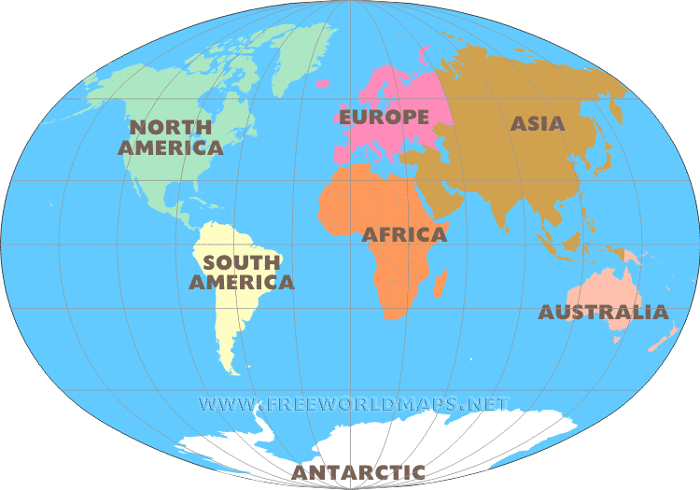
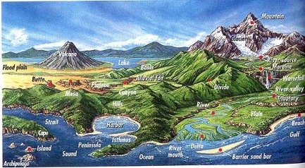
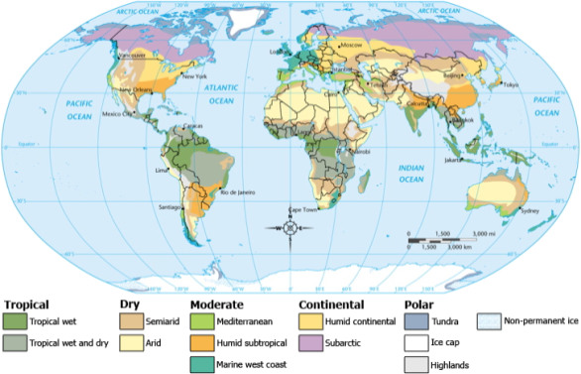
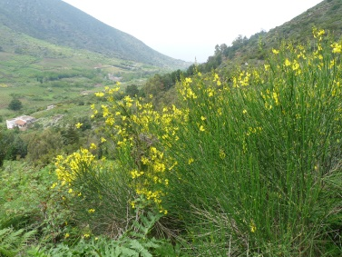
Key Vocabulary
Geography- the study of Earth and its people
Continent- one of the seven large landmasses of Earth
Landform- a naturally formed feature of Earth’s land surface
Climate- the pattern of weather conditions in a certain locations over a long period of time
Vegetation- the plant life of an area

Slide 9
Key Vocabulary Cont.
Theme- topics of discussion
Precise- very definite or exact
Interaction- when two or more things affect each other
Influence- to have an effect of impact on something

Slide 10
Build on what YOU know
With a partner, complete the following:
Describe the perfect place to live?

Slide 11
Your Town is part of the world’s geography!
What you just described is everything we study in Geography!

Slide 12
The study of earth and its people is called Geography
Geographers study the land and water that cover Earth. They also study how people live on Earth.

Slide 13
Geography mixes up the physical and human aspects of our world into one field of study.
Geography shows the relationship between people and the environment.

Slide 14
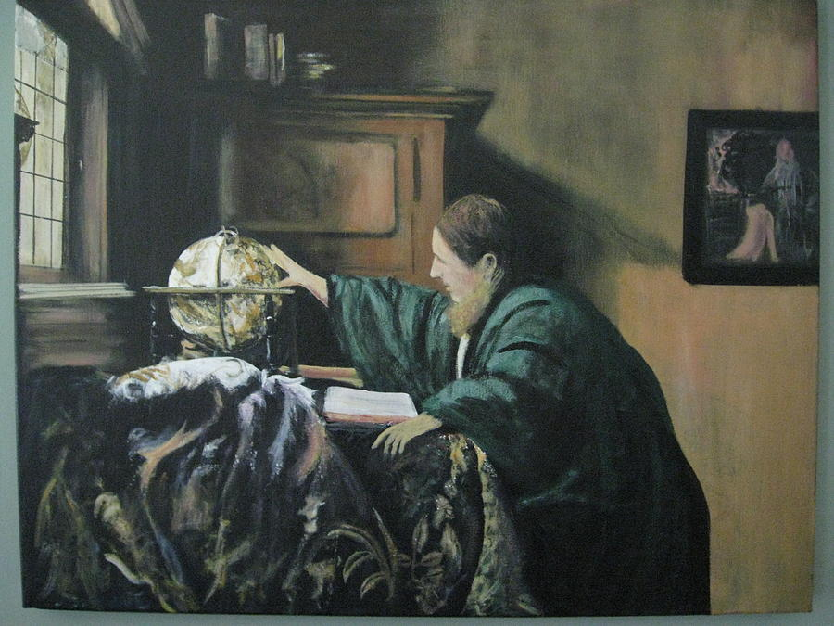
What is a Geographer?
Someone who analyzes the Earth from many points of view.

Slide 15
Geographers
In their work, geographers are guided by two questions…
Where are things located?
Why are they there?
What is the relationship between the people and their environment.

Slide 16
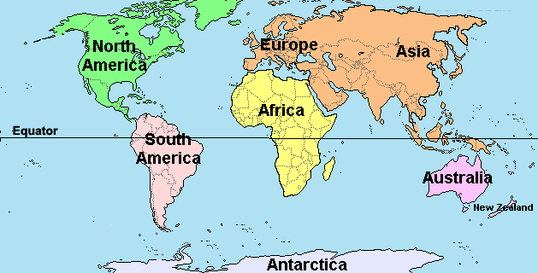
7 Continents Song

Slide 17
Why do we say “Don’t forget Australia” and Don’t forget Antarctica”

Slide 18
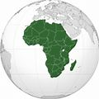
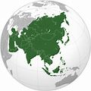
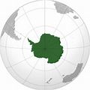
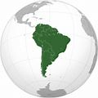
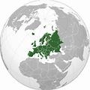
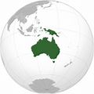
Critical Thinking
Why do you think geographers divide Earth into different units, such as continents, for study?
These units represent places where the land, water, and people have certain basic features in common.

Slide 19
Warm Up: As you come in, please fill out your planner, sit in your assigned seat, and take a couple minutes to think about the following question from yesterday:
What is the purpose of the 5 themes of geography?
Organize information about a civilization
Help us study all the different parts of a civilization

Slide 20
To find the answers, geographers use five themes to organize information.
These themes are
Location
Place
Human-Environment Interaction
Movement
Region
Notes:
http://www.youtube.com/watch?v=AIqC79WrpKg&feature=player_embedded#!

Slide 21
The 5 Themes of Geography

Slide 22
1. Location
Geographers begin to study a place by finding where it is, or its location. There are two ways to talk about location.
Absolute Location
Relative Location

Slide 23
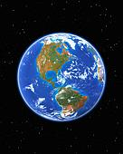
Absolute vs. Relative
Absolute location describes a place's exact position on Earth.
Relative location explains where a place is in relation to other places.

Slide 24
2. Place
Place describes what a location is like.
All places have
- Physical characteristics and
- Human characteristics
that distinguish them from other places.

Slide 25
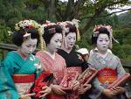
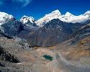
Physical vs Human Characteristics
Physical Characteristics: landforms(mountains, plains,etc) bodies of water ( oceans, lakes, bays, etc) ecosystems (soil, plants, animals, and climate)
Human Characteristics: bridges, roads, buildings, culture and customs, religion, music, food, and language.

Slide 26
3. Region
It is a group of places that share a common physical or human characteristic.

Slide 27
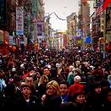
What are their unifying characteristics/features and how do they form and change over time?
Common Physical Features
The Great Lakes Region is a large area in the U.S. that shares common physical features.
Common Human Features
Chinatown in San Francisco is unified by a common human feature. It is culture!

Slide 28
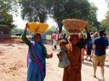
4. Movement How and why do people, goods and ideas move from place to place?
Migration, commuting to work and school and traveling on vacation are human movement.
Trade , importing and exporting of products, food and raw materials are movement of goods
Cell phones, internet, newspaper, books, television, fax and radio are how
ideas are “moved” or communicated around the world.

Slide 29
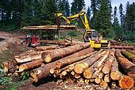
5. Human- Environment Interaction Describes the relationship between people and their environment.
Indonesia Rice Fields
Logging in the Amazon
How the environment affects people AND how do people affect the environment.

Slide 30
Human-Environment Interaction
Human-environment interaction looks at the relationships between people and their environment; how people adapt to the environment and how they change it.
How do people depend on the environment? (Example: In ancient times, the annual flooding of the Nile River produced good soil for growing crops.)
How do people adapt to the environment? (Example: The ancient Egyptians rebuilt their homes each year, after the annual flooding. As time went on, they built their homes above the flood plain.)
How do people modify the environment? (Example: The ancient Egyptians built irrigation ditches to help water the crops. In modern times, Egypt built a dam to control the flood waters of the Nile River.)

Slide 31
How do I remember this…
Location
Place
Region
Movement
Human- Environment Interaction
Lets make a funny sentence to remember the 5 themes…
Lazy People Randomly Move Home

Slide 32
What is the purpose of the 5 themes of geography?
Organize information about a civilization
Help us study all the different parts of a civilization

Slide 33
Critical Thinking
What are the 5 themes of geography?
Location
Place
Region
Movement
Human- Environment Interaction
What kinds of features can be included in a geographer’s description of place?
Physical Features
Human Features
Which two geography themes are most concerned with people?
Movement
Human – Environment Interaction

Slide 34
Make a geography Themes poster Assignment
The purpose of this is to understand that the 5 themes of geography relate to peoples every day lives
Task:
1. Review the 5 themes of geography
2. With a partner, you are to create a poster that illustrates the 5 themes of geography.
3. You may find or draw your pictures to illustrate each theme.

Slide 35
Critical Thinking
How does climate affect people’s lives?
Affects where and how they live
What does it mean to adapt?
You make adjustment based on the environment and where you are living
How do people adapt to their environment?
ie where a coat in cold weather and dress in light in warm weather

Slide 36
Formative Assessment
On a separate sheet of paper complete the following task:
Describe each of the 5 themes as they relate to your town.

Slide 37
How Environment Affects People
Reading Activity

Slide 38
Reading Codes
+ New information
* I know this information
? Confusing
P Problem
S Solution
C Connection
X I disagree
☺ I agree
V New vocabulary

Slide 39
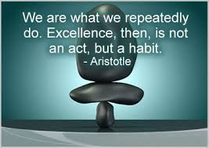
Critical Thinking
Why is using a reading technique such as “reading codes” important to use when looking at different sources within this class?
It is an analytical reading strategy that helps students identify and isolate essential information in a text like key terms and claims.
Marking a Text requires students to read carefully as they evaluate the importance of ideas in a text.
When students read with purpose, their comprehension and retention of essential ideas increases.

Slide 40
Processing- complete on page 5 of your spiral
What is the perfect place for human settlement?
Respond in an claim/ evidence/ reasoning paragraph
Sentence starter that restates the question:
The perfect place for humans to settle is_________________. This is the perfect place to settle due ________.
Make sure to consider the following in your response as evidence:
Continents
Landforms
5 Themes
Climate
Vegetation

