Slide 1
Warm Up
What are the most important factors when determining where to establish a civilization?

Slide 2
Where to establish a civilization
Water
Resources
Usable Farmland
Geography (Natural Barriers)
Climate

Slide 3
Warm Up
You will not need your spiral today!
After taking out your worksheet, think to yourself…
What do we always do first when working with documents…
TLC a map:
Title
Legend
Compass Rose
Symbols
Scale
Labels
Colors
Caption

Slide 4
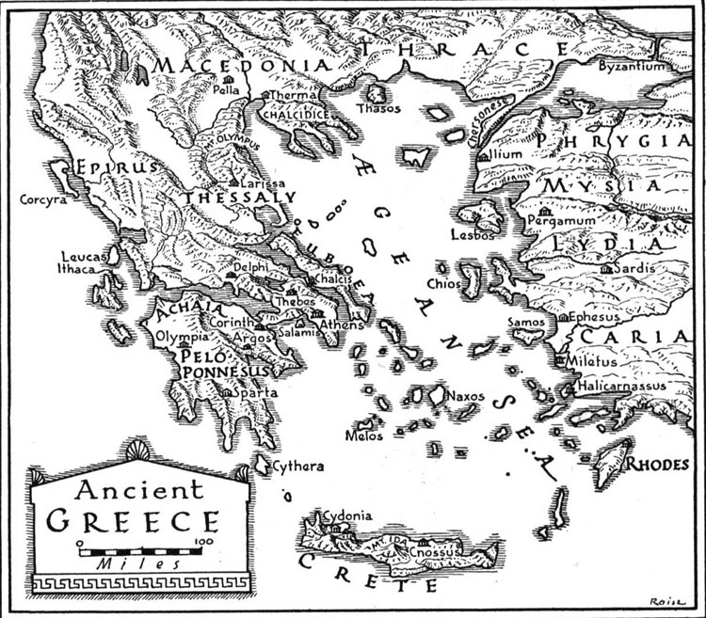
Greece Geography Challenge

Slide 5
Learning Target
I can describe the geography of Greece and the impact it had on settlement.
Success Criteria:
Label a map
Analyze map of Greece
Answer questions using maps
Make historical hypotheses based upon maps

Slide 6
What do we always do first when working with documents…

Slide 7
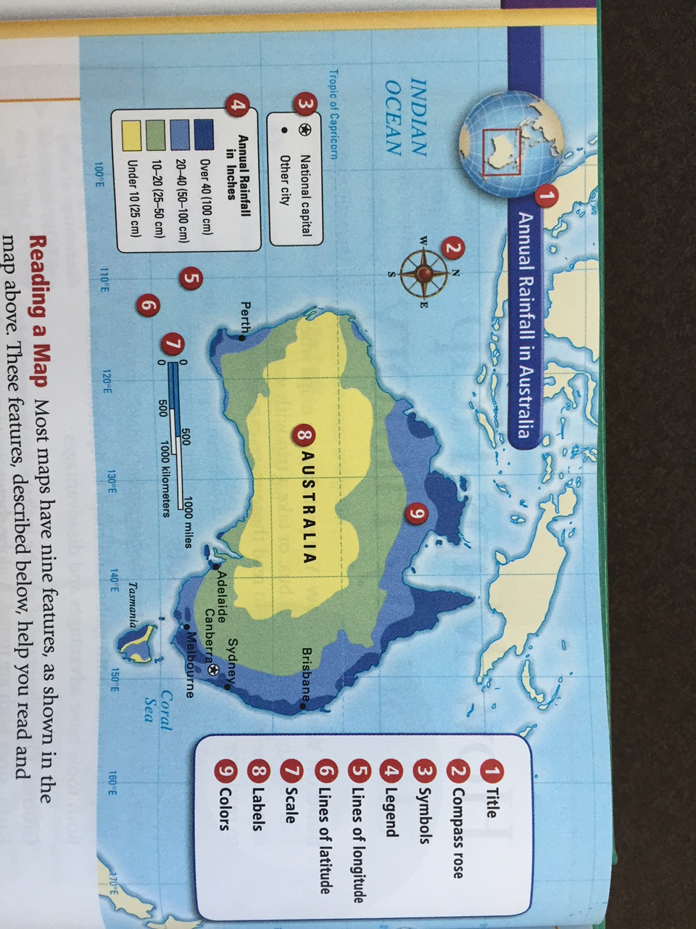
TLC of Reading a Graphs/ Charts/ Maps/ Data Copy this information down under your map on page 8
TLC a map:
Title
Legend
Compass Rose
Symbols
Scale
Labels
Colors
Caption
In addition, look for:
Lines of Longitude
Lines of Latitude

Slide 8
What is the difference between a continent and a country?

Slide 9
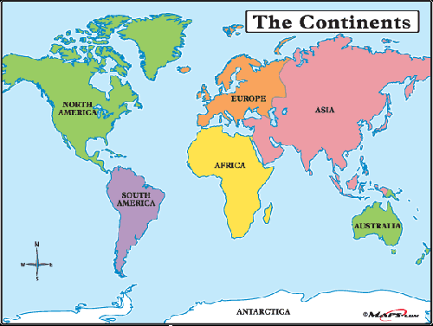

Slide 10
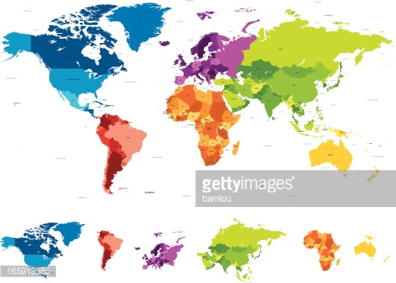

Slide 11
Task
Starting on page 245 of the textbook, independently complete the Geography Challenge Worksheet. You will be answering questions and labeling a map of Greece.
Use a separate sheet of paper to give you more room to answer the questions if needed.
All questions must be answer in complete sentences.
You have the period to work on this and it will be due at the end of the period TODAY!

Slide 12
Once you are done…
Draw a map of Greece on a separate sheet of paper
Include:
How they travelled and traded
Show the geographic environment/features
Location of major colonies
Location of major bodies of water
Surroundings

Slide 13
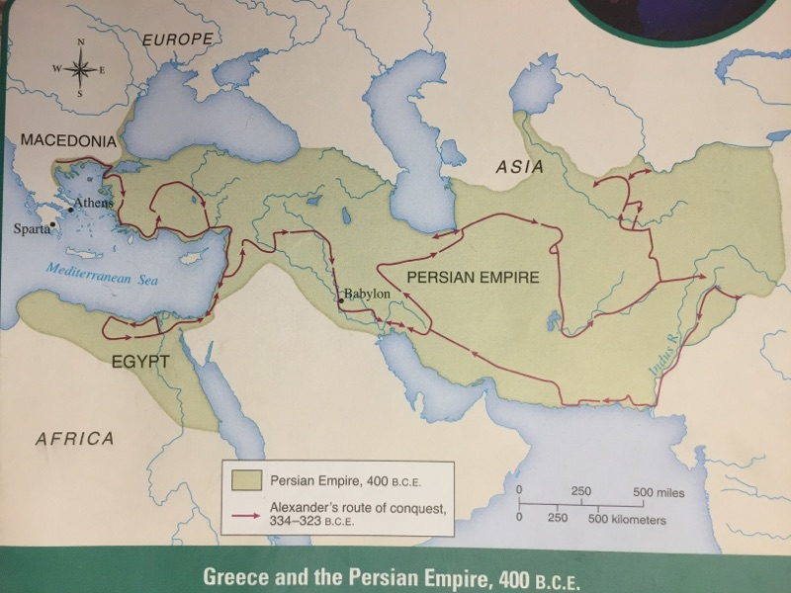
Page 245 Map

Slide 14
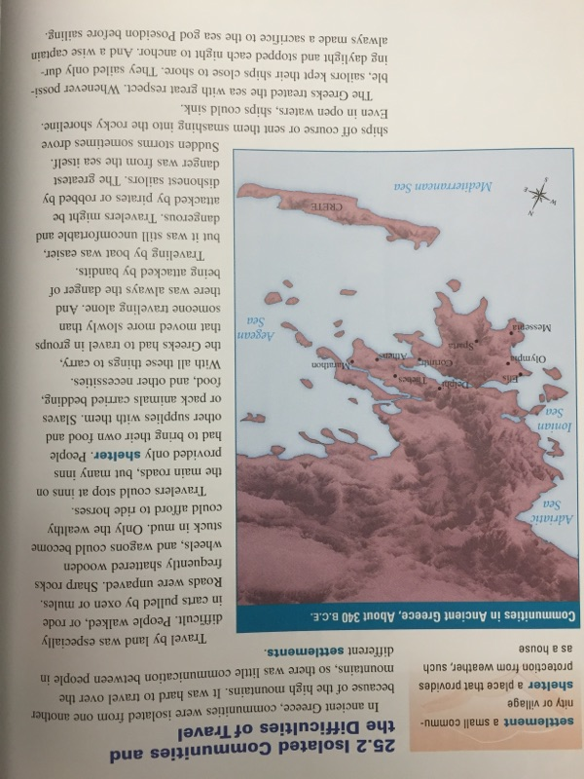
Section 25.2

Slide 15
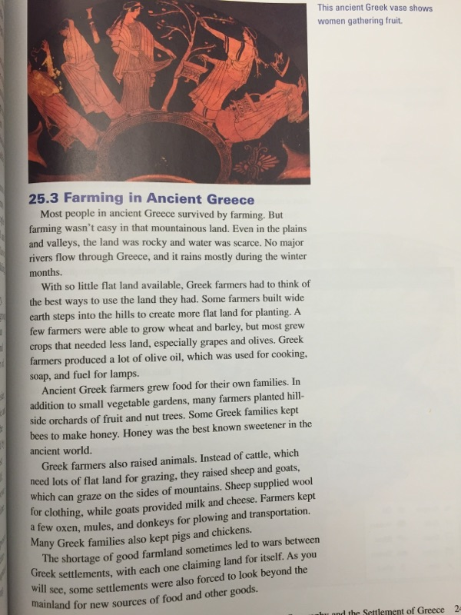
Section 25.3

Slide 16
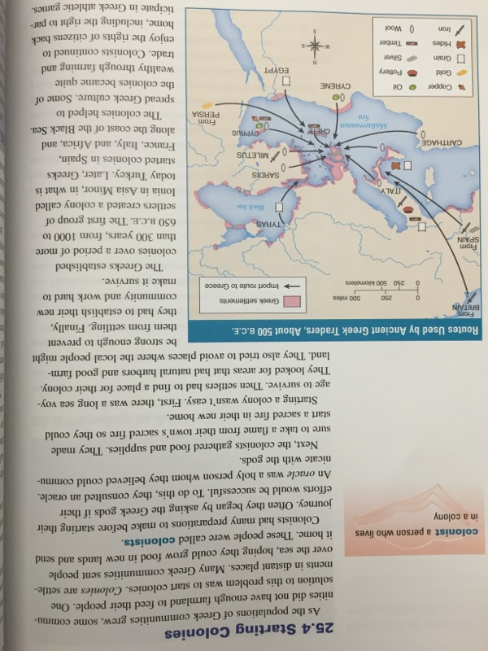
Section 25.4

Slide 17
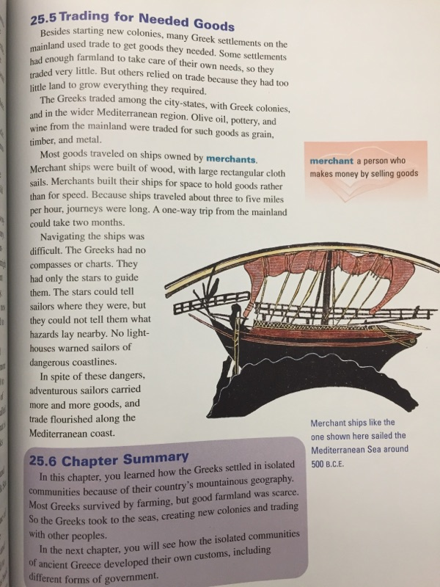
Section 25.5

