Slide 1
Warm up
After picking up your spiral, answer the following warm up question…
Which of the following forms of government is the most restrictive on its people, justify
Monarchy
Oligarchy
Tyranny (Dictatorship)
Democracy

Slide 2
Warm Up
Define the following form of government in one word:
Monarchy
Oligarchy
Tyranny (Dictatorship)
Democracy

Slide 3
Different Forms of Government
Reviewing

Slide 4
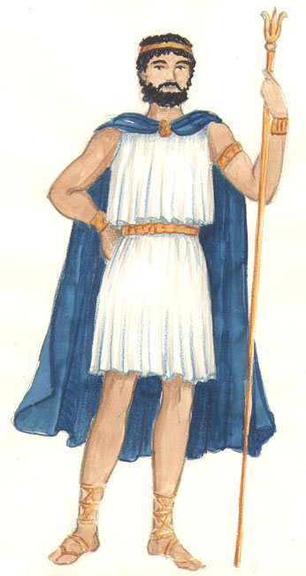
Under a Monarchy…
One person inherits power
The power to make political decisions is in the hands of one person.
Ex. I lost power because I depended on the aristocrats to help me during war, but they demanded more power and finally overthrew me

Slide 5
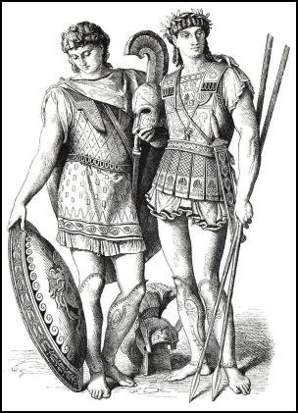
Under an oligarchy…
A few people share power
The power to make political decisions is in the hands of a few people.
Ex. We lost power because we ignored the needs of most of the people. We passed unpopular laws and used the army to enforce them. We passed laws that protected our wealth. The rich got richer, the poor got poorer, and eventually the poor turned to leaders in the army. These new leaders overthrew us.

Slide 6
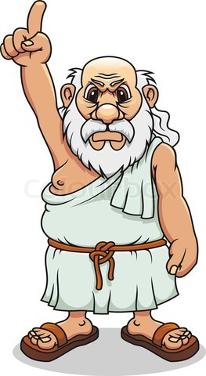
Under a tyranny…
One person takes power by force
The power to make political decisions is in the hands of one person who is not a lawful ruler.
Ex. I lost power because sometimes I ruled and ignored the needs of the people, and the people forced me out.

Slide 7
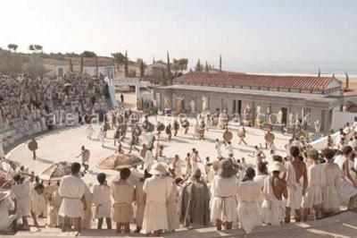
Under a democracy…
All Citizens share power
The power to make political decisions is in the hands of all citizens

Slide 8
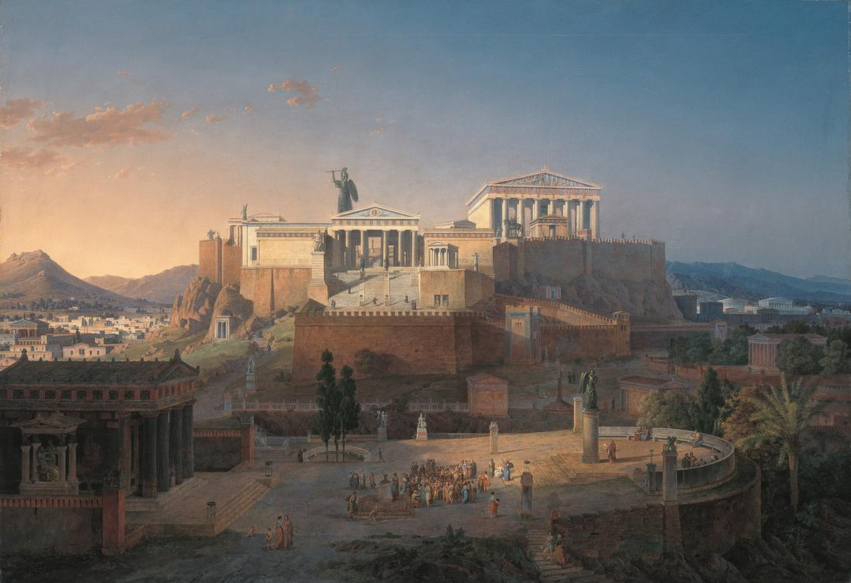
The Rise of Democracy in Greece

Slide 9
Learning Target
I can describe how city states of ancient Greece developed four very different forms of government.
Success Criteria:
Describe the transition of Greece from monarchy to democracy
Explain the reasons of failure of monarchy, oligarchy, and tyranny in ancient Greece
State the key similarities and differences between ancient Greece’s democracy and the present USA’s democracy

Slide 10
Key Vocabulary
City States
Monarch
Aristocrat
Oligarch
Tyrant
Democracy
Citizen
Assembly

Slide 11
Use pages 254- 257 in the textbook to complete the chart on page 70 of your spiral
Government | Pro | Con
Monarchy
Oligarchy
Tyranny (Dictatorship)
Democracy

Slide 12
The Rise of Democracy
Page 253

Slide 13
Copy this chart on to page 70 of your spiral and title it “Rise of Democracy in Greece”
Government | When existed? Who had the power? | What did citizens roles look like in Greece? | Why did this government survive or failed? | I lost power because…
Monarchy (26.2)
Oligarchy (26.3)
Tyranny (Dictatorship) (26.4)
Democracy (26.5)

Slide 14
Task
In your group of four, you will be responsible for filling in your section of the chart from the reading. Use pages 254- 257 in the textbook to complete this task.
1 will do 26.2 on page 254
2 will do 26.3 on page 255
3 will do 26.4 on page 256
4 will do 26.5 on page 257
Remember to read carefully and fill in your part of the chart as completely as you can because you are responsible for teaching the other members of the group about your section.
You have 10 minutes!

Slide 15
Share Out and Take Notes
You have 15 minutes to share out all 4 sections.
As your group members share out their information, please take notes.

Slide 16
How did the role of the Greek citizen evolved over time within each form of government Greece used? How did unhappiness with these government systems lead to democracy?
Discussion

Slide 17
Warm up
Why do you think the type of government changed so many times in Greece?

Slide 18
Review of the Rise of Democracy in Greece

Slide 19
Under a Monarchy…
One person inherits power
The power to make political decisions is in the hands of one person.
Ex. I lost power because I depended on the aristocrats to help me during war, but they demanded more power and finally overthrew me

Slide 20
Under an oligarchy…
A few people share power
The power to make political decisions is in the hands of a few people.
Ex. We lost power because we ignored the needs of most of the people. We passed unpopular laws and used the army to enforce them. We passed laws that protected our wealth. The rich got richer, the poor got poorer, and eventually the poor turned to leaders in the army. These new leaders overthrew us.

Slide 21
Under a tyranny…
One person takes power by force
The power to make political decisions is in the hands of one person who is not a lawful ruler.
Ex. I lost power because sometimes I ruled and ignored the needs of the people, and the people forced me out.

Slide 22
Under a democracy…
All Citizens share power
The power to make political decisions is in the hands of all citizens

Slide 23
The Rise of Democracy in Greece

Slide 24
Learning Target
I can describe how city states of ancient Greece developed four very different forms of government.
Success Criteria:
Describe the transition of Greece from monarchy to democracy
Explain the reasons of failure of monarchy, oligarchy, and tyranny in ancient Greece
State the key similarities and differences between ancient Greece’s democracy and the present USA’s democracy

Slide 25
Key Vocabulary
Monarch
Aristocrat
Oligarch
Tyrant
Citizen
Assembly

Slide 26
Processing
Using the chart on page 70 of your spiral as well as page 254-257 in the textbook, answer the following question:
Evaluate the reason for the transition in Greece from monarchy to democracy and how did this impact the citizen’s role?
Make sure to address monarchy, oligarchy, tyranny, and democracy

Slide 27
Steps
Plan first by filling out the outline located on the worksheet.
Once you have finished the outline, begin writing your essay on the line side of the paper.
Whatever you do not finish in class is homework and will be due Monday!

