Slide 1
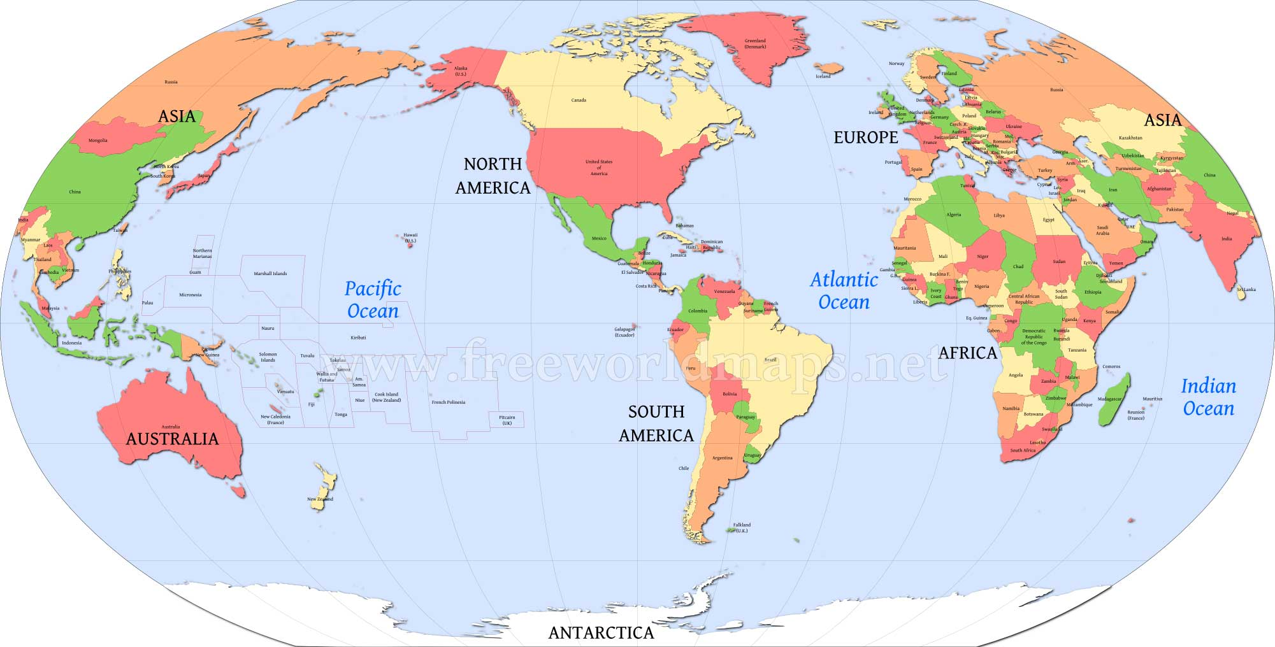
Warm Up
Can you learn about a place that you’ve never been to without studying maps?

Slide 2
How Maps Help Us Study History
Essential Question: What role do maps play in studying civilizations?
Can you study the world without maps?

Slide 3
Objective
Students will be able to:
Describe the tools used by geographers to study Earth
Describe the different types of maps geographers use

Slide 4
Key Vocabulary
Turn to page one and add the following terms:
Longitude
Latitude
Hemisphere
Political Map
Physical Map
Thematic Map

Slide 5
Critical Thinking
Why do we use maps instead of globes?
Globes look more like earth. It shows the viewers exactly how continents and oceans appear on Earth’s curved surface. Map, on the other hand, is a flat representation of Earth’s surface.
NO FLAT MAP CAN BE AS ACCURATE AS A GLOBE BECAUSE THE SURFACE IS DISTORTED!
Notes:
Blow up Globe!!!

Slide 6
So Why do we study maps?
Let you measure distance more easily
You can see the world at a glance
Easier to carry

Slide 7
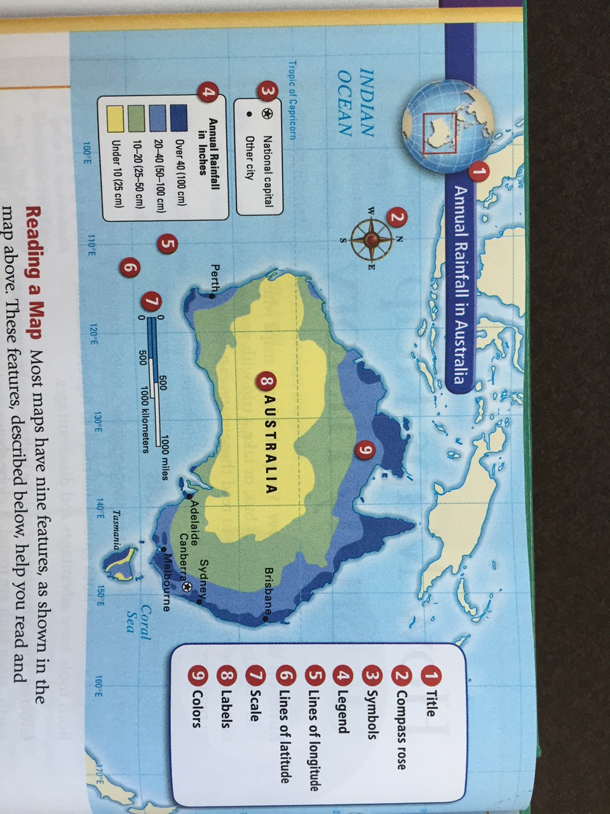
Reading a Map
TLC a map:
Title
Legend
Compass Rose
Symbols
Scale
Labels
Colors
Caption
In addition, look for:
Lines of Longitude
Lines of Latitude

Slide 8
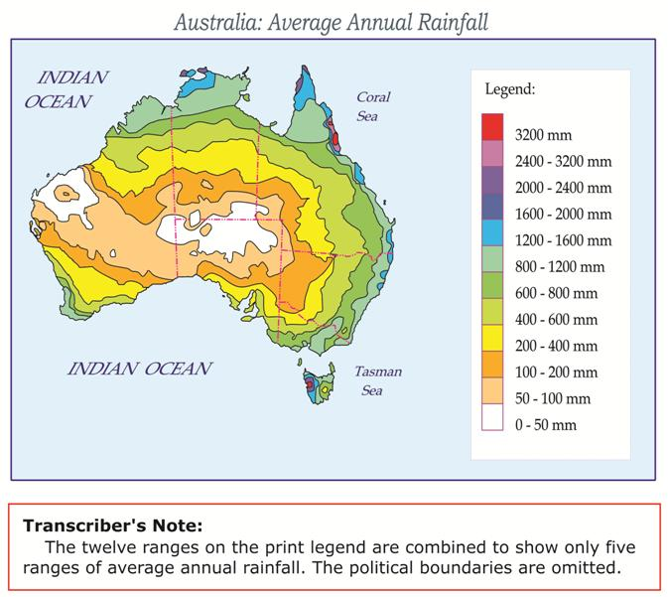
Let’s id each of the key components of this map in your spiral on the top of page 8

Slide 9
Processing
You will have 10 minutes to create a map of the classroom on page 7 that has the following things:
Title
Legend
Compass Rose
Symbols
Scale
Labels
Colors
Caption

Slide 10
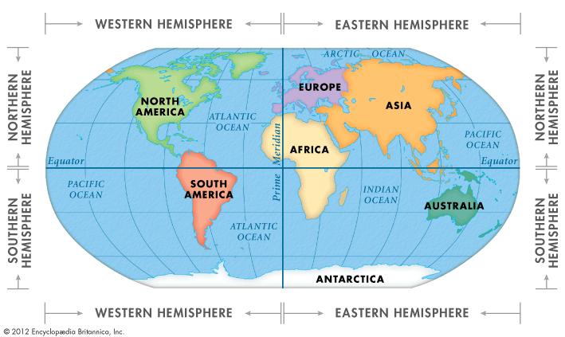
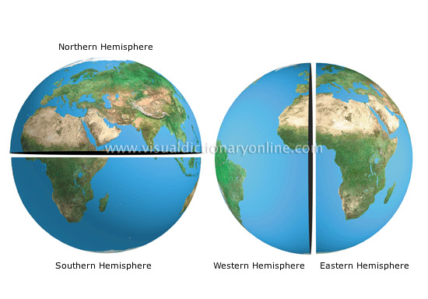
Hemispheres
To study the earth, geographers divide the glove into equal halve. Each half is called a hemisphere.

Slide 11
Critical Thinking
What different maps do we use to see natural and human-made features and to understand patterns?
Physical
Political
Thematic

Slide 12
Different Maps for Different Purposes

Slide 13
Notes
On page 10 of your spiral
Label the page Type of Maps
Take note on each of the three types
Add visual representation of each type

Slide 14
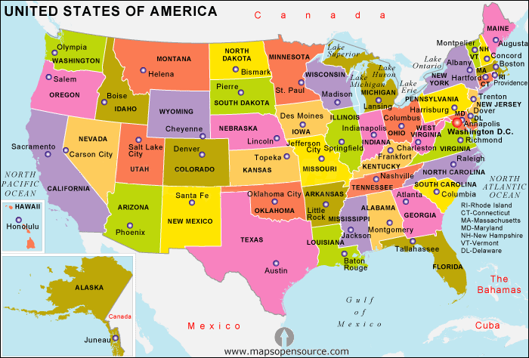
Political Maps
They show features people have created such as cities, states, provinces, territories, and countries.

Slide 15
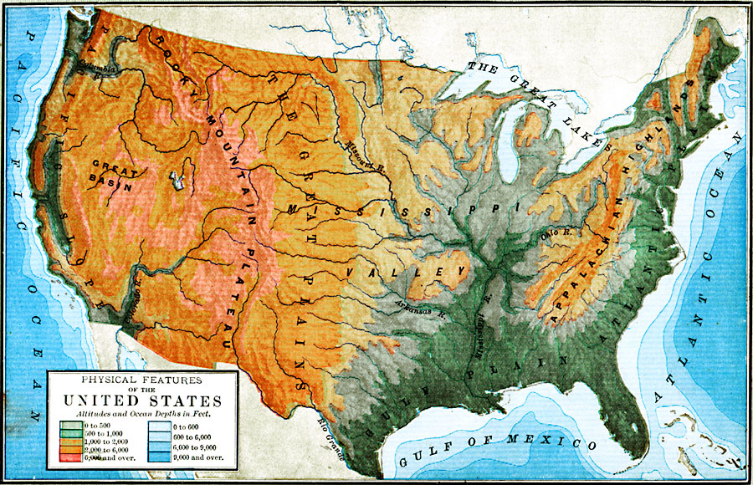
Physical Maps
They show the landforms and bodies of water on the Earth’s surface. Colors show elevation.

Slide 16
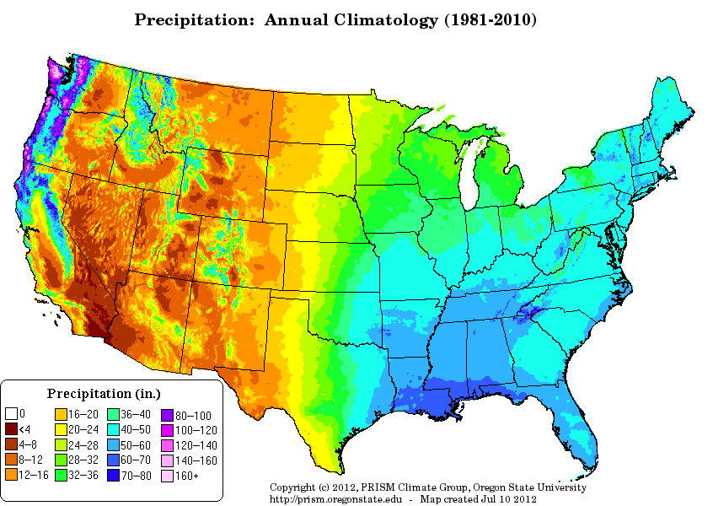
Thematic Map
They show certain information about a place or region such as climate, population, vegetation, resources, historical events.

Slide 17
Quiz: Complete on page 9 of your spiral
What are the three basic types of maps
What type of map would you use to:
Learn about the religions in a particular location?
Determine the size and shape of an area?
Determine where mountains are in a area?
Identify the natural resources in an area?
Determine the direction that a river flows?
Determine the climate of an area?
Determine the neighbors of a particular location?
Notes:
Collect formative data

Slide 18
Comparing Maps
3. Using these two maps, what physical features might explain the large area of tropical wet climate in the north of Brazil?

Slide 19
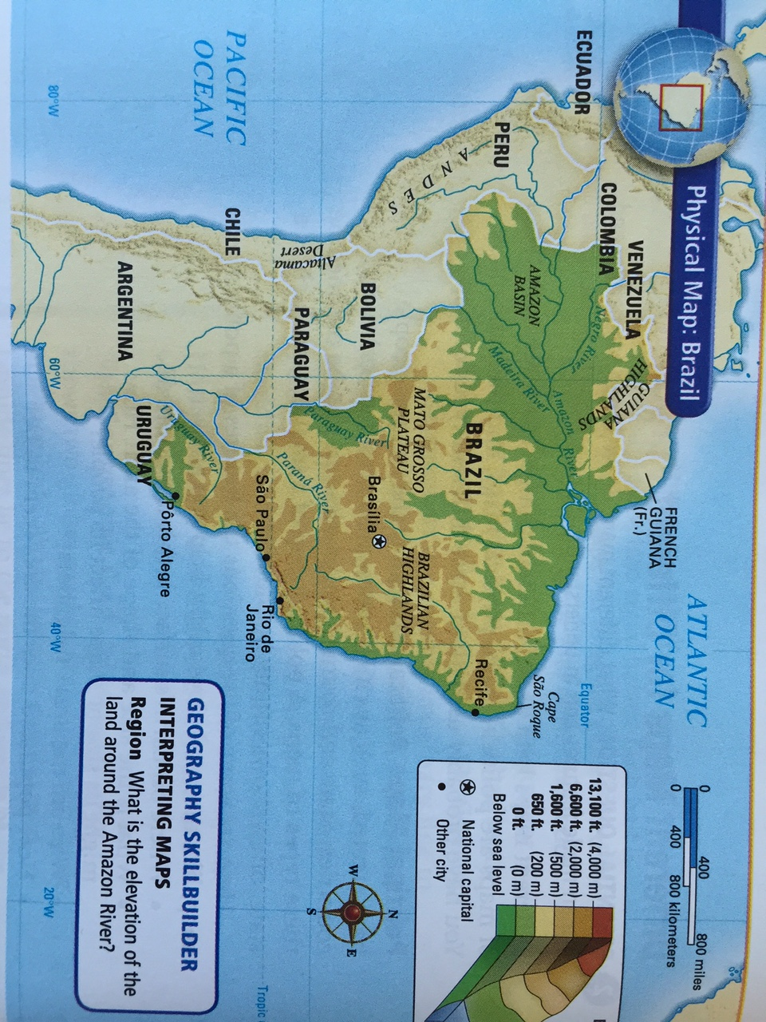

Slide 20
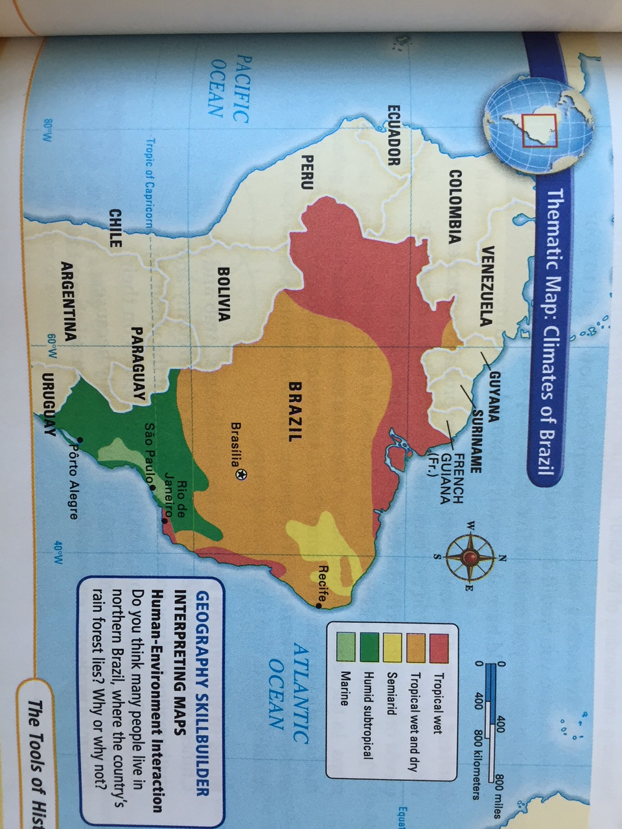

Slide 21
Quiz Answers
What are the three basic types of maps
Physical, Political, Thematic
What type of map would you use to:
Learn about the religions in a particular location?
Thematic
Determine the size and shape of an place?
Political
Determine where mountains are in a area?
Physical
Identify the natural resources in an area?
Thematic
Determine the direction that a river flows?
Physical
Determine the climate of an area?
Thematic
Determine the neighbors of a particular location?
Political
3. Using these two maps, what physical features might explain the large area of tropical wet climate in the north of Brazil?
Amazon River system and the low elevation

