Slide 1
Warm Up
The Persian Empire was located between the civilizations of Egypt and China. How do you think this impacted them?

Slide 2
Warm Up
The Persian Empire was located between the civilizations of Egypt and China. How do you think this impacted them?
It was often evaded but also a trade center

Slide 3
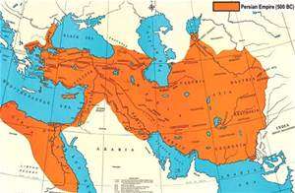
Between the East and the West
Building of the Persian Empire

Slide 4
Learning Target
I am learning about the development of the Persian Empire
Success Criteria
Explain impact of geographic location
Evaluate how the Persians acquired land
Explain how the Persians ruled over their empire

Slide 5
Key Vocabulary
Anatolia: land within modern-day Turkey
Toleration: acceptance of habits, beliefs, and practices of others
Province: a political division of a country
Satrap: a Persian governor
Royal Road: a road in Persia used for government purposes

Slide 6
Task
Read the handout pages 129-133 QUIETLY and INDIVIDUALLY!
Complete the lesson review questions 1-23 on page 133 and 134 of the packet on a separate sheet of paper QUIETLY and INDIVIDUALLY!
This will be due at the end of the period!

