Slide 1
Warm Up
After picking up your spiral, answer the following question in your warm up section…
What is an Empire?
How is an Empire created?
How is an Empire controlled?

Slide 2
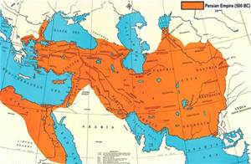
Between the East and the West
Building of the Persian Empire

Slide 3
Learning Target
I can explain the rise of the Persian Empire and how it was governed
Success Criteria:
Explain the impact of geography on an Empire
Evaluate how the Persians acquired land
Explain how the Persians ruled their Empire

Slide 4
Key Vocabulary
Anatolia: Land within modern day Turkey
Toleration: Acceptance of habits, beliefs, and practices of others
Province: political division of a country
Satrap: A Persian Governor
Royal Road: a road in Persia used for government purposes
Tribute: Payment made periodically by one state or ruler to another, especially as a sign of dependence.

Slide 5
Discussion
How would you describe the Persian Empire?

Slide 6
Introduction to the Persian Empire
Reading with Purpose
In your spiral page 74, create this chart
Why was Cyrus so successful in creating an empire? | In what ways does geography hinder or encourage the growth of an empire?
How did Darius govern such a vast empire? | What can we learn from how the Persians created and ruled their empire?

Slide 7
Task
Reread about the Persian Empire but with a purpose this time.

Slide 8
Why was Cyrus so successful in creating an empire? Had an almost unstoppable military Practiced toleration. Did try to change people. Let the people follow their own customs, beliefs and religion. Made friends instead of enemies | In what ways does geography hinder or encourage the growth of an empire? Hinder: Too large to control Mountains/large bodies of water make it difficult to trade/travel/manage Encourage: Royal Road: Encourage trade and communication
How did Darius govern such a vast empire? Stopped rebellions Divided the empire into provinces (similar to how a state has local governments) Set up governors called Satraps to carry out his orders and collect taxes. Hired spies to watch the Satraps. Started the Royal Road (1775 miles) it purpose what for trade, military movement and mail | What can we learn from how the Persians created and ruled their empire? Answers will vary

Slide 9
Reviewing Persia’s control over Southwest Asia
How they acquired land…
Cyrus had a vision of conquering the lands around Persia and uniting these lands as one large empire. He lead swift, deadly attacks in this region to build an immense empire.
After the death of Cyrus came Darius, who grew the empire to 2,800 miles from east to west.
How they ruled the land…
Cyrus set up a policy of toleration, allowing people to keep their customs and beliefs. However, they did have to pay tribute. These policies of respect and toleration made friends instead of enemies. People lived in peace.
Darius divided the empire into 20 provinces, having each one being governed by satraps. The satraps job was to carry out his orders and to collect taxes. He also created the Royal Road, a road for government purposes.

Slide 10
Discussion
How were the Persians able to create and control such a vast empire?

Slide 11
Discussion
Would you want to go to war against Cyrus/Darius and the Persians at this time? Why/Why not?

Slide 12
Discussion
Based on what you have learned about the Greeks, what is one thing that could unite Athens and Sparta?

Slide 13
Warm Up
After picking up your spiral, answer the following question in your warm up section…
Based on what you have learned about the Greeks, what is one thing that could unite Athens and Sparta?

Slide 14
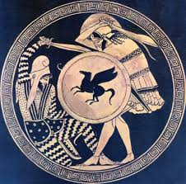
Introduction to the Persian Wars

Slide 15
Learning Target
I can analyze the impact of the different battles of the Persian wars.
Success Criteria:
  Evaluating Images to make inferences about the Persian wars
  Compare my inferences to the reading about the Persian wars to determine which forces were stronger.

Slide 16
Key Vocabulary
Persians
Persian Wars
Allies
Calvary
Hellespont
Ionians

Slide 17
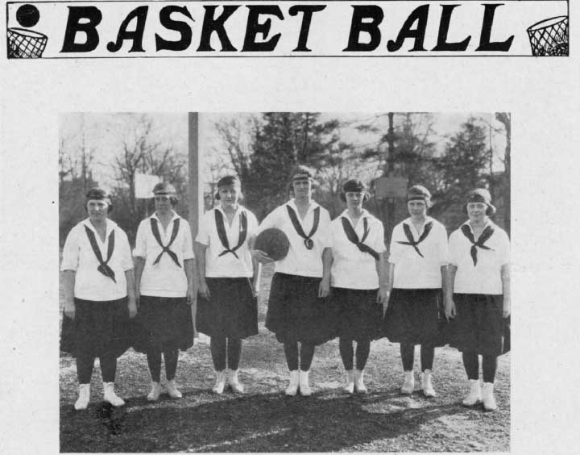
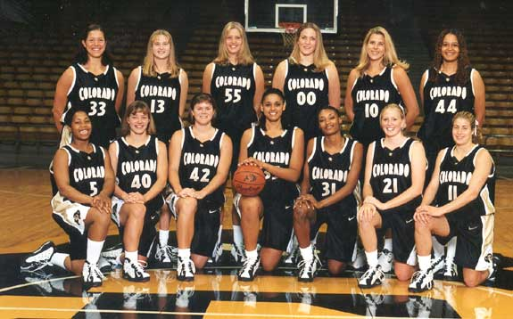
The Lions Versus the Buffs
As you hear the following paragraph about the Lions vs the Buffs, complete the following chart on page 76 with strengths and weaknesses for each team.
 | Lions | Buffs
Strengths
Weaknesses
Notes:
It seems quite unlikely the Wildcats will win the game, an equally unlikely group of weak Greek city-states was able to defeat the powerful Persians

Slide 18
Script for The Lions Versus the Buffs
Hello, sports fans!
  Here we are at Miles Pavilion to watch the Lions take on the Buffs in this championship basketball game. To be honest with you folks, I don’t see how the Lions have a chance, and I’m afraid this game is going to be a real blowout. The Buffs have a tremendously strong coach- and don’t forget that great Buffs’ captain who is so respected by the team. Check out those great uniforms- the Buffs’ sponsors certainly shower the team with everything they need. The Lions are really outmatched in this game, they don’t even have a coach! It’s really sad to see the way the team members are constantly fighting with each other. Just look, folks, at the shabby way the team is dressed. Why, I even see one member who doesn’t have shoes! This team certainly doesn’t have any money. Well, who do you think will win this game?

Slide 19
Discussion
What is an ally?
Why is is important to have allies in times of war?
Ally is a country or group that joins with another for a common purpose, such as a fight against a common enemy

Slide 20
Fighting the Persian Wars
Observe
Question
Reflect/Inference

Slide 21
Fighting the Persian Wars
Partner read page 271
Discuss with a partner following questions:
  What was the Persian Empire?
  What was the cause of the Persian wars?
  What caused Athens and Sparta to become allies?
  Which side had the advantage and why?

Slide 22
Fighting the Persian Wars
Examine the illustration on page 271
  What do you see?
  What are the occupations of the two figures?
  From what country or countries do you think each soldier is from?
  Why do you think the soldier on left is larger than the soldier on the right?
Notes:
Explain to students that they will soon discover how the weak city-states of Greece were able to defeat the powerful Persian Empire and prevent Persia from expanding its power to Europe.

Slide 23
Intro Video Clip
Persian Wars
Introduction video
What caught your attention?
What are you excited to learn about?
What conclusions can you draw after watching that video?

Slide 24
Warm Up
After picking up your spiral, answer the following question in your warm up section…
What do you think the Greeks will need to do in order to beat the Persians?
What do you think the Persians will need to do in order to beat the Greeks?
What would be the impact if Persia won?

Slide 25
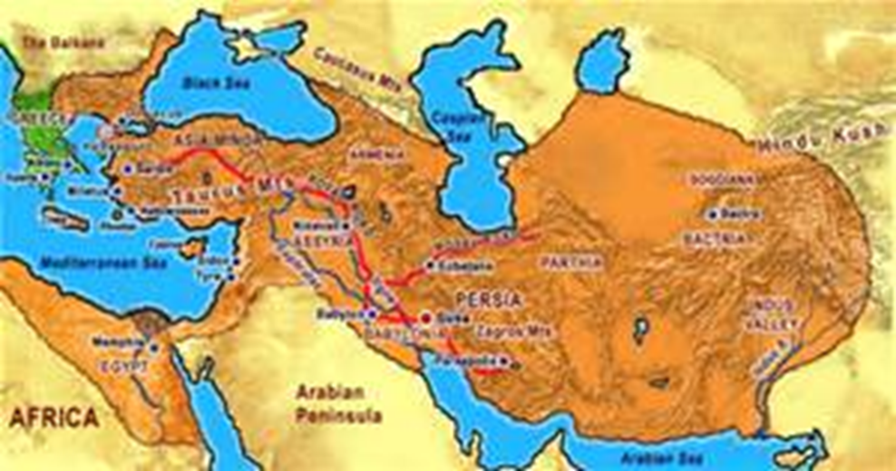
Introduction to the Persian Wars

Slide 26
Learning Target
I can analyze the impact of the different battles of the Persian wars.
Success Criteria:
  Evaluating Images to make inferences about the Persian wars
  Compare my inferences to the reading about the Persian wars to determine which forces were stronger.

Slide 27
Key Vocabulary
Persians
Persian Wars
Allies
Calvary
Hellespont
Ionians

Slide 28
Title page 75
Persian Wars- 499 B.C.E to 479 B.C.E
The Ionian Revolt
The Battle of Marathon
The Battle of Thermopylae
The Battle of Salamis
The Battle of Plataea

Slide 29
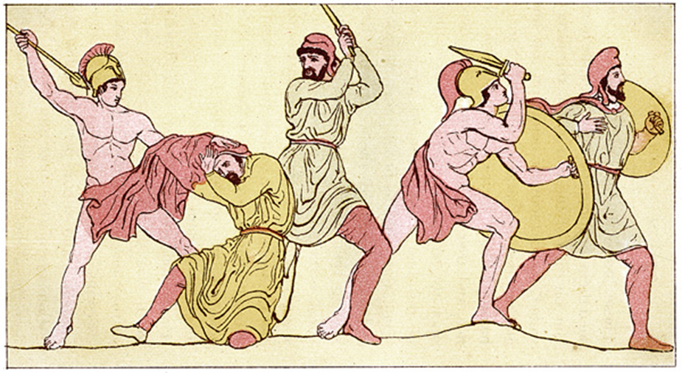
Persian Wars- 499 B.C.E to 479 B.C.E
The Ionian Revolt
The Battle of Marathon
The Battle of Thermopylae
The Battle of Salamis
The Battle of Plataea

Slide 30
Discussion
Why do wars last for so long?
Is war inevitable?

Slide 31
Task for each of the following images…
For each image and complete the following:
  Observe: Identify 8 details in the following images Write this to the left of the image
    Draw a line to each detail, and label it.
  Question: Identify 2 questions that you have and right of the image
  Reflection/Inference: write three guesses about what is happening at this council of war. Support each guess with details from the picture

Slide 32
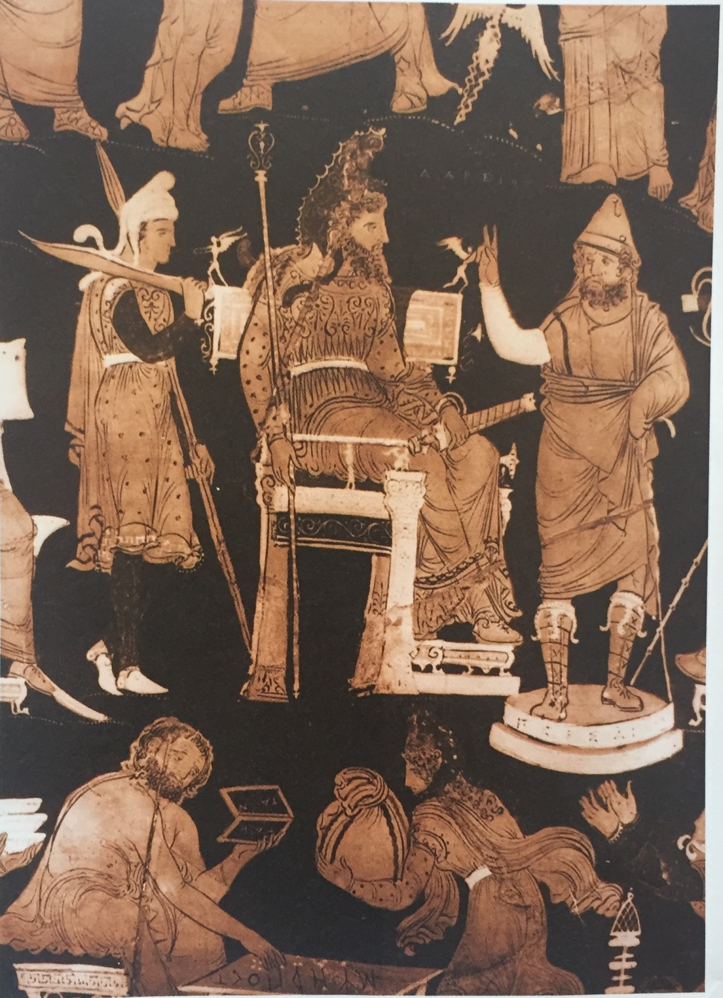
Ionian Revolt
Darius at a War Council

Slide 33
Fighting the Persian Wars
King Darius of Persia is seated at the center of the image. He is seeking advise from one of his governs about the advisability of attacking Greece. Behind him is a Persian soldier who will fight in the war. The figures at the bottom represent conquered areas that had to pay tribute to Darius. Ionia, one of these conquered areas, resented paying money and rebelled. Because some city-states helped Ionia, Darius decided to declare war on the Greek city-states after he crushed the Ionia revolt

Slide 34
Once you have Observed/Question/Reflect…
Read section 28.2, answering the following questions…
  Why did the Ionians revolt against Persian rule?
  What happened to the Ionians?
Then circle the soldier who represents the stronger force at this time, located on the bottom of the page.

Slide 35
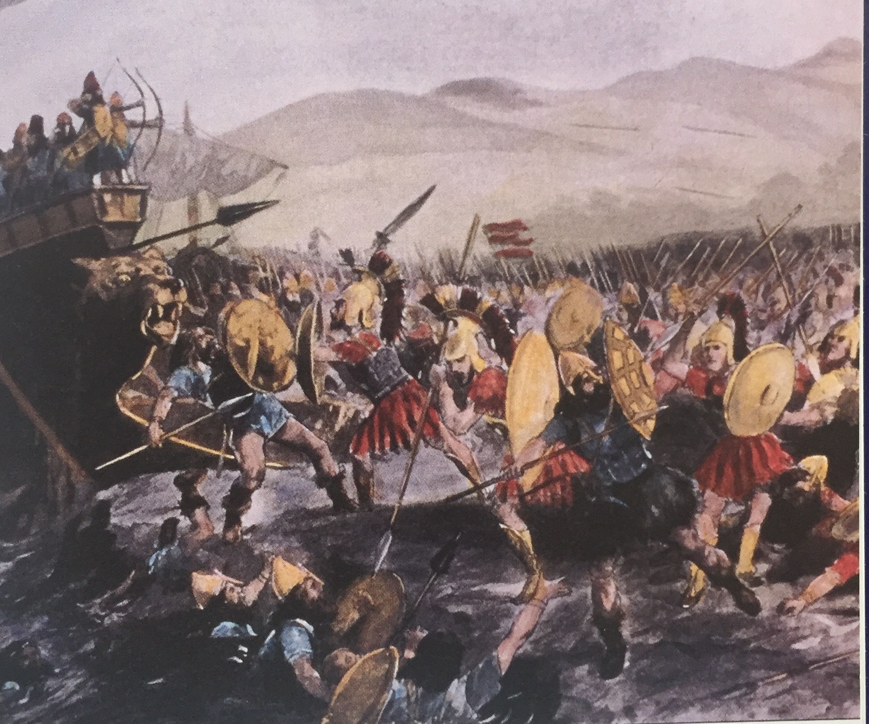
Battle of Marathon
Marathon

Slide 36
Once you have Observed/Question/Reflect…
Read section 28.3, answering the following questions…
  What happened at Marathon?
  Why was the Battle of Marathon important to the Greek city-states?
Then circle the soldier who represents the stronger force at this time, located on the bottom of the page.

Slide 37
Warm Up
After picking up your spiral, answer the following question in your warm up section…
If your city was conquered, how would you have responded?

Slide 38
Introduction to the Persian Wars

Slide 39
Learning Target
I can analyze the impact of the different battles of the Persian wars.
Success Criteria:
  Evaluating Images to make inferences about the Persian wars
  Compare my inferences to the reading about the Persian wars to determine which forces were stronger.

Slide 40
Key Vocabulary
Persians
Persian Wars
Allies
Calvary
Hellespont
Ionians

Slide 41
Persian Wars- 499 B.C.E to 479 B.C.E
The Ionian Revolt
The Battle of Marathon
The Battle of Thermopylae
The Battle of Salamis
The Battle of Plataea

Slide 42
Task for each of the following images…
For each image and complete the following:
  Observe: Identify 8 details in the following images Write this to the left of the image
    Draw a line to each detail, and label it.
  Question: Identify 2 questions that you have and right of the image
  Reflection/Inference: write three guesses about what is happening at this council of war. Support each guess with details from the picture

Slide 43
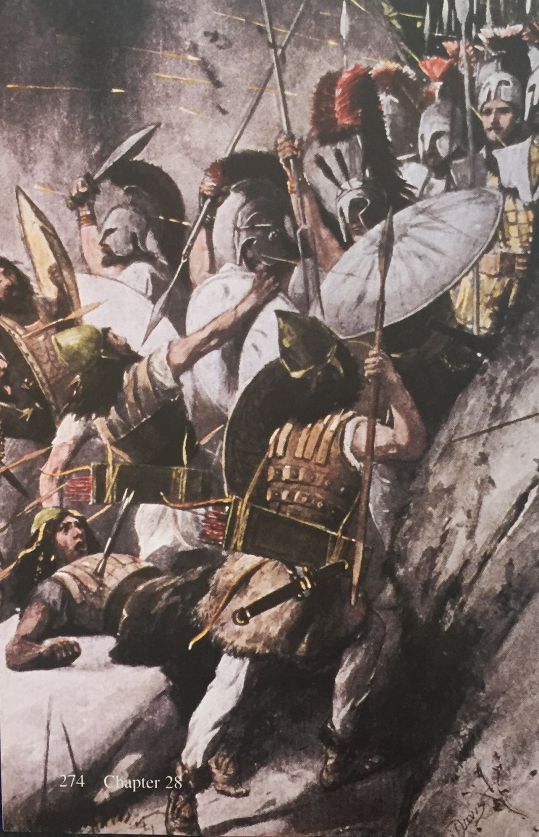
Battle of Thermopylae
Thermopylae

Slide 44
Once you have Observed/Question/Reflect…
Read section 28.4, answering the following questions…
  How were the Spartans able to hold off such a large Persian army?
  How ere the Persians eventually able to defeat the Spartans?
  Why did the Spartans refuse to escape although they knew they would be killed?
Then circle the soldier who represents the stronger force at this time, located on the bottom of the page.

Slide 45
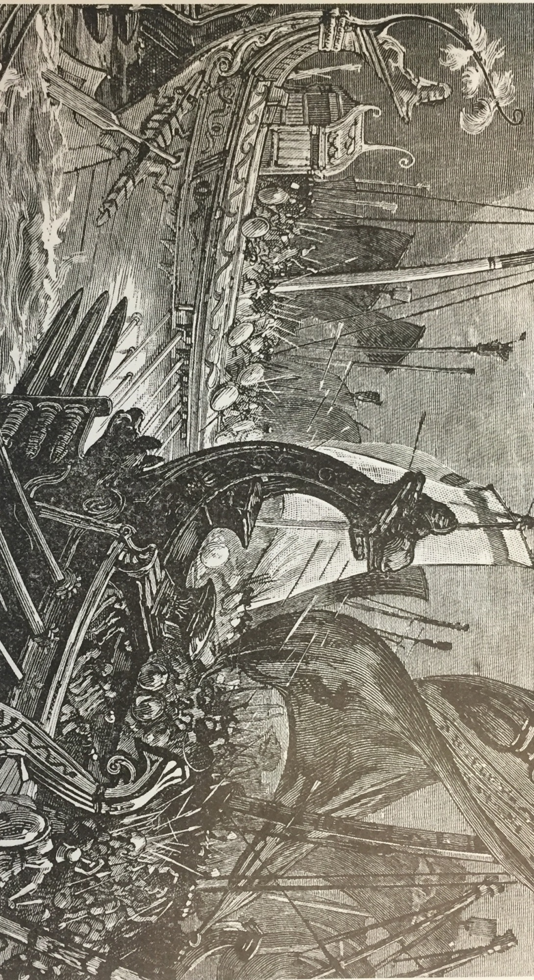
Battle of Salamis
Salamis

Slide 46
Once you have Observed/Question/Reflect…
Read section 28.5, answering the following questions…
  Why did the Athenians sail to nearby islands in panic?
  How ere the Greeks able to defeat the Persian fleet, even though they were outnumbered?
Then circle the soldier who represents the stronger force at this time, located on the bottom of the page.

Slide 47
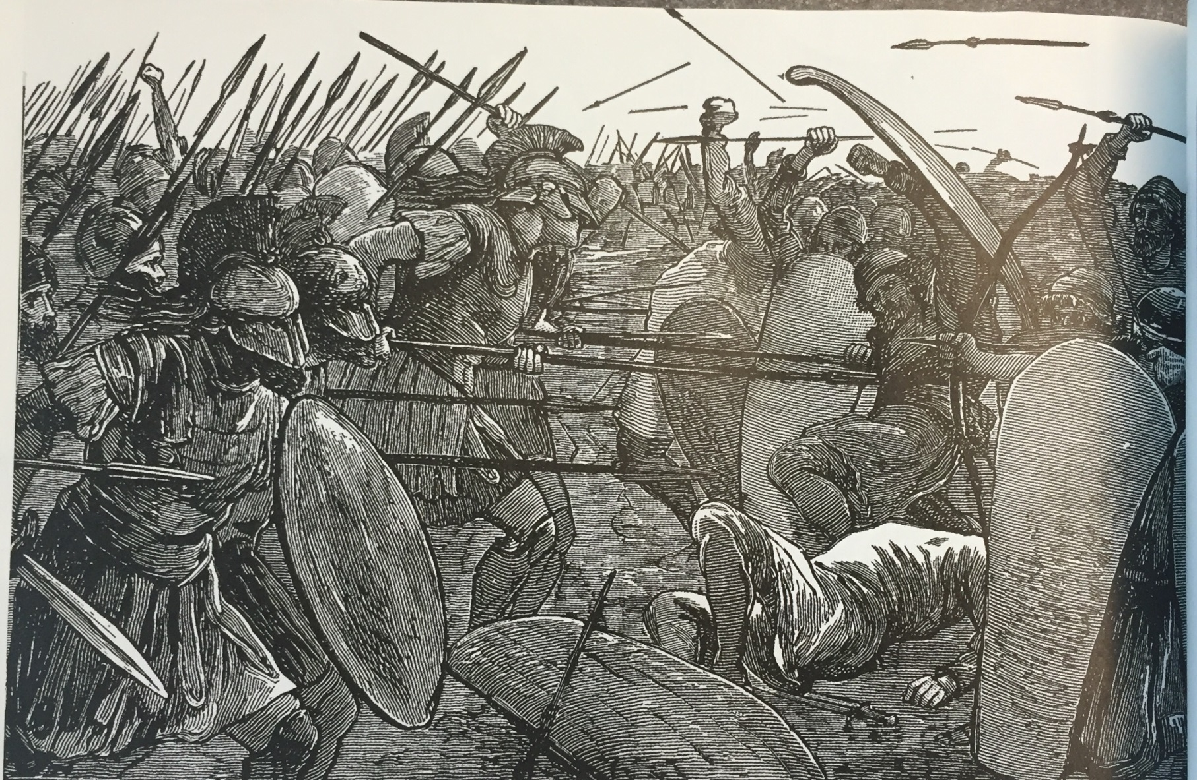
Battle of Plataea
Plataea

Slide 48
Once you have Observed/Question/Reflect…
Read section 28.6 and 28.7, answering the following questions…
  What happened at the Battle of Plataea?
  Why were the Persian wars important?
Then circle the soldier who represents the stronger force at this time, located on the bottom of the page.

Slide 49
Processing
Based on your knowledge of the Persian Wars, write a headline for each picture.

Slide 50
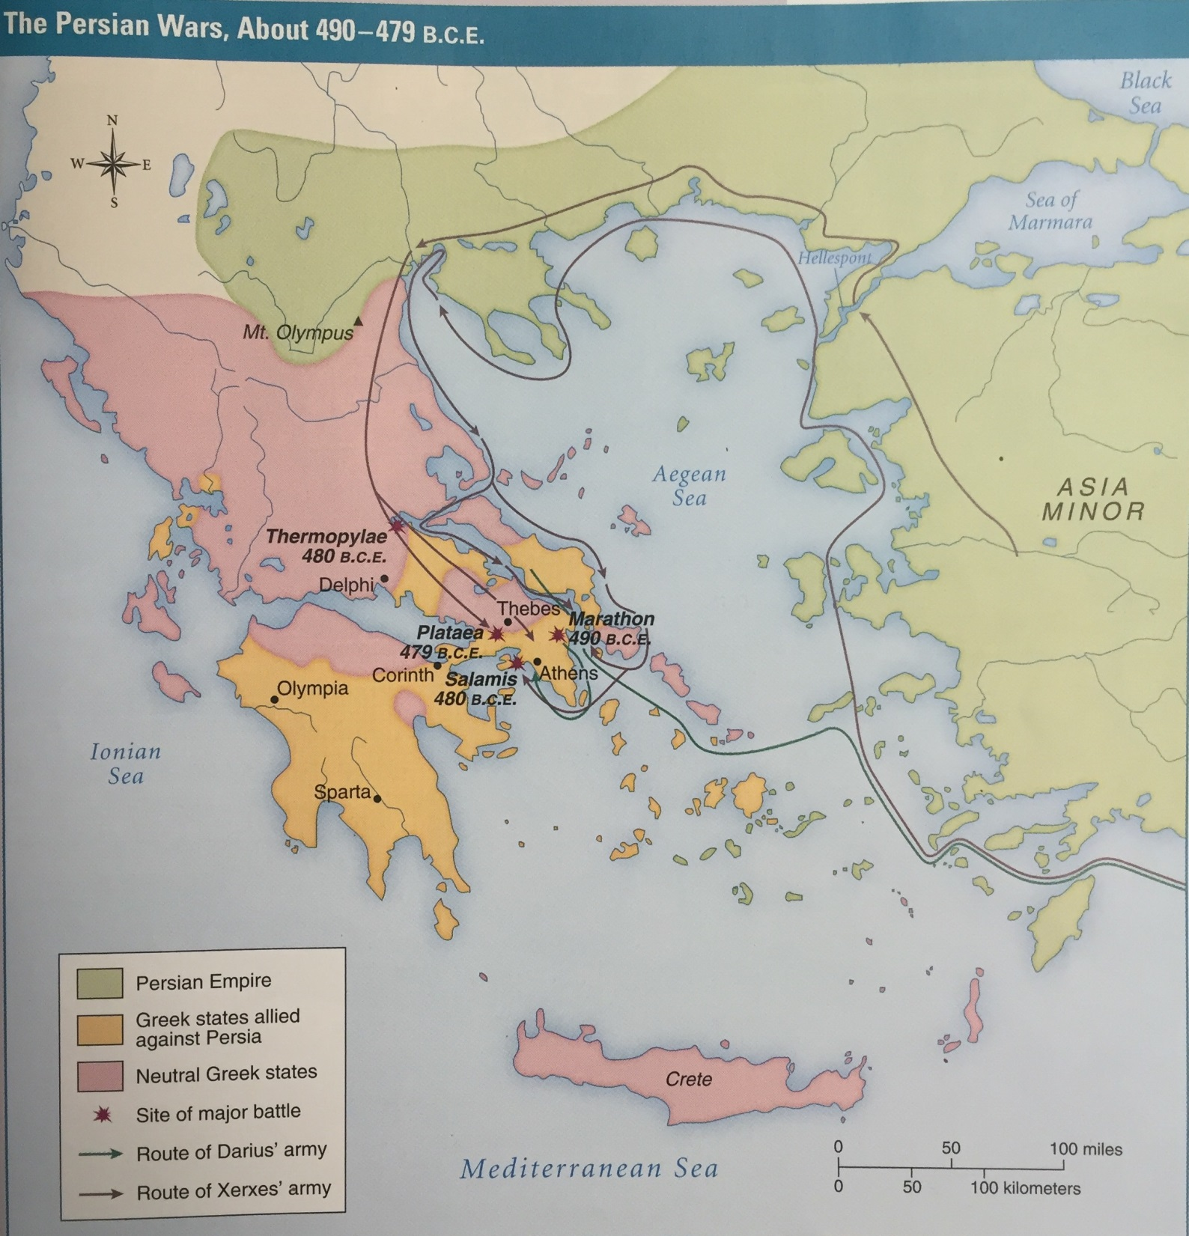
Discussion
Looking at the following map, who is doing majority of the work based on this map?
Why would it be a benefit to fight on your own soil?

Slide 51
Discussion
Despite being severely outnumbered, the Greeks successfully fended off two Persian invasions. The following factors all played a role in the Greek victory:
Military technology (weapons, armor, etc.)
Knowledge and use of natural landscape
Battle tactics (phalanx formation, etc.)
Rank these factors in order of most important to least important to the Greek victory over the Persians. Explain your rankings.

Slide 52
Homework
Construct a paragraph in which you argue for one fact as the most important.

Slide 53
Processing
What factors contributed to the Greeks’ ability to repel the Persian invasions?

