Slide 1
Warm Up
In your warm up section of your spiral, please answer the following questions QUIETLY and INDEPENDENTLY…
  What was the main cause of the Peloponnesian War?
  What was the significant effect of the Peloponnesian War.
  What are the drawbacks of wanting to be the greatest?

Slide 2
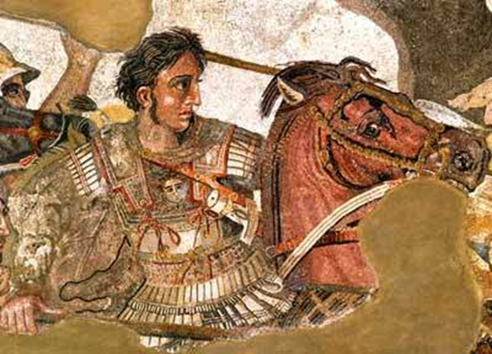
How great was Alexander the Great

Slide 3
Learning Target
I can evaluate sources to determine if Alexander the Great was actually great.
Success Criteria:
  Complete questions related to background questions
  Use TLC and O/Q/R to analyze documents
  Form a historical opinion
  Justify an opinion using data

Slide 4
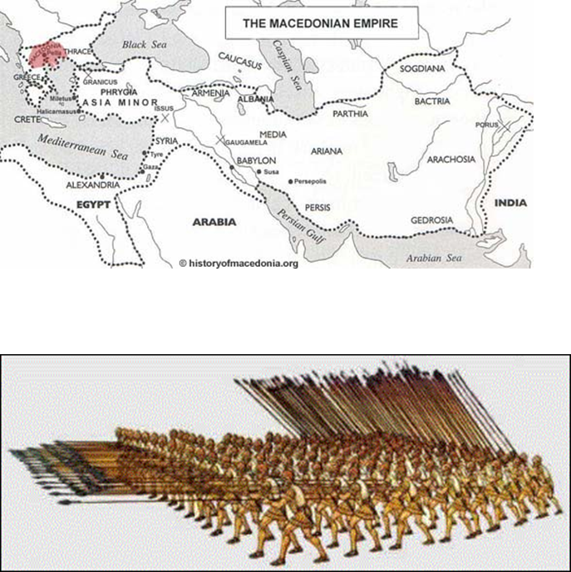
Key Vocabulary
Macedonia
Alexander the Great
Empire
Asia Minor
Phalanx
Garrison Towns
Legend

Slide 5
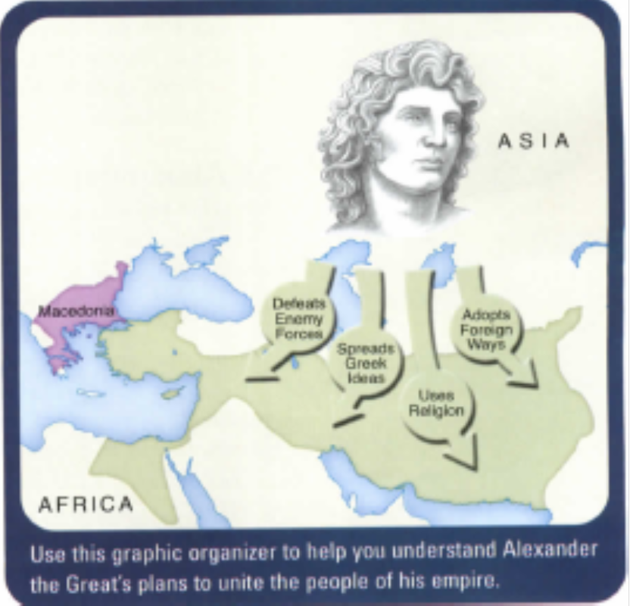
Discussion
What do you see?
What do you think the green area represents?
Who might the figure be?
What phrases are written in the arrows?
What might they mean?
Teacher reads page 289 in the text to class

Slide 6


Slide 7
Task
As you listen to the teacher read page 289 in the textbook, think about the following questions:
  Who was Alexander the Great?
  Where was he from?
  Where is Macedonia?
  What did Alexander do?

Slide 8
Hook
Draw a figure to represent a good leader on the TOP HALF of page 78. Around the figure, list five characteristics that you believe make a good leader. Draw a line from each characteristic to the part of the figure that symbolizes that characteristic.

Slide 9

Example
If a good leader should be persuasive, write the word Persuasive beside the figure.
Then draw a line from the word to the figure’s mouth.
Persuasive

Slide 10
Overview
Alexander III of Macedonia streaked like a meteor across the ancient world. When he was only 20, he inherited an empire that included the kingdom of Macedonia and the city-states of Greece. Almost immediately, Alexander set out to conquer the Persian Empire, which stretched from Egypt to India. He achieved his dream by the time he was 30, but he died just a few years later. In recent times, historians have debated Alexander’s character and accomplishments.

Slide 11
What do you think someone might have to do, or may have done, to earn the identity or “title” of GREAT?
Discussion

Slide 12
From this list, what do you believe a person must have to be considered great? Pick 3
Courage
Intelligence
Creativity
Leadership
Concern for Others
Discipline
Remarkable achievement
Integrity

Slide 13
Over the next couple of days, you will have to decide whether He deserves to be called “Alexander the Great.”

Slide 14
Warm Up
From this list, what do you believe a person must have to be considered great? Pick 3
  Courage
  Intelligence
  Creativity
  Leadership
  Concern for Others
  Discipline
  Remarkable achievement
  Integrity

Slide 15
How great was Alexander the Great

Slide 16
Learning Target
I can evaluate sources to determine if Alexander the Great was actually great.
Success Criteria:
  Speculate about the chances for success of Philip’s and Alexander’s war plans as they trace the development of each.
  Describe and speculate about the chances for success of Alexander’s plan to unit his empire, including his plans to spread Greek culture eastward.

Slide 17
Key Vocabulary
Macedonia
Alexander the Great
Empire
Asia Minor
Phalanx
Garrison Towns
Legend

Slide 18
Background Essay
Review the timeline on the back of the background essay
Review vocabulary
  Legend: a popular story handed down from earlier times that may or may not be
  Macedonia: a small, ancient kingdom just to the North of Greece
  Phalanx: a tight infantry fighting formation with overlapping spears and shields
  Asia Minor: the westernmost peninsula of Asia, modern-day Turkey.
  Garrison Town: A town established for soldiers who are there to protect and secure an area
Read the background essay aloud
Answer the background essay questions on the BOTTOM HALF of page 78 of your spiral.

Slide 19
Background Essay Questions
Would Alexander have heard of Jesus? Explain.
  No Jesus was born more than 300 years ago.
2. How old was Alexander when he launched his invasion of the Persian Empire?
  Alexander was about 20 years old.
3. Why was the death of Darius important to Alexander's conquest of Persia?
  Darius was the Persian King. It was necessary for Alexander to remove the Persian head so that he could rule over the Persian body.
4. After 8 years on the march, what caused Alexander to turn back?
  His army refused to go any further.
5. What is the problem with the king not leaving an heir?
  There might be fighting among those who seek the throne.
6. Why, 300 years after Alexander’s death, was Julius Caesar in tears?
  He was overcome by the thought that Alexander had achieved so much at such a young age
7. Define these terms:
  Legend: a popular story handed down from earlier times that may or may not be
  Macedonia: a small, ancient kingdom just to the North of Greece
  Phalanx: a tight infantry fighting formation with overlapping spears and shields
  Asia Minor: the westernmost peninsula of Asia, modern-day Turkey.
  Garrison Town: A town established for soldiers who are there to protect and secure an area

Slide 20
Understanding the Question
Answer the following questions on an index card
What are we trying to figure out?
  How great was “Alexander the Great”
What term in the question needs to be more clearly defined?
  Great
Rewrite the question in your own words. Question should be written to reflect the traits of greatness decided upon in the hook exercise
  Example: During his life, did Alexander show enough intelligence, concern for others and remarkable achievement to be called great?

Slide 21
Warm UP
Answer the following questions on the half sheet of paper Mrs. Law handed you as you entered the room…
What are we trying to figure out?
  How great was “Alexander the Great”
What term in the question needs to be more clearly defined?
  Great
Rewrite the question in your own words. Question should be written to reflect the traits of greatness decided upon in the hook exercise
  Example: During his life, did Alexander show enough intelligence, concern for others and remarkable achievement to be called great?

Slide 22
How great was Alexander the Great

Slide 23
Learning Target
I can evaluate sources to determine if Alexander the Great was actually great.
Success Criteria:
  Speculate about the chances for success of Philip’s and Alexander’s war plans as they trace the development of each.
  Describe and speculate about the chances for success of Alexander’s plan to unit his empire, including his plans to spread Greek culture eastward.

Slide 24
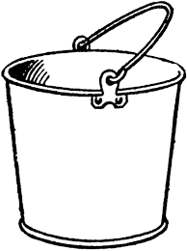

Pre- Bucketing
THEN

Slide 25
Pre- Bucketing
Great
Not Great
THEN
Reason 1
Reason 2
Reason 3

Slide 26
How great was Alexander the Great

Slide 27
Document Analysis
For documents A and E, complete the following right on your copy:
  TLC the document with the following highlighter colors:
    Title is Pink
    Legend is Green
    Caption is Blue
  Observe/Question/Reflect
    Observation above the document
    Questions to the left of the document
    Reflection/Inference to the right of the document
  Answer the document analysis questions on the worksheet

Slide 28
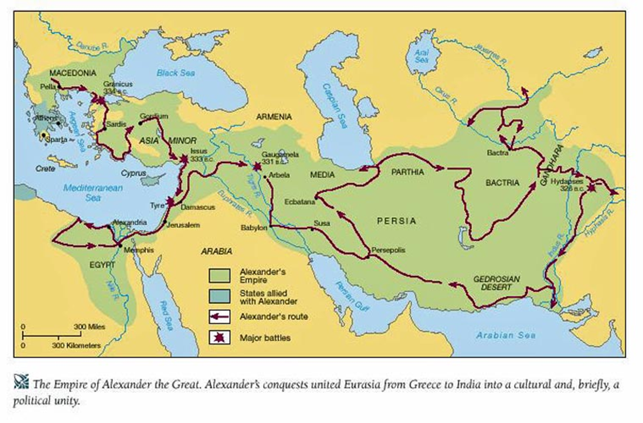
Alexander the Great’s Empire

Slide 29
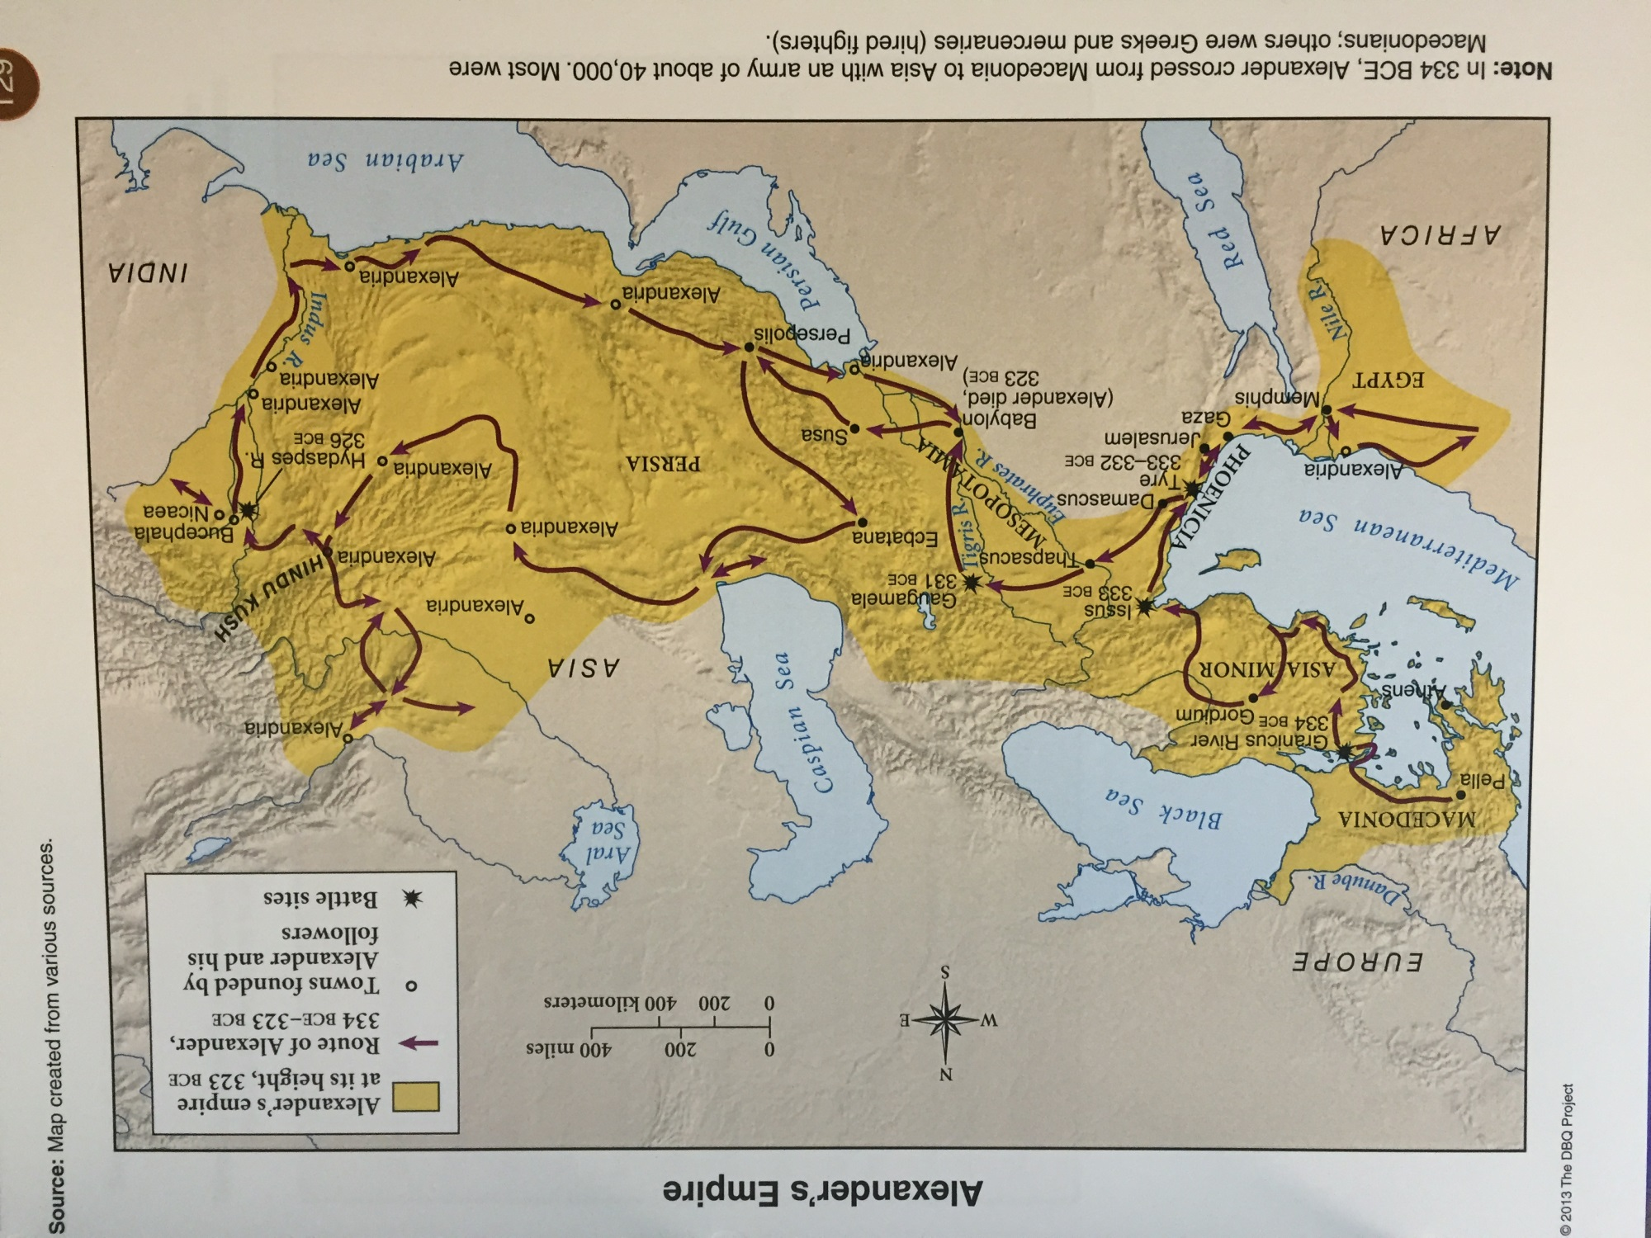

Slide 30
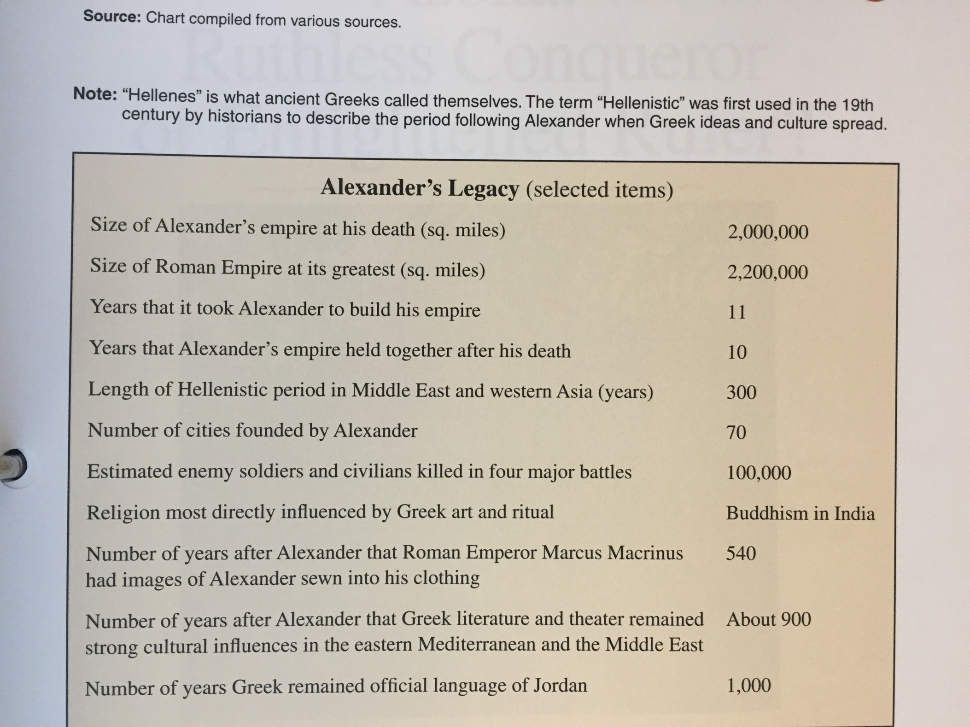

Slide 31
Processing
Claim: What is your position about Alexander?
Evidence: Cut out and highlight/label evidence that proves your claim
Reasoning: Explain how the evidence you selected proves the Alexander was great or not great

Slide 32
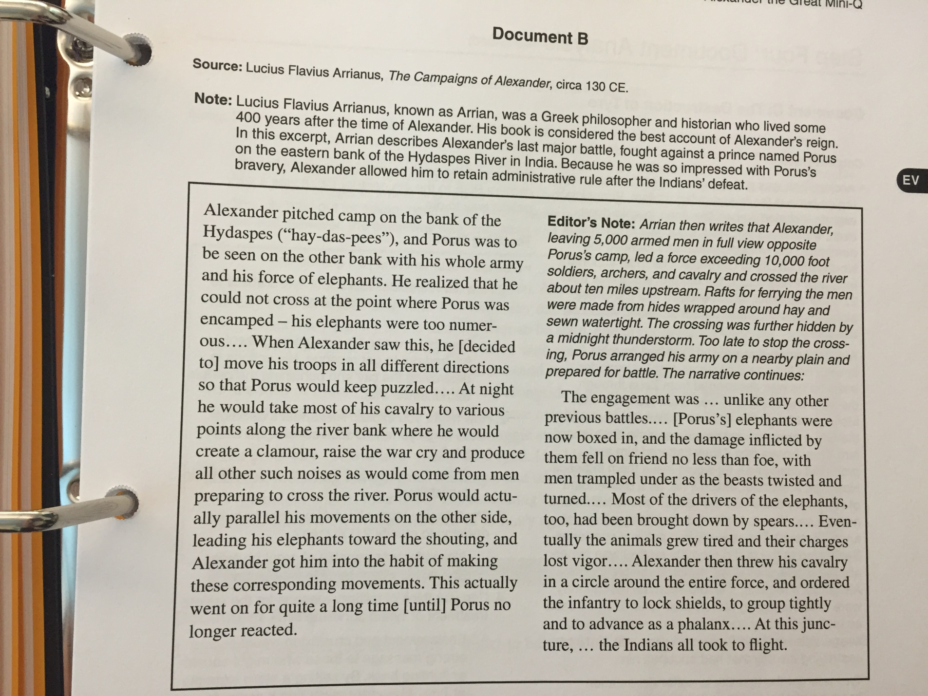

Slide 33
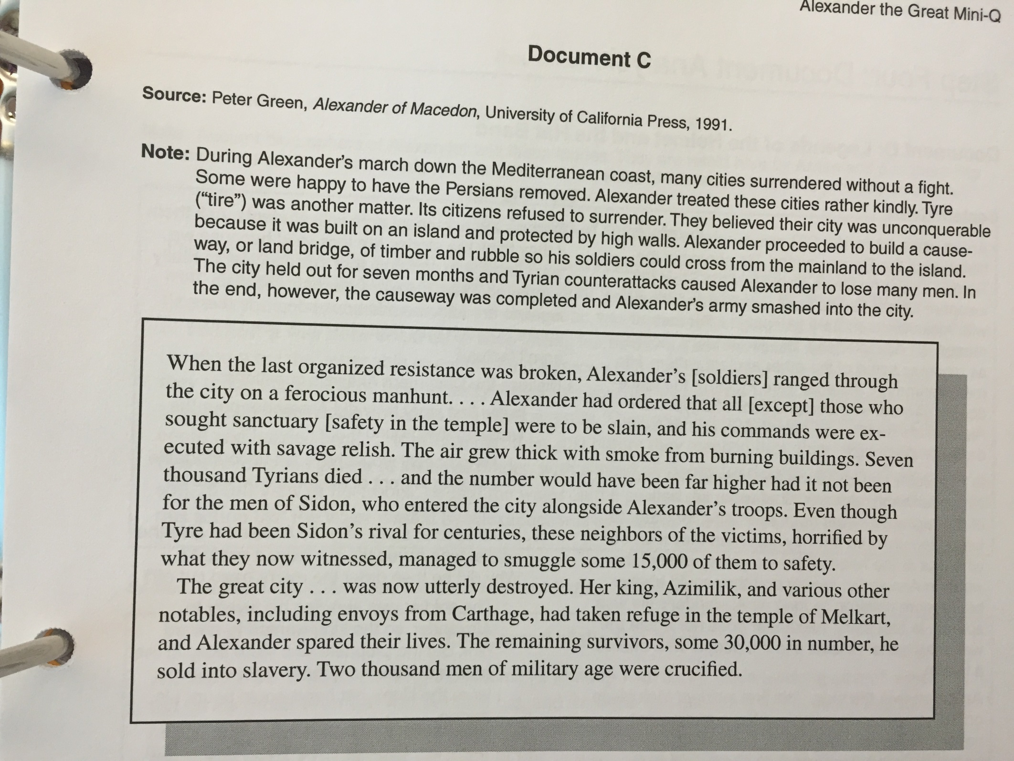

Slide 34
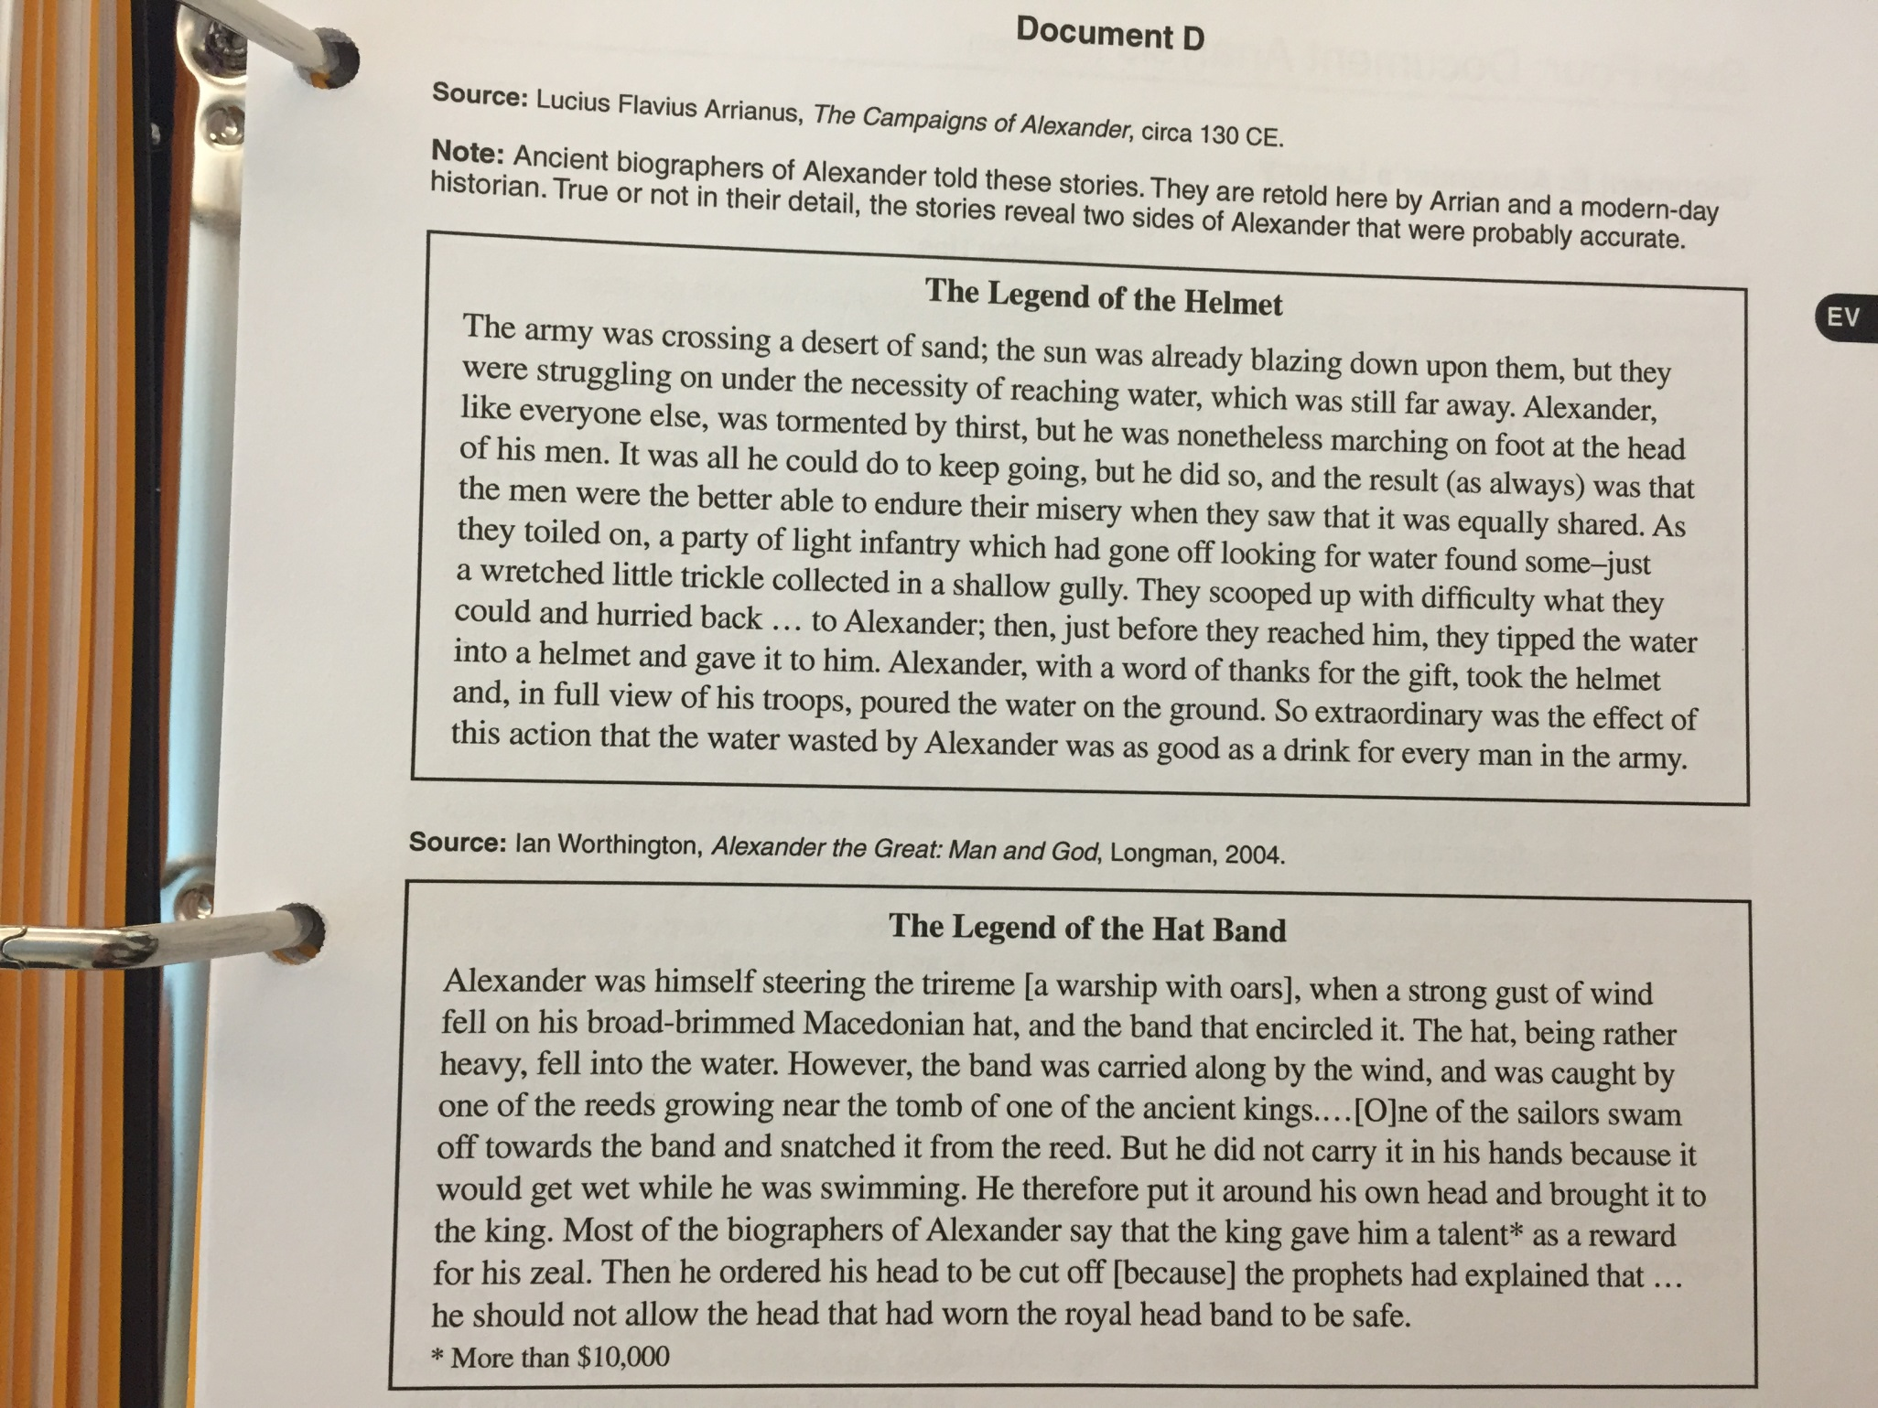

Slide 36
Post Spring Break
Had to divide this lesson into pre/post spring break

Slide 37
As you come in, pick up your Alexander the Great worksheet from the counter

Slide 38
How was everyone’s spring break?!?!
What was your favorite part of Spring Break?
What are you looking forward to for the last 8 weeks of school?

Slide 39
Finishing up How Great was Alexander the Great
Ancient Rome
Citizenship in Athens and Rome: Which Was the Better System?
Medieval Ages
Renaissance
Where are we headed this quarter

Slide 40
Overview
Alexander III of Macedonia streaked like a meteor across the ancient world. When he was only 20, he inherited an empire that included the kingdom of Macedonia and the city-states of Greece. Almost immediately, Alexander set out to conquer the Persian Empire, which stretched from Egypt to India. He achieved his dream by the time he was 30, but he died just a few years later. In recent times, historians have debated Alexander’s character and accomplishments.

Slide 41
Warm-Up
Pick up your Alexander the Great Document from the counter.
Review the Document A, and your answers to the questions for Document A
After analyzing Document A, describe what you learned about Alexander the Great from that document.

Slide 42
Warm UP
After taking out your documents as well as your reflection sheet from yesterday, think about the following…
Does the ability to conquer make someone great?
Why do you think America is considered great?

Slide 43
How great was Alexander the Great

Slide 44
Learning Target
I can evaluate sources to determine if Alexander the Great was actually great.
Success Criteria:
  Complete questions related to background questions
  Use TLC and O/Q/R to analyze documents
  Form a historical opinion
  Justify an opinion using data

Slide 45
Key Vocabulary
Macedonia
Alexander the Great
Empire
Asia Minor
Phalanx
Garrison Towns
Legend

Slide 47
From this list, what do you believe a person must have to be considered great? Pick 3
Courage
Intelligence
Creativity
Leadership
Concern for Others
Discipline
Remarkable achievement
Integrity

Slide 49
Processing
Claim: What is your position about Alexander?
Answer the question “How great was Alexander the Great”
Evidence: Cut out and highlight/label evidence that proves your claim
Reasoning: Explain how the evidence you selected proves the Alexander was great or not great

Slide 50
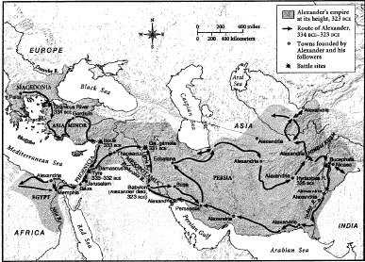
Example
Although Alexander completed many tasks, he should not be considered great. As shown in document A, “ “, there were seven
major battles caused by Alexander. If he was truly great and accepted by the Persians/Greeks, there wouldn’t be any battles.
Also shown in doc E, “ “. If he killed that many civilians, how should he be considered great. He murdered the innocent to get land. In all honesty, that is not being great. It is being a greedy leader

