Slide 1
Warm Up
Finish up your Persian War Document Analysis worksheet. Once you have completed this, think about the following question and be ready to discuss as a class…
How did the results of the Battle of Salamis and Plataea lead to the end of the Persian Wars?
Battle of Salamis: the Greeks, along with the Athenian Navy, will trick the Persians into entering a narrow channel, where the Greeks rammed the Persian ships
Battle of Plataea: Xerxes will leave the rest of his army in Greece with orders to attack Athens in the Spring. The Spartans feared that the Athenians, with their city destroyed, would agree to make peace with Persia. The Spartans will lead the fight against the Persians in a fierce battle outside of the City of Plataea..

Slide 2
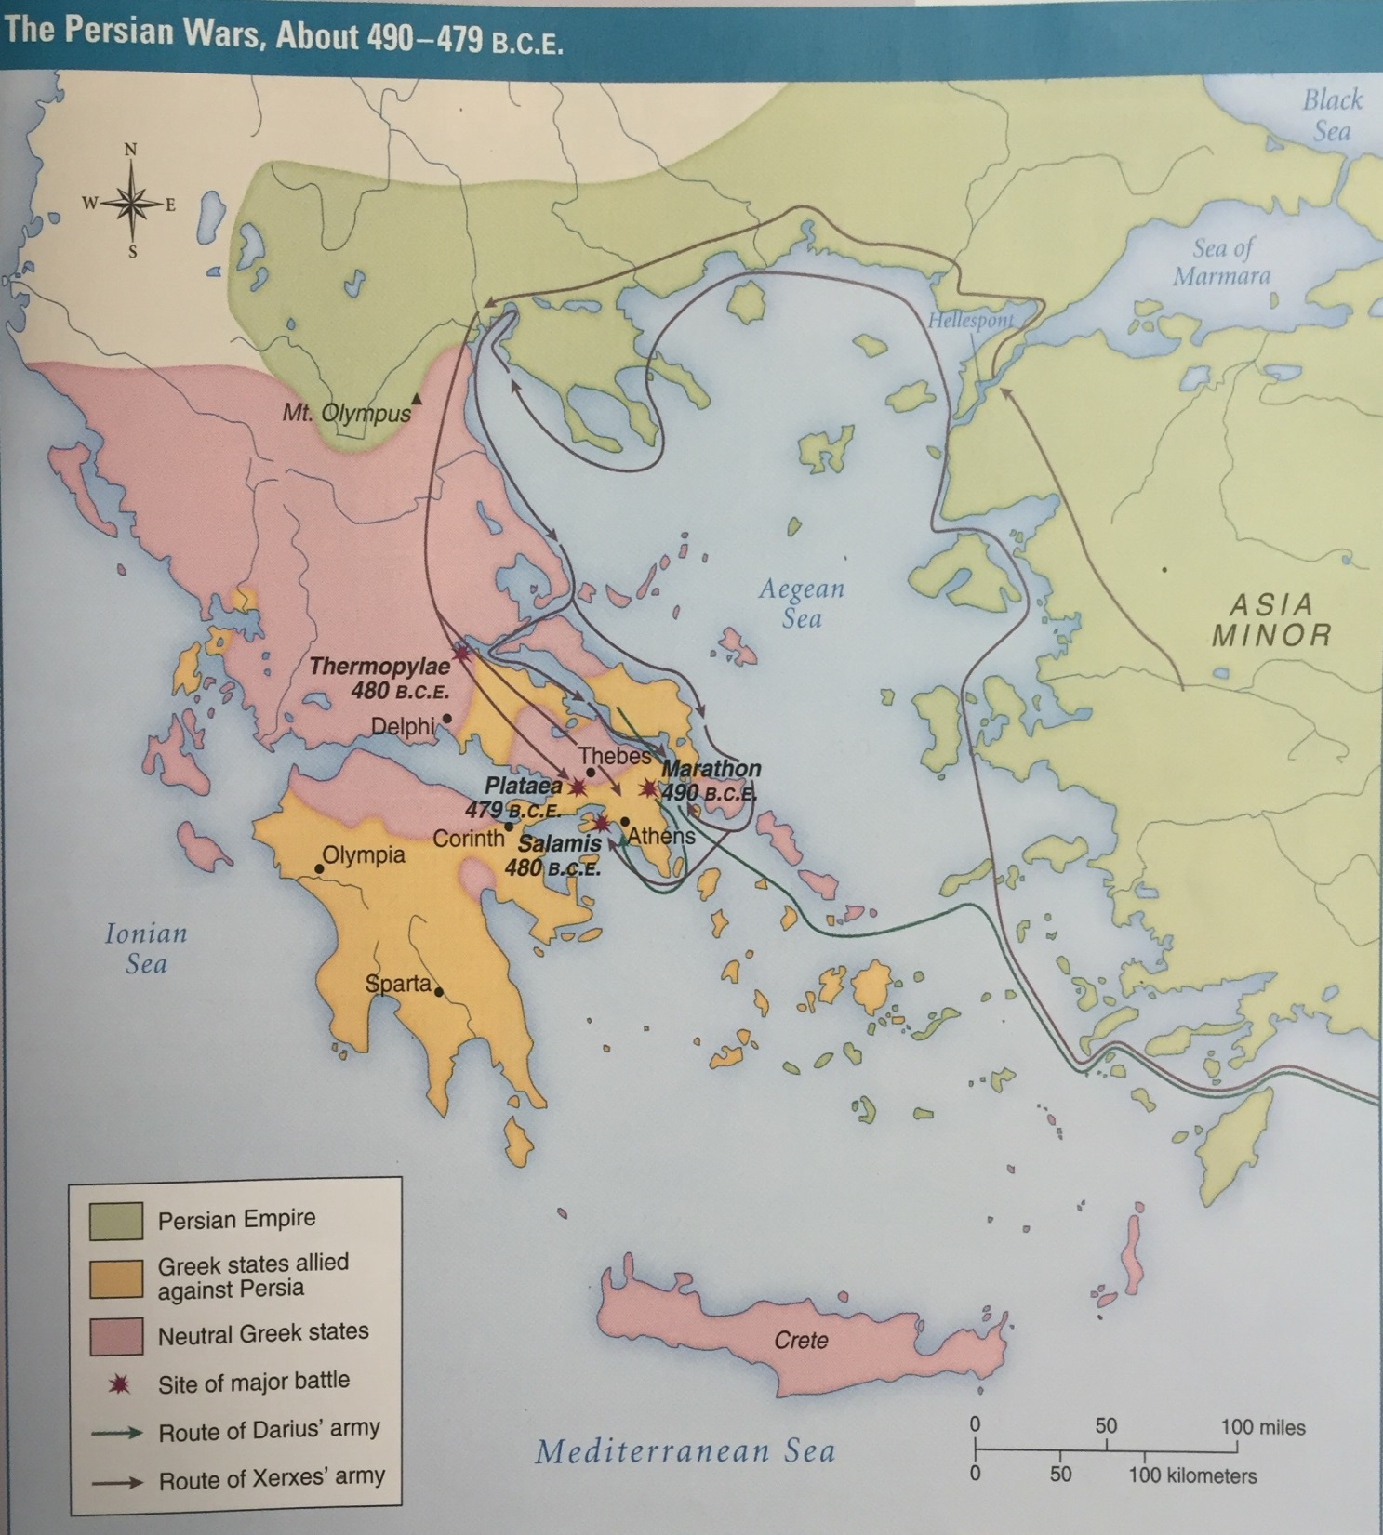
499 B.C.E. to 479 B.C.E

Slide 3
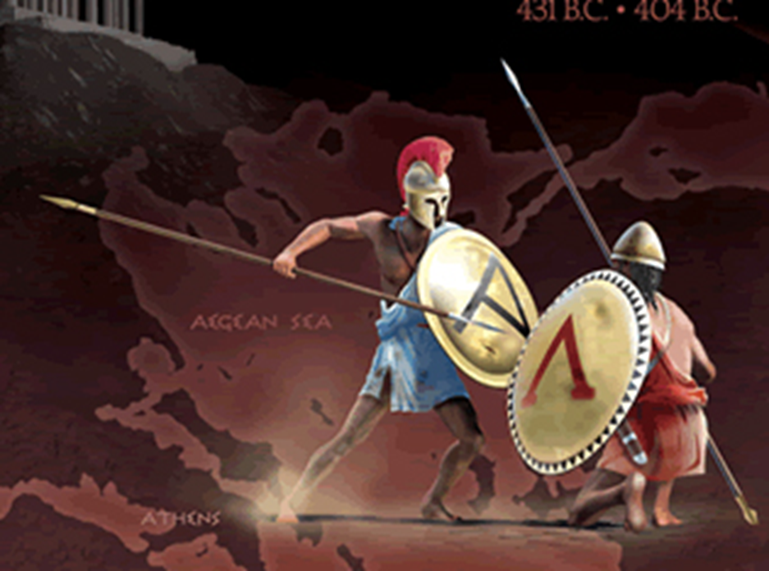
Peloponnesian War
431 B.C.E. to 404 B.C.E

Slide 4
Learning Target
I can discuss the cause and effect of the Peloponnesian War.
Success Criteria:
Explain the roles of Athens and Sparta in the Peloponnesian War.
Explain the result of the Peloponnesian War

Slide 5
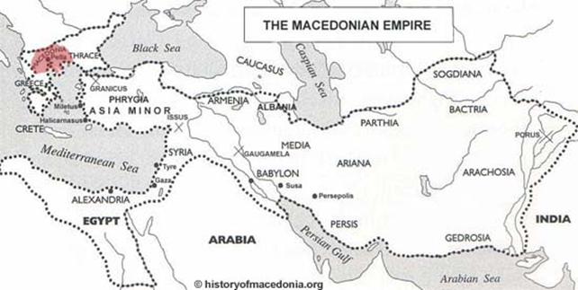
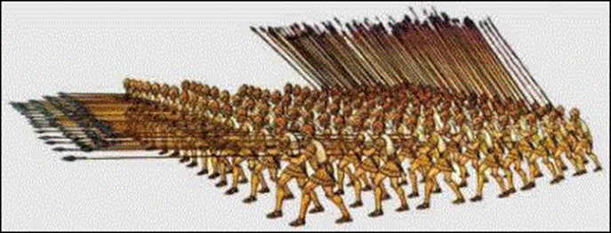
Key Vocabulary
Peloponnesian War
Macedonia
Alexander the Great
Empire
Asia Minor
Phalanx
Garrison Towns

Slide 6
Task
We will be giving you guiding questions to help you figure out what happened during the Peloponnesian wars.
All I ask is for EVERYONE to participate in the class discussion!

Slide 7
Discovery Question 1
Do you think Sparta and Athens had a better relationship after the Persian war?
The victory preserved Greeks independence and kept Persia from conquering all of Europe. However, the Greeks paid a high price for their victory! After the war, both returned to their city states to rebuild with the connection between them lost.

Slide 8
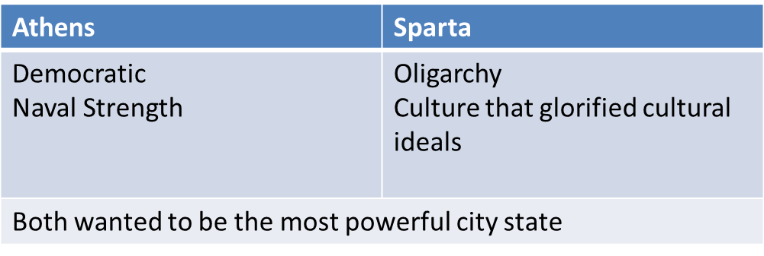
Discovery Question 2
How are Sparta and Athens now different?
How though are they similar?
Both can not be the most powerful
How would this cause war?

Slide 9
Discovery Question 3
If Sparta had the army, which was destroyed during the Persian war, why then would other city states fear Athens?
Power and prestige
Athens just won a major battle against the Persian Empire
Grew from a city state to a navel empire
Athenian settlers began to more into other city states
Allowed for more allies
They create the Delian League run by Pericles, which was create for the mutual protection of city states that belonged to the group.

Slide 10
Athenian Empire was at its height just before the Peloponnesian War

Slide 11
Discovery Question 4
How do you think Sparta should respond to this league that they are not a part of?
They create the Peloponnesian League, which is created of city states that are located on Peloponnesus

Slide 12
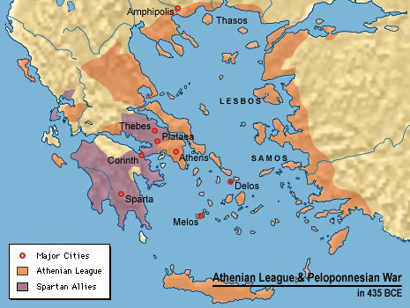
/Delian
/Peloponnesian

Slide 13
Discovery Question 5
What would you do if your opposing enemy created a league similar to yours?
Who do you think is going to react first? Why?
In 431 B.C.E., Sparta declares war on Athens.

Slide 14
Discussion Question 6
What can happen to both sides in a war when fighting goes on for to many years?
Death, destruction to the city, lack of trade and development

Slide 15
Discussion Question 6
What can happen to both sides in a war when fighting goes on for to many years?
Wealth prestige policies and power of Athens caused resentment among other city states
Plague killed many Athenians and help Sparta defeat Athens
Peloponnesian war weakened all Greek city states for 50 years as a result. They weren't focused on their trading, production of goods, developing. When you go to war, everything is put on hold!
Why do the Spartans and Athenians become enemies, dissolving their alliance after the Persian war?

Slide 16
Summary of the War
Wealth, prestige, policies, and the power of Athens caused resentment among other city states
Plague killed many Athenians and help Sparta defeat Athens
Peloponnesian war weakened all Greek city states. They weren't focused on their trading, production of goods, developing. When you go to war, everything is put on hold!

Slide 17
Sparta replaced Athens as the dominant power in Greece after the Peloponnesian War

Slide 18
Discovery Question 7
How does a war effect a country mentally?
fear, unsafe, tired, sick, weak
How does a war effect a country physically?
Damaged to the infrastructure of the city, farmland damage, death of citizens
How does a war effect a country geographically?
Boundaries change whether you win or lose

Slide 19
Let's Recap the Peloponnesian War
Video 1
Video 2

Slide 20
Let's Recap the Peloponnesian War https://www.youtube.com/watch?v=_BKD2fVDij0 or https://www.youtube.com/watch?v=_KBf01cxxXY up until 2:50
http://study.com/academy/lesson/the-peloponnesian-war-history-cause-result.html
http://study.com/academy/lesson/history-of-the-peloponnesian-war-and-the-fall-of-athens.html

Slide 21
Processing
What was the main cause of the Peloponnesian War?
What was the significant effect of the Peloponnesian War.
What are the drawbacks of wanting to be the greatest?

