Slide 1
Warm UP: Think about the following two questions and be ready to discuss
What do you already know about Rome?
What do you want to know about Rome?

Slide 2
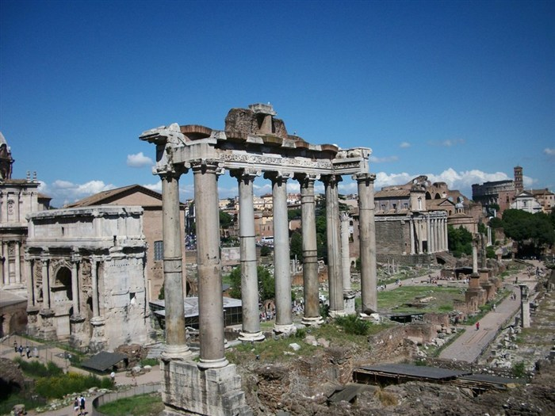
Ancient Rome Vocab
Day 1

Slide 3
Objective
I can use new vocabulary when discussing Rome.
Success Criteria:
Define the terms
Use appropriately in a sentence
Create a visual representation
Generate synonyms/antonyms
Participate in vocabulary activities about Rome.

Slide 4
Key Vocabulary
Etruscans
Romulus & Remus
Republic
Patricians
Plebeians
Roman Senate
Consuls
Tribunes
Assembly
Veto
Punic Wars
Ides of March
Pax Romana

Slide 5
Circle
Don’t Know- Heard It- Know It

Slide 6
Vocabulary Pre-Groupings
Without knowing the definitions, with your group members, organize the 15 words into categories and be ready to explain why you organized them the way you did.

Slide 7
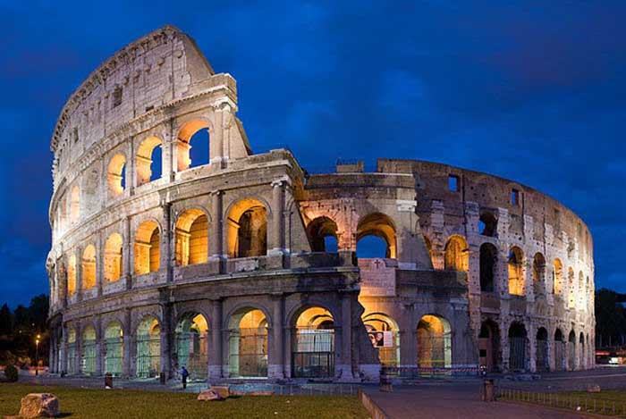
Vocabulary Chant
Repeat after me the following terms:
Etruscans
Romulus & Remus
Republic
Patricians
Plebeians
Roman Senate
Consuls
Tribunes
Assembly
Veto
Punic Wars
Ides of March
Pax Romana

Slide 8
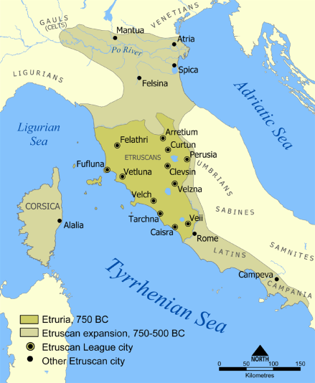
Definitions- 8 words or less
Etruscans: modern name given to a civilization of ancient Italy in the area
corresponding roughly to Tuscany, western Umbria, and northern Lazio
Romulus & Remus: twin brothers and main characters of Rome's foundation myth
Republic: the governance of the city of Rome
Patricians: a group of ruling class families in ancient Rome
Plebeians: the general body of free Roman citizens who were not patricians
Roman Senate: political institution in ancient Rome set up of wiser members of the society or ruling class
Consuls: the highest elected office of the Roman Republic and an appointive office under the Empire
Tribunes: the title of various elected officials in Ancient Rome
Assembly: political institutions in the ancient Roman Republic in which the people had the final say
Veto: Latin for "I forbid" – is the power to unilaterally stop an official action
Punic Wars: a series of three wars fought between Rome and Carthage from 264 BC to 146 BC
Ides of March: the date of the assassination of Julius Caesar in 44 BC
Pax Romana: the long period of relative peace and minimal expansion by the Roman military

Slide 9
Definitions:
As a group, you need to complete the following:
Read the definitions for all 17 words on the back
Put the definition on your paper in 8 words or less.
Draw a picture representing each word in the box with the definition
With the 2 assigned vocab words, draw and color a picture for each word, on the computer paper, that represents the word.

Slide 10
Sentences:
As a group, you need to complete the following:
Read the definitions that you and your group came up with for each word.
Create an image that will help you remember each word.
Write a sentence that contains each word.

Slide 11
Definitions
Etruscans: modern name given to a civilization of ancient Italy in the area corresponding roughly to Tuscany, western Umbria, and northern Lazio
Romulus & Remus: twin brothers and main characters of Rome's foundation myth
Republic: the governance of the city of Rome
Patricians: a group of ruling class families in ancient Rome
Plebeians: the general body of free Roman citizens who were not patricians
Roman Senate: political institution in ancient Rome set up of wiser members of the society or ruling class
Consuls: the highest elected office of the Roman Republic and an appointive office under the Empire
Tribunes: the title of various elected officials in Ancient Rome
Assembly: political institutions in the ancient Roman Republic in which the people had the final say
Veto: Latin for "I forbid" – is the power to unilaterally stop an official action
Punic Wars: a series of three wars fought between Rome and Carthage from 264 BC to 146 BC
Ides of March: the date of the assassination of Julius Caesar in 44 BC
Pax Romana: the long period of relative peace and minimal expansion by the Roman military

Slide 12
Warm Up:
Take out a blank sheet of paper as well as pick up your vocab sheet from yesterday located on the counter…
Sort the following words into one three piles.
Green: a pile for words you could teach to another student offering several examples
Yellow: a pile for words you know the meaning to
Red: a pile for words you really are not sure what the meaning is
Etruscans
Romulus & Remus
Republic
Patricians
Plebeians
Dictator
Roman Senate
Consuls
Tribunes
Assembly
Veto
Punic Wars
Gladiator
Ides of March
Pax Romana
Constantine
Huns

Slide 13
Warm Up:
Take out your vocabulary worksheet from yesterday. You will have 5 minutes to complete your sentences QUIETLY and INDIVIDUALLY

Slide 14
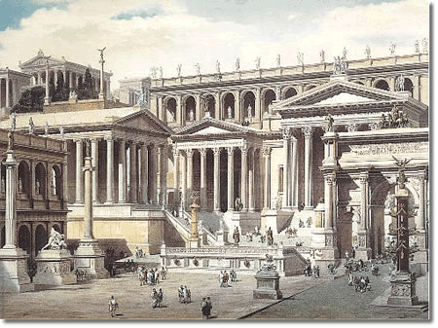
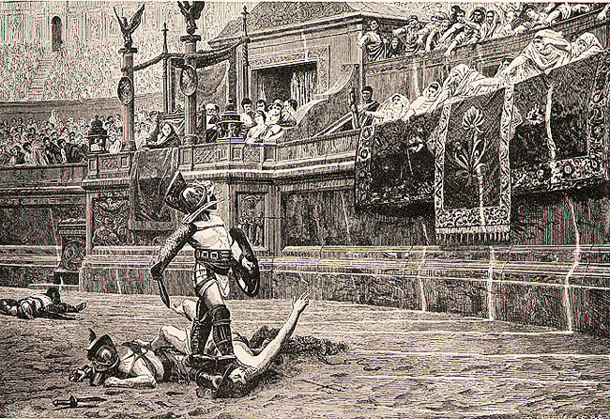
Ancient Rome Vocab
Day 2

Slide 15
Objective
I can use new vocabulary when discussing Rome.
Success Criteria:
Define the terms
Use appropriately in a sentence
Create a visual representation
Generate synonyms/antonyms
Participate in vocabulary activities about Rome.

Slide 16
Key Vocabulary
Etruscans
Romulus & Remus
Republic
Patricians
Plebeians
Dictator
Roman Senate
Consuls
Tribunes
Assembly
Veto
Punic Wars
Ides of March
Pax Romana

Slide 17
Sentences:
As a group, you need to complete the following:
Read the definitions that you and your group came up with for each word.
Create an image that will help you remember each word.
Write a sentence that contains each word.

Slide 18
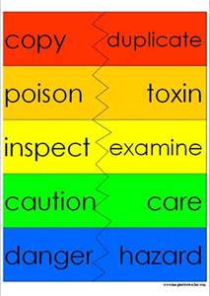
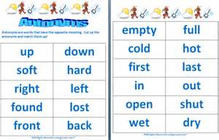
Synonyms/ Antonyms
With your elbow partner, come up with a synonym as well as an antonym for each word.
Synonym: a word or phrase that means exactly or nearly the same as another word
Antonym: a word or phrase that means the opposite in meaning to another word

Slide 19
Common Mistakes with Synonyms/Antonyms
Multiple words/phrases
Picking words you don’t know the definition of
They are related but don’t mean the same thing
Incorrect synonyms/antonyms
Picking at random off of the internet
Just trying to finish the work as quickly as possible, not trying to actually learn the words
REMEMBER…
When you see this word in the unit, these are suppose to help you out so that you don’t stumble!

Slide 20
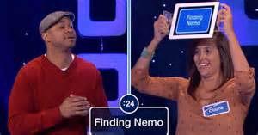
Heads Up for Vocabulary
Here's how you play:
One player holds the flash card up to his/her forehead.
The other players give clues to help the player guess the word (without using the word).
Once the word is guessed correctly, the player will pick up another flashcard so that a new word will pop up on the screen.
A player can "pass" on a word by saying “pass” and placing that card in a separate pile.
Play continues for 60 seconds.
Player counts the words solved correctly.
The notecards are then shuffled and passed to another player and the game continues until everyone has a turn.
For an extra challenge:
Try the 'the act it out - no words' rule.

Slide 21
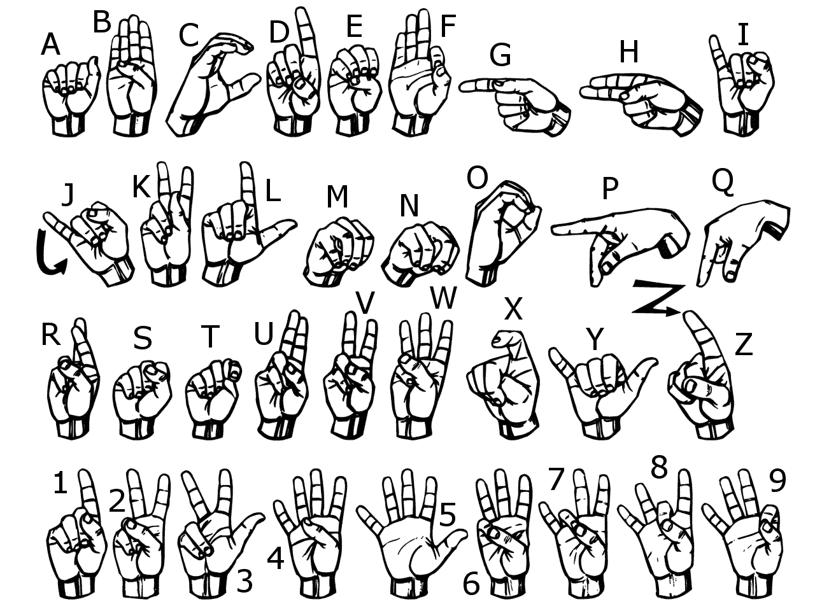
Sign Language
Use American Sign Language to spell each vocabulary word.
Now use your finger and write each word in the air

Slide 22
Sort Your Words
Sort your words by making three piles. A pile for words you could teach to another student offering several examples, a pile for words you know the meaning to, a pile for words you really are not sure what the meaning is.

Slide 23
Words in Words
Divide your paper into 9 boxes, (3 boxes in 3 rows). Choose 9 of your vocabulary words; write one vocabulary word at the top of each box. Now try to find as many words as you can within each chosen vocabulary word.

Slide 24
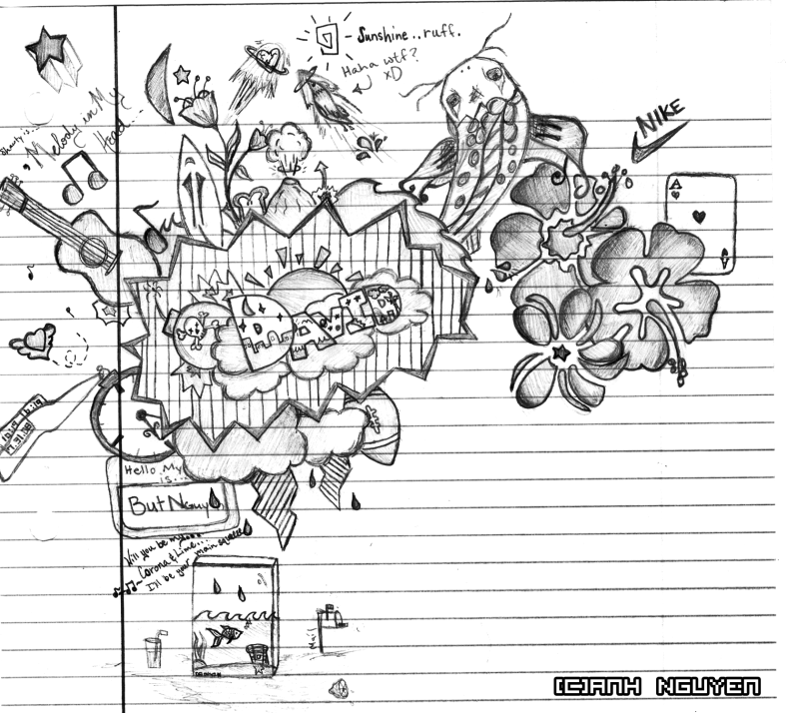
Doodle Words
Choose 5 words you totally understand and write your words using doodles to show what each word means on a separate sheet of paper. When you are done, put a star by your favorite doodle word.

Slide 25
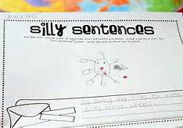
Silly Sentences
Create several silly sentences by using as many vocabulary words as you can. Can you turn a silly sentence into a tongue twister ?

Slide 26
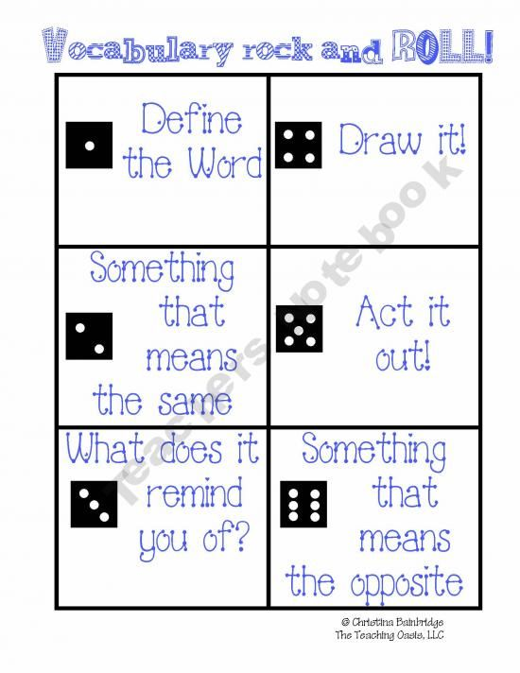
Vocabulary Rock and Roll

Slide 27
Vocabulary Quiz
Directions:
Choose 5 vocabulary words from your list and free write a paragraph using all 5 words.
Be sure to underline all 5 words.
Your paragraph will be graded on you using all of the words correctly and creatively.
If your paragraph does not make sense, then you will not receive a passing grade.

