Slide 1
Warm Up
What physical features are needed to create a civilization?
What characteristics/features are needed to make civilizations successful?

Slide 2
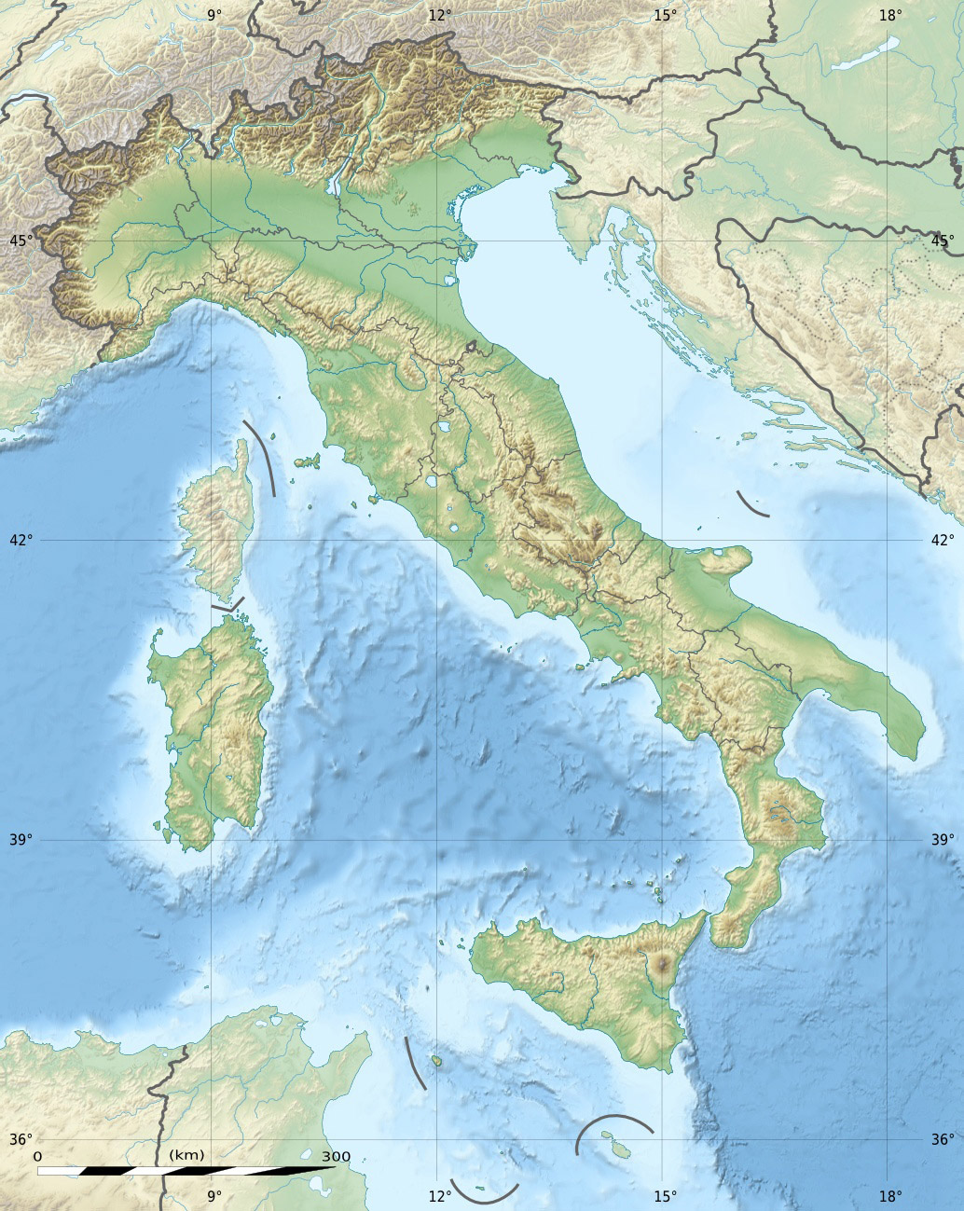
Warm Up
Take out your vocab sheet and be ready to turn it in. Then on a separate sheet of paper, answer the following question…
Where is the ideal location for a settlement?
Provide 3 reasons as to why you selected this location

Slide 3
Rome
Geography Challenge

Slide 4
Learning Target
I can describe the geography of Rome and the impact it had on settlement.
Success Criteria:
Label a map
Analyze map of Rome
Answer questions using maps
Make historical hypotheses based upon maps

Slide 5
Key Vocabulary
Etruscans
Romulus & Remus
Republic
Patricians
Plebeians
Roman Senate
Consuls
Tribunes
Assembly
Veto
Punic Wars
Ides of March
Pax Romana

Slide 6
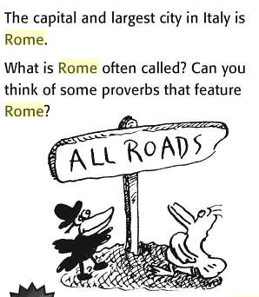
Think about…

Slide 7
Think about…

Slide 8
What do we always do first when working with documents…

Slide 9
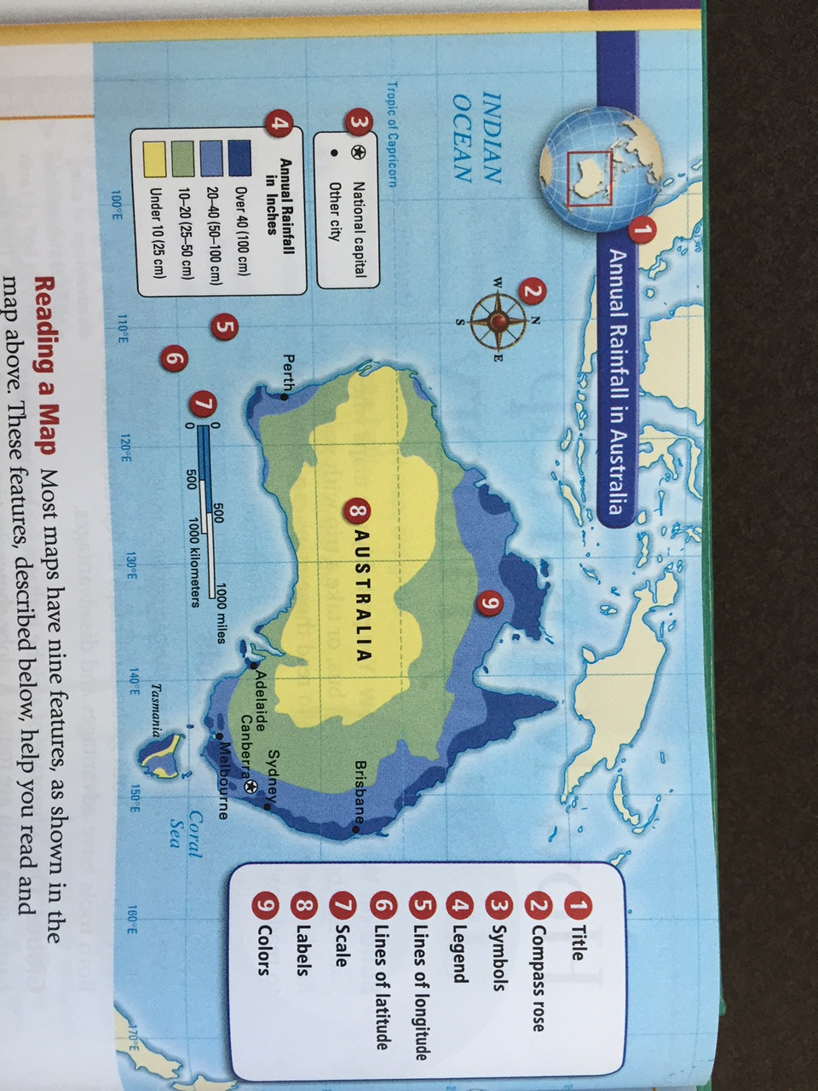
TLC of Reading a Graphs/ Charts/ Maps/ Data
TLC a map:
Title
Legend
Compass Rose
Symbols
Scale
Labels
Colors
Caption
In addition, look for:
Lines of Longitude
Lines of Latitude

Slide 10
What is the difference between a continent and a country?

Slide 11
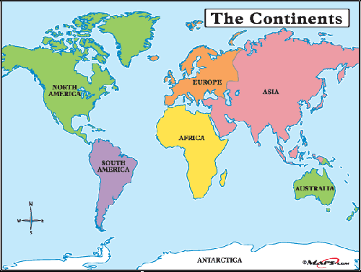

Slide 12
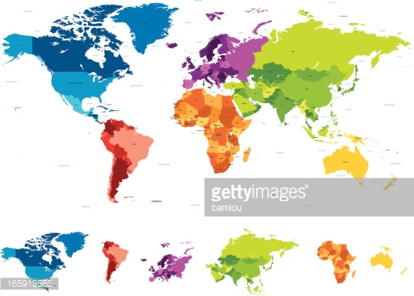

Slide 13
Task
Starting on page 307 to 315 of the textbook, independently complete the Geography Challenge Worksheet. You will be answering questions and labeling a map of Rome.
Use a separate sheet of paper to give you more room to answer the questions if needed.
All questions must be answer in complete sentences.
You have the period to work on this and it will be due at the end of the period TODAY!

Slide 14
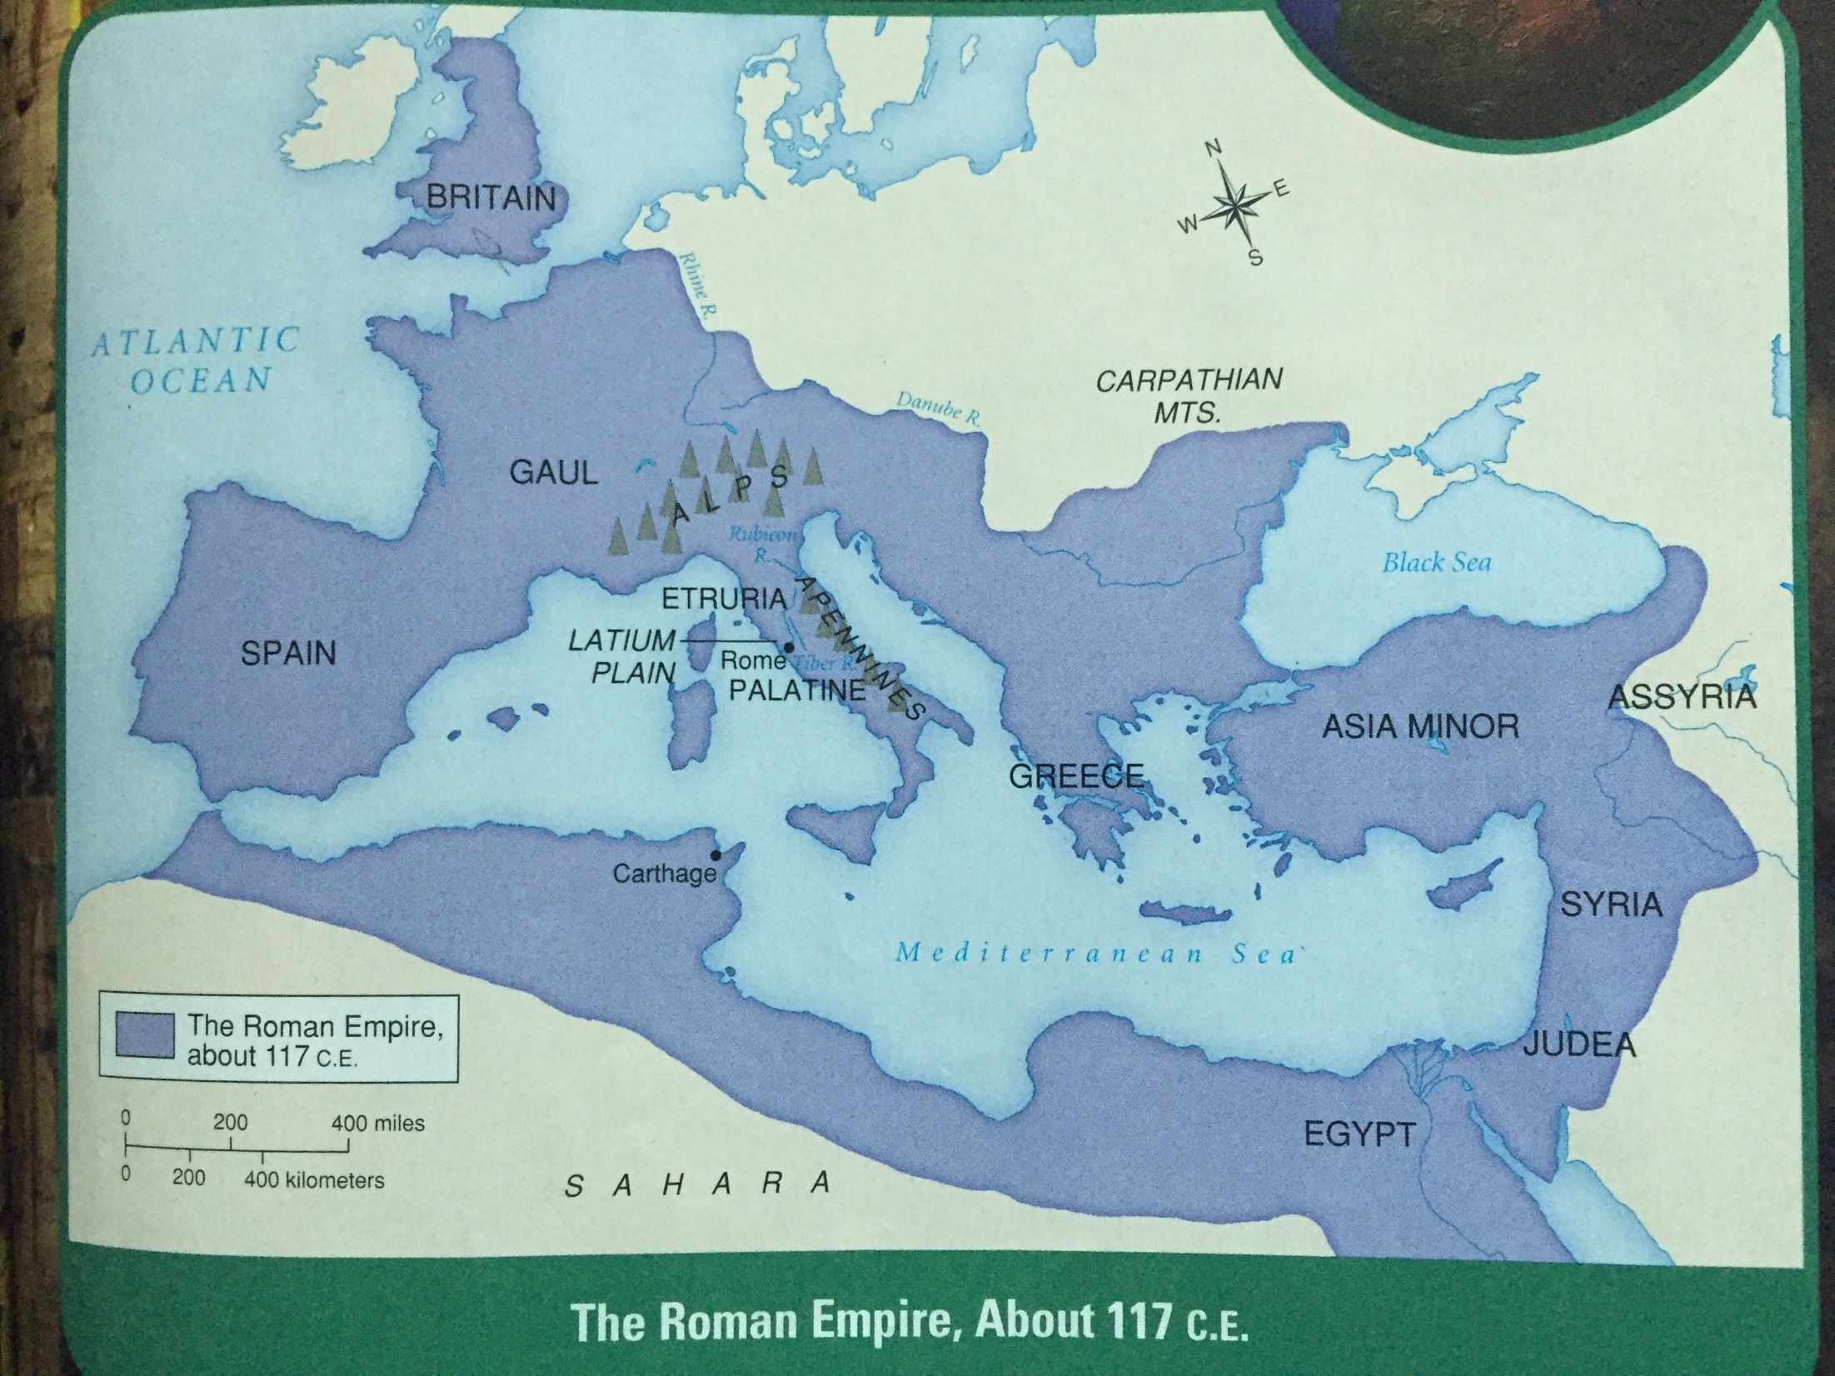

Slide 16
Ancient Rome Question 1
What is the name of the plain on which Rome is located?
Label the city of Rome on your map. Then color the plain on which Rome is located yellow, and label it.

Slide 17
Ancient Rome Question 2
What mountain ranges are located to the east and north of Rome?
Draw in these mountain ranges on your map, color them brown, and label them

Slide 18
Ancient Rome Question 3
What three large bodies of water did the Roman Empire touch?
Label these bodies of water on your map, and color them blue.

Slide 19
Ancient Rome Question 4
What river connects Rome to the Mediterranean Sea?
Draw in this river on your map, color it blue, and label it.

Slide 20
Ancient Rome Question 5
What three features formed the central northern boundary of the Roman Empire?
Label these features on your map.

Slide 21
Ancient Rome Question 6
One of the major territories controlled by Rome in 117 C.E. was Britain. What were four others?
Label these territories on your map.

Slide 22
Ancient Rome Question 7
What desert formed the southern boundary of the Roman Empire?
Label this desert on your map, and color it red.

Slide 23
Ancient Rome Question 8
Approximately how many miles did the Roman Empire stretch from east to west?
Label the scale of miles on your map.

Slide 24
Let’s Check Our Work
The plain on which Rome is located is called the Latium Plain.
The mountain ranges to the east and north of Rome are the Apennines and the Alps.
The 3 bodies of water that the Roman Empire touched are the Mediterranean Sea, Black Sea, and Atlantic Ocean.
The Tiber River connects Rome to the Mediterranean Sea.
The features that formed the central northern boundary of the Roman Empire are the Danube River, the Carpathian Mountains, and the Rhine River.
Besides Britain, the major territories controlled by Rome in the year 117 CE were Spain, Gaul, Greece, Asia Minor, Syria, Judea, and Egypt.
The Sahara Desert formed the southern boundary of the Roman Empire.
The Roman Empire stretched 2,500 miles from east to west.

Slide 25
Critical Thinking
Consider the location of the Italian peninsula. How might this location have helped the Romans control trade in the Mediterranean region?
How might the mountain ranges of Italy have affected people’s lives in ancient times?
Were the Romans more likely to choose a land or a water route to Spain? Ex- plain your answer.
At one time, the Romans avoided sea travel because the Italian peninsula had few good harbors. What evidence can you find to support the argument that this geographical drawback was eventually overcome?
Notes:
http://www.cantonlocal.org/Downloads/Chapter%2032%20Notes%20Geography%20of%20Rome.pdf

Slide 26
Once you are done…
Draw a map of Italy on a separate sheet of paper
Include:
How they travelled and traded
Show the geographic environment/features
Location of major colonies
Location of major bodies of water
Surroundings

Slide 27
Processing
What geographic features contributed to the growth of Rome's vast empire?

