Slide 1
As you come in…
Please pick up your spirals and sit in any seat until Mrs. Law gives you further directions

Slide 2
Warm Up
When coming in or completing any activity, why is it so important to follow the directions?

Slide 3
Spiral Set Up
Label page 80 Unit 7 Ancient Rome
On page 80 underneath the title, write
Essential Question: I will be able to evaluate the lessons learned from Ancient Rome to help with the foundation of America
Highlight the outer edge orange
Label page 79 Ancient Rome Vocabulary

Slide 4
Spiral Set Up continued…
Label page 81 Founding of Rome, the Legend of Romulus and Remus
Label page 82 Rise of the Roman Republic
Label page 83 Roman Republic
Label page 84 The Punic Wars
Label page 85 Roman Slavery and Gladiators
Label page 86 Architecture and Engineering
Label page 87 Daily Life
Label page 88 Fall of Rome

Slide 5
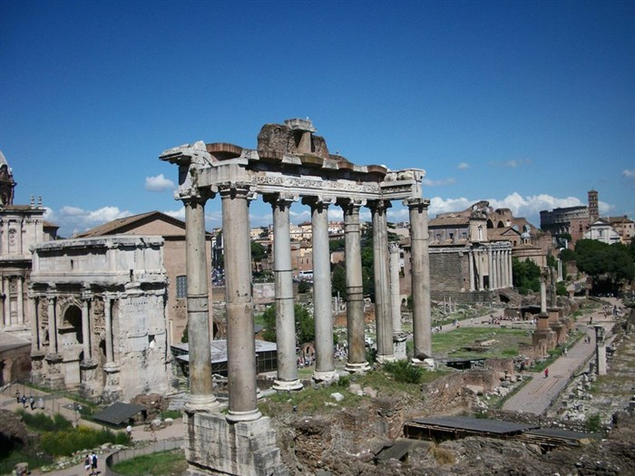
Ancient Rome Stations

Slide 6
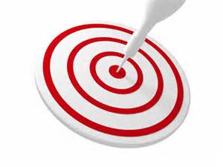
Objective
I will be able to analyze social and cultural developments of Rome
Success Criteria:
Set up spiral for Roman Stations
Assigned Silver or Purple
Read directions for assigned group
Begin station activity to learn about the civilization of Rome.

Slide 7
Key Vocabulary
Etruscans
Romulus & Remus
Republic
Patricians
Plebeians
Roman Senate
Consuls
Tribunes
Assembly
Veto
Punic Wars
Ides of March
Pax Romana

Slide 8
Group Roles and Responsibilities
At each station you will be selecting a role/responsibility.
The purpose of the roles/responsibilities is to ensure that all groups can be successful
Prior to begin a new station, each group member must select a role/responsibility.
Leave these roles/responsibilities on your desk as you work through the station.
You will select a new role/responsibility at each new station.

Slide 9
DIRECTOR Makes sure all group members read the directions completely Check to make sure all group members understand the directions Start the task from the beginning Sounds like: “Let read the directions together as a group.” “Does everyone know what we are going to do first?” | ORGANIZER Hand out all materials at the appropriate time. Make sure the folder is appropriately organized and put back together at the end of the time period. Keep track of paper clips and binder clips, let teacher know if something is damaged. Sounds like: “Please hand me your papers so I can get them organized.” “Does everyone have copy of the reading?”
PROGRESS MONITOR Make sure students are on task and keeping up with the other group members. Remind students that are off task to stay focused Sounds like: “Now that we have finished Question #1, let move on to question #2.” “Hey Joe, can I help you with something, you seem a little distracted.” | REPORTER Serves as group spokesperson to the teacher Summarizes the group’s questions, activities and/or conclusions. Sounds like: “We are confused about step 2 in the directions, could you please explain?”
TIME KEEPER Encourages the group to stay on task Announces when time is halfway through and when time is nearly up. Sound like: "We only have five minutes left. Let’s see if we can wrap up by then.”

Slide 10
Direction
Step 1: Turn to the appropriate page in your spiral
Step 2: Draw a ROLE/RESPONSIBILITY from the cup.
Write that role/responsibility on the upper right hand corner of page you are completing the task on.
Step 3: Remember to read the directions first.
Some stations will require you work with your group members while other stations will have you work individually
Paying attention to your colored task: SILVER or PURPLE
Step 4: Begin working on your station, remember you only have 30 minutes.

Slide 11
Station Work
Station 1: Founding of Rome, the Legend of Romulus and Remus
Station 2: Rise of the Roman Republic
Station 3: Roman Republic
Station 4: The Punic Wars
Station 5: Roman Slavery and Gladiators
Station 6: Architecture and Engineering
Station 7: Daily Life
Station 8: Fall of Rome

Slide 12
As you come in…
Please pick up your spirals and sit in the desks you were sitting in on Monday QUIETLY. Please wait for further instructions from Mrs. Law
If you were not here yesterday, please pick up your spiral and wait in the back of the room for further directions.

Slide 13
Warm Up
What do you think are important contributions of the Romans?

Slide 14
Warm Up
Please pick up your spirals and sit in the desks you were sitting in on Tuesday.
If you were not here yesterday, please stand in the back of the room.
Answer the following warm up questions QUIETLY!
When working in groups, why is it important for everyone to have a specific job/responsibility?

Slide 15
Task…
You have 8 minutes to finish up the current station that you are sitting at.
If your group thinks they are done, please go through and check your work as you will need your work for your assessment.

Slide 16
Warm Up
Please pick up your spirals and sit in the desks you were sitting in on Thursday.
You have 8 minutes to finish up the current station that you are sitting at QUIETLY!
If your group thinks they are done, please go through and check your work as you will need your work for your assessment.

Slide 17
Warm Up
Please pick up your spirals and sit in the desks you were sitting in on Friday.
You have 5 minutes to answer the following warm up question QUIETLY!
What is the difference between the Republic of Rome and the Roman Empire?

Slide 18
Republic of Rome vs Roman Empire
During the Republic: (flourished for about 500 years before an era of Roman Empire started)
Rome expanded
Rome was ruled by the Senate
Equites (the army) had relatively not much influence
the army was (mainly) conscripted
During the Empire: (started by Julius Caesar)
Rome's borders were stable
Rome was ruled by the emperor
Senate lost most if its influence
Equites (the army) replaced most senatorial positions
the army was (mainly) volunteer

Slide 19
Warm Up
Please pick up your spirals and sit in the desks you were sitting in on Monday.
You have 5 minutes to answer the following warm up question QUIETLY!
Why would the Romans create an Emperor?
How did the creation of an Emperor lead to the destruction of the republic?

Slide 20
Warm Up
Please pick up your spirals and sit in the desks you were sitting in on Tuesday.
You have 5 minutes to answer the following warm up question QUIETLY!
Why do you think Rome fell? Why do you think that historians have different theories about why Rome fell?

Slide 21
Warm Up
Please pick up your spirals and sit in the desks you were sitting in on Monday.
You have 5 minutes to answer the following warm up question QUIETLY!
What is the most interesting thing that you have learned about Ancient Rome? How does it relate to the United States?

Slide 22
Ancient Rome Stations

Slide 23
Learning Target
I will be able to analyze the social and cultural development of Rome.
Success Criteria:
Participate in each station
Analyze primary and secondary sources
Make inferences

Slide 24
Key Vocabulary
Etruscans
Romulus & Remus
Republic
Patricians
Plebeians
Roman Senate
Consuls
Tribunes
Assembly
Veto
Punic Wars
Ides of March
Pax Romana

Slide 25
Group Roles and Responsibilities
At each station you will be selecting a role/responsibility.
The purpose of the roles/responsibilities is to ensure that all groups can be successful
Prior to begin a new station, each group member must select a role/responsibility.
Leave these roles/responsibilities on your desk as you work through the station.
You will select a new role/responsibility at each new station.

Slide 26
DIRECTOR Makes sure all group members read the directions completely Check to make sure all group members understand the directions Start the task from the beginning Sounds like: “Let read the directions together as a group.” “Does everyone know what we are going to do first?” | ORGANIZER Hand out all materials at the appropriate time. Make sure the folder is appropriately organized and put back together at the end of the time period. Keep track of paper clips and binder clips, let teacher know if something is damaged. Sounds like: “Please hand me your papers so I can get them organized.” “Does everyone have copy of the reading?”
PROGRESS MONITOR Make sure students are on task and keeping up with the other group members. Remind students that are off task to stay focused Sounds like: “Now that we have finished Question #1, let move on to question #2.” “Hey Joe, can I help you with something, you seem a little distracted.” | REPORTER Serves as group spokesperson to the teacher Summarizes the group’s questions, activities and/or conclusions. Sounds like: “We are confused about step 2 in the directions, could you please explain?”
TIME KEEPER Encourages the group to stay on task Announces when time is halfway through and when time is nearly up. Sound like: "We only have five minutes left. Let’s see if we can wrap up by then.”

Slide 27
Direction
Step 1: Turn to the appropriate page in your spiral
Step 2: Draw a ROLE/RESPONSIBILITY from the cup.
Write that role/responsibility on the upper right hand corner of page you are completing the task on.
Step 3: Remember to read the directions first.
Some stations will require you work with your group members while other stations will have you work individually
Paying attention to your colored task: SILVER or PURPLE
Step 4: Begin working on your station, remember you only have 30 minutes.

Slide 28
Station Work
Station 1: Founding of Rome, the Legend of Romulus and Remus
Station 2: Rise of the Roman Republic
Station 3: Roman Republic
Station 4: The Punic Wars
Station 5: Roman Slavery and Gladiators
Station 6: Architecture and Engineering
Station 7: Daily Life
Station 8: Fall of Rome

Slide 29
Show us what you’ve learned
Create a graphic organizer that illustrates the story of Rome, from its Rise to its Fall.
You are free to create this in any form that you would like.
Each of the 8 stations must be represented
Must take up the entire paper
Must have color

Slide 30
Processing
Based upon what you have learned about Rome, select one of the proverbs below and explain its meaning.
All Roads lead to Rome
Rome wasn’t built in a Day
Carpe Diem
Must be written in paragraph form, minimum 8-12 sentences

