Slide 1
Warm Up:
Take out a blank sheet of paper as well as assignment from yesterday…
Sort the following words into one three piles.
Green: a pile for words you could teach to another student offering several examples
Yellow: a pile for words you know the meaning to
Red: a pile for words you really are not sure what the meaning is
Chivalry
Guilds
Crusades
Feudalism
Manor
Middle Ages
Lord
Serfs
Vassal
Charlemagne
Clergy
Bubonic Plague
Migrate

Slide 2
Warm UP: Take out your vocabulary sheet and on page 91 of your spiral, answer the following two questions
What do you already know about the Middle Ages?
What do you want to know about the Middle Ages?

Slide 3
Before we begin…
Today is national HIGH FIVE DAY!!!
Get up, walk around the room giving high fives to your classmates!
With each high five that you give, tell them something that you are looking forward to this weekend!

Slide 4
Spiral Set Up
Label page 90 Middle Ages
Highlight around Green
Label page 89 Vocab
Chivalry
Guilds
Crusades
Feudalism
Manor
Middle Ages
Lord
Serfs
Vassal
Charlemagne
Clergy
Bubonic Plague
Migrate
Label 91 Pretest
Label 92 Post-test

Slide 5
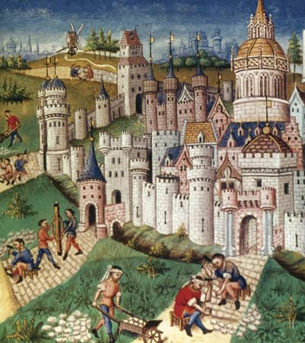
Middle Ages Vocab
Day 1

Slide 6
Objective
I can use new vocabulary when discussing the Middle Ages.
Success Criteria:
Define the terms
Use appropriately in a sentence
Create a visual representation
Generate synonyms/antonyms
Participate in vocabulary activities about Middle Ages.

Slide 7
Key Vocabulary
Chivalry
Guilds
Crusades
Feudalism
Manor
Middle Ages
Lord
Serfs
Vassal
Charlemagne
Clergy
Bubonic Plague
Migrate

Slide 8
Circle
Don’t Know- Heard It- Know It

Slide 9
Vocabulary Pre-Groupings
Without knowing the definitions, with your group members, organize the 15 words into categories and be ready to explain why you organized them the way you did.

Slide 10
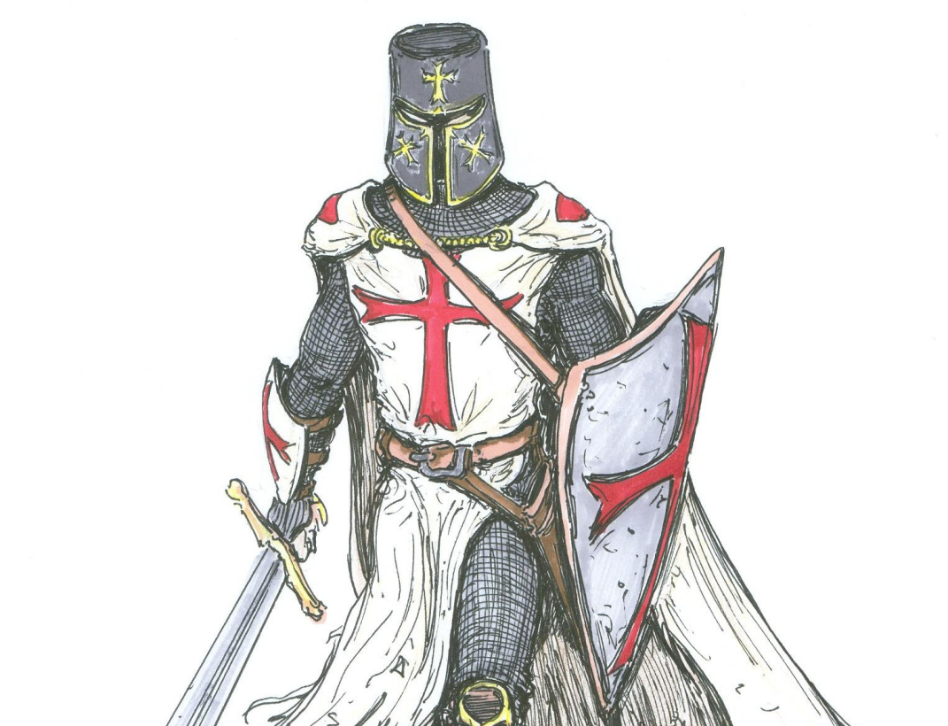
Vocabulary Chant
Repeat after me the following terms:
Chivalry
Guilds
Crusades
Feudalism
Manor
Middle Ages
Lord
Serfs
Vassal
Charlemagne
Clergy
Bubonic Plague
Migrate

Slide 11
Definitions- 8 words or less
Middle Ages: period between the fall of the Roman Empire in Europe, in which lords fave land to vassals in exchange for serve and loyalty
Charlemagne: king of the Franks who conquered much of Europe and spread Christianity
Crusades: series of military expeditions from Christian Europe to Palestine between the 1100s and 1200s
Feudalism: political and social system of the Middle Ages in Europe, in which lords gave land to vassals in exchange for service and loyalty
Manor: noble’s house and the villages on his land where the peasants lived
Lord: powerful landowners
Vassals: people in feudal society who received land and protection from lords in return for loyalty
Chivalry: code of conduct of knights, focusing on bravery, honor, and respect toward women and the weak
Serfs: people who lived and worked on the manor of a lord or vassal
Clergy: people with priestly authority in a religion
Guilds: associations of people sharing a trade or craft, intended to control the quality and quantity of their production and to protect their interests
Bubonic Plague: disease that struck western Eurasia in the mid-1300’s, in an outbreak known as the black Death
Migrate: to relocate to a new region

Slide 12
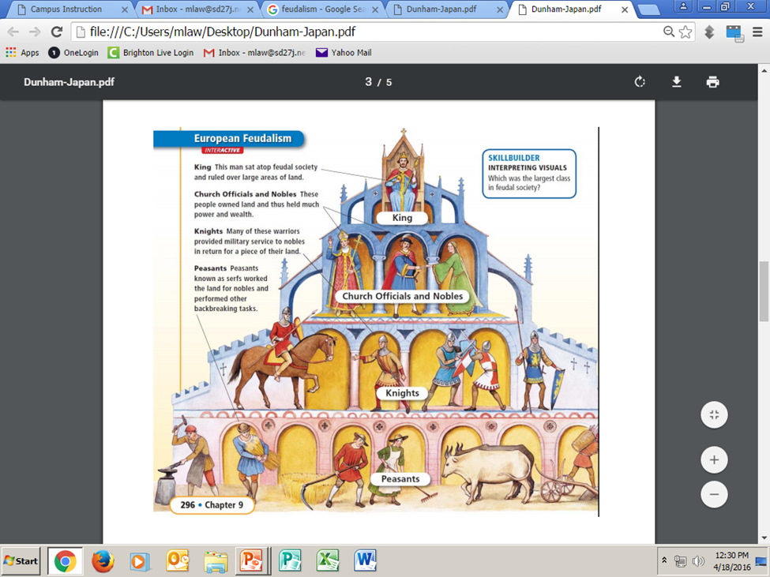
Examples

Slide 13
Definitions:
As a group, you need to complete the following:
Read the definitions for all 17 words on the back
Put the definition on your paper in 8 words or less.
Draw a picture representing each word in the box with the definition
With the 2 assigned vocab words, draw and color a picture for each word, on the computer paper, that represents the word.

Slide 14
Sentences:
As a group, you need to complete the following:
Read the definitions that you and your group came up with for each word.
Create an image that will help you remember each word.
Write a sentence that contains each word.

Slide 15
Warm UP: Think about the following two questions and be ready to discuss
What do you already know about the Middle Ages?
What do you want to know about the Middle Ages?

Slide 16
Warm Up:
Take out your vocabulary worksheet from yesterday. You will have 5 minutes to complete your sentences using the SYNONYMS you came up with yesterday QUIETLY and INDIVIDUALLY

Slide 17
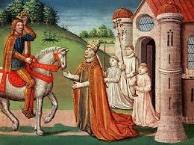
Middle Ages Vocab
Day 2

Slide 18
Objective
I can use new vocabulary when discussing Middle Ages.
Success Criteria:
Define the terms
Use appropriately in a sentence
Create a visual representation
Generate synonyms/antonyms
Participate in vocabulary activities about Middle Ages.

Slide 19
Key Vocabulary
Chivalry
Guilds
Crusades
Feudalism
Manor
Middle Ages
Lord
Serfs
Vassal
Charlemagne
Clergy
Bubonic Plague
Migrate

Slide 20
Sentences:
As a group, you need to complete the following:
Read the definitions that you and your group came up with for each word.
Create an image that will help you remember each word.
Write a sentence that contains each word.

Slide 21
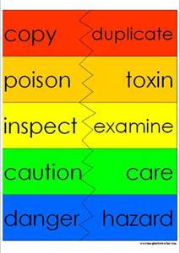
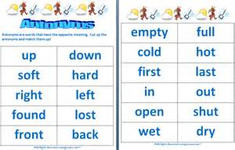
Synonyms/ Antonyms
With your elbow partner, come up with a synonym as well as an antonym for each word.
Synonym: a word or phrase that means exactly or nearly the same as another word
Antonym: a word or phrase that means the opposite in meaning to another word

Slide 22
Common Mistakes with Synonyms/Antonyms
Multiple words/phrases
Picking words you don’t know the definition of
They are related but don’t mean the same thing
Incorrect synonyms/antonyms
Picking at random off of the internet
Just trying to finish the work as quickly as possible, not trying to actually learn the words
REMEMBER…
When you see this word in the unit, these are suppose to help you out so that you don’t stumble!

Slide 23
Feudalism Map
Use the following vocabulary to create your own Feudalism Social Pyramid:
Chivalry
Guilds
Crusades
Feudalism
Middle Ages
Lord
Serfs
Vassal
Charlemagne
Clergy
Bubonic Plague
Migrate

Slide 24
Draw It Out
Using as many of the vocabulary terms as you possible can, create a drawing/concept map that represents life during the Middle Ages.
Chivalry
Guilds
Crusades
Feudalism
Manor
Middle Ages
Lord
Serfs
Vassal
Charlemagne
Clergy
Bubonic Plague
Migrate

Slide 25
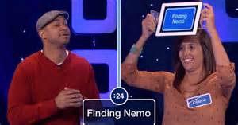
Heads Up for Vocabulary
Here's how you play:
One player holds the flash card up to his/her forehead.
The other players give clues to help the player guess the word (without using the word).
Once the word is guessed correctly, the player will pick up another flashcard so that a new word will pop up on the screen.
A player can "pass" on a word by saying “pass” and placing that card in a separate pile.
Play continues for 60 seconds.
Player counts the words solved correctly.
The notecards are then shuffled and passed to another player and the game continues until everyone has a turn.
For an extra challenge:
Try the 'the act it out - no words' rule.

Slide 26
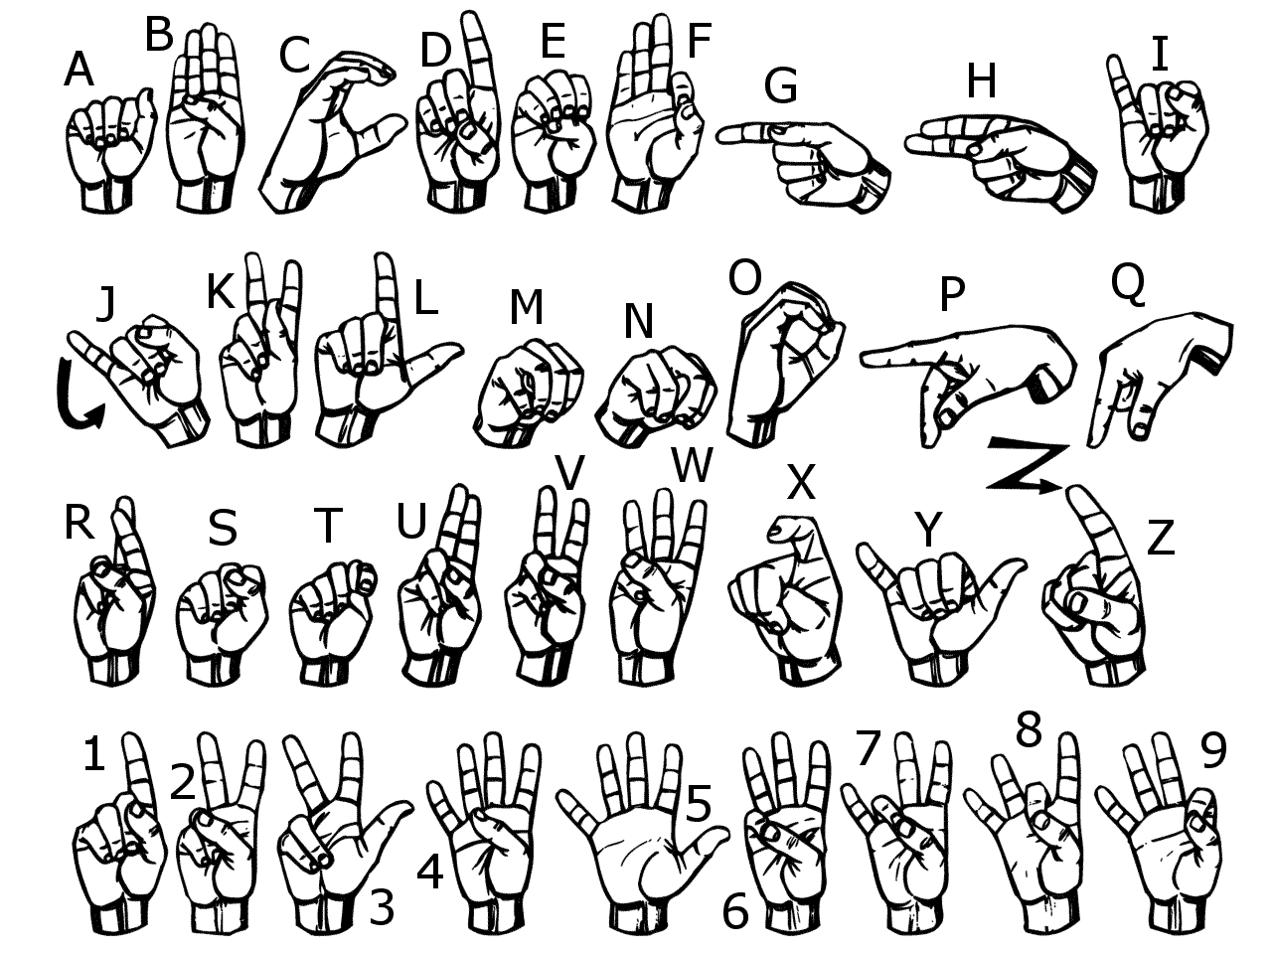
Sign Language
Use American Sign Language to spell each vocabulary word.
Now use your finger and write each word in the air

Slide 27
Sort Your Words
Sort your words by making three piles. A pile for words you could teach to another student offering several examples, a pile for words you know the meaning to, a pile for words you really are not sure what the meaning is.

Slide 28
Words in Words
Divide your paper into 9 boxes, (3 boxes in 3 rows). Choose 9 of your vocabulary words; write one vocabulary word at the top of each box. Now try to find as many words as you can within each chosen vocabulary word.

Slide 29
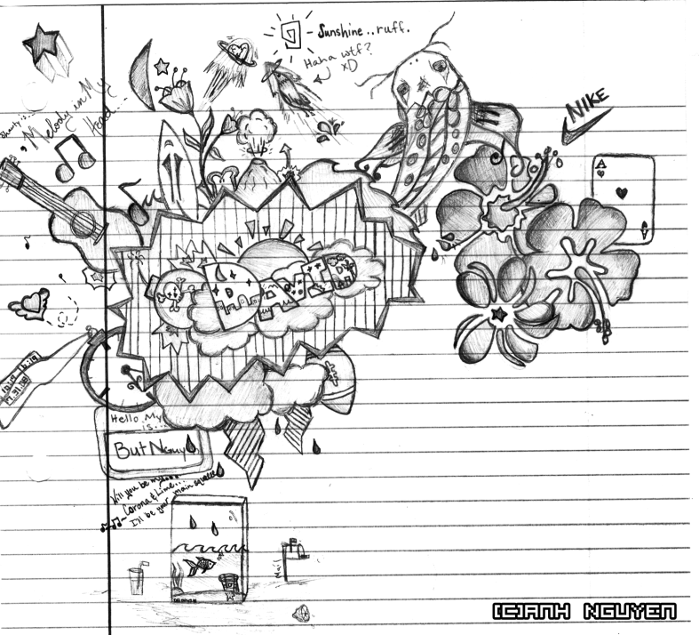
Doodle Words
Choose 5 words you totally understand and write your words using doodles to show what each word means on a separate sheet of paper. When you are done, put a star by your favorite doodle word.

Slide 30
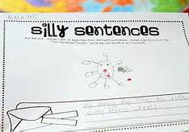
Silly Sentences
Create several silly sentences by using as many vocabulary words as you can. Can you turn a silly sentence into a tongue twister ?

Slide 31
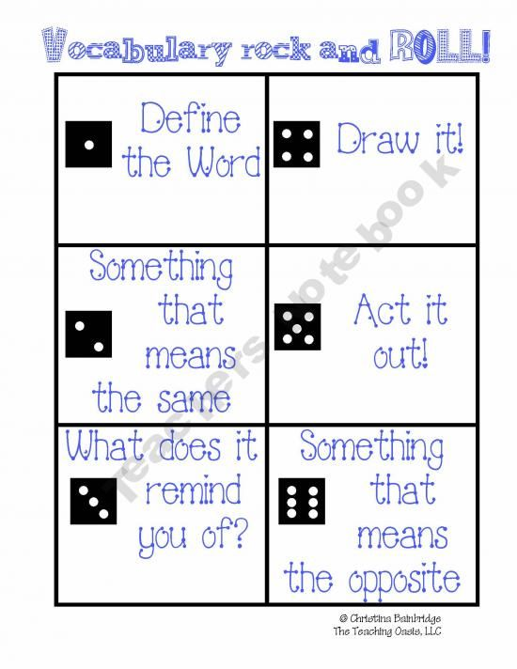
Vocabulary Rock and Roll

Slide 32
Vocabulary Quiz
Directions:
Choose 5 vocabulary words from your list and free write a paragraph using all 5 words.
Be sure to underline all 5 words.
Your paragraph will be graded on you using all of the words correctly and creatively.
If your paragraph does not make sense, then you will not receive a passing grade.

