Slide 1
Warm Up
What do you think happens to Europe after the Roman Empire falls?

Slide 2
Warm Up
Was Rome falling a good or bad thing? Explain

Slide 3
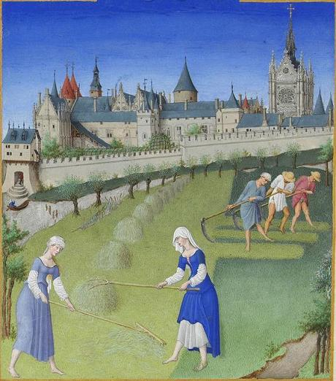
Introduction to the Middle Ages

Slide 4
Learn Target
I will be able to analyze how the fall of the Roman Empire changed Europe. I will know the basic structure of European Feudal and Manoral system.
Success Criteria:
Analyze “Feudalism in Medieval Europe” article
Use reading codes throughout “Feudalism in Medieval Europe” article
Create a graphic organizer of summarizing the changes to Europe after the fall of Rome
Analyze “Feudalism vs the Manor System” article
Create a Venn Diagram to organize information.

Slide 5
Key Vocabulary
Chivalry
Guilds
Crusades
Feudalism
Magna Carta
Manor
Middle Ages
Lord
Serfs
Vassal
Charlemagne
Clergy
Bubonic Plague
Migrate

Slide 6
Discussion
When you hear the word “Middle Ages”, what comes to mind?

Slide 7
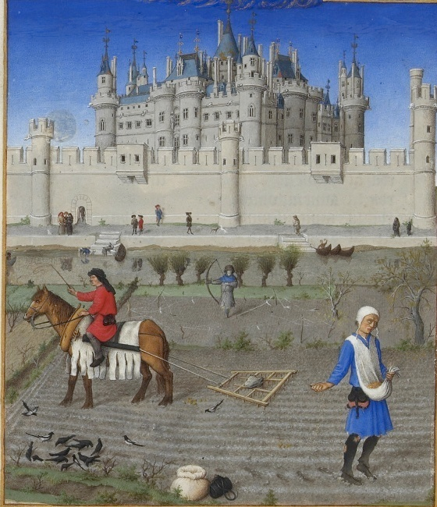
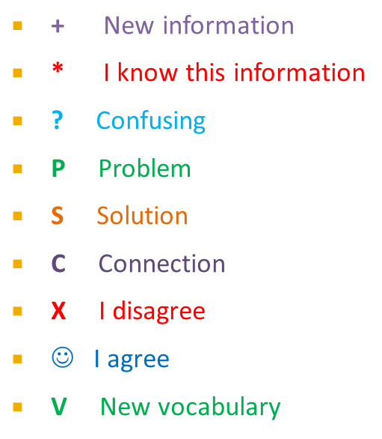
Task
INDIVIDUALLY, you are going to read the following article titled “Feudalism in Medieval Europe” (page 463).
As you read, use the following reading codes throughout the text:
(ALL CODES MUST BE USED 2 to 3 times throughout the text)

Slide 8
Task Part 1
On the TOP HALF of the backside of the “Feudalism in Medieval Europe” article, INDIVIDUALLY create and fill in a graphic organizer summarizing the changes to Europe after the fall of Rome
You must include:
Images
All 4 changes that occurred to Europe after the fall of Rome.
4 sentence summary

Slide 9
Once you have completed your graphic organizer, pick up the article title “Feudalism vs the Manor System” and quietly begin reading it. This is a class set so please DO NOT WRITE ON IT!

Slide 10
Feudal System vs the Manor System
Feudalism was a political while manoral was an economic

Slide 11
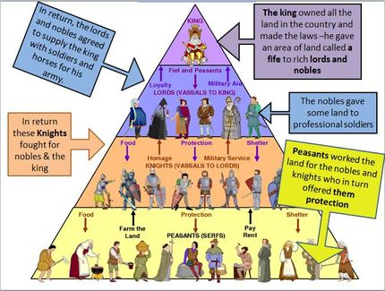
Feudal System
During the Middle Ages there was an absence of a central government, therefore the people of Medieval Europe create their own government. The people saw a need for protection and justice. This government that the people created was called Feudalism. Feudalism provided protection for the townspeople. A characteristic that Feudalism held was the use of a social structure.

Slide 12
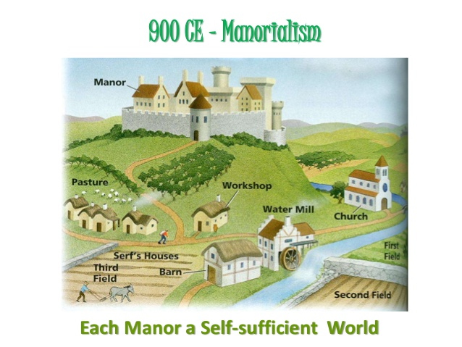
Manor System
The manor system was a way that feudal lords organized their lands in order to produce agricultural goods.

Slide 13
Task Part 2
After reading the article “Feudalism vs the Manor System”, on the BOTTOM HALF of the backside of the “Feudalism in Medieval Europe”, INDIVIDUALLY create and fill in a Venn Diagram that compares/contrasts the Feudal System to the Manor system.

