Slide 1
Warm Up
What is the difference between the feudalism system and the manor system?

Slide 2
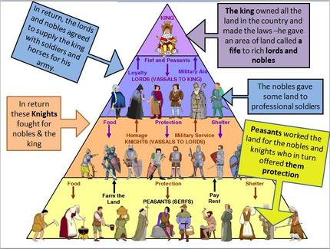
Feudal System
During the Middle Ages there was an absence of a central government, therefore the people of Medieval Europe create their own government. The people saw a need for protection and justice. This government that the people created was called Feudalism. Feudalism provided protection for the townspeople. A characteristic that Feudalism held was the use of a social structure.

Slide 3
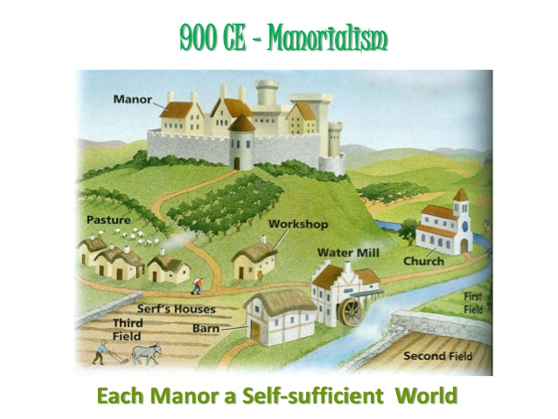
Manor System
The manor system was a way that feudal lords organized their lands in order to produce agricultural goods.

Slide 4
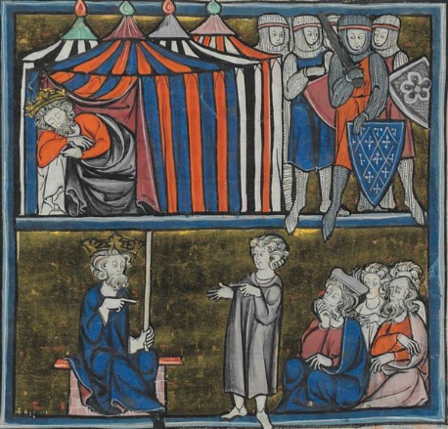
The Rise of the Dark Ages
Notes:
https://sheg.stanford.edu/dark-ages

Slide 5
Learning Target
I can analyze historical documents to determine if the “Dark Ages” were really dark.
Success Criteria:
  Analyze Documents
  Use documents to answer guiding questions
  Develop a claim
  Provide evidence that supports your claim

Slide 6
Discussion
As Rome was falling apart, what do you think was the result ?

Slide 7
Overview
Through this multi-day lesson, you will be able to question the validity of using “Dark Ages” to describe Europe from the fall of the Roman Empire to the Renaissance. In the process, you will examine a variety of primary and secondary sources highlighting different social, political, economic, cultural, and environmental facets of life in Europe during this period.

Slide 8
When working with documents, what do we do first?
TLC
  Title: No Title
  Legend: No Legend
  Captions: The American Cyclopaedia: A Popular Dictionary of General Knowledge, 1883
Observe, Question, Reflect
  What do you Observe?
  What questions do you have?
  What reflections/inferences can you make?
“The Dark Ages is a term applied in its widest sense to that period of intellectual depression in the history of Europe from the establishment of the barbarian supremacy in the fifth century (400 AD) to the revival of learning at about the beginning of the fifteenth (1400 AD), thus nearly corresponding in extent with the Middle Ages.”
-The American Cyclopaedia: A Popular Dictionary of
General Knowledge, 1883

Slide 9
Think about…
“The Dark Ages is a term applied in its widest sense to that period of intellectual depression in the history of Europe from the establishment of the barbarian supremacy in the fifth century (400 AD) to the revival of learning at about the beginning of the fifteenth (1400 AD), thus nearly corresponding in extent with the Middle Ages.”
-The American Cyclopaedia: A Popular Dictionary of
General Knowledge, 1883
What is meant by intellectual depression?
What is meant by barbarian supremacy
What is meant by the revival of learning?
How long do the “Dark Ages” last according to this statement?
Notes:
The American Cyclopaedia: A Popular Dictionary of General Knowledge, was a multi-volume set of encyclopedia’s published in New York and sold across the country in the years following the Civil War.

Slide 10
Discussion
What is meant by intellectual depression?
What is meant by barbarian supremacy
What is meant by the revival of learning?
How long do the “Dark Ages” last according to this statement?
“The Dark Ages is a term applied in its widest sense to that period of academic decline in the history of Europe from the formation of the German rule in the fifth century (400 AD) to the recovery of learning at about the beginning of the fifteenth (1400 AD), thus nearly corresponding in extent with the Middle Ages.”
-The American Cyclopaedia: A Popular Dictionary of
General Knowledge, 1883
Notes:
The American Cyclopaedia: A Popular Dictionary of General Knowledge, was a multi-volume set of encyclopedia’s published in New York and sold across the country in the years following the Civil War.

Slide 11
Dark Ages
After analyzing the document, with your shoulder partner on a sticky note write a definition for the term “Dark Ages”

Slide 12
Discussion
Do you think education defines a period?

Slide 13
Background
The time period following the fall of Rome in Europe is sometimes known as the “Dark Ages.”
                The term implies that the time between the fall of the Roman Empire and the European Renaissance was a period of decline for Europe.
                This time is also called the Middle Ages because it falls in the middle of 2 important time periods: Classical Period (Greece & Rome) and the European Renaissance.

Slide 14
Why “Dark”?
The metaphor of “dark” and “light” was originally used by Christians to describe the “darkness” people lived in before God sent Jesus Christ to bring “light” to the world.
Petrarch was an Italian scholar during the 1300s who loved Greek and Roman writing.
He used the terms “dark” and “light” to describe learning instead of religion. He believed that Europe was in the “dark” after the “light” of the Greek and Roman empires were gone.

Slide 15
Why “Dark”?
Historians, and others, since Petrach continued to use the phrase “Dark Ages.”
They argued that during the centuries following the fall of the Roman Empire, Europe…
Did not support learning
Created very little culture (art, literature, architecture, etc.)
Was repeatedly invaded
Had no central government
Had a bad economy
Was basically a miserable place to live

Slide 16
Today
Today many historians disagree with the term “Dark Ages”. They think it is not the proper way to describe this period of time. But, people continue to use term “Dark Ages.”
What do you think: Was Europe really in a “Dark Age” for almost 900 years?
Your Task: Analyze historical documents to determine if the dark ages was really dark.

Slide 17
Warm Up
Based on your learning from Friday, define the “Dark Ages”?

Slide 18
The Rise of the Dark Ages
Notes:
https://sheg.stanford.edu/dark-ages

Slide 19
Learning Target
I can analyze historical documents to determine if the “Dark Ages” were really dark.
Success Criteria:
  Analyze Documents
  Use documents to answer guiding questions
  Develop a claim
  Provide evidence that supports your claim

Slide 20
When working with documents, what do we do first?
TLC
  Title:
  Legend:
  Captions:
Observe, Question, Reflect
  What do you Observe?
  What questions do you have?
  What reflections/inferences can you make?

Slide 21
Document A:
Textbook (Excerpt)
During the early Middle Ages much of Europe passed through a time of turmoil and confusion, of ignorance and lawlessness . . . The early Middle Ages may justly be called the Dark Age . . . During the early Middle Ages, from 476 to about 1100, European civilization slipped back into semi-barbarism. The chief cause of this decline was lack of a government which could keep order. The Germanic Kingdoms which had been set up by 476 were unable to suppress violence. There were so many highway robbers that travel became dangerous. Europe suffered a decline in commerce and manufacturing, in education, in literature and the arts, and in almost all that makes possible a high civilization. Cities grew smaller and in some cases practically disappeared, and western Europe became a region of poverty-stricken farming communities, each virtually isolated from the rest of the world.
Source: Roehm, A., Buske, M., Webster, H. & Wesley, E,. (1954). The Record of Mankind. Heath and Company.

Slide 22
Question 5
Document A:
Textbook (Excerpt)
The American Cyclopedia entry
During the early Middle Ages much of Europe passed through a time of turmoil and confusion, of ignorance and lawlessness . . . The early Middle Ages may justly be called the Dark Age . . . During the early Middle Ages, from 476 to about 1100, European civilization slipped back into semi-barbarism. The chief cause of this decline was lack of a government which could keep order. The Germanic Kingdoms which had been set up by 476 were unable to suppress violence. There were so many highway robbers that travel became dangerous. Europe suffered a decline in commerce and manufacturing, in education, in literature and the arts, and in almost all that makes possible a high civilization. Cities grew smaller and in some cases practically disappeared, and western Europe became a region of poverty-stricken farming communities, each virtually isolated from the rest of the world.
Source: Roehm, A., Buske, M., Webster, H. & Wesley, E,. (1954). The Record of Mankind. Heath and Company.
“The Dark Ages is a term applied in its widest sense to that period of intellectual depression in the history of Europe from the establishment of the barbarian supremacy in the fifth century (400 AD) to the revival of learning at about the beginning of the fifteenth (1400 AD), thus nearly corresponding in extent with the Middle Ages.”
-The American Cyclopaedia: A Popular Dictionary of General Knowledge, 1883

Slide 23
Document B:
Textbook (Excerpt)
From 1000 to 1300, the economy of Europe developed and prospered. Available farmland tripled, and the food supply increased notably, bringing up the population. Europeans re-settled lands that had been depopulated by the ninth- and tenth-century invasions and also opened new lands for farming . . . Technological improvements like the heavy plow, the shoulder collar for horses, metal horshoes, and more efficient water and windmills contributed to the jump in food supply. Between 500 and 1300 Europe’s population grew from 25 million to more than 70 million.
Source: Cassar, G.H., Goff, R.D., Holoka, J.P., Terry, J.J., Upshur, Jiu-Hwa (Eds.). (2002). World History Before 1600: The Development of Early Civilization. Stamford, CT: Cengage Learning.

Slide 24
Question 4
Document B:
Textbook (Excerpt)
The American Cyclopedia entry
From 1000 to 1300, the economy of Europe developed and prospered. Available farmland tripled, and the food supply increased notably, bringing up the population. Europeans re-settled lands that had been depopulated by the ninth- and tenth-century invasions and also opened new lands for farming . . . Technological improvements like the heavy plow, the shoulder collar for horses, metal horshoes, and more efficient water and windmills contributed to the jump in food supply. Between 500 and 1300 Europe’s population grew from 25 million to more than 70 million.
Source: Cassar, G.H., Goff, R.D., Holoka, J.P., Terry, J.J., Upshur, Jiu-Hwa (Eds.). (2002). World History Before 1600: The Development of Early Civilization. Stamford, CT: Cengage Learning.
“The Dark Ages is a term applied in its widest sense to that period of intellectual depression in the history of Europe from the establishment of the barbarian supremacy in the fifth century (400 AD) to the revival of learning at about the beginning of the fifteenth (1400 AD), thus nearly corresponding in extent with the Middle Ages.”
The American Cyclopaedia: A Popular Dictionary of General Knowledge, 1883

Slide 25
Middle Ages Timeline
(“Dark Ages” according to the American Cyclopaedia, 1883)
Central Historical Question
400 AD
1400 AD
476 AD
Fall of Rome
1000
Beginning of prosperity
(Textbook B)
1100
End of Dark Ages
(Textbook A)

Slide 26
What is the Point of View for Document A as well as Document B?

Slide 27
First Claim
Based upon your analysis of Document A and B, answer the following:
Was the time period of 400 AD and 1400 AD a “Dark Ages” for Europe? (Claim)
List 2-3 pieces of evidence from either document to support your claim (Evidence)

Slide 28
When citing your evidence…
The author wrote…
The illustration shows…
An example on page ___ is…
In the text it said…
On page___, the author said…
The author states…
According to the text…
The text explicitly states…
I can infer from…
On page___, ...
The author says, “___” (pg__)
For instance…
The author said…
The text stated, “___” (pg__)
Based on what the author said…
Based upon the reading…
For example…
From the reading, …
___ proves that…

Slide 29
The American Cyclopedia entry
“The Dark Ages is a term applied in its widest sense to that period of intellectual depression in the history of Europe from the establishment of the barbarian supremacy in the fifth century (400 AD) to the revival of learning at about the beginning of the fifteenth (1400 AD), thus nearly corresponding in extent with the Middle Ages.”
The American Cyclopaedia: A Popular Dictionary of General Knowledge, 1883

Slide 30
Warm Up
Based on what you learned from analyzing Documents A and B, was the “Dark Ages” really dark?

Slide 31
The Rise of the Dark Ages
Notes:
https://sheg.stanford.edu/dark-ages

Slide 32
Learning Target
I can analyze historical documents to determine if the “Dark Ages” were really dark.
Success Criteria:
  Analyze Documents
  Use documents to answer guiding questions
  Develop a claim
  Provide evidence that supports your claim

Slide 33
When working with documents, what do we do first?
TLC
  Title:
  Legend:
  Captions:
Observe, Question, Reflect
  What do you Observe?
  What questions do you have?
  What reflections/inferences can you make?

Slide 34
Document C:
Abbey of Xanten Records (Modified)
The following document is from the yearly records of the Abbey of Xanten, a city in modern day Germany. An abbey is a place where Catholic monks and nuns live. The document describes Europe’s troubles in the mid ninth century. It focuses on invasions by heathens, or non-Christian barbarian tribes. Specifically, it mentions the Vikings, or “Northmen,” and Saracens, Arab tribes. Most of the names mentioned are cities or areas in Germany. Gaul is basically modern day France, and Christendom is the Christian part of Europe.
845 Twice in Worms there was an earthquake. In the same year the heathen broke in upon the Christians at many points, but more than twelve thousand of them died. Another party of invaders devastated Gaul, and more than six hundred of them died.
846 According to their custom, the Northmen plundered eastern and western Frisia and burned down the town of Dordrecht, with two other villages, before the eyes of Lothair [The Emperor]. He was in the castle of Nimwegen but could not punish the crime. The Northmen returned to their own country with many men and goods. At this same time the Saracens killed all the Christians whom they found outside the walls of Rome. They also carried men and women away prisoners. Their crimes from day to day bring sorrow to Christians.
849 The heathen from the North caused trouble in Christendom as usual and grew greater in strength, but it is revolting to say more of this matter.
853 A great famine in Saxony so that many were forced to live on horse meat.
Source: Modified excerpt from the “Annals of Xanten,” probably written by the abbey’s monks in the middle of the 9th century.

Slide 35
Document D:
Medieval Economic Law (Modified)
The excerpts below come from different laws of the late 8th and early 9th centuries defining the worth of currency, regulating the exchange of currency, and establishing penalties for people breaking these laws. The first two come from what is today part of France and the third from what is now part of Germany.
Capitulary (Law) of Aix-la-Chapelle on the Value of Commodities, 797.
C.11. Be it noted how much the solidi (unit of currency) of the Saxons ought to be worth. It should be worth a young ox. One solidus should also be worth forty bushels of oats and fifteen bushels of rye. For those who live near to us, 1 solidi should be worth 1/2 sigla of honey. For people who live in the north, 1 solidi should be worth 2 sigla of honey.
Capitulary of Aix-la-Chapelle Concerning Adulterers of Money, 817.
C.19. Concerning false money, we have ordered that he who has been proved to have made it shall have his hand cut off. And he who does not obey this, if he is free, shall pay sixty solidi; if he be serf, let him have sixty lashes.
Capitulary of Frankfort on the Legality of Coinage, 794.
C.5. In all places, in all states, and in all markets, the new denarii shall be exchanged as money and be received by all . . . If any one refuses to negotiate a purchase or a sale, they can bring the case before the king. They can do this only if they are a free man. But if they are servile and they own a business, let them lose the business, or be stripped any publicly beaten in the presence of people. However, if he refuses to use the money for purchase or sale because he was ordered by his master, then the master shall pay 15 solidi.
Source: 8th Century Economic Laws, from: J. P. Migne, ed., Patrologiae Cursus Completus, (Paris, 1862), Vols. XCVI, p. 1518, XCVII, pp. 194, 202, 287, reprinted in Roy C. Cave & Herbert H. Coulson, A Source Book for Medieval Economic History, (1965) 131-132.

Slide 36
What is the Point of View for Document C as well as Document D?

Slide 37
Second Claim
Based upon your analysis of Document C and D, answer the following:
Was the time period of 400 AD and 1400 AD a “Dark Ages” for Europe? (Claim)
List 2-3 pieces of evidence from either document to support your claim (Evidence)

Slide 38
When citing your evidence…
The author wrote…
The illustration shows…
An example on page ___ is…
In the text it said…
On page___, the author said…
The author states…
According to the text…
The text explicitly states…
I can infer from…
On page___, ...
The author says, “___” (pg__)
For instance…
The author said…
The text stated, “___” (pg__)
Based on what the author said…
Based upon the reading…
For example…
From the reading, …
___ proves that…

Slide 39
Warm Up
What has been the most challenging part of analyzing the documents?

Slide 40
The Rise of the Dark Ages
Notes:
https://sheg.stanford.edu/dark-ages

Slide 41
Learning Target
I can analyze historical documents to determine if the “Dark Ages” were really dark.
Success Criteria:
  Analyze Documents
  Use documents to answer guiding questions
  Develop a claim
  Provide evidence that supports your claim

Slide 42
When working with documents, what do we do first?
TLC
  Title:
  Legend:
  Captions:
Observe, Question, Reflect
  What do you Observe?
  What questions do you have?
  What reflections/inferences can you make?

Slide 43
Document F:
The Rise of Universities
Beginning in the early 11th century, universities were founded throughout Europe. Below is a list of the 10 oldest European universities in Europe. Attendance at these universities was limited to a small percentage of the population. However, universities introduced a new system of education, eventually replacing the monastery and church schools.
Year (approximately) | Current location | Name
1088 | Bologna, Italy | University of Bologna
1150 | Paris, France | University of Paris
1167 (1254) | Oxford, UK | University of Oxford
1209 (1231) | Cambridge, UK | University of Cambridge
1218 | Salamanca, Spain | University of Salamanca
1222 | Padua, Italy | University of Padua
1224 | Naples, Italy | University of Naples Federico II
1229 | Toulouse, France | University of Toulouse
1240 | Siena, Italy | University of Siena
1241 | Valladolid, Spain | University of Valladolid
Source: “List of Oldest Universities in Continuous Operation,” Wikipedia.
http://en.wikipedia.org/wiki/List_of_oldest_universities_in_continuous_operation

Slide 44
Document G:
Gothic Cathedrals
Cathédrale Notre Dame de Paris, or Our Lady of Paris Cathedral, is one of the most famous gothic cathedrals in Europe. The gothic style of architecture was common in the late Middle Ages. Common features of gothic cathedrals included architectural innovations, including: large columns, high celings with ribbed vaults, flying buttresses, and large stained glass windows. Gothic cathedrals were usually the tallest and largest buildings in a city. Notre Dame is 420 ft. long, 226 ft. wide, and its two towers are 226 ft. high. Construction on the cathedral began in 1163 and was completed in 1345.
Flying buttress
Source: View of Notre Dame from the River Seine,
http://commons.wikimedia.org/wiki/File:Notredame_Paris.JPG
Source: View of Notre Dame’s
South Rose Window,
http://commons.wikimedia.org/wi
ki/File:GothicRayonnantRose003.
jpg
Source: View of Notre Dame from the front,
http://commons.wikimedia.org/wiki/File:Facade-notredame-
paris-ciel-bleu.JPG

Slide 45
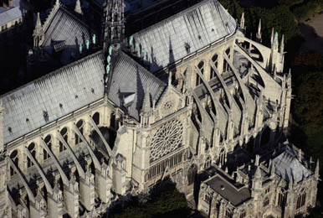
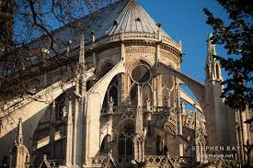
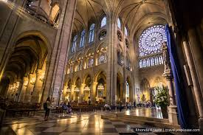
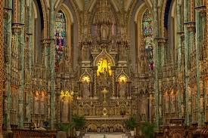
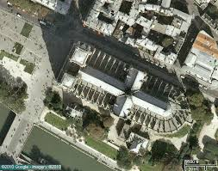
More Images of Notre Dame Cathedral

Slide 46
The American Cyclopedia entry
“The Dark Ages is a term applied in its widest sense to that period of intellectual depression in the history of Europe from the establishment of the barbarian supremacy in the fifth century (400 AD) to the revival of learning at about the beginning of the fifteenth (1400 AD), thus nearly corresponding in extent with the Middle Ages.”
The American Cyclopaedia: A Popular Dictionary of General Knowledge, 1883

Slide 47
What is the Point of View for Document F as well as Document G?

Slide 48
Third Claim
Based upon your analysis of Document F and G, answer the following:
Was the time period of 400 AD and 1400 AD a “Dark Ages” for Europe? (Claim)
List 2-3 pieces of evidence from either document to support your claim (Evidence)

Slide 49
When citing your evidence…
The author wrote…
The illustration shows…
An example on page ___ is…
In the text it said…
On page___, the author said…
The author states…
According to the text…
The text explicitly states…
I can infer from…
On page___, ...
The author says, “___” (pg__)
For instance…
The author said…
The text stated, “___” (pg__)
Based on what the author said…
Based upon the reading…
For example…
From the reading, …
___ proves that…

Slide 50


Slide 51
Warm Up
Why do historians disagree on historical events?

Slide 52
The Rise of the Dark Ages
Notes:
https://sheg.stanford.edu/dark-ages

Slide 53
Learning Target
I can analyze historical documents to determine if the “Dark Ages” were really dark.
Success Criteria:
  Analyze Documents
  Use documents to answer guiding questions
  Develop a claim
  Provide evidence that supports your claim

Slide 54
Hash Out
Taking a Stance
Should the Dark Ages be really called the Dark Ages?
YES NO

Slide 55
Warm Up
Did your claim change over the course of the lesson? How and why?

Slide 56
The Rise of the Dark Ages
Notes:
https://sheg.stanford.edu/dark-ages

Slide 57
Learning Target
I can analyze historical documents to determine if the “Dark Ages” were really dark.
Success Criteria:
  Analyze Documents
  Use documents to answer guiding questions
  Develop a claim
  Provide evidence that supports your claim

Slide 58
Final Claim
Based upon your analysis of all the documents, answer the following:
Was the time period of 400 AD and 1400 AD a “Dark Ages” for Europe? (Claim)
List 3 pieces of evidence from the documents to support your claim (Evidence/Reasoning)

Slide 59
Recap 1
Recap 2
How dark were the Dark Ages?

Slide 60
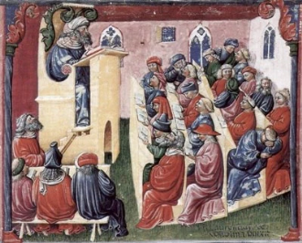
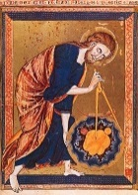
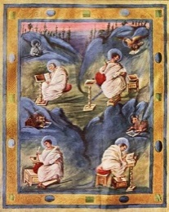
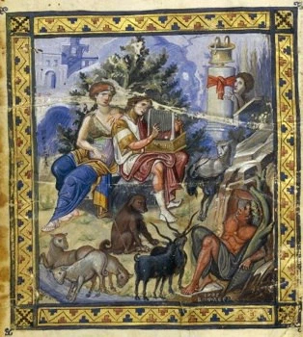
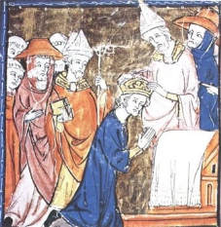
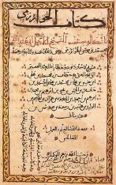
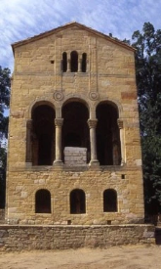
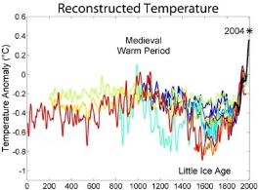
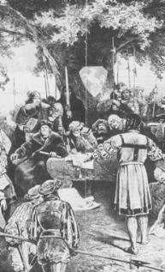
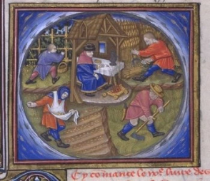
Top 10 Reasons The Dark Ages Were Not Dark
Universities Are Born
Scientific Foundations Laid
Carolingian Renaissance
Byzantine Golden Age
Religious Unity
Algebra Arrived
Art and Architecture
Fantastic Weather
Law Becomes Fair
Agricultural Boom
Notes:
http://listverse.com/2008/06/09/top-10-reasons-the-dark-ages-were-not-dark/

Slide 61
Discussion Questions
Did anyone’s claim change over the course of the lesson? How and why?
Why has the term “Dark Ages” to describe the Middle Ages been debated by historians? Do you think it is a valid description, why or why not?
Why do historians label time periods? What is the danger in this? What are challenges in trying to describe different periods of history?
What other sources would you want to analyze to continue exploring the issue of whether or not the “Dark Ages” was truly dark?

