Slide 1
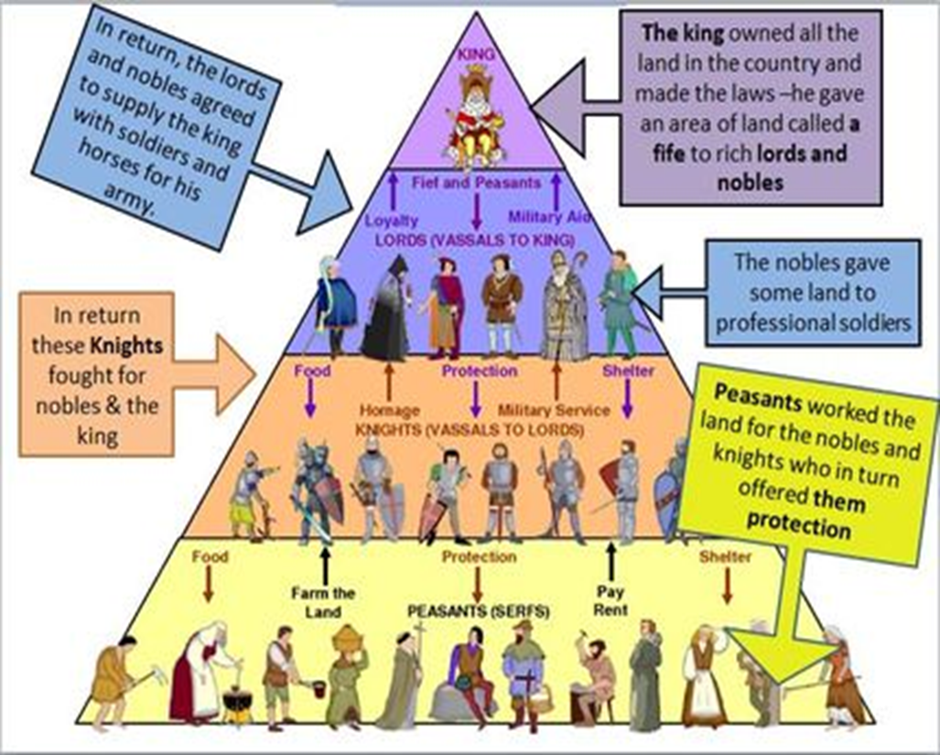
Warm Up
With the rise of Feudalism, what other organization started to gain power?

Slide 2
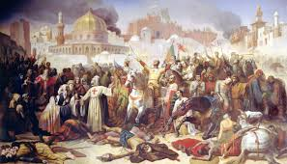
The Roman Catholic Church and the Crusades
1096-1204

Slide 3
Learning Target
I will be able to identify and describe factors that contributed to disputes between different groups during the Crusades.
Success Criteria:
Analyze Maps
Make inferences to answer questions
Explain causes of conflicts among Eurasian powers

Slide 4
Key Vocabulary
Middle Ages
Chivalry
Guilds
Crusades
Feudalism
Manor
Vassals
Lord
Serfs
Charlemagne
Clergy
Bubonic Plague
Migrate

Slide 5
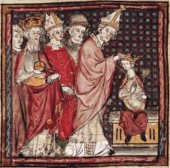
The Roman Catholic Church gains strength throughout the middle ages

Slide 6
Power of the Roman Catholic Church
In the Middle Ages, almost all Europeans were Christians and members of the Roman Catholic Church. In Southwest Asia, most people were Muslims.
From the 1000s through 1400s, some aspects of feudalism could still be found in Europe. For example, nobles still ruled much of the countryside. However, both the Roman Catholic Church and Europe’s monarchies were increasing their power. The Church and the monarchies were also trying to centralize political and religious authority.

Slide 7
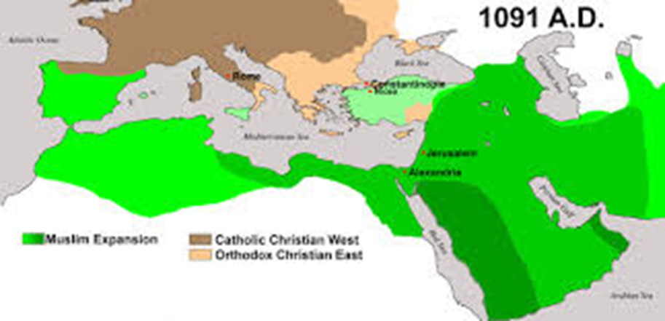

Slide 8
Discussion
Why you think the Catholic Church would become so powerful during the Middle Ages?

Slide 9
The Power of the Roman Catholic Church
After the fall of Rome, the Church grew in power and acted as a unifying force in Europe
Christian missionaries converted the pagan barbarian tribes of Europe
Many groups adopted the Latin alphabet
The Church served the political, social, and religious needs of the people.
Daily life revolved around the Christian calendar—a cycle of feast days, and holy days

Slide 10
In the Middle Ages, almost all Europeans were Christians and members of the Roman Catholic Church. IN Southwest Asia, most people were Muslims.

Slide 11
Understanding Terms
Islam and Muslim are words that are both interconnected and are used to represent the message and religion revealed to Prophet Muhammad.
I am a Muslim, my religion is Islam.

Slide 12
Non-Christians
Jewish communities existed in Europe for centuries. Many Jewish people were moneylenders since Christians were not allowed to enter that profession of lending money.
As Europe became more Christianized, tolerance for non-Christians decreased
Jews sought refuge in Eastern Europe and the Holy Land

Slide 13
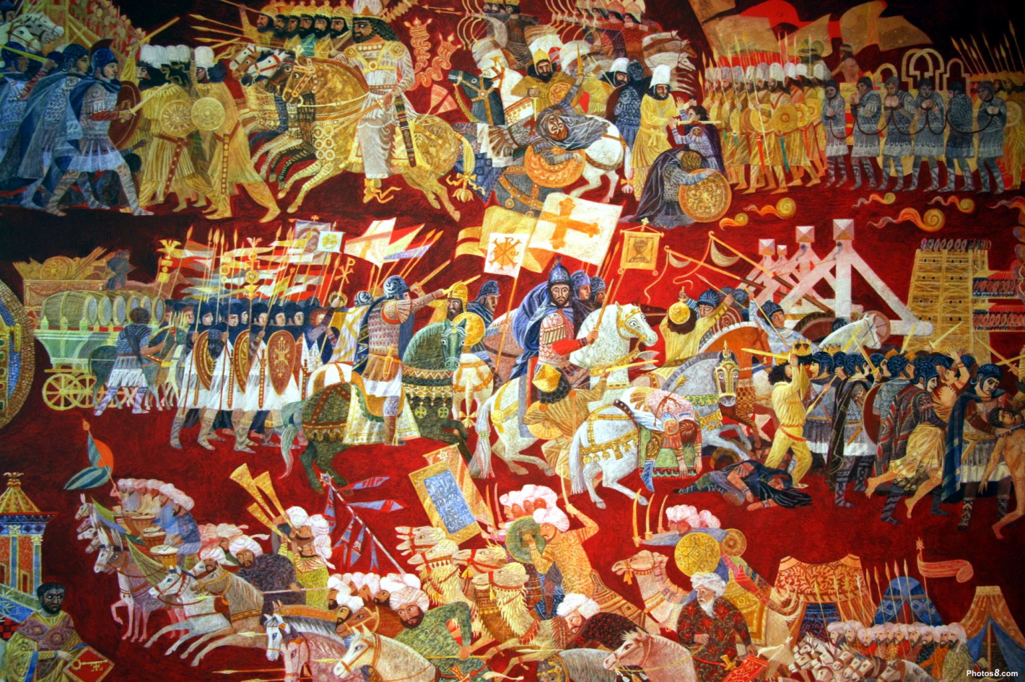
The Crusades

Slide 14
The Christian Church and Politics
The pope wanted Europeans to take over the Holy Land, the region in which Jesus had lived. For many years, the region had been in the hands of another religious group, the Muslims.
Thousands of people answered the pope’s call for the Crusades. They traveled thousands of miles to fight the church's enemies.

Slide 15
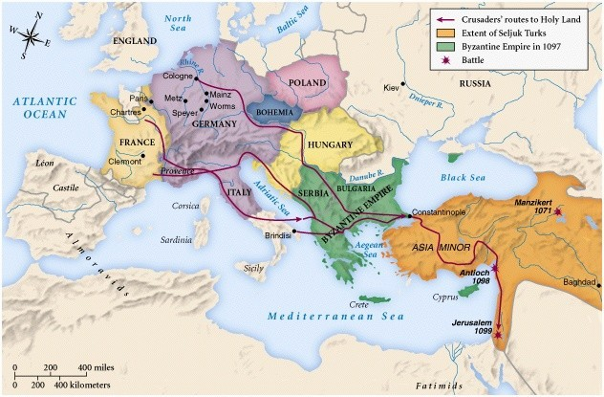
Movement
In 1096, the pope called on Christian Crusaders to take the Holy Land away from the Muslims who controlled it.
Abased on the map below, which direction di the Crusaders travel?

Slide 16
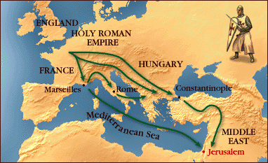
The Crusades
The Crusades was a series of military expeditions from Christian Europe to Jerusalem (located in present day Palestine) issued by the Pope, which is also known as the Holy land, between 1000’s and 1200’s.

Slide 17
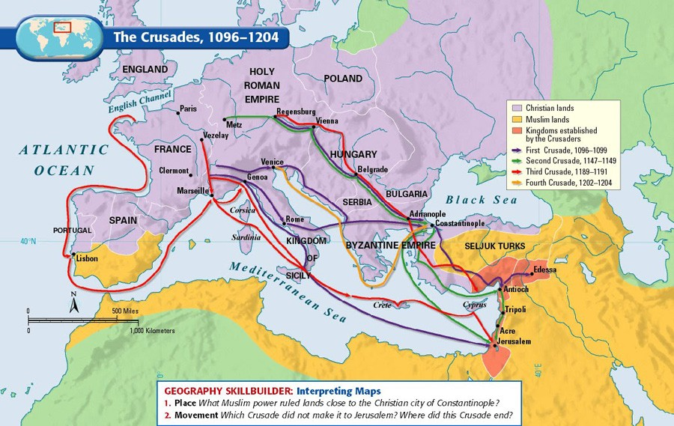

Slide 18
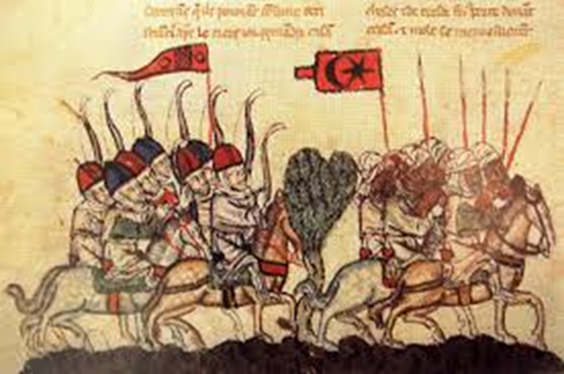
The Crusades will leave a lasting impact on European politics and society!

