Slide 1
Warm Up
What events caused the Crusades?

Slide 2
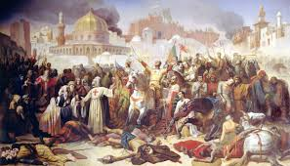
The Crusades
1096-1204

Slide 3
Learning Target
I will be able to identify and describe factors that contributed to disputes between different groups during the Crusades.
Success Criteria:
Analyze Maps
Make inferences to answer questions
Explain causes of conflicts among Eurasian powers

Slide 4
Key Vocabulary
Middle Ages
Chivalry
Guilds
Crusades
Feudalism
Manor
Vassals
Lord
Serfs
Charlemagne
Clergy
Bubonic Plague
Migrate

Slide 5
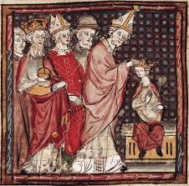
The Roman Catholic Church gains strength throughout the middle ages

Slide 6
The Power of the Roman Catholic Church
After the fall of Rome, the Church grew in power and acted as a unifying force in Europe
Christian missionaries converted the pagan barbarian tribes of Europe
Many groups adopted the Latin alphabet
The Church served the political, social, and religious needs of the people.
Daily life revolved around the Christian calendar—a cycle of feast days, and holy days

Slide 7
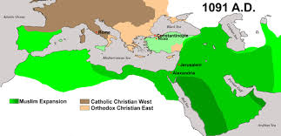
In the Middle Ages, almost all Europeans were Christians and members of the Roman Catholic Church. IN Southwest Asia, most people were Muslims.

Slide 8
Understanding Terms
Islam and Muslim are words that are both interconnected and are used to represent the message and religion revealed to Prophet Muhammad.
I am a Muslim, my religion is Islam.

Slide 9
Non-Christians
Jewish communities existed in Europe for centuries. Many Jewish people were moneylenders since Christians were not allowed to enter that profession of lending money.
As Europe became more Christianized, tolerance for non-Christians decreased
Jews sought refuge in Eastern Europe and the Holy Land

Slide 10
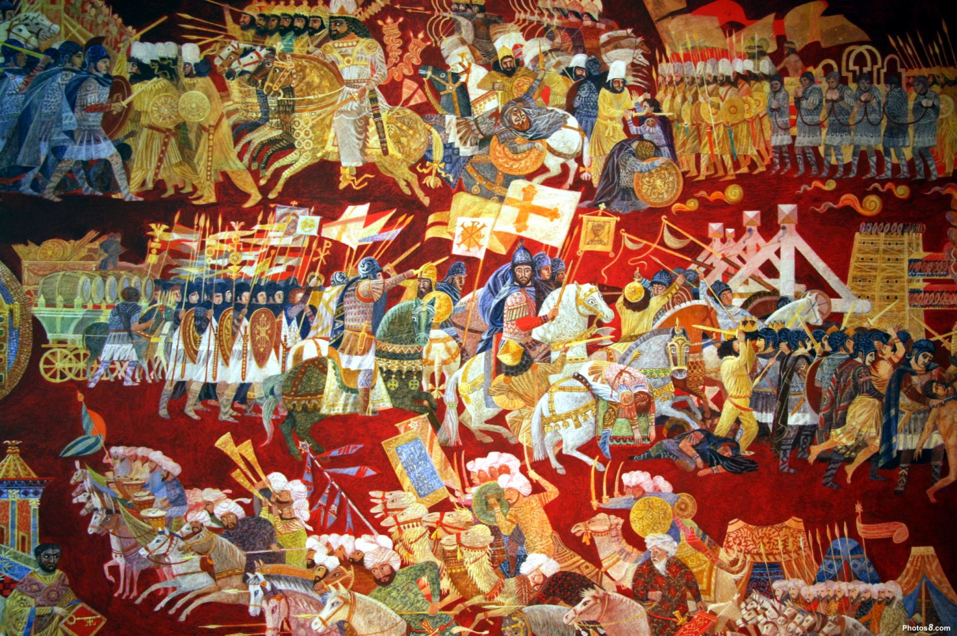
The Crusades

Slide 11
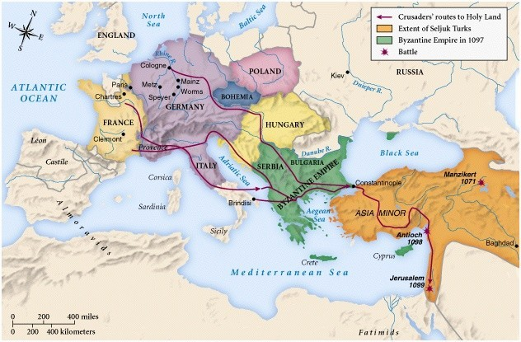
Movement
In 1096, the pope called on Christian Crusaders to take the Holy Land away from the Muslims who controlled it.
Abased on the map below, which direction di the Crusaders travel?

Slide 12
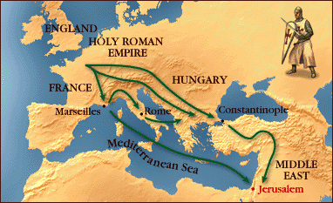
The Crusades
The Crusades was a series of military expeditions from Christian Europe to Jerusalem (located in present day Palestine) issued by the Pope, which is also known as the Holy land, between 1000’s and 1200’s.

Slide 13
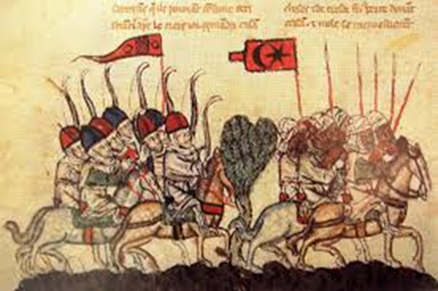
The Crusades will leave a lasting impact on European politics and society!

Slide 14
A Map Assignment: The Crusades
It is hard to understand the Crusades if you do not understand how the world looked in the 11th century. Therefore I have put together a very fun and informative map assignment for you. To complete it, you will need:
“My Map of the Crusades” Directions
The following colored pencils colors
Brown
Dark Green
Light Green
Dark Purple
Light Purple
Blue
Red
The following 4 maps.

Slide 19
Processing
Why did the Christians begin a series of wars to conquer Jerusalem/Holy Land and Palestine?
How the Crusades continue to affect the world today?
Notes:
http://westernreservepublicmedia.org/middleages/crusade_rhymes.htm

