Slide 1
Warm Up
What is an epidemic?

Slide 2
Warm Up
What is an epidemic?
An epidemic is a widespread occurrence of an infectious disease in a community at a particular time.
Example: flu
Synonyms: outbreak, plague, pandemic

Slide 3
Warm Up
What are some synonyms for an epidemic?

Slide 4
Warm Up
What are some synonyms for an epidemic?
Examples:
Outbreak
Plague
Pandemic
Disease
Viruses

Slide 5
Warm Up
What was the belief and concern expressed for the plague based on document 1?

Slide 6
Warm Up
What was the belief and concern expressed for the plague based on document 1?
Beliefs:
Clean streets would prevent the plague from coming
Those left behind behaviors of either cutting themselves off from the public or drinking a great deal.
Carrying bunches of flowers, herbs or spices to feel healthy and to stop the smell of dead/dying bodies
Concerns:
Brother leaving brothers and husbands leaving wives.
The amount of dying bodies and the smell left behind
Morning not able to count the amount of corpses in the streets
Huge trenches to deal with all the dead bodies

Slide 7
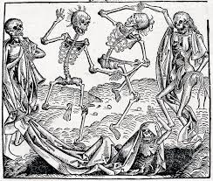
The Black Plague
An Investigation of the Epidemic

Slide 8
Learning Target
I can analyze and make inferences about how an epidemic impacts a society
Success Criteria
Analyze historical background information about the Black plague
Analyze documents
Make inferences to answer question

Slide 9
Key Vocabulary
Lords
Serfs
Manors
Middle Ages
Black Plague
Epidemic
Migrate

Slide 10
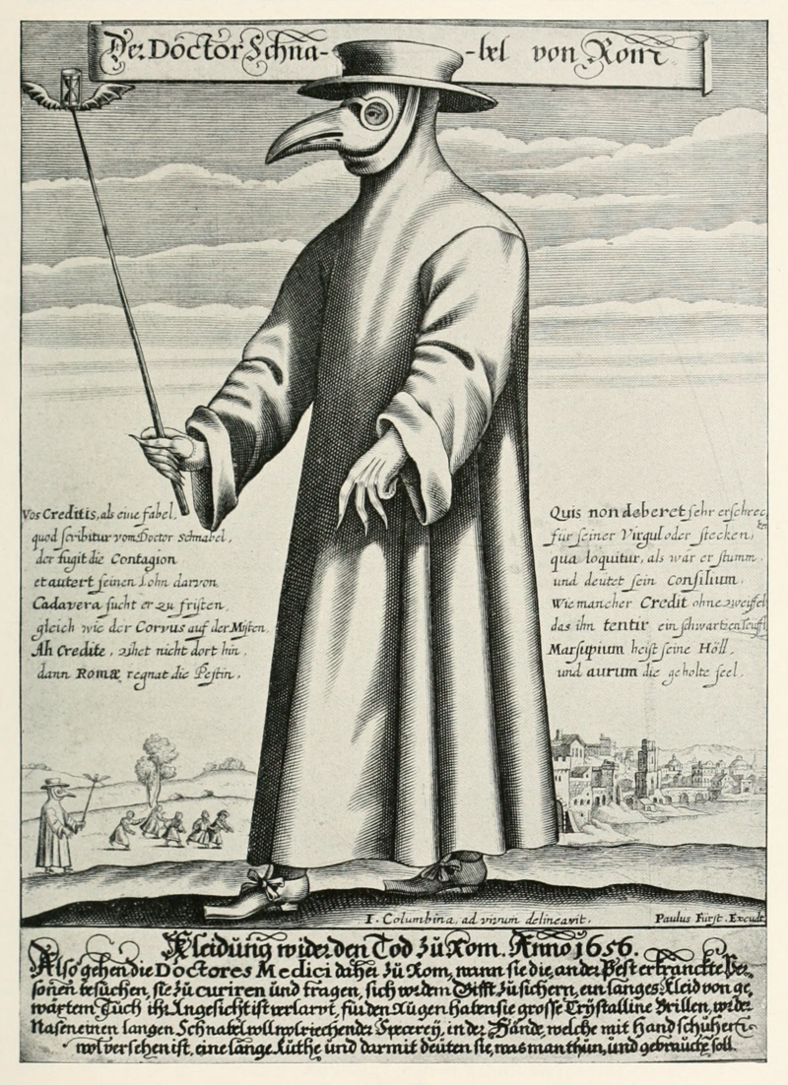
Observe
Question
Reflect

Slide 11
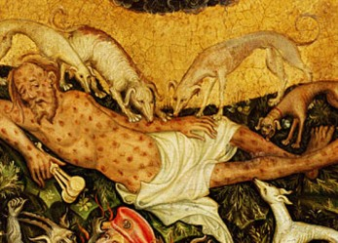
Historical Background
What was the Black Plague?

Slide 13
Three forms for the Plague:
Bubonic Plague,
the most common form, bacteria infect the lymph system and causes it to become inflamed. Within three to seven days of exposure to plague bacteria, you will develop flu-like symptoms such as fever, headache, chills, weakness, and swollen, tender lymph glands (called buboes—hence the name bubonic). ubonic plague is rarely spread from person to person.
Septicemic P​lague
This form of plague occurs when the bacteria multiply in the blood. Symptoms include fever, chills, weakness, abdominal pain, shock, and bleeding underneath the skin or in other organs. Buboes, however, do not develop. Septicemic plague is rarely spread from person to person.
Pneumonic Plague
This is the most serious form of plague and occurs when Y. pestis bacteria infect the lungs and cause pneumonia. You get primary pneumonic plague when you inhale plague bacteria from an infected person or animal. You usually have to be in direct or close contact with the ill person or animal. Pneumonic plague is contagious. If someone has pneumonic plague and coughs, droplets containing Y. pestis bacteria are released into the air. An uninfected person can then develop pneumonic plague by breathing in those droplets.

Slide 14
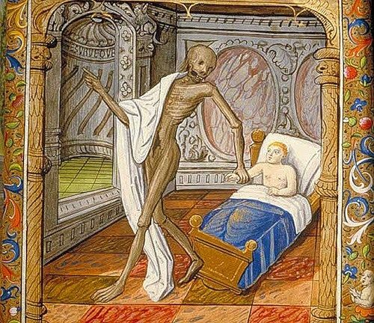
Historical Background
What was the Black Plague?
Read the Historical Background article about the Black Plague
Complete the following questions on page 98 of your spiral QUIETLY and INDIVIDUALLY!

Slide 15
Historical Background Essay
During the fourteenth century, Europe was living through a deadly epidemic known as the Great Plague. Probably originating in Asia in 1330, the Black Death spread through the land and sea trading routes of the time. Contact from these trade routes reached North Africa, Europe and the Middle East. Known by names such as the Great Plague, the Black Death and the Black Plague the disease that tore through Europe is now more commonly known as the bubonic plague.
The plague's rapid transmission can be traced to a small bacterium, Yersina pestis, that usually infected the black rat. Infected fleas, however, transmitted the disease to humans initially. Eventually humans spread the disease as well, through infected saliva. Once people became infected, the symptoms of the disease were painful and difficult, and many died. Symptoms included swollen nodes in the groin, severe headache and severe pneumonia. The disease became known as the black plague because of the dark blood clots that appeared under the skin.
The overall effects of the plague devastated Europe. The population decreased as much as 33% in 20 years, affecting agricultural production, family structure and economics.

Slide 16
Historical Background Questions
Completed on page 98 of your spiral
1. Why do you think the plague spread to rapidly throughout Europe?
2. What areas of medieval life probably faced the most impact as a result of this plague?
3. What were the likely effects of a die-off of about one third of a total population in a 10-year period upon the economic life and structure in medieval times?
4. What were the likely effects of a die-off of about one third of a total population in a 10-year period upon the family life and structure in medieval times?
5. What were the likely effects of a die-off of about one third of a total population in a 10-year period upon the population growth or decline in medieval times?

Slide 17
Copy the following chart down on to page 97 of your spiral
Document | What was the belief and concern expressed for the plague by this document. Support with evidence from the document.
1
2
3
4
5
6
7
8
9
10

Slide 18
Task to be completed on page 97
With your elbow partner, you are going to investigate the previous discussion questions further through an activity using documents from the fourteenth through the eighteenth centuries.
1. Look through documents 1-10 and at the various responses to the outbreaks of plague in the fourteenth and fifteenth centuries.
2. For each document, what was the belief and concern expressed for the plague. Support with evidence from the document.

Slide 19
Key Words for this Assignment
Doc 2: avarice= greed
Doc 2: plunder= steal
Doc 6: miasmas= smell
Doc 7: injurious= likely to cause damage
Doc 8: sentient= feel
Doc 9: pestilence= fatal disease

Slide 20
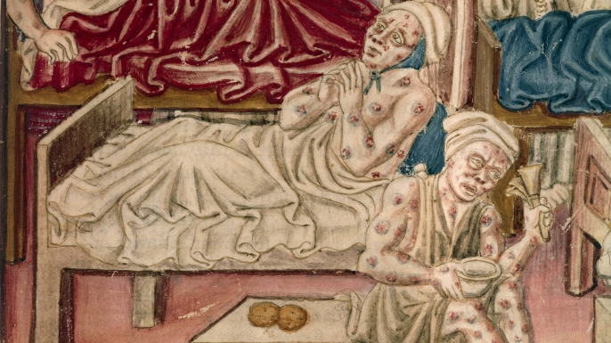
After analyzing each of the documents, answer the following questions INDIVIDUALLY, on a separate sheet of paper, using evidence to support your responses.

Slide 21
1. Do you believe the pope's fear of losing power was justified? Why or why not?
2. Which 3 documents or reactions to the plague seemed most interesting to you? Support your answer with evidence from the document on why.
3. Which 3 reactions seemed the most unrealistic or outrageous? Support your answer with evidence from the document on why.
4. Do you understand the concept of a scapegoat? Support your answer with evidence from the document on what your definition.
5. What would a modern Black Plague do to society today? Questions 5 and 6 are the same as earlier in the day, appling to current times.
6. What are the likely effects of a die-off of about one third of a total population in a 10-year period upon the economic life and structure in current times?
7. What would be the effects on family life and structure in current times?
8. What would be the effects on the role of religion, religious tolerance and the rise or fall of secularism?
9. If you lived through and survived a catastrophe like the Black Plague, would it strengthen or weaken your religious faith?
10. What about your belief in the power and utility of the scientific method?
11. What modern epidemics or plagues have we seen today?

Slide 22
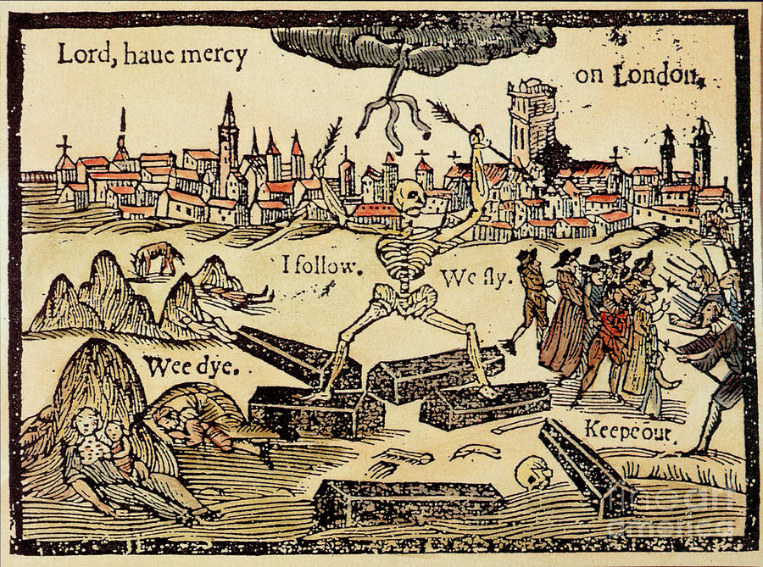
What if the Black Plague never happened?

Slide 23
Additional Middle Ages Facts
The bread eaten by people of the Middle Ages was gritty from the millstones used to grind the grain. This caused the people's teeth wear down quickly.
Peasants were not allowed to hunt on the lord's land. Punishment for killing a deer was sometimes death.
Medicine was very primitive at the time. Sometimes doctors would "bleed" people by putting leeches on their skin.
People mostly drank ale or wine. The water was bad and would make them sick.
Marriages were often arranged, especially for nobles. Noble girls often married at 12 years old and boys at 14.

Slide 24
The Black Plague Newspaper
On the outlined sheet of paper from the teacher, you are going to be creating a newspaper describing the arrival of the plague on your city and exactly what is happening to the people around you.
You will need to have the following requirements within your newspaper:
Title
Catchy Headline
1 Article about life in the city during the Black Plague
1 Advertisement for a Plague Doctor
1 Advertisement for a Priest
This will be due at the end of the period on Friday!

Slide 25
Processing
On the opposite side of your sheet of paper, answer the following question:
Based on what you have learned, was the black plague a curse or a blessing?
Remember how we write here at Stuart when answering prompts ☺

